Slide 1
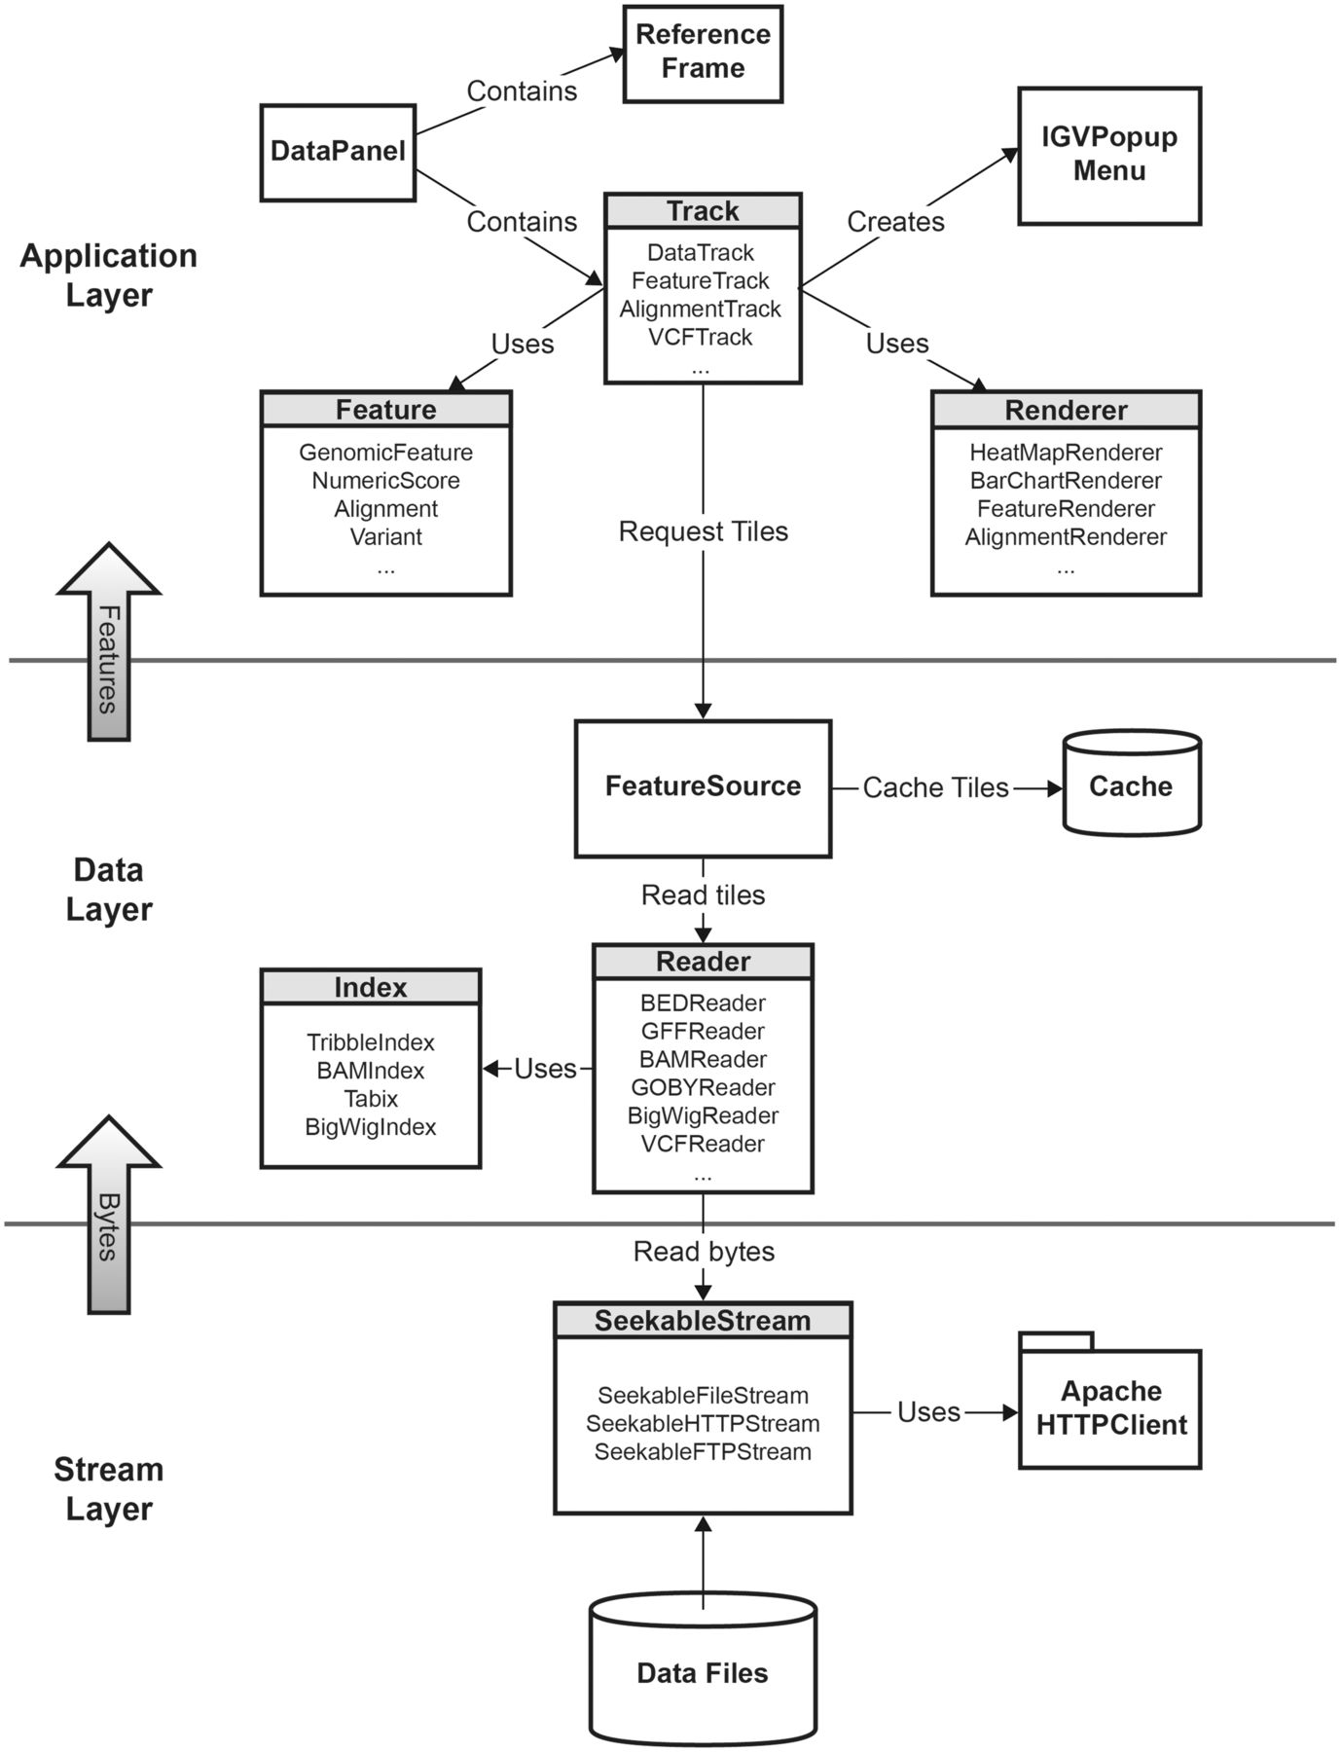
Figure 1: IGV class diagram, illustrating the IGV software structure.
Notes:
Figure 1: IGV class diagram, illustrating the IGV software structure.
Unless provided in the caption above, the following copyright applies to the content of this slide: © The Author(s) 2012. Published by Oxford University Press.This is an Open Access article distributed under the terms of the Creative Commons Attribution Non-Commercial License (http://creativecommons.org/licenses/by-nc/3.0), which permits unrestricted non-commercial use, distribution, and reproduction in any medium, provided the original work is properly cited.

Slide 2
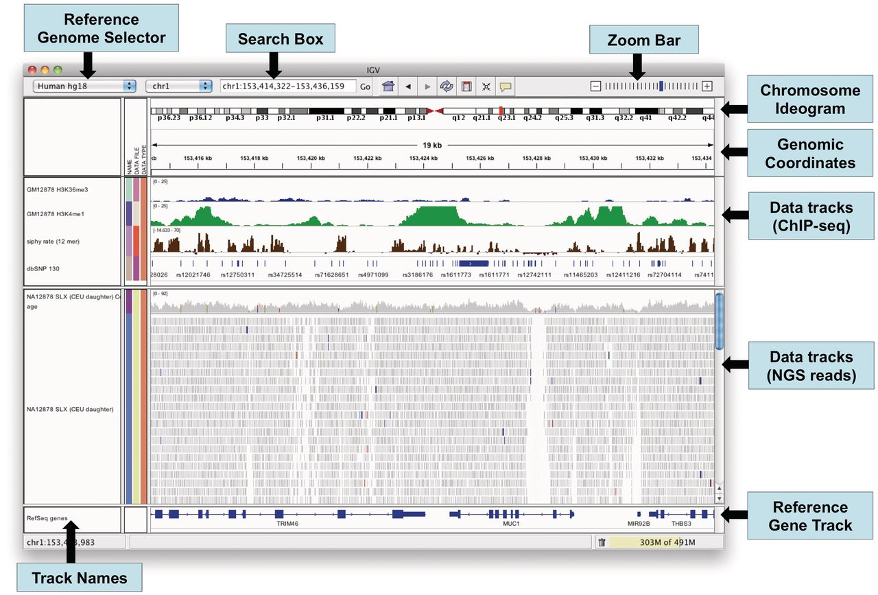
Figure 2: The IGV application window.
Notes:
Figure 2: The IGV application window.
Unless provided in the caption above, the following copyright applies to the content of this slide: © The Author(s) 2012. Published by Oxford University Press.This is an Open Access article distributed under the terms of the Creative Commons Attribution Non-Commercial License (http://creativecommons.org/licenses/by-nc/3.0), which permits unrestricted non-commercial use, distribution, and reproduction in any medium, provided the original work is properly cited.

Slide 3
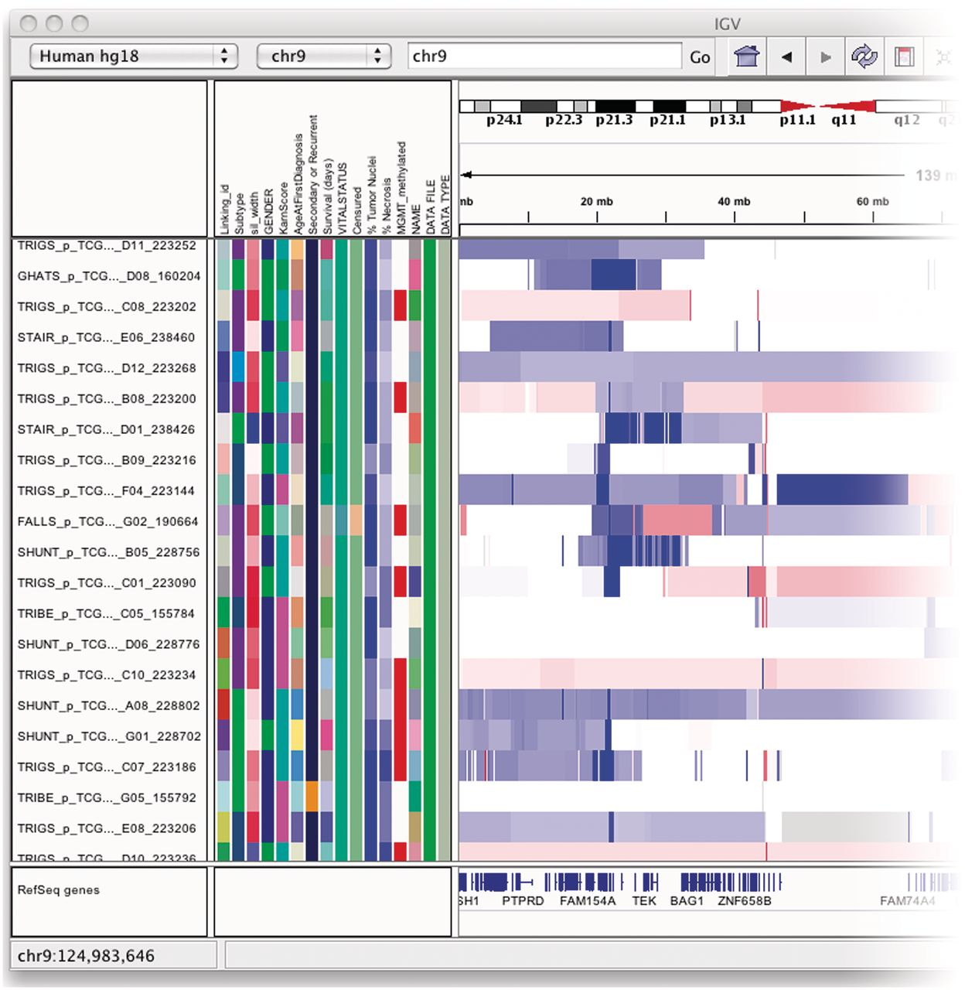
Figure 3: The attribute panel displays a color-coded matrix of phenotypic and clinical data. Clicking on a column ...
Notes:
Figure 3: The attribute panel displays a color-coded matrix of phenotypic and clinical data. Clicking on a column header will sort the tracks by the corresponding attribute.
Unless provided in the caption above, the following copyright applies to the content of this slide: © The Author(s) 2012. Published by Oxford University Press.This is an Open Access article distributed under the terms of the Creative Commons Attribution Non-Commercial License (http://creativecommons.org/licenses/by-nc/3.0), which permits unrestricted non-commercial use, distribution, and reproduction in any medium, provided the original work is properly cited.

Slide 4
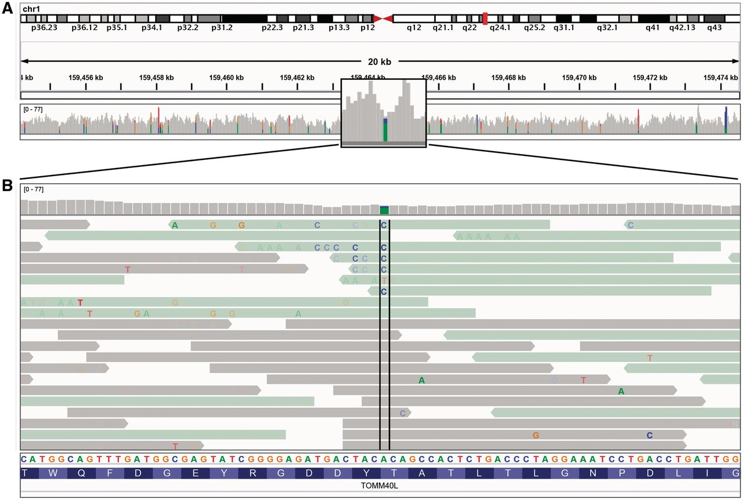
Figure 4: Read alignment views at 20 kb and base pair resolution. IGV displays varying level of data detail depending ...
Notes:
Figure 4: Read alignment views at 20 kb and base pair resolution. IGV displays varying level of data detail depending on the zoom level, and uses color and transparency to highlight interesting events in the data. (A) Reads are summarized as a coverage plot. Positions with a significant number of mismatches with respect to the reference are highlighted with color bars indicative of both the presence of mismatches and the allele frequency. (B) Individual base mismatches are displayed with alpha transparency proportional to quality. In this example, the reads have been sorted and colored by strand.
Unless provided in the caption above, the following copyright applies to the content of this slide: © The Author(s) 2012. Published by Oxford University Press.This is an Open Access article distributed under the terms of the Creative Commons Attribution Non-Commercial License (http://creativecommons.org/licenses/by-nc/3.0), which permits unrestricted non-commercial use, distribution, and reproduction in any medium, provided the original work is properly cited.

Slide 5
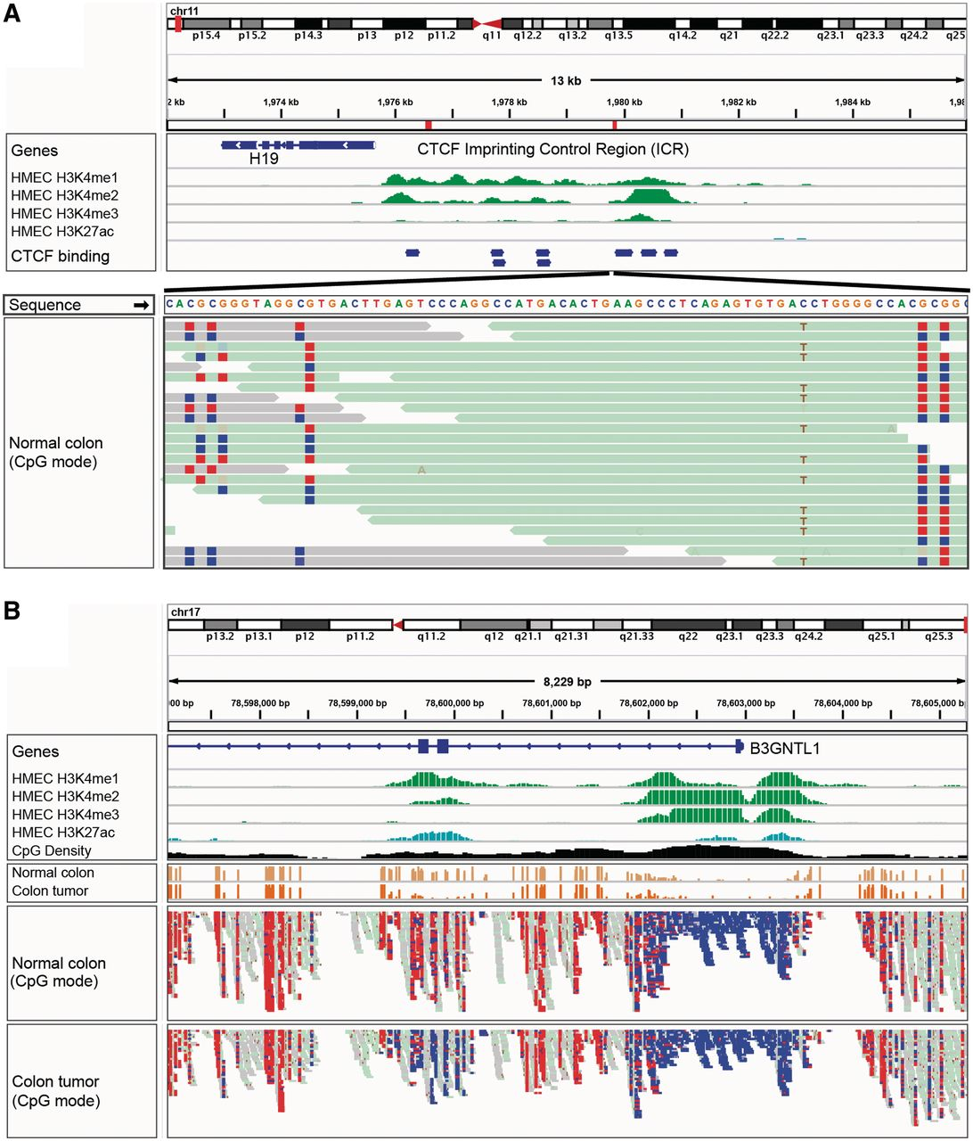
Figure 5: IGV bisulfite sequencing view. (A) Two views of the IGF2/H19 Imprinting Control Region (ICR), illustrating ...
Notes:
Figure 5: IGV bisulfite sequencing view. (A) Two views of the IGF2/H19 Imprinting Control Region (ICR), illustrating allele-specific methylation of CTCF binding sites. The top view shows a 13-kb region of ChIP-seq histone marks from the ENCODE normal epithelial tissue (HMEC) cell line. The second view shows WGBS read alignments from normal colonic mucosa [19], zoomed in to 75 bp. CpG dinucleotides are shown as blue (unmethylated) and red (methylated) squares. A heterozygous C/T SNP is also apparent, and the T allele is overwhelmingly associated with reads that have methylated CpGs (from the paternal chromosome). (B) The enhancer region surrounding exons 2 and 3 of the B3GNTL1 gene is apparent from the ENCODE tracks showing characteristic enhancer histone marks in a normal epithelial (HMEC) cell line. The bisulfite sequencing view of the read alignments shows that this enhancer is methylated (red – lighter) in normal colon mucosa, but almost completely unmethylated (blue – darker) in the matched colon tumor sample [19]. The cancer-specific de-methylation of this enhancer is consistent with the upregulation of the B3GNTL1 transcript in the tumor.
Unless provided in the caption above, the following copyright applies to the content of this slide: © The Author(s) 2012. Published by Oxford University Press.This is an Open Access article distributed under the terms of the Creative Commons Attribution Non-Commercial License (http://creativecommons.org/licenses/by-nc/3.0), which permits unrestricted non-commercial use, distribution, and reproduction in any medium, provided the original work is properly cited.

Slide 6
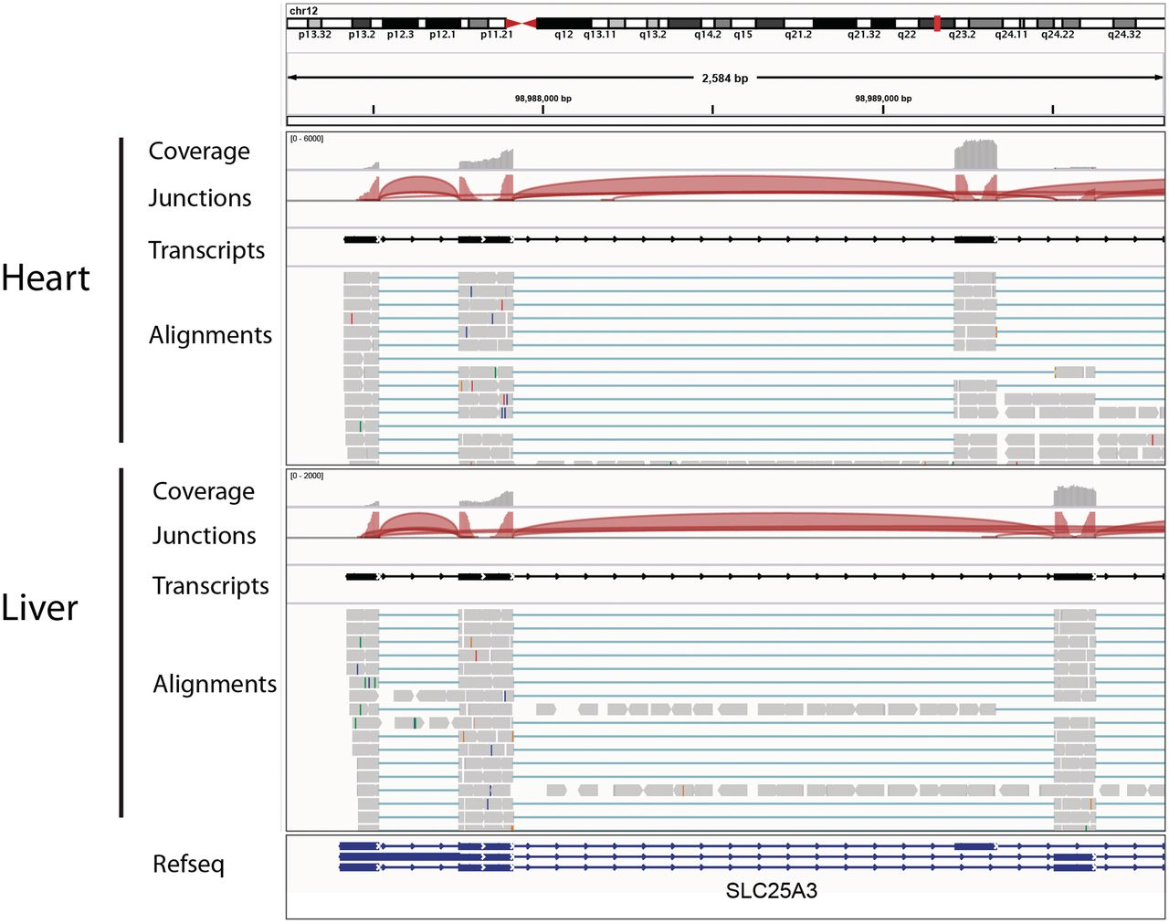
Figure 6: Visualization of RNA-seq data from heart and liver tissue samples. Each panel includes tracks for total ...
Notes:
Figure 6: Visualization of RNA-seq data from heart and liver tissue samples. Each panel includes tracks for total coverage, junction coverage, predicted transcripts and read alignments. Reads that span junctions are connected with thin blue lines. In the junction track, the height of each arc is proportional to the total number of reads spanning the junction. There is clear evidence of alternative splicing between the two tissues.
Unless provided in the caption above, the following copyright applies to the content of this slide: © The Author(s) 2012. Published by Oxford University Press.This is an Open Access article distributed under the terms of the Creative Commons Attribution Non-Commercial License (http://creativecommons.org/licenses/by-nc/3.0), which permits unrestricted non-commercial use, distribution, and reproduction in any medium, provided the original work is properly cited.

Slide 7
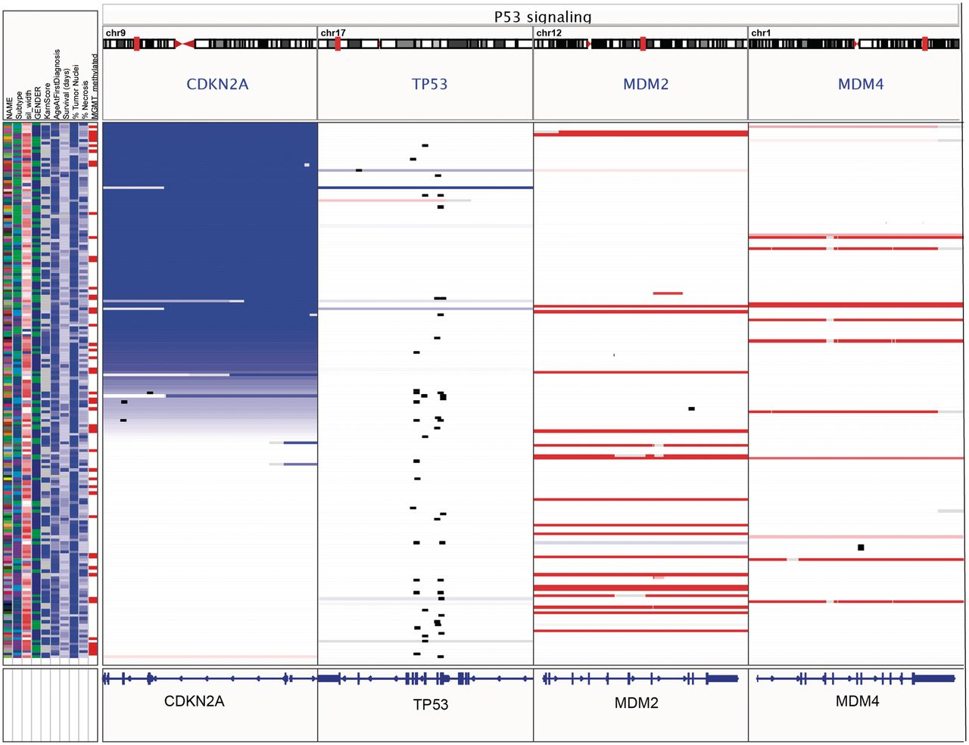
Figure 7: Gene-list view of copy number, mutation and clinical data from 202 glioblastoma samples from the TCGA ...
Notes:
Figure 7: Gene-list view of copy number, mutation and clinical data from 202 glioblastoma samples from the TCGA project. The IGV window has been split into panels corresponding to four genes from the p53 signaling pathway. Copy number is indicated by color, with blue denoting deletion and red amplification. Mutations are overlaid as small black rectangles. The samples have been sorted by copy number of CDKN2A. In this view it is apparent that deletion of CDKN2A and mutation of TP53 tend to be mutually exclusive.
Unless provided in the caption above, the following copyright applies to the content of this slide: © The Author(s) 2012. Published by Oxford University Press.This is an Open Access article distributed under the terms of the Creative Commons Attribution Non-Commercial License (http://creativecommons.org/licenses/by-nc/3.0), which permits unrestricted non-commercial use, distribution, and reproduction in any medium, provided the original work is properly cited.

Slide 8
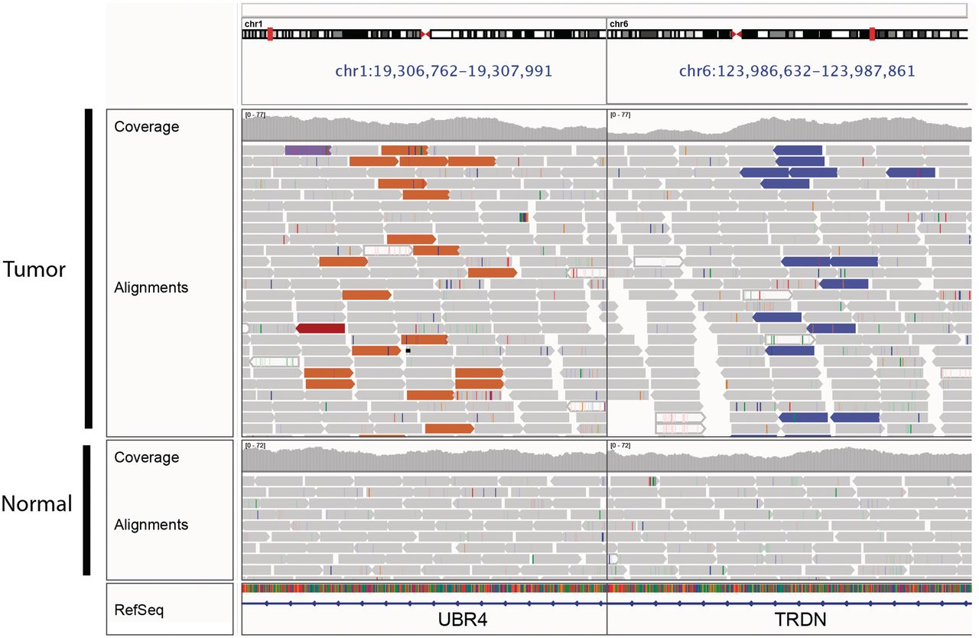
Figure 8: Split-screen view of read alignments from a glioblastoma multiforme tumor sample and matched normal, ...
Notes:
Figure 8: Split-screen view of read alignments from a glioblastoma multiforme tumor sample and matched normal, displaying regions of chromosomes 1 and 6. In this example, alignments whose mate pairs are mapped to unexpected locations are color-coded by the chromosome of the mate; other alignments are displayed in light gray. The brown alignments on the left panel and purple alignments on the right are matepairs, indicating a fusion between these loci. There is no evidence of this rearrangement in the matched normal.
Unless provided in the caption above, the following copyright applies to the content of this slide: © The Author(s) 2012. Published by Oxford University Press.This is an Open Access article distributed under the terms of the Creative Commons Attribution Non-Commercial License (http://creativecommons.org/licenses/by-nc/3.0), which permits unrestricted non-commercial use, distribution, and reproduction in any medium, provided the original work is properly cited.

