Slide 1
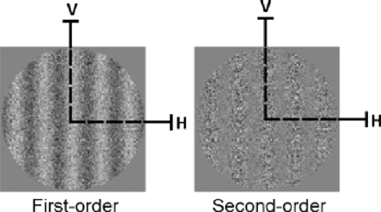
Fig. 1 Schematic representation of static stimuli used for experiment 1. First- and second-order stimuli are ...
Notes:
Fig. 1 Schematic representation of static stimuli used for experiment 1. First- and second-order stimuli are presented in their vertical (V) orientation. Both static and dynamic forms of first- and second-order information are initially processed in parallel by separate passive mechanisms using similar principles of detection. Specifically, first stage filters, operating within V1, extract first-order orientation or motion direction whereas second-order information is detected at a second stage of filtering at a coarser spatial scale (in areas V2/V3), but only after full-wave rectification of the second-order signals (Wilson et al., 1992; Chubb and Sperling, 1988, Cavanagh and Mather, 1989; Sperling et al., 1994; Baker, 1999). For this reason, first-order information can be considered to be simple and second-order information complex because the latter type recruits more extensive neural circuitry as well as additional processing prior to detection.
Unless provided in the caption above, the following copyright applies to the content of this slide: © The Author (2005). Published by Oxford University Press on behalf of the Guarantors of Brain. All rights reserved. For Permissions, please email: journals.permissions@oxfordjournals.org

Slide 2
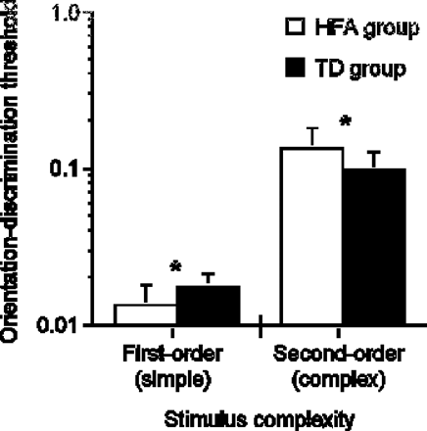
Fig. 2 Orientation-discrimination thresholds as a function of stimulus complexity for HFA and TD participants. Since ...
Notes:
Fig. 2 Orientation-discrimination thresholds as a function of stimulus complexity for HFA and TD participants. Since first- and second-order stimuli are constructed using different image attributes, the absolute difference between first- and second-order thresholds is uninformative. Error bars represent 1 standard deviation.
Unless provided in the caption above, the following copyright applies to the content of this slide: © The Author (2005). Published by Oxford University Press on behalf of the Guarantors of Brain. All rights reserved. For Permissions, please email: journals.permissions@oxfordjournals.org

Slide 3
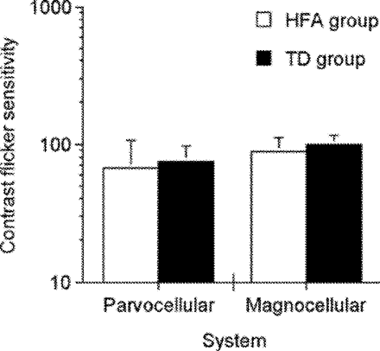
Fig. 3 Contrast flicker sensitivity measures for parvocellular and magnocellular functioning for HFA and TD groups. ...
Notes:
Fig. 3 Contrast flicker sensitivity measures for parvocellular and magnocellular functioning for HFA and TD groups. Error bars represent 1 standard deviation.
Unless provided in the caption above, the following copyright applies to the content of this slide: © The Author (2005). Published by Oxford University Press on behalf of the Guarantors of Brain. All rights reserved. For Permissions, please email: journals.permissions@oxfordjournals.org

