Slide 1
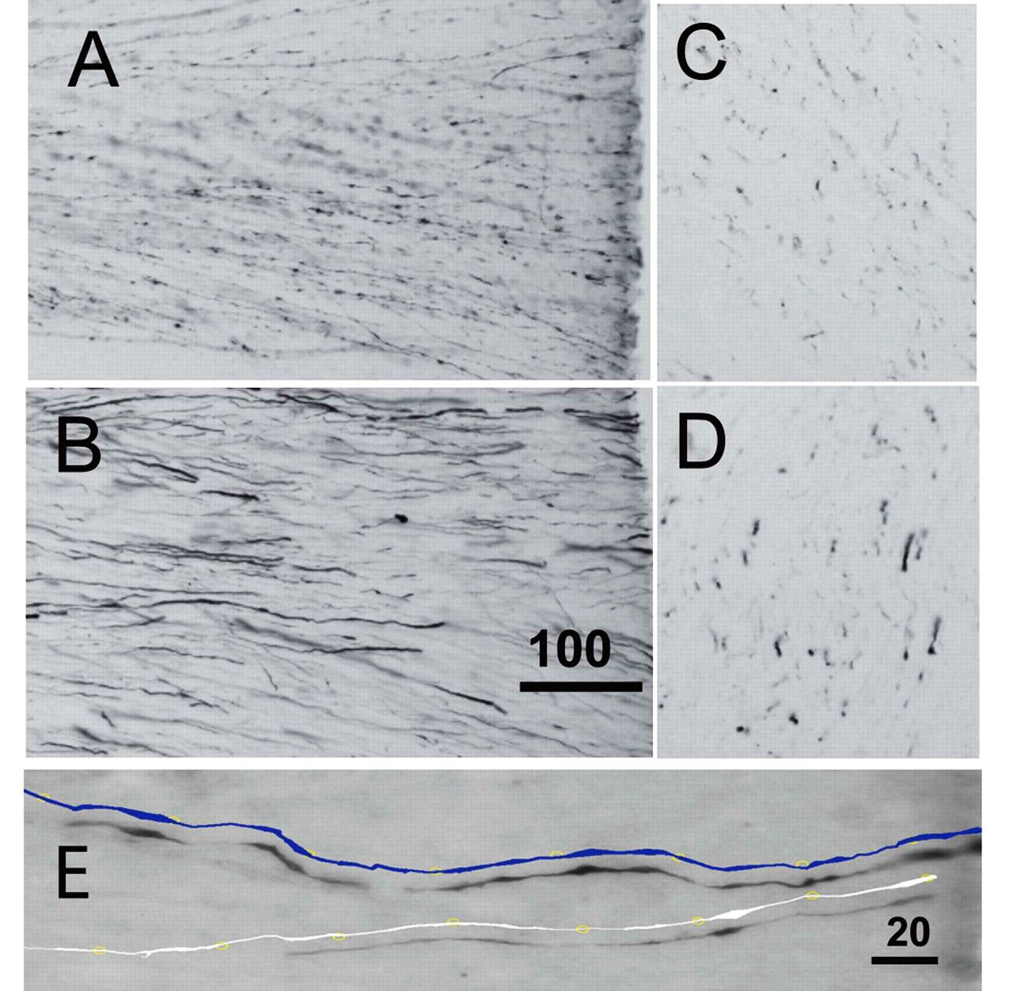
Figure 1. Photomicrographs of callosal axons originating from prefrontal cortex (exp CCT2; A and C) and from area 4 ...
Notes:
Figure 1. Photomicrographs of callosal axons originating from prefrontal cortex (exp CCT2; A and C) and from area 4 (exp CCT5; B and D) in sections longitudinal (A and B) and transverse (C and D) to their trajectory. In (E), 2 axons from area 2 (exp CCT2) are shown at higher magnification and redrawn (blue) on the plane of the photomicrograph. Notice that axons from motor cortex are thicker than those from prefrontal cortex and that the axons undergo changes in diameter along their trajectory. The diameter was measured at regular intervals along the reconstructions (yellow circles). Scale bars in μm.
Unless provided in the caption above, the following copyright applies to the content of this slide: © The Author 2012. Published by Oxford University Press. All rights reserved. For permissions, please e-mail: journals.permissions@oup.com

Slide 2
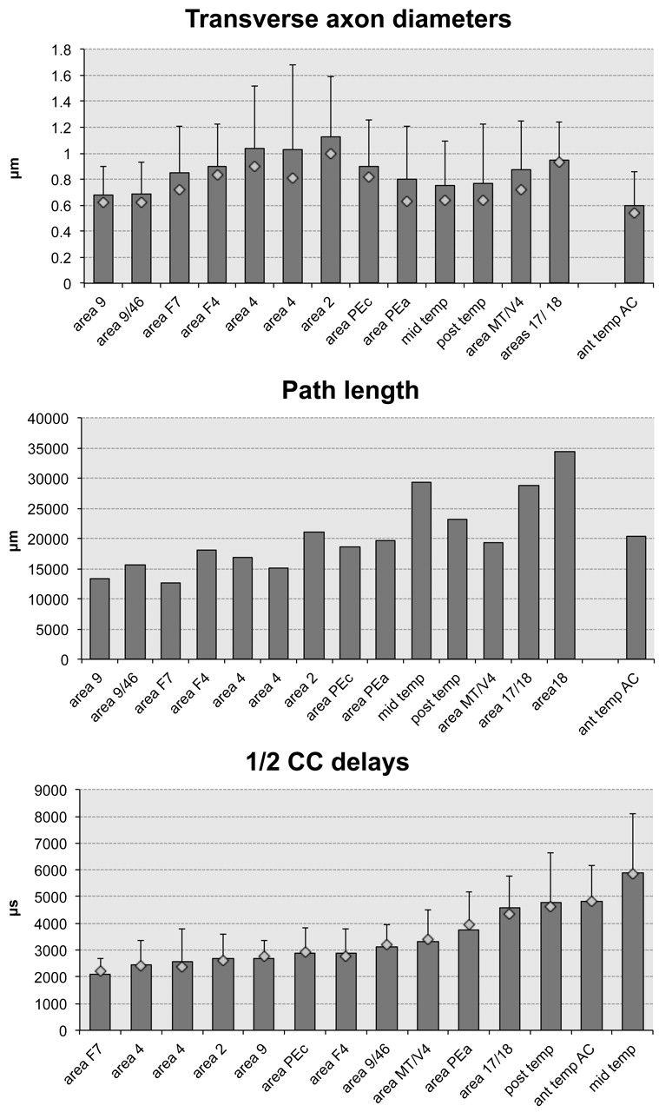
Figure 2. Top: means (with standard deviations) and medians (diamonds) of measurements of commissural axon diameters in ...
Notes:
Figure 2. Top: means (with standard deviations) and medians (diamonds) of measurements of commissural axon diameters in transverse sections. Middle: curvilinear path lengths to the midline. Bottom: means (with standard deviations) and medians (diamonds) of computed conduction delays to the midline. In top and middle panel, origins of projections are ordered according to the anterior–posterior topography of the CC; in bottom panel, they are in the increasing order of mean delays. Path length was different for axons originating near the 17/18 border or in area 18 (middle panel), but the 2 axonal systems were indistinguishable at the midline (top panel), and the conduction delays were computed on the average of the 2 conduction distances (bottom panel).
Unless provided in the caption above, the following copyright applies to the content of this slide: © The Author 2012. Published by Oxford University Press. All rights reserved. For permissions, please e-mail: journals.permissions@oup.com

Slide 3
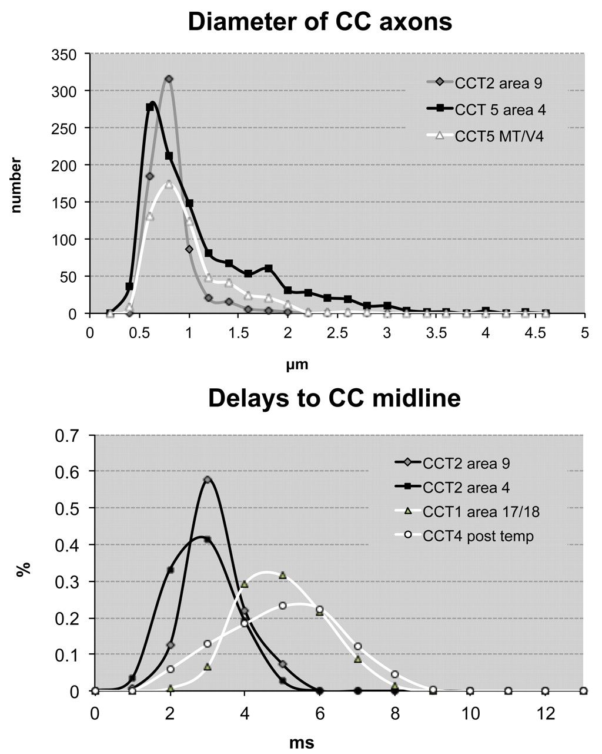
Figure 3. Top: frequency of diameters in axons from prefrontal, motor, and one peristriate area. Bottom: frequency of ...
Notes:
Figure 3. Top: frequency of diameters in axons from prefrontal, motor, and one peristriate area. Bottom: frequency of delays to the callosal midline in axons from prefrontal, motor, primary visual, and posterior temporal areas.
Unless provided in the caption above, the following copyright applies to the content of this slide: © The Author 2012. Published by Oxford University Press. All rights reserved. For permissions, please e-mail: journals.permissions@oup.com

Slide 4
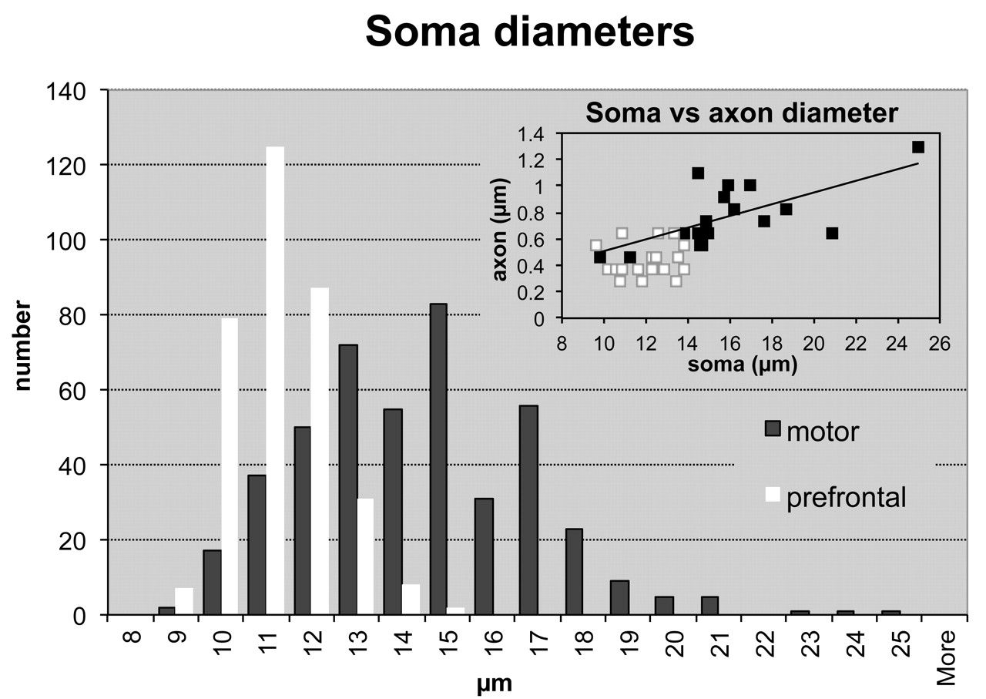
Figure 4. Distribution of soma diameters of callosally projecting neurons in motor and prefrontal areas. Inset shows ...
Notes:
Figure 4. Distribution of soma diameters of callosally projecting neurons in motor and prefrontal areas. Inset shows the relations between somata and their axon diameters in individual callosally projecting neurons in both areas. The 2 are linearly correlated (Pearson = 0.73; P < 0.001).
Unless provided in the caption above, the following copyright applies to the content of this slide: © The Author 2012. Published by Oxford University Press. All rights reserved. For permissions, please e-mail: journals.permissions@oup.com

Slide 5
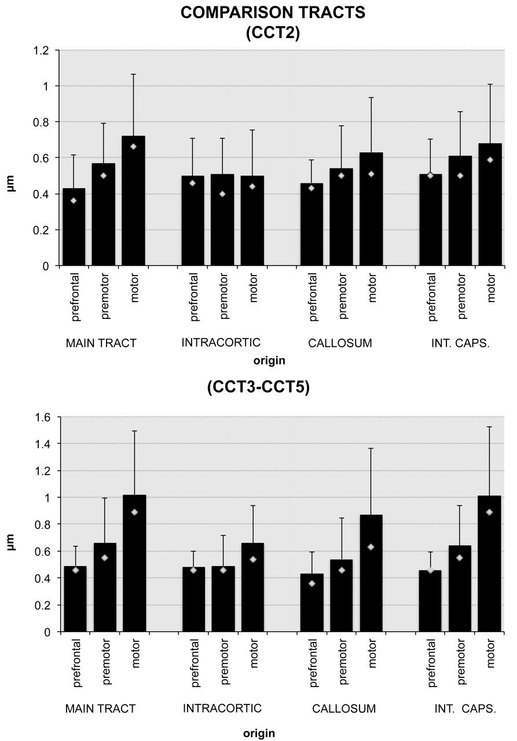
Figure 5. Means (columns, with standard deviations) and medians (diamonds) of longitudinal measurements of diameters ...
Notes:
Figure 5. Means (columns, with standard deviations) and medians (diamonds) of longitudinal measurements of diameters for axons in 4 tracts, originating in prefrontal, premotor, and motor areas (data from three experiments).
Unless provided in the caption above, the following copyright applies to the content of this slide: © The Author 2012. Published by Oxford University Press. All rights reserved. For permissions, please e-mail: journals.permissions@oup.com

Slide 6
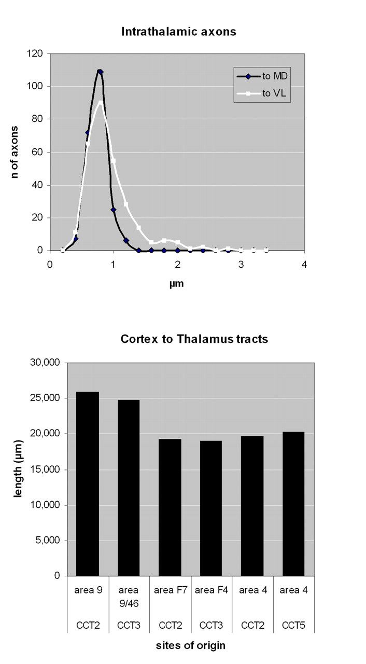
Figure 6. Top: frequency of diameters of intrathalamic axons from prefrontal cortex to the nucleus MD (experiment CCT3) ...
Notes:
Figure 6. Top: frequency of diameters of intrathalamic axons from prefrontal cortex to the nucleus MD (experiment CCT3) and from motor cortex to nucleus VL (experiment CCT5). Bottom: lengths of pathways to thalamus from prefrontal, premotor, and motor cortex.
Unless provided in the caption above, the following copyright applies to the content of this slide: © The Author 2012. Published by Oxford University Press. All rights reserved. For permissions, please e-mail: journals.permissions@oup.com

Slide 7
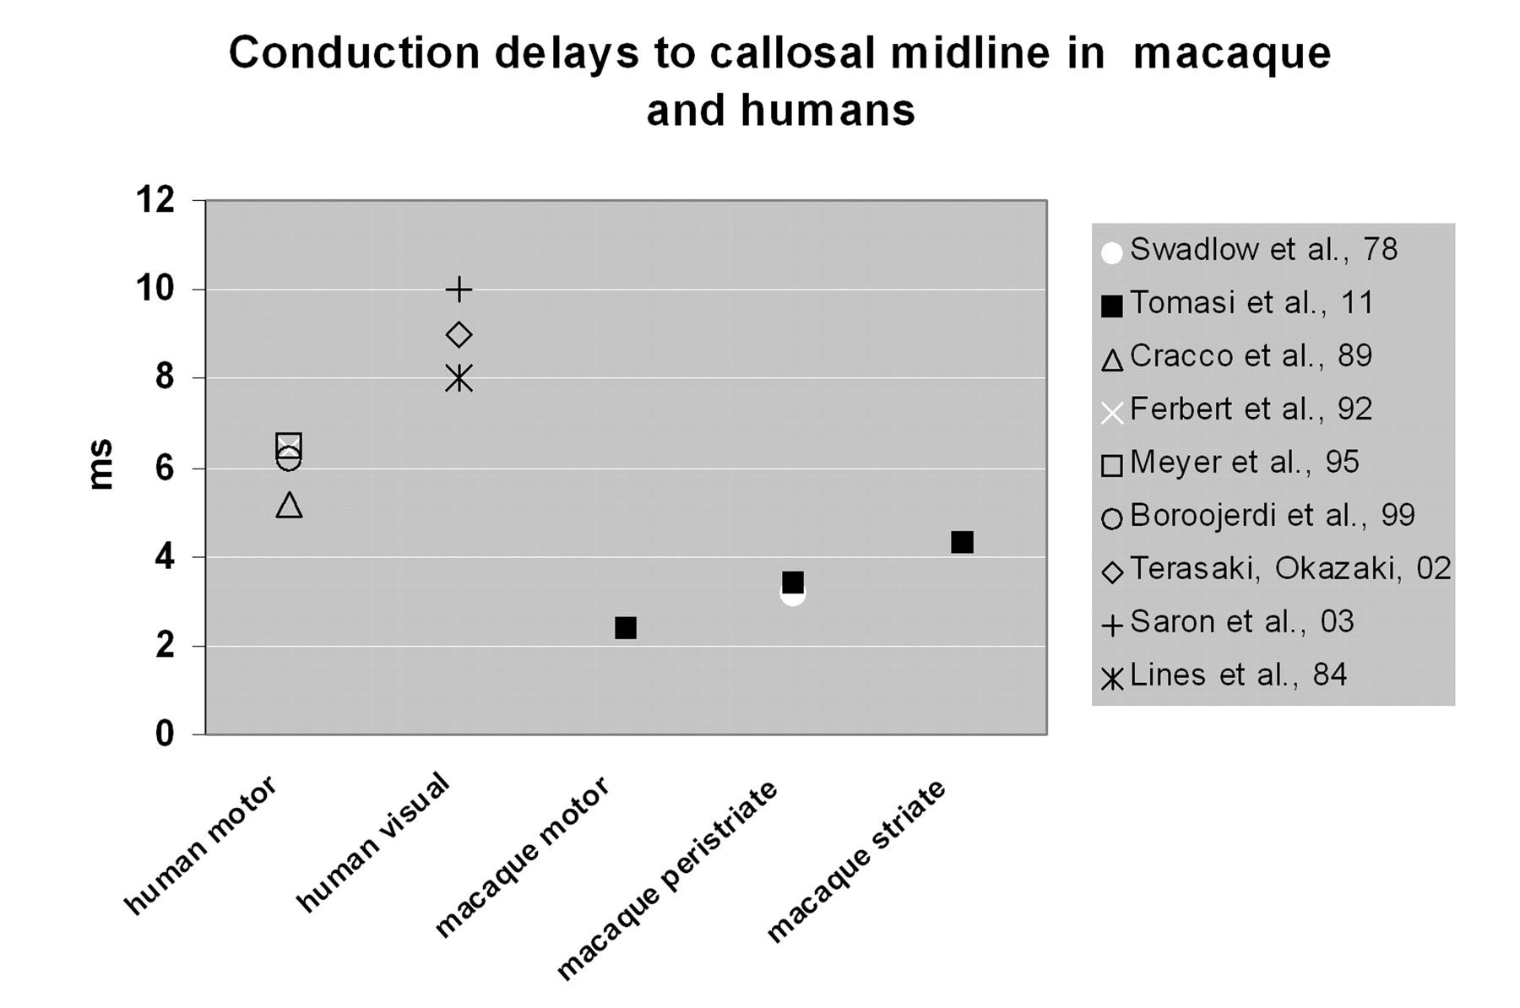
Figure 7. Comparison of conduction times to the midline calculated from anatomical data and estimated from ...
Notes:
Figure 7. Comparison of conduction times to the midline calculated from anatomical data and estimated from electrophysiological experiments in macaques and humans. Further explanations in text.
Unless provided in the caption above, the following copyright applies to the content of this slide: © The Author 2012. Published by Oxford University Press. All rights reserved. For permissions, please e-mail: journals.permissions@oup.com

