Slide 1
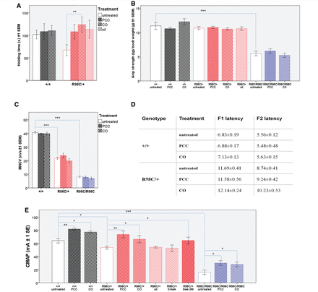
Figure 1 PCC or CO treatment ameliorates motor function and persistently improves compound muscle action potential ...
Notes:
Figure 1 PCC or CO treatment ameliorates motor function and persistently improves compound muscle action potential amplitudes. (A) Rotating rod analysis of motor function revealed that 6-week-old PCC (P = 0.029) or CO (P = 0.002) treated R98C/+ mice (P = 0.006) remain on the rod for a significantly longer period than untreated R98C/+ littermates. PCC- or oil-treated control animals showed a tendency towards a better performance; however, it did not prove significant (n = 5–10/genotype/treatment group). R98C homozygous animals were unable to remain on the rod even after treatment and are, therefore, not shown on the graph (n = 5–10/genotype/treatment group). (B) We observed no significant difference in muscle strength among untreated or PCC/CO treated +/+ and R98C/+ animals. R98C/R98C animals were significantly (P < 0.001) weaker and did not improve with PCC or CO treatment (n = 10/treatment group/genotype). (C) Three months of PCC or CO treatment did not ameliorate the significantly slowed nerve conduction velocities in either R98C/+ or R98C/R98C mice. (D) Prolonged F-wave latencies in R98C/+ remained unchanged with PCC or CO treatment. F-wave latencies could not be distinguished in untreated or PCC/CO treated R98C/R98C animals because of severe temporal dispersion. F1 latency is the F-wave latency from the distal stimulation point (ankle). F2 latency is the F-wave latency from the more proximal stimulation point (sciatic notch). (E) Of note, compound muscle action potential amplitudes (measured in the thigh) increased significantly in R98C/+ mice when treated with PCC (P = 0.001) or CO (P = 0.015) even if treatment was initiated at 6 weeks of age (P = 0.04). In contrast, oil-treated control animals or heterozygous mice whose treatment was stopped at 6 weeks of age did not show any benefit. PCC/CO treatment increased in wild-type (P = 0.001/P = 0.015) and even doubled R98C/R98C in compound muscle action potential amplitudes (P = 0.013/P = 0.032) (n = 5/treatment group/genotype). CMAP = compound muscle action potential; MNCV = motor nerve conduction velocity. * = P < 0.05; ** = P < 0.01;*** = P < 0.001.
Unless provided in the caption above, the following copyright applies to the content of this slide: © The Author (2012). Published by Oxford University Press on behalf of the Guarantors of Brain. All rights reserved. For Permissions, please email: journals.permissions@oup.com

Slide 2
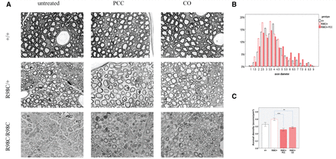
Figure 2 PCC or CO treatment does not affect myelination directly, but exerts its effects on axons. (A) Semi-thin ...
Notes:
Figure 2 PCC or CO treatment does not affect myelination directly, but exerts its effects on axons. (A) Semi-thin sections illustrate hypomyelination and the absence of large-diameter fibres in R98C/+ animals, and severe dysmyelination in R98C/R98C mice. Several large-diameter fibres can be observed in PCC or CO treated R98C/+ animals. Treatment failed to improve hypomyelination. Bar = 10 μm. (B) By 3 months of age, the distribution of axon diameter returned to normal in PCC or CO treated (not shown) R98C/+ mice (P < 0.001 for both CO and PCC when compared with untreated R98C/+); the proportion of large-diameter fibres was fully corrected (n = 2–3/genotype/treatment group). (C) Increased axonal density in untreated R98C/+ mice was markedly reduced in PCC (P < 0.001) or CO (P = 0.002) treated R98C/+ animals in correlation with the increase in axon size. * = P < 0.05; ** = P < 0.01; *** = P < 0.001.
Unless provided in the caption above, the following copyright applies to the content of this slide: © The Author (2012). Published by Oxford University Press on behalf of the Guarantors of Brain. All rights reserved. For Permissions, please email: journals.permissions@oup.com

Slide 3
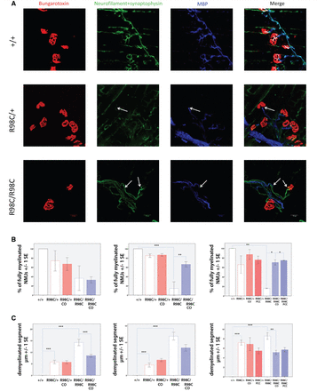
Figure 3 PCC or CO treatment improves the innervation of neuromuscular junctions in R98C animals. (A) Magnified (×60) ...
Notes:
Figure 3 PCC or CO treatment improves the innervation of neuromuscular junctions in R98C animals. (A) Magnified (×60) confocal images of neuromuscular junctions of wild-type and R98C animals at 6 weeks of age. Arrows indicate the demyelinated segment. Scale bar = 10 μm. (B and C) Virtually all neuromuscular junctions of untreated and PCC/CO treated wild-type mice were fully myelinated. Untreated wild-type values are included as control in the graphs. Percentage of fully myelinated neuromuscular junctions in the triangularis sterni muscle in R98C mice at post-natal Day 13, 6 weeks and 3 months of age. A tendency towards a lower number of normally myelinated junctions could be seen at post-natal Day 13 in R98C mice. By 6 weeks of age, R98C/R98C animals exhibited a significantly reduced number of normally myelinated junctions, which was rescued by CO treatment (P = 0.004). Benefits of treatment in R98C/R98C animals could be maintained even at 3 months of age (PCC P = 0.013, CO P = 0.017). Virtually all neuromuscular junctions of wild-type mice were fully myelinated, data not shown in the graphs. (C) The length of demyelinated segments proved to be longer in R98C/R98C animals than in R98C/+ mice (post-natal Day 13 P < 0.001, 6 week P = 0.003). CO treatment resulted in shorter demyelinated segments in R98C/R98C animals (post-natal Day 13 P < 0.001, 3 month P = 0.00815). NMJ = neuromuscular junction.
Unless provided in the caption above, the following copyright applies to the content of this slide: © The Author (2012). Published by Oxford University Press on behalf of the Guarantors of Brain. All rights reserved. For Permissions, please email: journals.permissions@oup.com

Slide 4
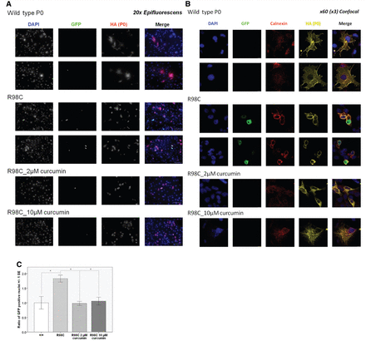
Figure 6 Curcumin treatment attenuated XBP1 splicing elicited by altered trafficking of the R98C mutant in Cos-7 ...
Notes:
Figure 6 Curcumin treatment attenuated XBP1 splicing elicited by altered trafficking of the R98C mutant in Cos-7 cells. (A) Green fluorescence in the nucleus indicates the activation of the IRE1 pathway of the unfolded protein response in a cell culture reporter system where alternative splicing of XBP1 pulls GFP into frame. Representative epifluorescent images demonstrate that XBP1 splicing occurred more frequently in Cos-7 cells transfected with R98C than in those transfected with wild-type P0 and that curcumin treatment reduced the number of GFP-positive nuclei. Scale bar = 100 μm. (B) Confocal images illustrate that although wild-type P0 reached the cell surface, the R98C mutant was retained in the endoplasmic reticulum as well as elicited XBP1 splicing. At 2 μM curcumin treatment altered trafficking of P0R98C protein remained, but the number of GFP-positive nuclei decreased; whereas at 10€ μM curcumin treatment, the number of GFP-positive nuclei decreased but some mutant protein appeared to reach the cell surface, as every cell process and protrusion is labelled with haemagglutinin staining (see arrows). Scale bar = 10 μm. (C) Quantification of XBP1 splicing in vitro. The percentage of GFP-positive nuclei was significantly higher (P = 0.05) in Cos-7 cells transfected with the R98C mutant as in those transfected with the wild-type construct. In the end, 2 and 10 μM curcumin treatment reduced XBP1 splicing to the same extent (for both P = 0.05).
Unless provided in the caption above, the following copyright applies to the content of this slide: © The Author (2012). Published by Oxford University Press on behalf of the Guarantors of Brain. All rights reserved. For Permissions, please email: journals.permissions@oup.com

Slide 5
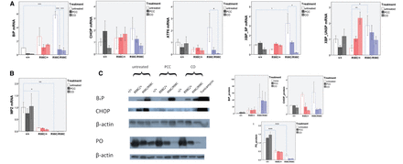
Figure 5 PCC or CO treatment partially attenuated the UPR at 3 months of age, but did not change MPZ protein levels. ...
Notes:
Figure 5 PCC or CO treatment partially attenuated the UPR at 3 months of age, but did not change MPZ protein levels. (A) Real-time PCR analyses of UPR activation at 3 months of age (n = 3–6). BiP, the general marker of UPR activation, was highly upregulated (P < 0.001) in untreated R98C/R98C animals compared with wild-type littermates. PCC/CO treatment reduced significantly (for both P < 0.001) the elevation of BiP in R98C/R98C mice. Note the activation of all three arms of the UPR [spliced XBP1 (XBP SP) P < 0.001]. The upregulation of two arms was significantly reduced at the messenger RNA level by PCC/CO treatment (spliced XBP1 both for PCC and CO P = 0.010; ATF6 PCC P = 0.003, CO P = 0.010) (n = 3–6). (B) Real-time PCR confirmed reduced MPZ levels in untreated (R98C/+ P = 0.023; R98C/R98C P = 0.01) and treated knock-in mice compared with wild-type animals (n = 3). (C) Western blot analyses indicated that BiP was highly upregulated in untreated (both R98C/+ and R98C/R98C P < 0.001) and treated mutants. Elevated CHOP protein levels were slightly but significantly reduced in treated animals (R98C/+ CO P = 0.019; R98C/R98C PCC P = 0.012, CO P = 0.014), but it was considered functionally uncertain because CHOP translocation to the nucleus is no longer observed at this age (data not shown). Positive control: 10-fold diluted liver samples from tunicamycin treated animals. P0 protein levels were reduced similarly in untreated and PCC/CO treated R98C/+ and R98C/R98C animals when compared with wild-type littermates (P < 0.001 both for R98C/+ and R98C/R98C). UNSP = unspliced. * = P < 0.05; ** = P < 0.01; *** = P < 0.001.
Unless provided in the caption above, the following copyright applies to the content of this slide: © The Author (2012). Published by Oxford University Press on behalf of the Guarantors of Brain. All rights reserved. For Permissions, please email: journals.permissions@oup.com

Slide 6
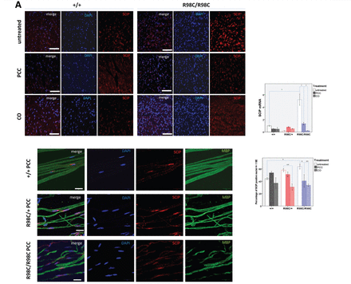
Figure 4 Curcumin derivatives alter expression of transcription factors in adult R98C mice immunohistochemistry and ...
Notes:
Figure 4 Curcumin derivatives alter expression of transcription factors in adult R98C mice immunohistochemistry and real-time PCR analyses of SCIP, c-Jun and Krox-20 messenger RNA levels at 3 months of age (n = 2–6/genotype/treatment group). (A) Immunohistochemistry on sciatic nerve cross sections and teased fibre preparations confirmed nuclear SCIP localization. The percentage of SCIP-positive nuclei was elevated in untreated R98C/+ mice, and it was elevated to a greater extent in R98C/R98C mice (P = 0.029). PCC and CO treatment reduced SCIP upregulation in R98C/R98C (PCC P = 0.013; CO P = 0.003) animals. Scale bars : cross section = 50 μm, teased fibre = 20 μm. Markedly elevated SCIP messenger RNA levels in R98C/R98C animals compared with wild-type littermates (P = 0.001) were also significantly reduced in PCC/CO treated R98C/R98C animals (for both PCC and CO P = 0.010). (B) The increased percentage of c-Jun-positive nuclei in the mutant animals was significantly reduced by PCC (P = 0.002) or CO (P = 0.018) treatment in R98C/R98C mice. Scale bar = 50 μm. No significant difference was detected in c-Jun messenger RNA levels between the genotypes and treatment groups. (C) Immunohistochemistry revealed no significant differences between untreated wild-type and mutant animals for Krox-20 expression at 3 months of age; treatment slightly decreased nuclear Krox-20 expression. Scale bar = 50 μm. Krox-20 messenger RNA levels were significantly elevated in R98C/R98C mice (P = 0.014) compared with wild-type animals. PCC- or CO-treated R98C/R98C animals showed a tendency towards reduced Krox-20 messenger RNA expression (CO P = 0.049). * = P < 0.05; ** = P < 0.01; *** = P < 0.001.
Unless provided in the caption above, the following copyright applies to the content of this slide: © The Author (2012). Published by Oxford University Press on behalf of the Guarantors of Brain. All rights reserved. For Permissions, please email: journals.permissions@oup.com

Slide 7
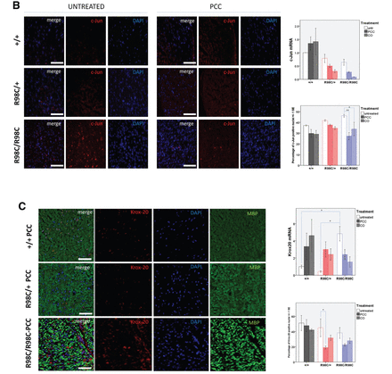
Figure 4 Curcumin derivatives alter expression of transcription factors in adult R98C mice immunohistochemistry and ...
Notes:
Figure 4 Curcumin derivatives alter expression of transcription factors in adult R98C mice immunohistochemistry and real-time PCR analyses of SCIP, c-Jun and Krox-20 messenger RNA levels at 3 months of age (n = 2–6/genotype/treatment group). (A) Immunohistochemistry on sciatic nerve cross sections and teased fibre preparations confirmed nuclear SCIP localization. The percentage of SCIP-positive nuclei was elevated in untreated R98C/+ mice, and it was elevated to a greater extent in R98C/R98C mice (P = 0.029). PCC and CO treatment reduced SCIP upregulation in R98C/R98C (PCC P = 0.013; CO P = 0.003) animals. Scale bars : cross section = 50 μm, teased fibre = 20 μm. Markedly elevated SCIP messenger RNA levels in R98C/R98C animals compared with wild-type littermates (P = 0.001) were also significantly reduced in PCC/CO treated R98C/R98C animals (for both PCC and CO P = 0.010). (B) The increased percentage of c-Jun-positive nuclei in the mutant animals was significantly reduced by PCC (P = 0.002) or CO (P = 0.018) treatment in R98C/R98C mice. Scale bar = 50 μm. No significant difference was detected in c-Jun messenger RNA levels between the genotypes and treatment groups. (C) Immunohistochemistry revealed no significant differences between untreated wild-type and mutant animals for Krox-20 expression at 3 months of age; treatment slightly decreased nuclear Krox-20 expression. Scale bar = 50 μm. Krox-20 messenger RNA levels were significantly elevated in R98C/R98C mice (P = 0.014) compared with wild-type animals. PCC- or CO-treated R98C/R98C animals showed a tendency towards reduced Krox-20 messenger RNA expression (CO P = 0.049). * = P < 0.05; ** = P < 0.01; *** = P < 0.001.
Unless provided in the caption above, the following copyright applies to the content of this slide: © The Author (2012). Published by Oxford University Press on behalf of the Guarantors of Brain. All rights reserved. For Permissions, please email: journals.permissions@oup.com

