Slide 1
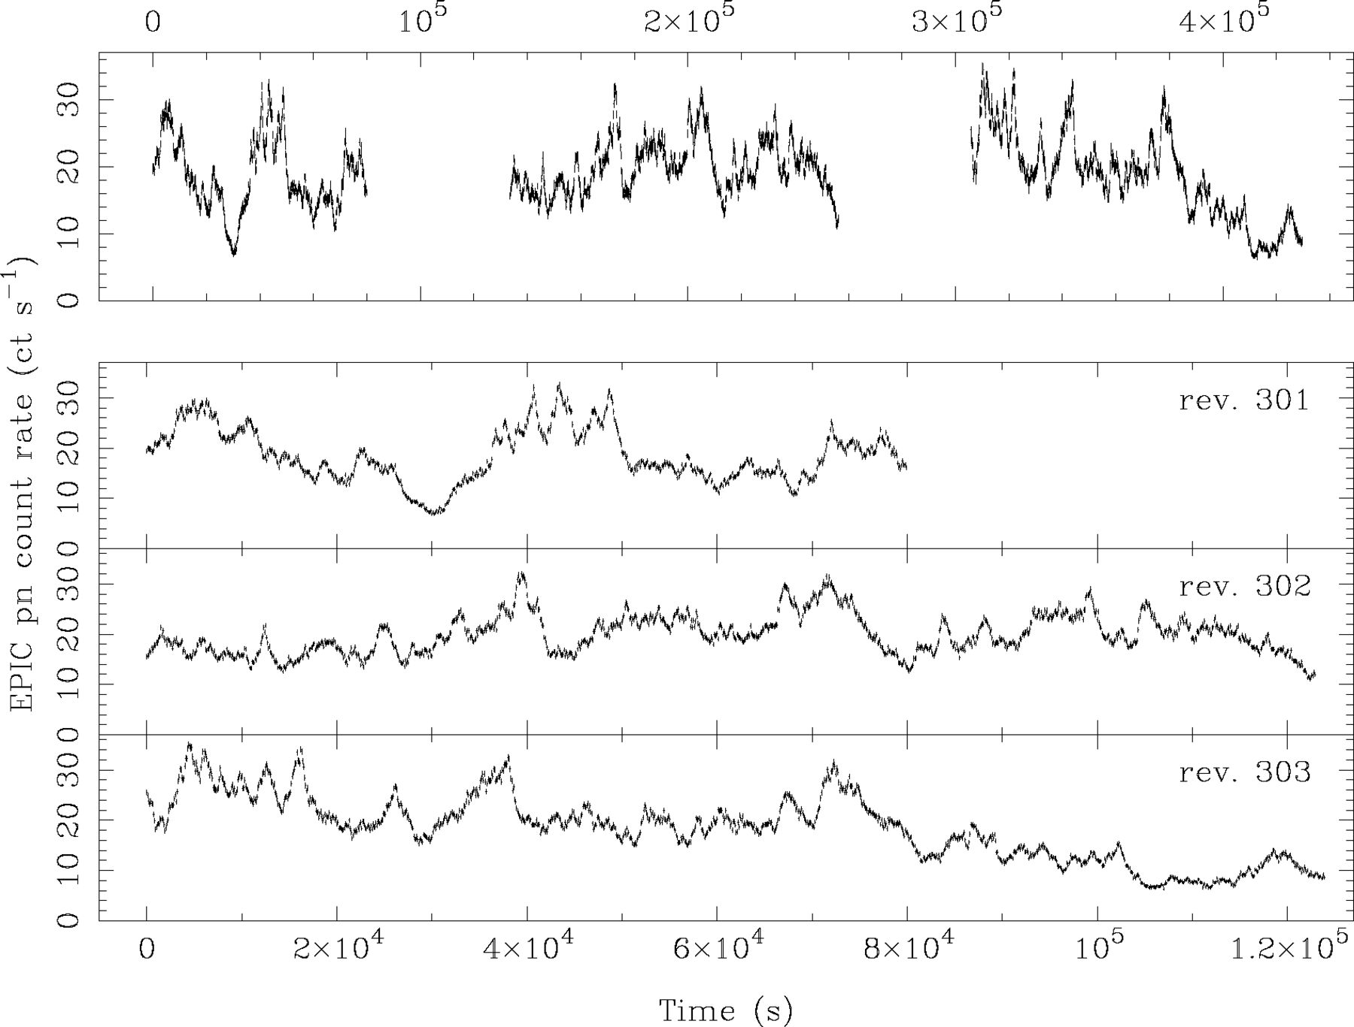
Figure 1 Full-band (0.2–10.0 keV) EPIC pn light curves in 100 s bins. The top panel shows all three consecutive light ...
Notes:
Figure 1 Full-band (0.2–10.0 keV) EPIC pn light curves in 100 s bins. The top panel shows all three consecutive light curves and the bottom panels show the individual light curves from each XMM-Newton revolution. This figure can be seen in colour in the online version of the journal on Synergy.
Unless provided in the caption above, the following copyright applies to the content of this slide: © © 2003 RAS 2003

Slide 2
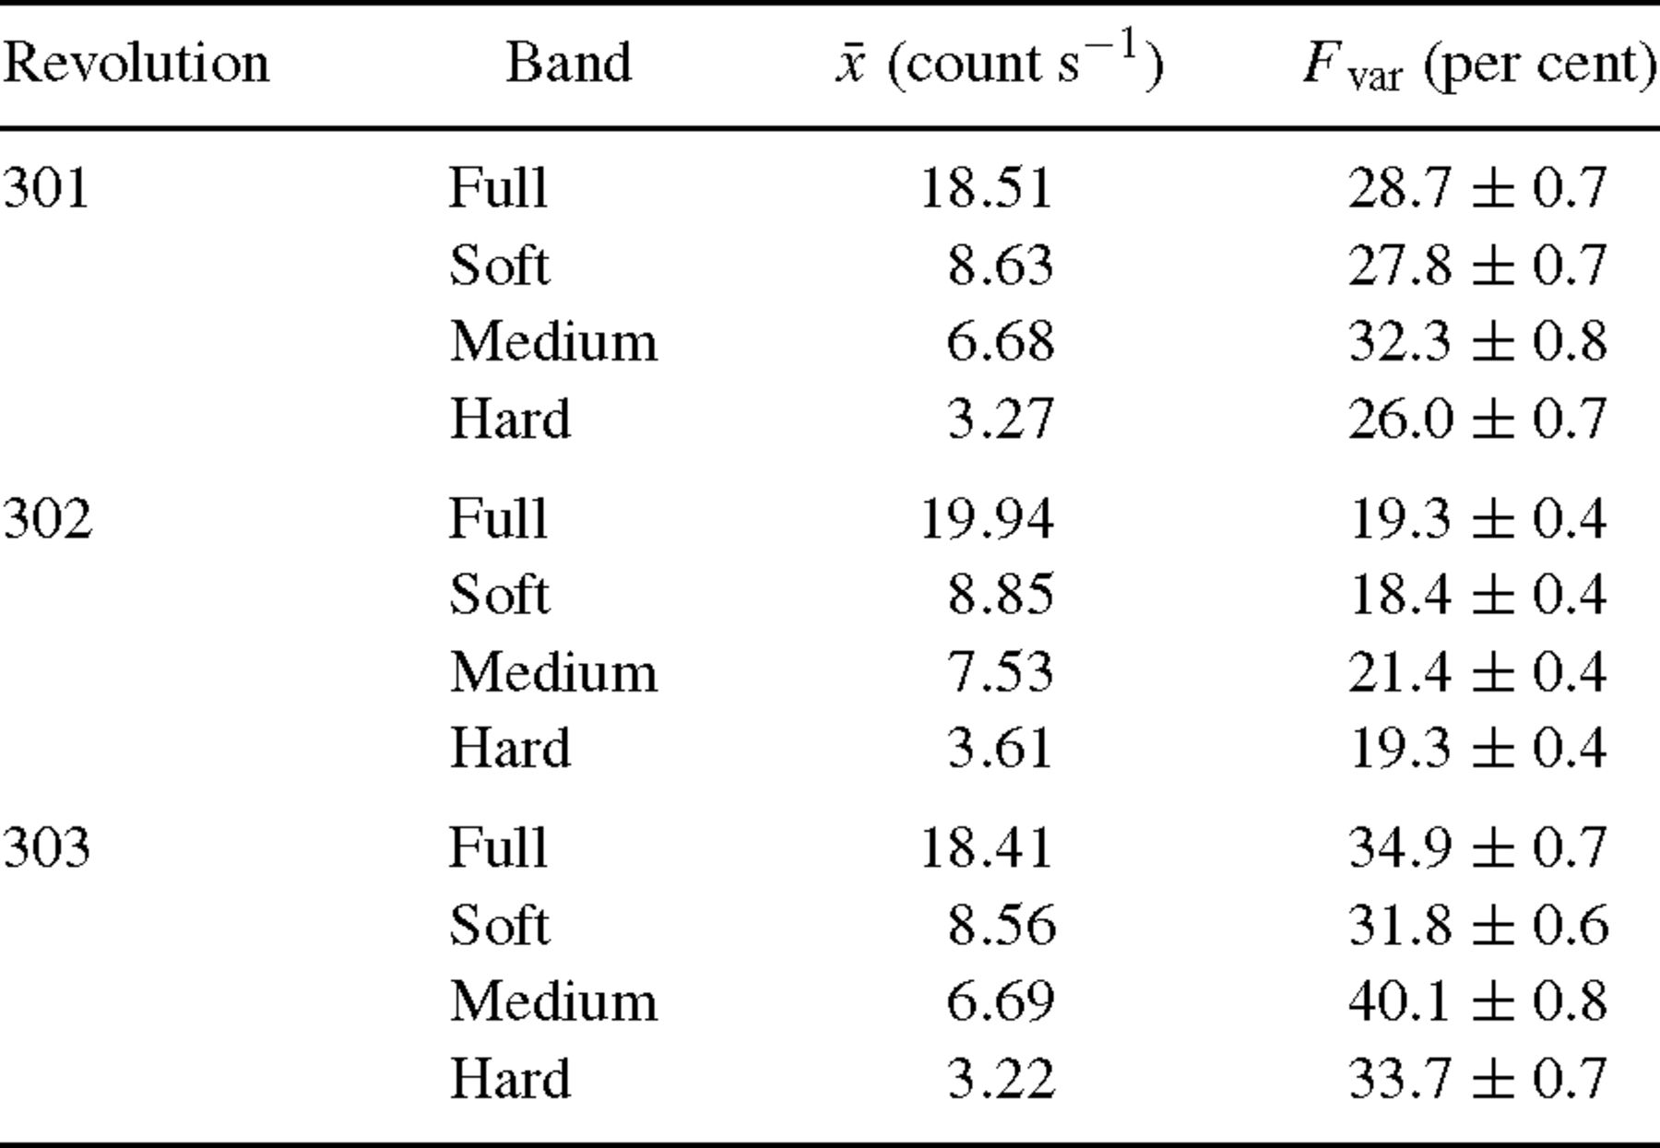
Table 1 Mean count rates (x) and fractional excess rms variability amplitudes (F_{var}) for the light curves ...
Notes:
Table 1 Mean count rates (x) and fractional excess rms variability amplitudes (Fvar) for the light curves from each revolution and in each energy band.
Unless provided in the caption above, the following copyright applies to the content of this slide: © © 2003 RAS 2003

Slide 3
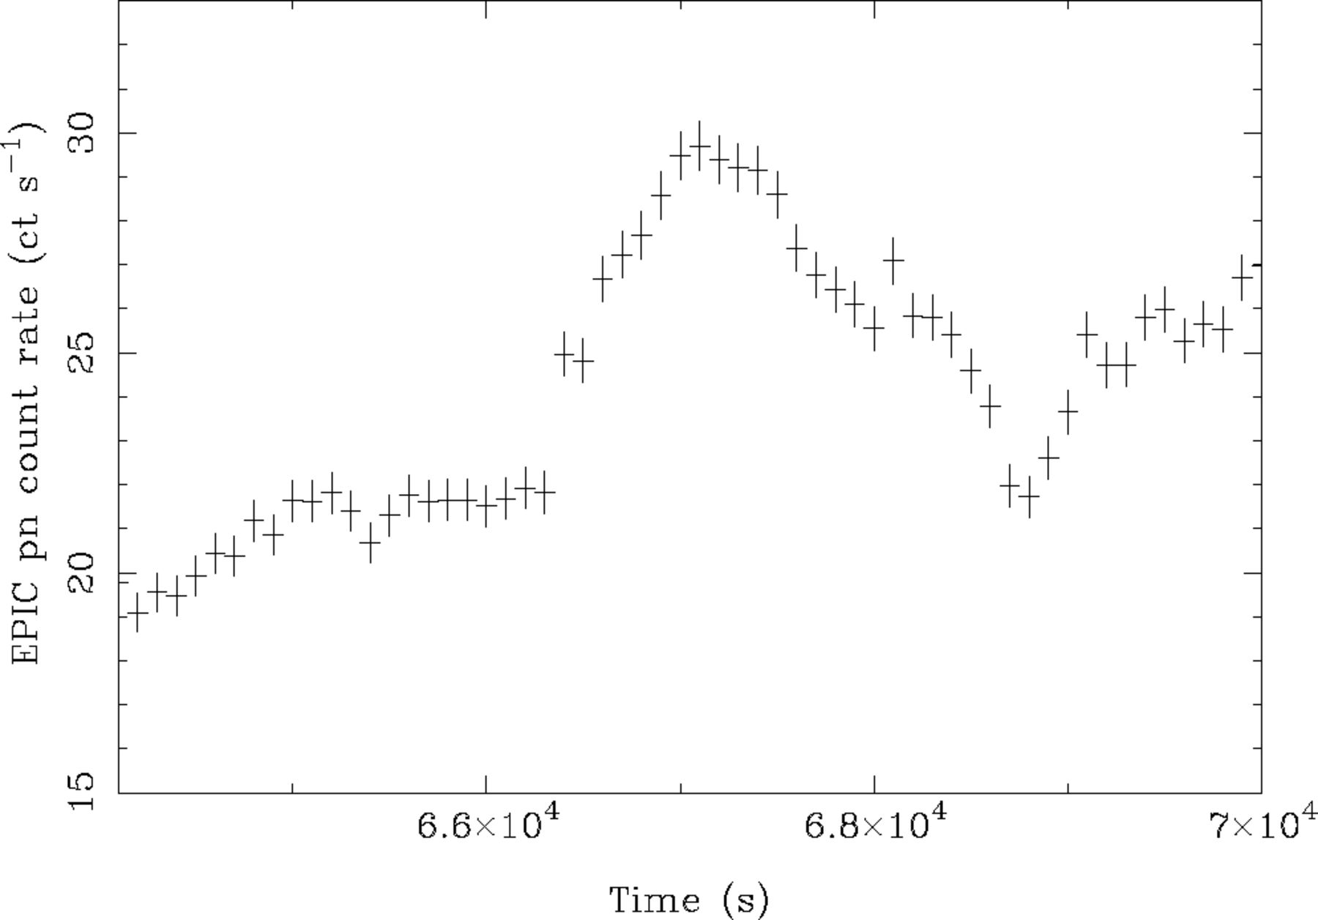
Figure 2 Section of the full-band (0.2–10.0 keV) EPIC pn light curve (from rev. 302) showing a rapid ‘flare’ event.
Notes:
Figure 2 Section of the full-band (0.2–10.0 keV) EPIC pn light curve (from rev. 302) showing a rapid ‘flare’ event.
Unless provided in the caption above, the following copyright applies to the content of this slide: © © 2003 RAS 2003

Slide 4
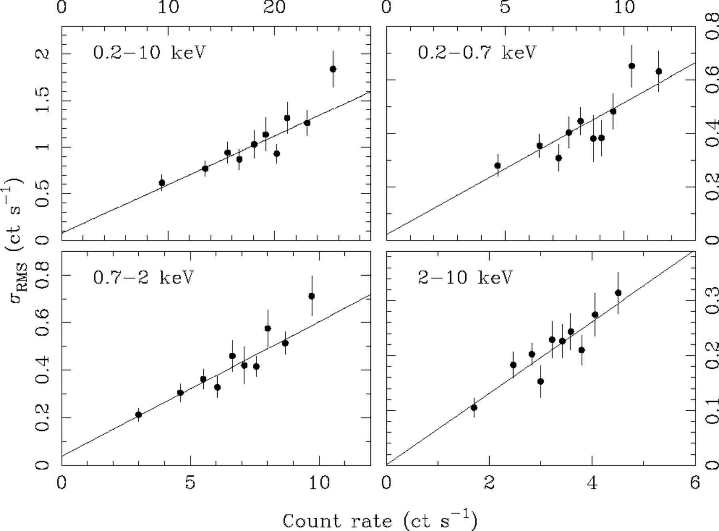
Figure 3 Correlation between rms variability amplitude and flux. This figure can be seen in colour in the online ...
Notes:
Figure 3 Correlation between rms variability amplitude and flux. This figure can be seen in colour in the online version of the journal on Synergy.
Unless provided in the caption above, the following copyright applies to the content of this slide: © © 2003 RAS 2003

Slide 5
Table 2 Results of fitting a linear function to the rms-flux correlation. Errors on the model parameters correspond ...
Notes:
Table 2 Results of fitting a linear function to the rms-flux correlation. Errors on the model parameters correspond to a 90 per cent confidence level for one interesting parameter (i.e. a Δχ2 = 2.7 criterion).
Unless provided in the caption above, the following copyright applies to the content of this slide: © © 2003 RAS 2003

Slide 6
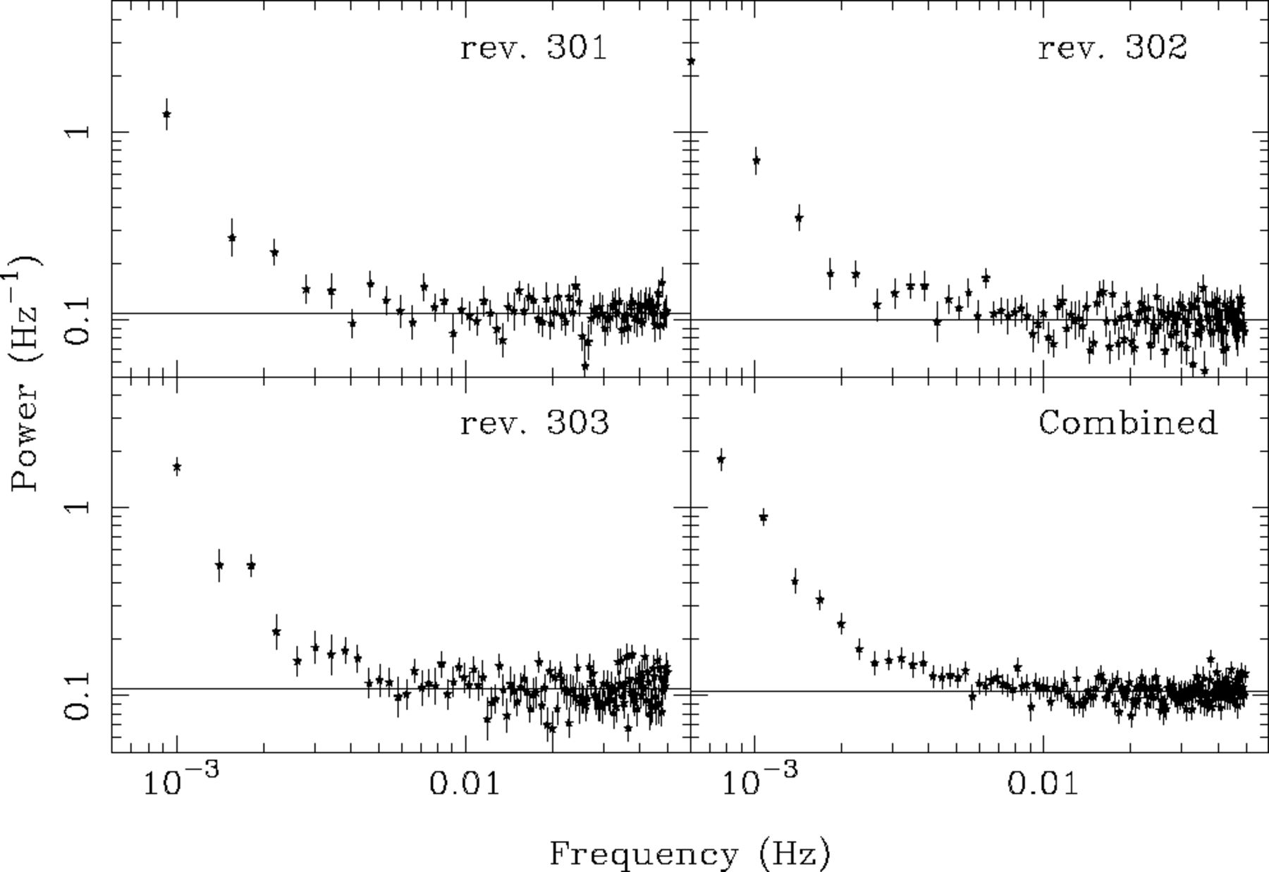
Figure 4 High-frequency periodograms estimated using 10-s resolution, full-band light curves. At high frequencies the ...
Notes:
Figure 4 High-frequency periodograms estimated using 10-s resolution, full-band light curves. At high frequencies the periodograms are dominated by the flat (white) Poisson noise spectrum. The solid lines show the expected Poisson noise levels. This figure can be seen in colour in the online version of the journal on Synergy.
Unless provided in the caption above, the following copyright applies to the content of this slide: © © 2003 RAS 2003

Slide 7
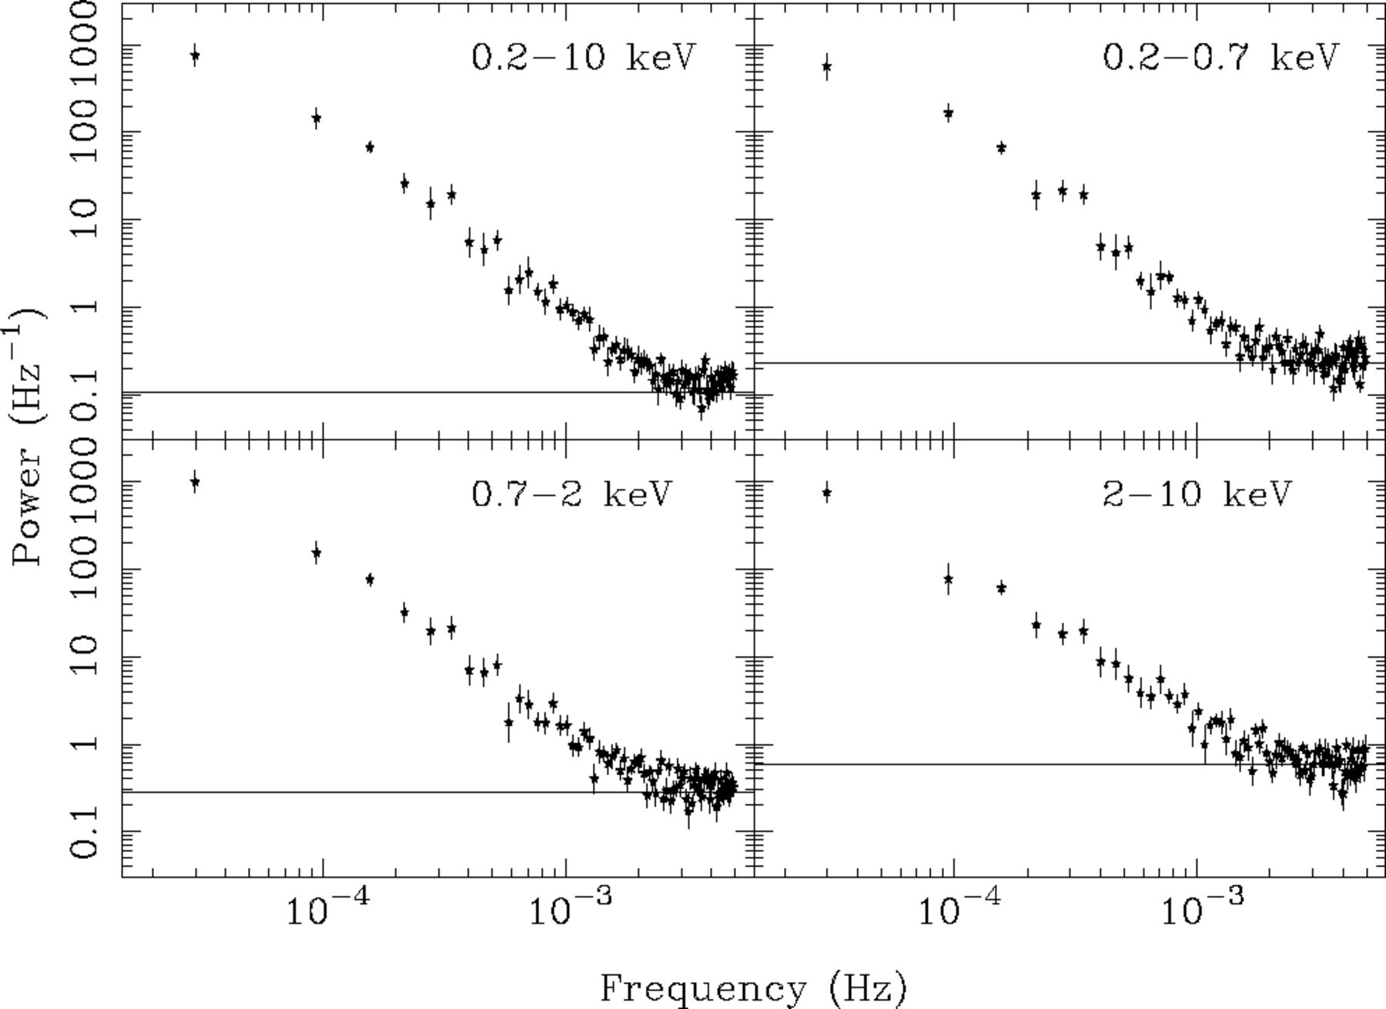
Figure 5 Periodograms for each energy band calculated using three revolutions of data. The solid lines show the ...
Notes:
Figure 5 Periodograms for each energy band calculated using three revolutions of data. The solid lines show the expected Poisson noise levels. This figure can be seen in colour in the online version of the journal on Synergy.
Unless provided in the caption above, the following copyright applies to the content of this slide: © © 2003 RAS 2003

Slide 8
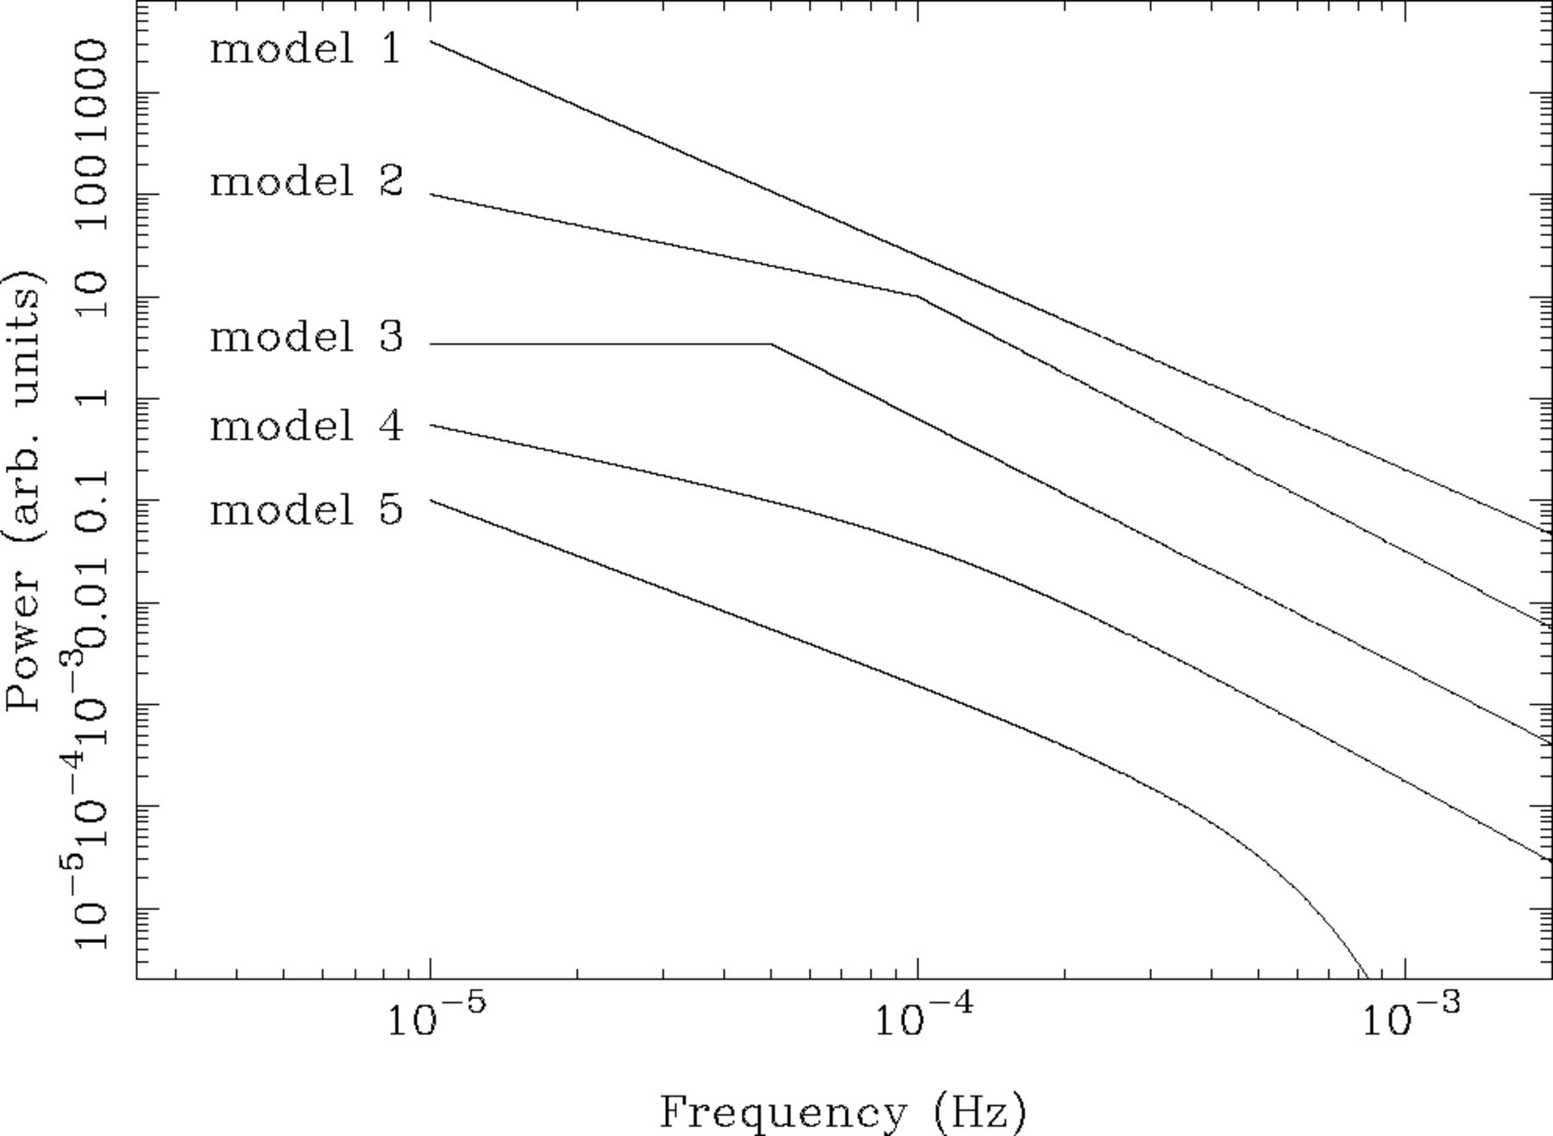
Figure 6 Trial PSD models used to fit the full-band data.
Notes:
Figure 6 Trial PSD models used to fit the full-band data.
Unless provided in the caption above, the following copyright applies to the content of this slide: © © 2003 RAS 2003

Slide 9
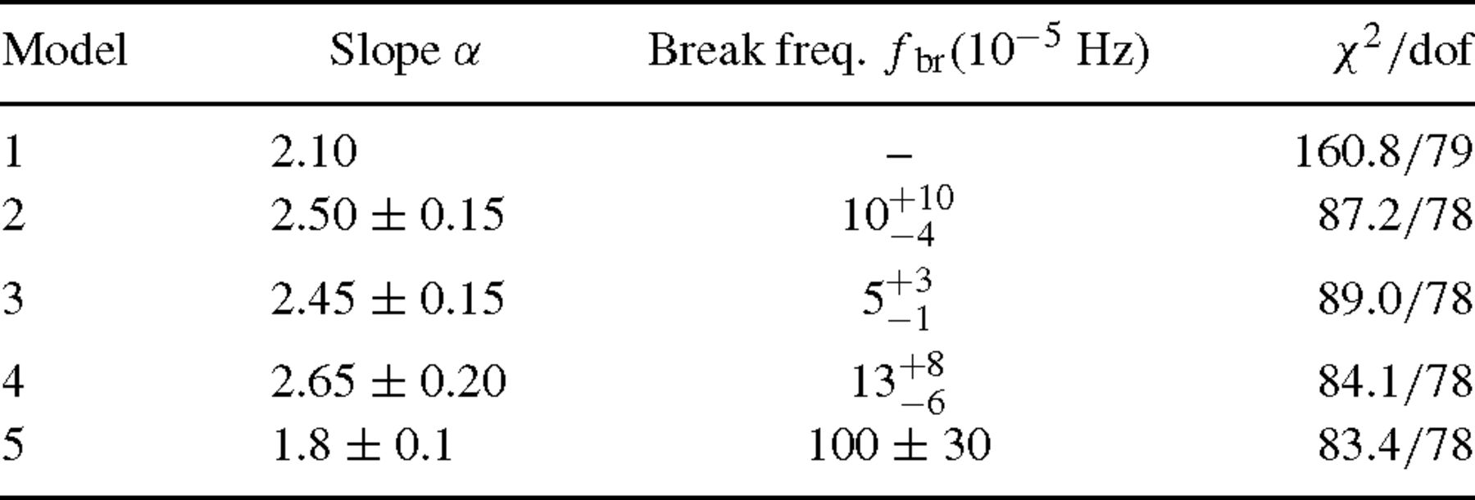
Table 3 Results of fitting the full-band periodogram with various trial models. The models are discussed in the text ...
Notes:
Table 3 Results of fitting the full-band periodogram with various trial models. The models are discussed in the text and shown in Fig. 6. Model 1 is a simple power law, model 2 is a power law breaking to a slope of αlow = 1 at low frequencies, model 3 is a power law with a break to αlow = 0, model 4 is a power law with a smooth transition to a slope of αlow = 1 at low frequencies and model 5 is an exponentially cut-off power law. Errors on the model parameters correspond to a 90 per cent confidence level for one interesting parameter (i.e. a Δχ2 = 2.7 criterion).
Unless provided in the caption above, the following copyright applies to the content of this slide: © © 2003 RAS 2003

Slide 10
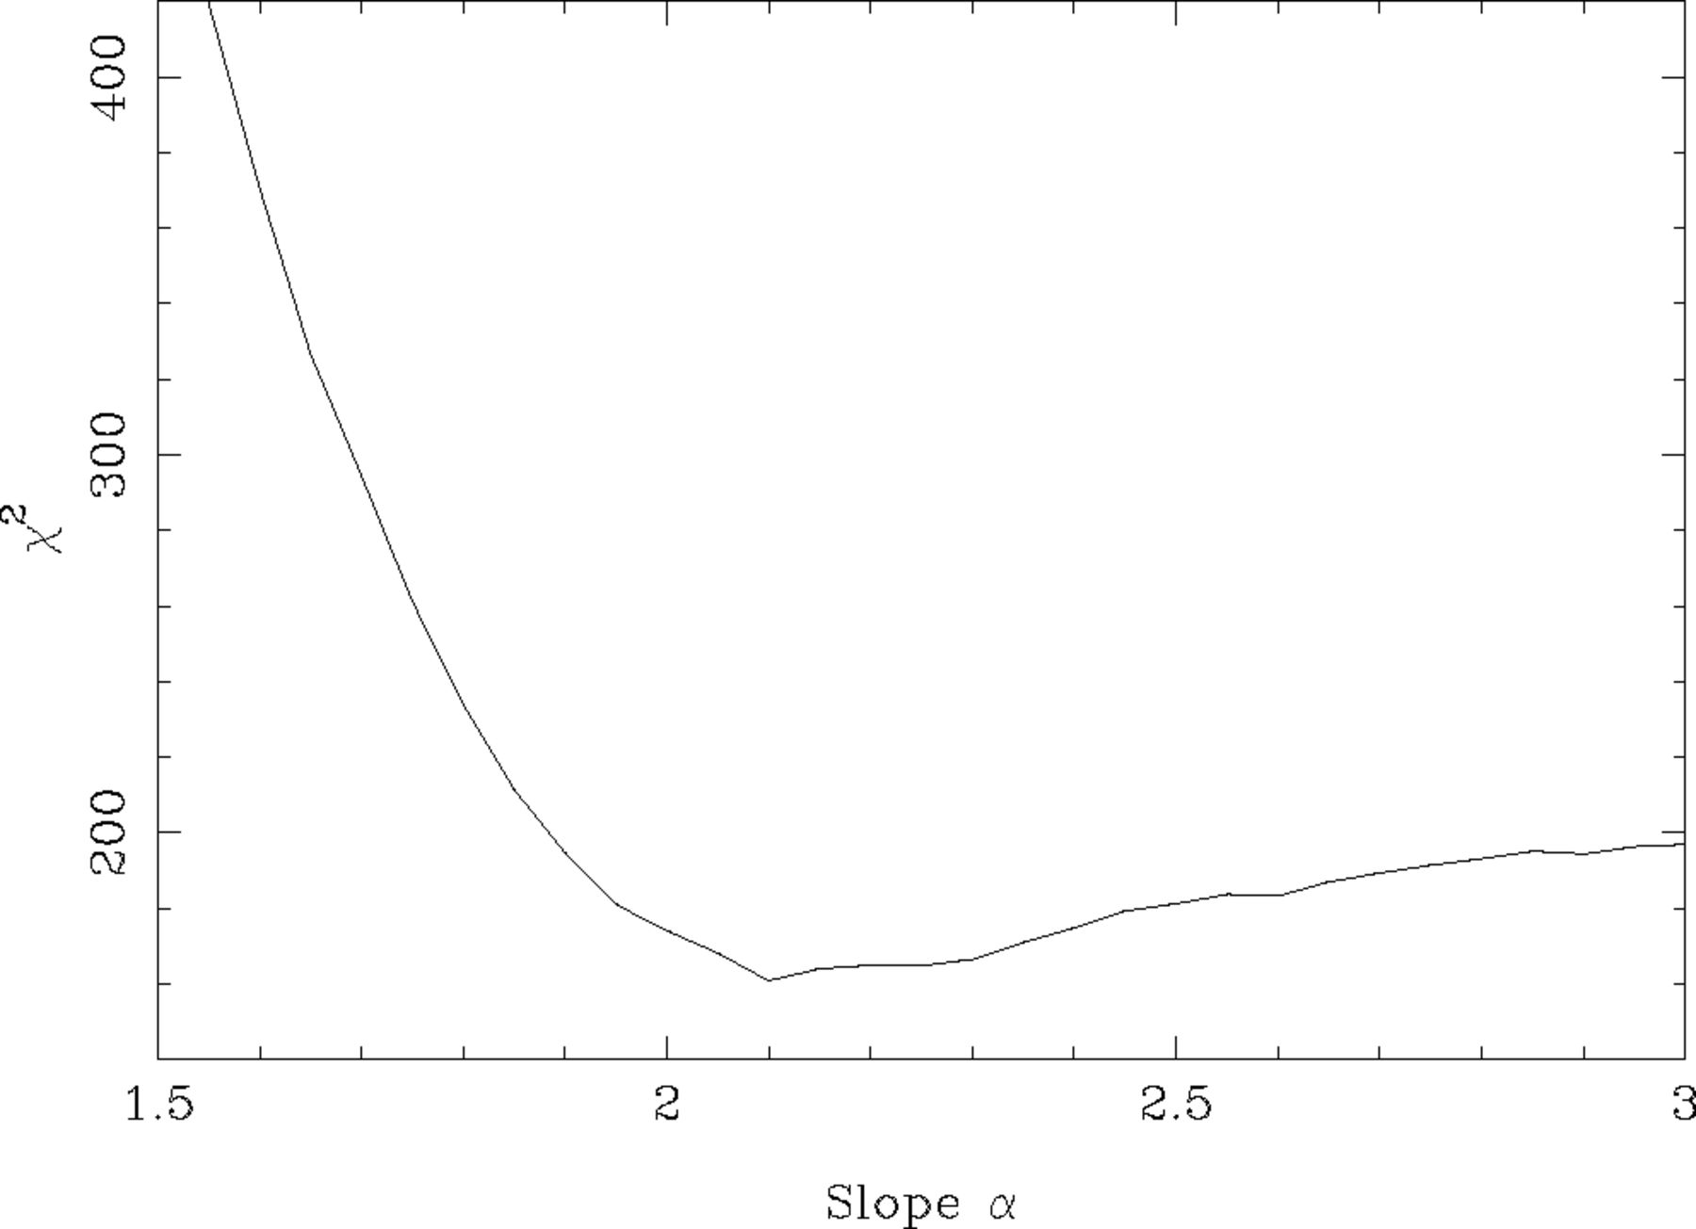
Figure 7 Fit statistic against power-law index for a simple power-law PSD model (model 1, with 79 dof).
Notes:
Figure 7 Fit statistic against power-law index for a simple power-law PSD model (model 1, with 79 dof).
Unless provided in the caption above, the following copyright applies to the content of this slide: © © 2003 RAS 2003

Slide 11
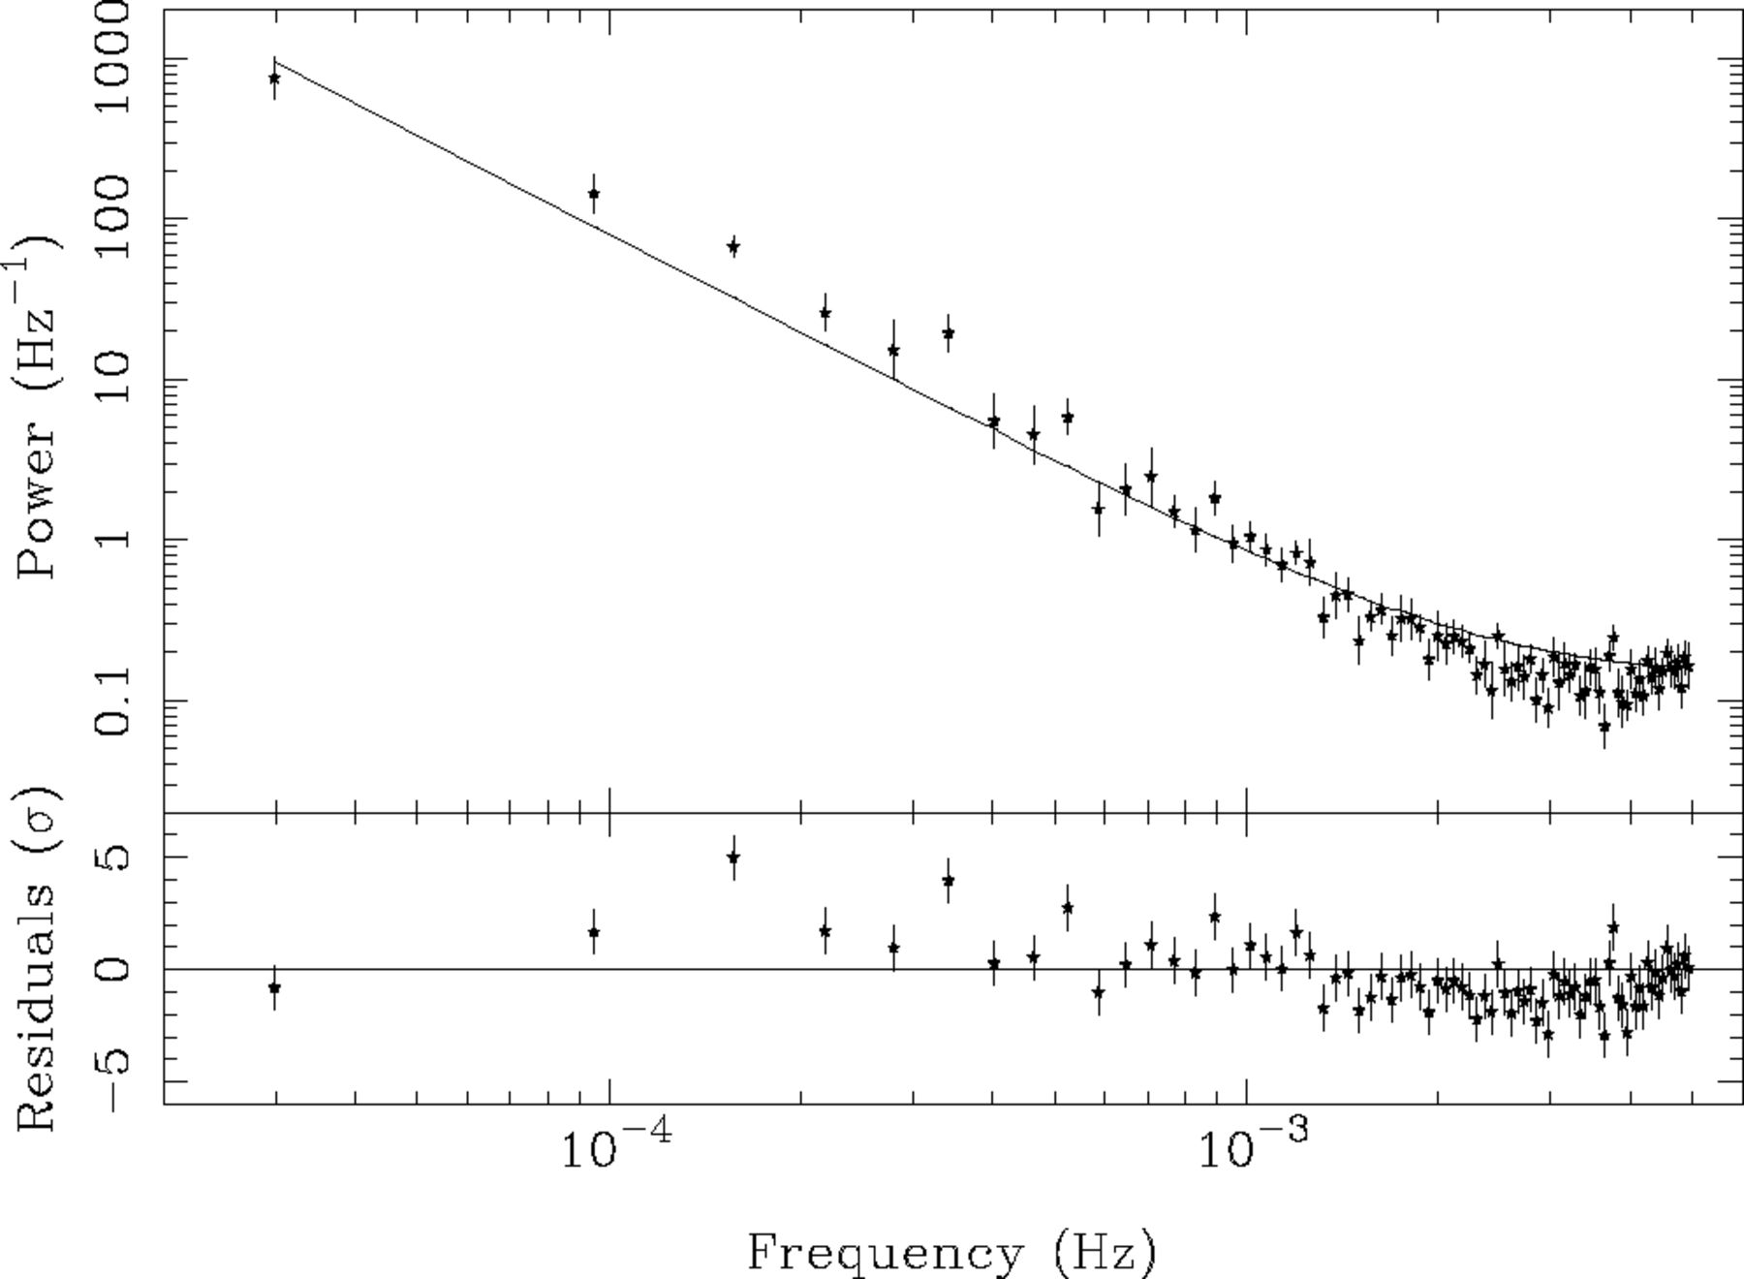
Figure 8 The full-band data (points with errors) and best-fitting single power-law model (model 1; solid line). The ...
Notes:
Figure 8 The full-band data (points with errors) and best-fitting single power-law model (model 1; solid line). The residuals from the fit are shown in the lower panel.
Unless provided in the caption above, the following copyright applies to the content of this slide: © © 2003 RAS 2003

Slide 12
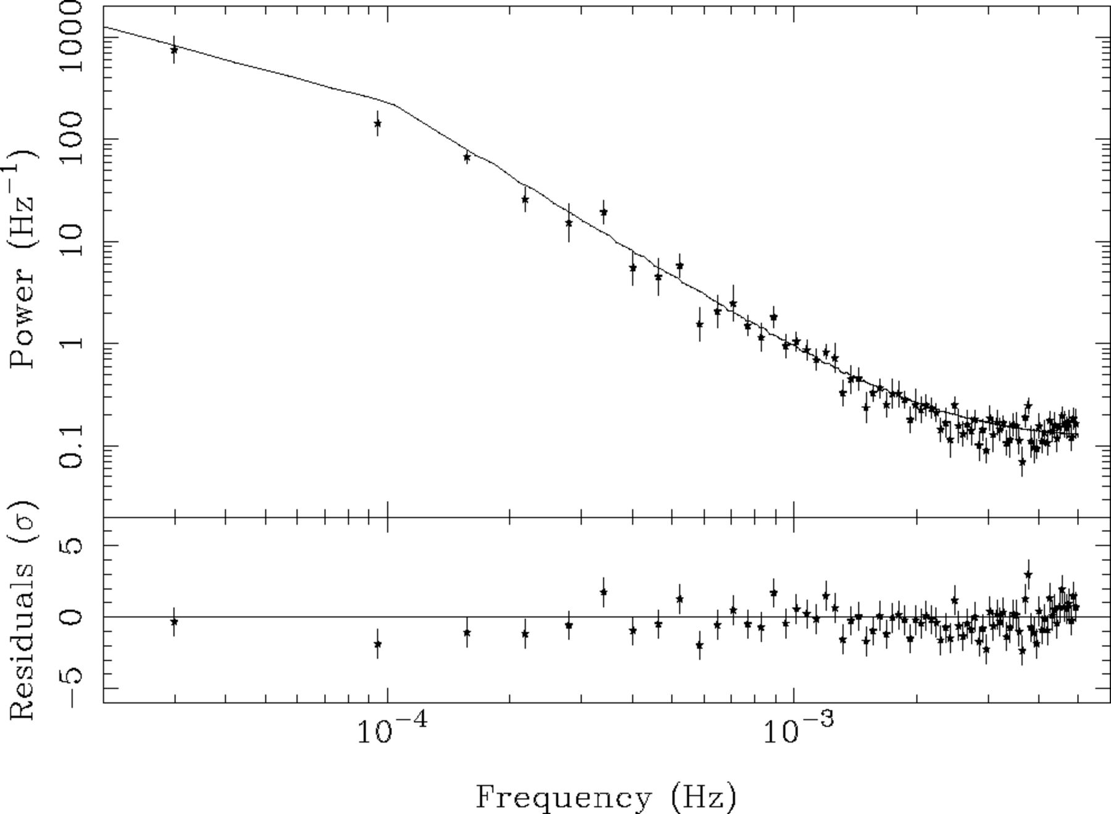
Figure 9 The full-band data and (folded) broken power-law model (model 2).
Notes:
Figure 9 The full-band data and (folded) broken power-law model (model 2).
Unless provided in the caption above, the following copyright applies to the content of this slide: © © 2003 RAS 2003

Slide 13
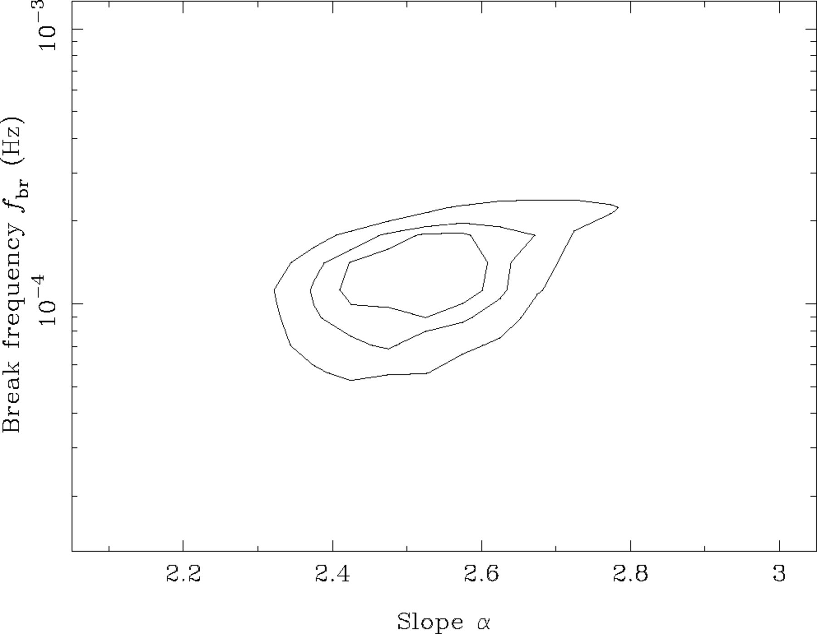
Figure 10 Contour plot showing the parameters of model 2. The contours represent 68.3, 90 and 99 per cent confidence ...
Notes:
Figure 10 Contour plot showing the parameters of model 2. The contours represent 68.3, 90 and 99 per cent confidence levels.
Unless provided in the caption above, the following copyright applies to the content of this slide: © © 2003 RAS 2003

Slide 14
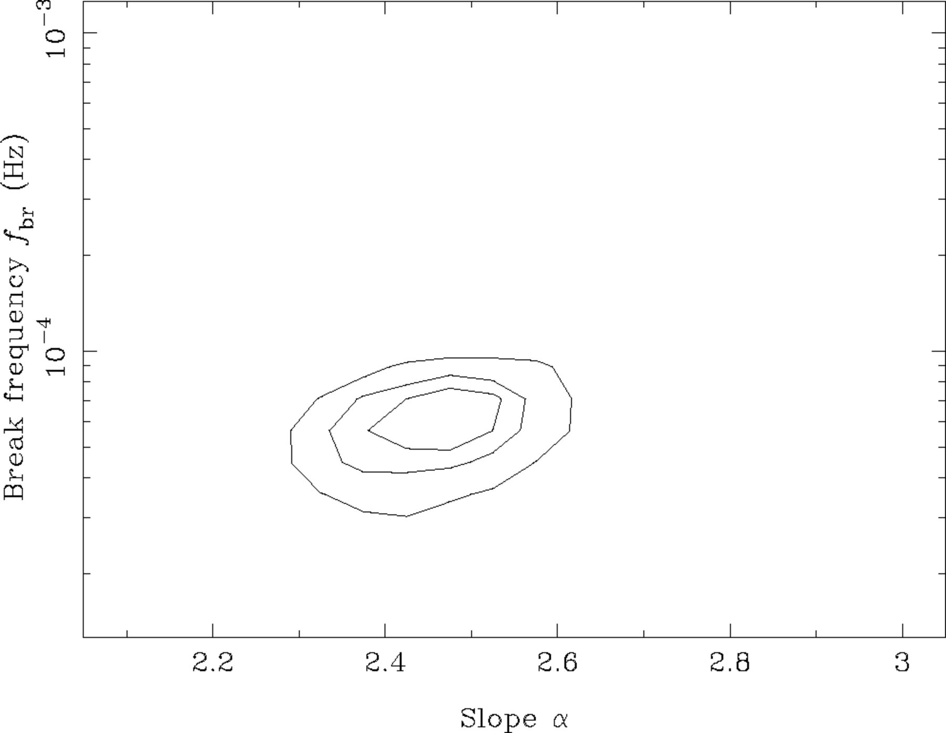
Figure 11 As Fig. 10 except for model 3.
Notes:
Figure 11 As Fig. 10 except for model 3.
Unless provided in the caption above, the following copyright applies to the content of this slide: © © 2003 RAS 2003

Slide 15
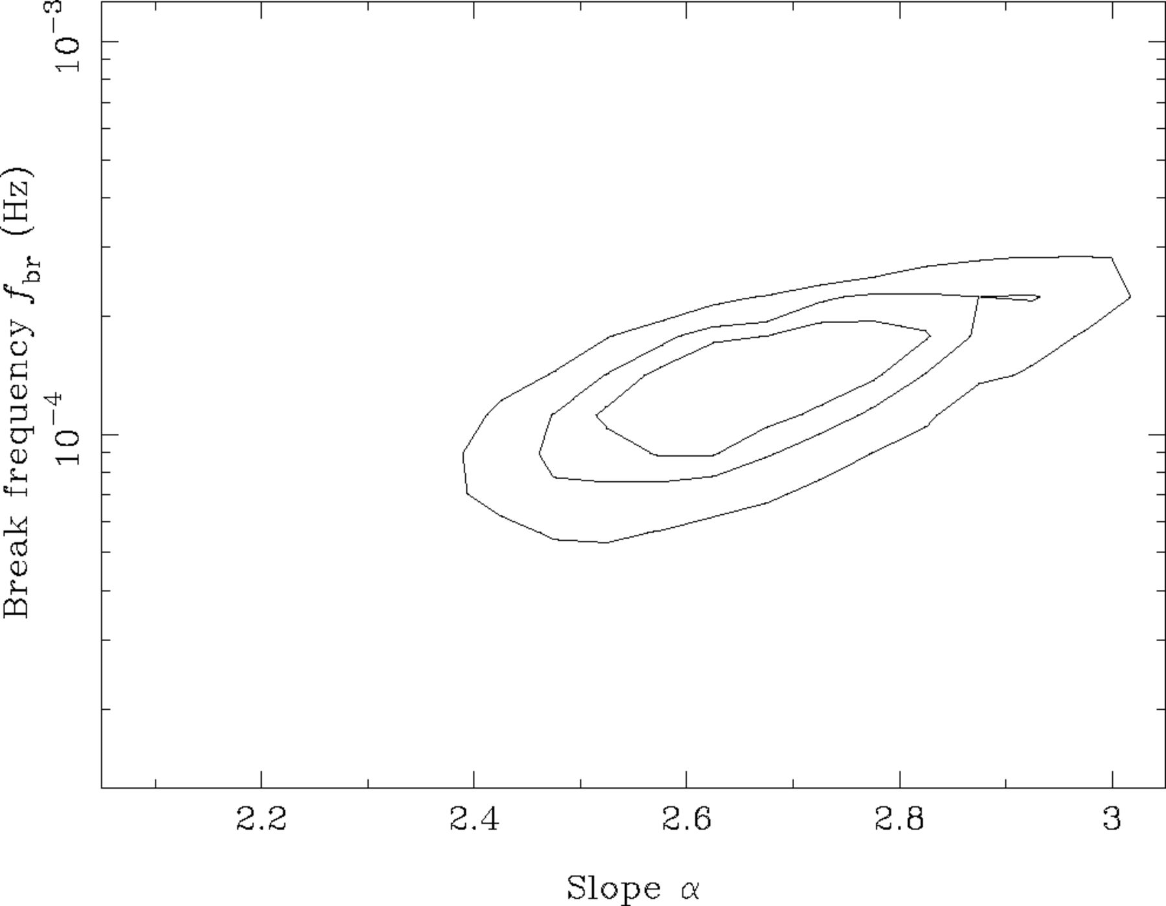
Figure 12 As Fig. 10 except for model 4.
Notes:
Figure 12 As Fig. 10 except for model 4.
Unless provided in the caption above, the following copyright applies to the content of this slide: © © 2003 RAS 2003

Slide 16
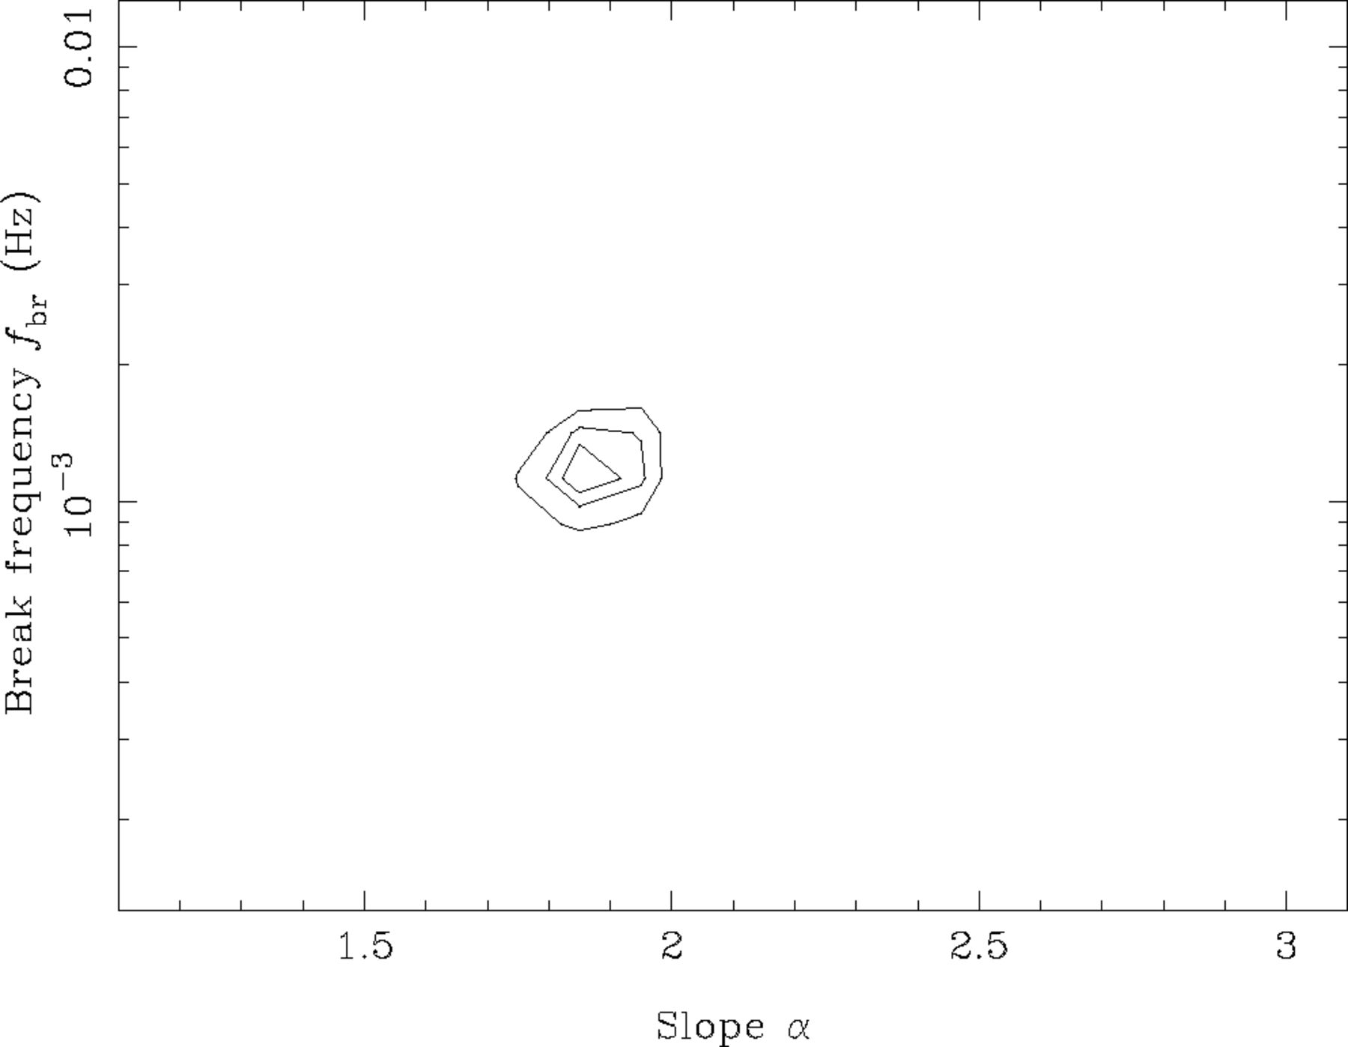
Figure 13 As Fig. 10 except for model 5.
Notes:
Figure 13 As Fig. 10 except for model 5.
Unless provided in the caption above, the following copyright applies to the content of this slide: © © 2003 RAS 2003

Slide 17
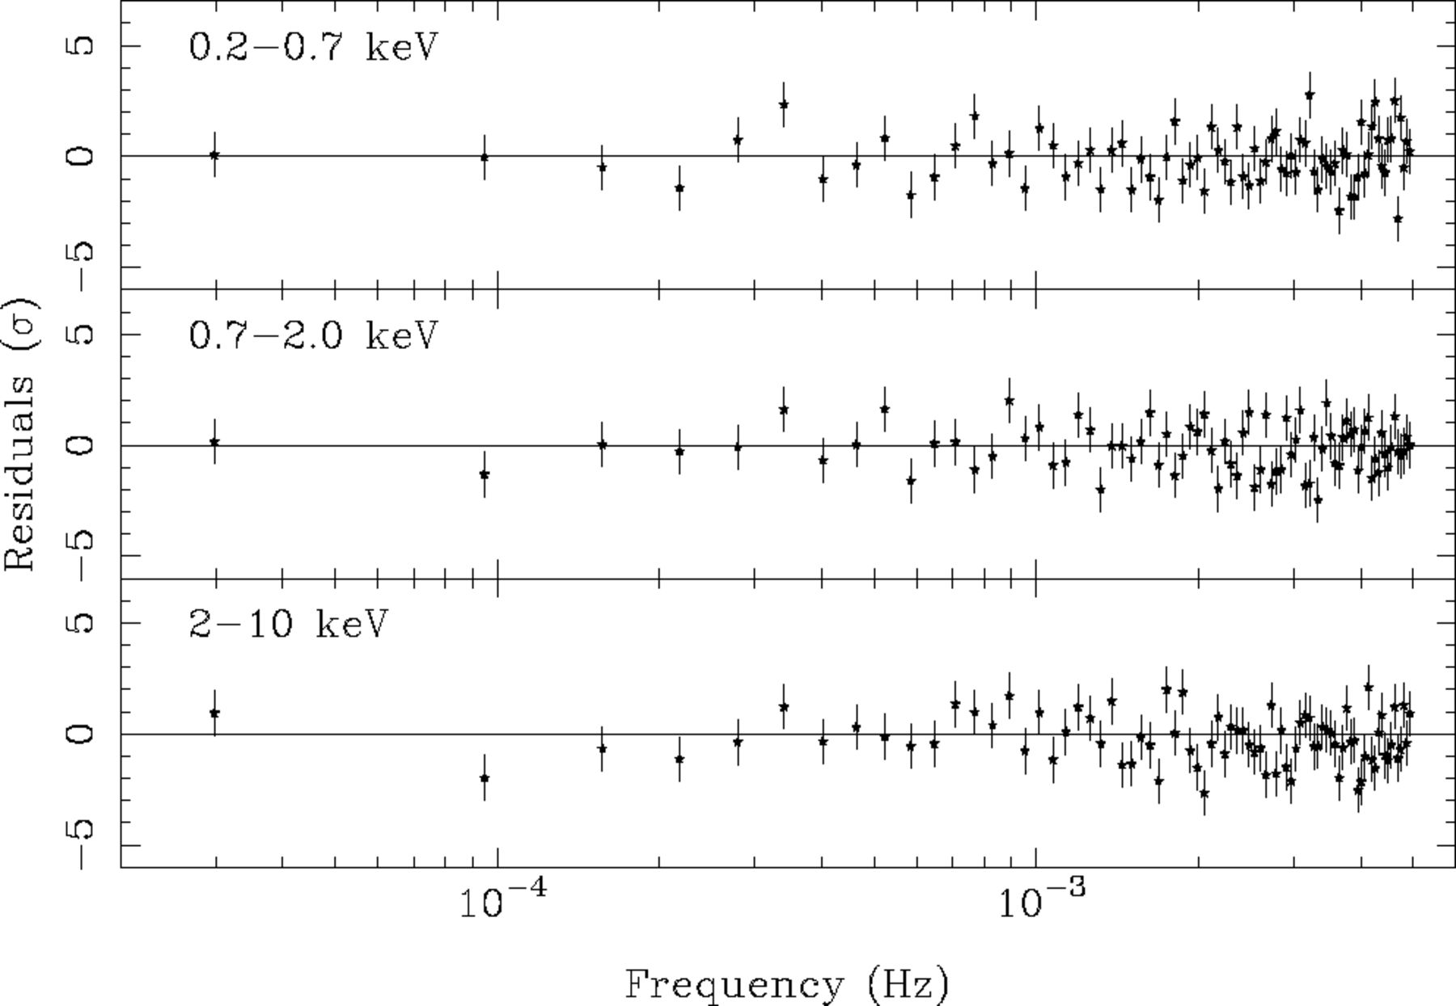
Figure 14 Residuals from fits to the soft-, medium- and hard-band data using the broken power-law model (model 2).
Notes:
Figure 14 Residuals from fits to the soft-, medium- and hard-band data using the broken power-law model (model 2).
Unless provided in the caption above, the following copyright applies to the content of this slide: © © 2003 RAS 2003

Slide 18
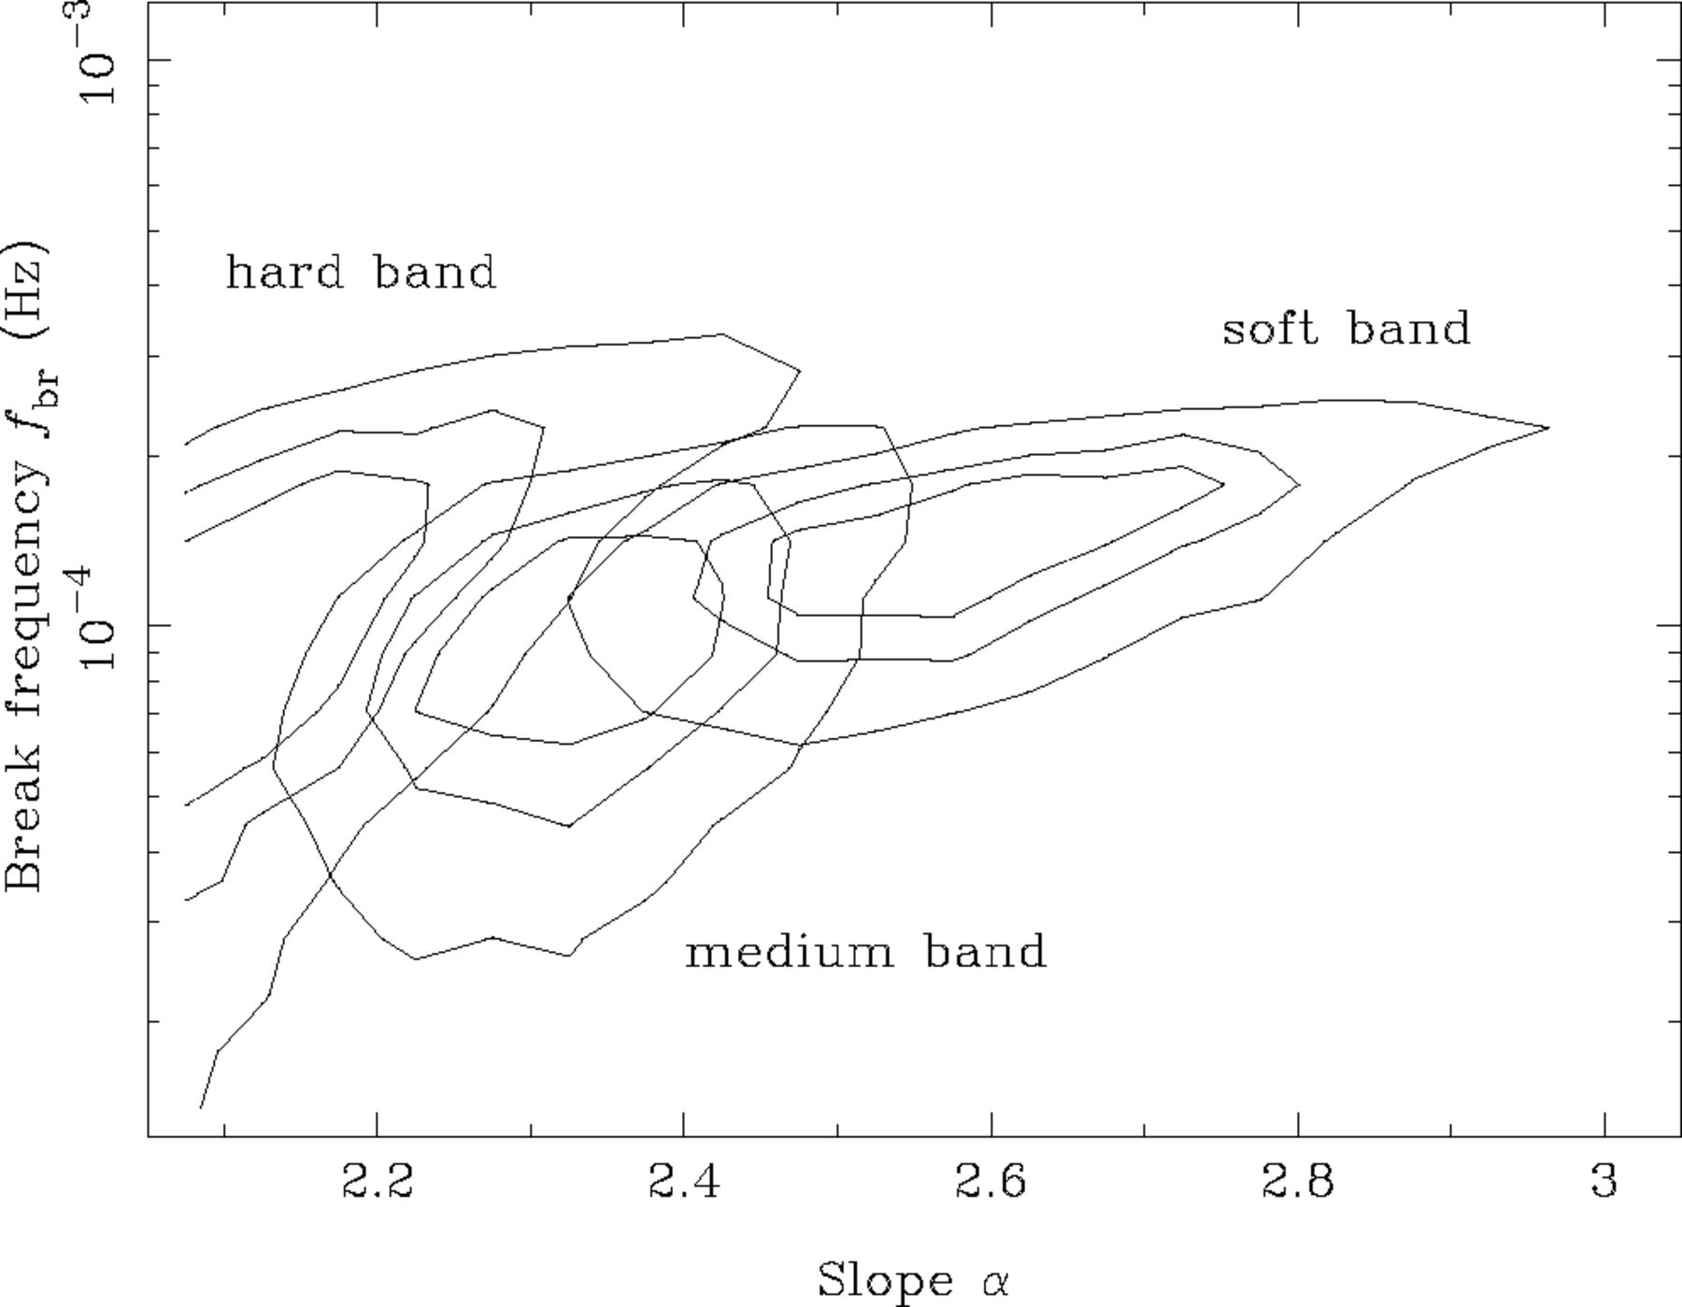
Figure 15 Contour plot showing the parameters of the broken power-law model (assuming a slope of α_{low} = 1 ...
Notes:
Figure 15 Contour plot showing the parameters of the broken power-law model (assuming a slope of αlow = 1 below the break) for the three energy subbands. The contours represent 68.3, 90 and 99 per cent confidence levels. This figure can be seen in colour in the online version of the journal on Synergy.
Unless provided in the caption above, the following copyright applies to the content of this slide: © © 2003 RAS 2003

Slide 19
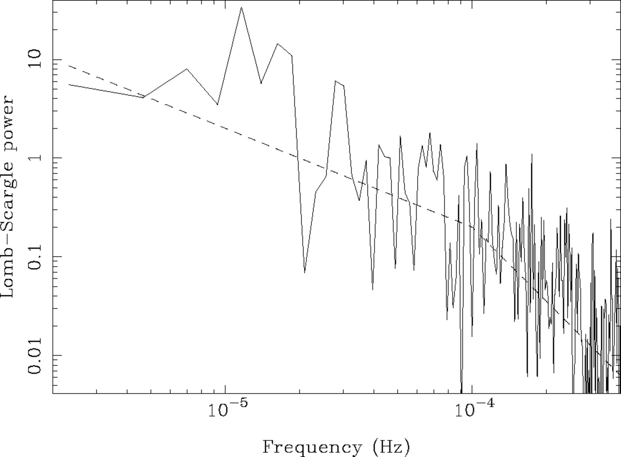
Figure 16 Unbinned Lomb-Scargle periodogram of the full-band light curve. The large scatter in the periodogram is ...
Notes:
Figure 16 Unbinned Lomb-Scargle periodogram of the full-band light curve. The large scatter in the periodogram is expected (see Section 4.1.3). The dashed line illustrates the broken power-law model used in Section 4.4. Note that the model has not been fitted to the data and that the Lomb-Scargle periodogram is normalized differently from the periodogram discussed in Section 4.1.1.
Unless provided in the caption above, the following copyright applies to the content of this slide: © © 2003 RAS 2003

Slide 20
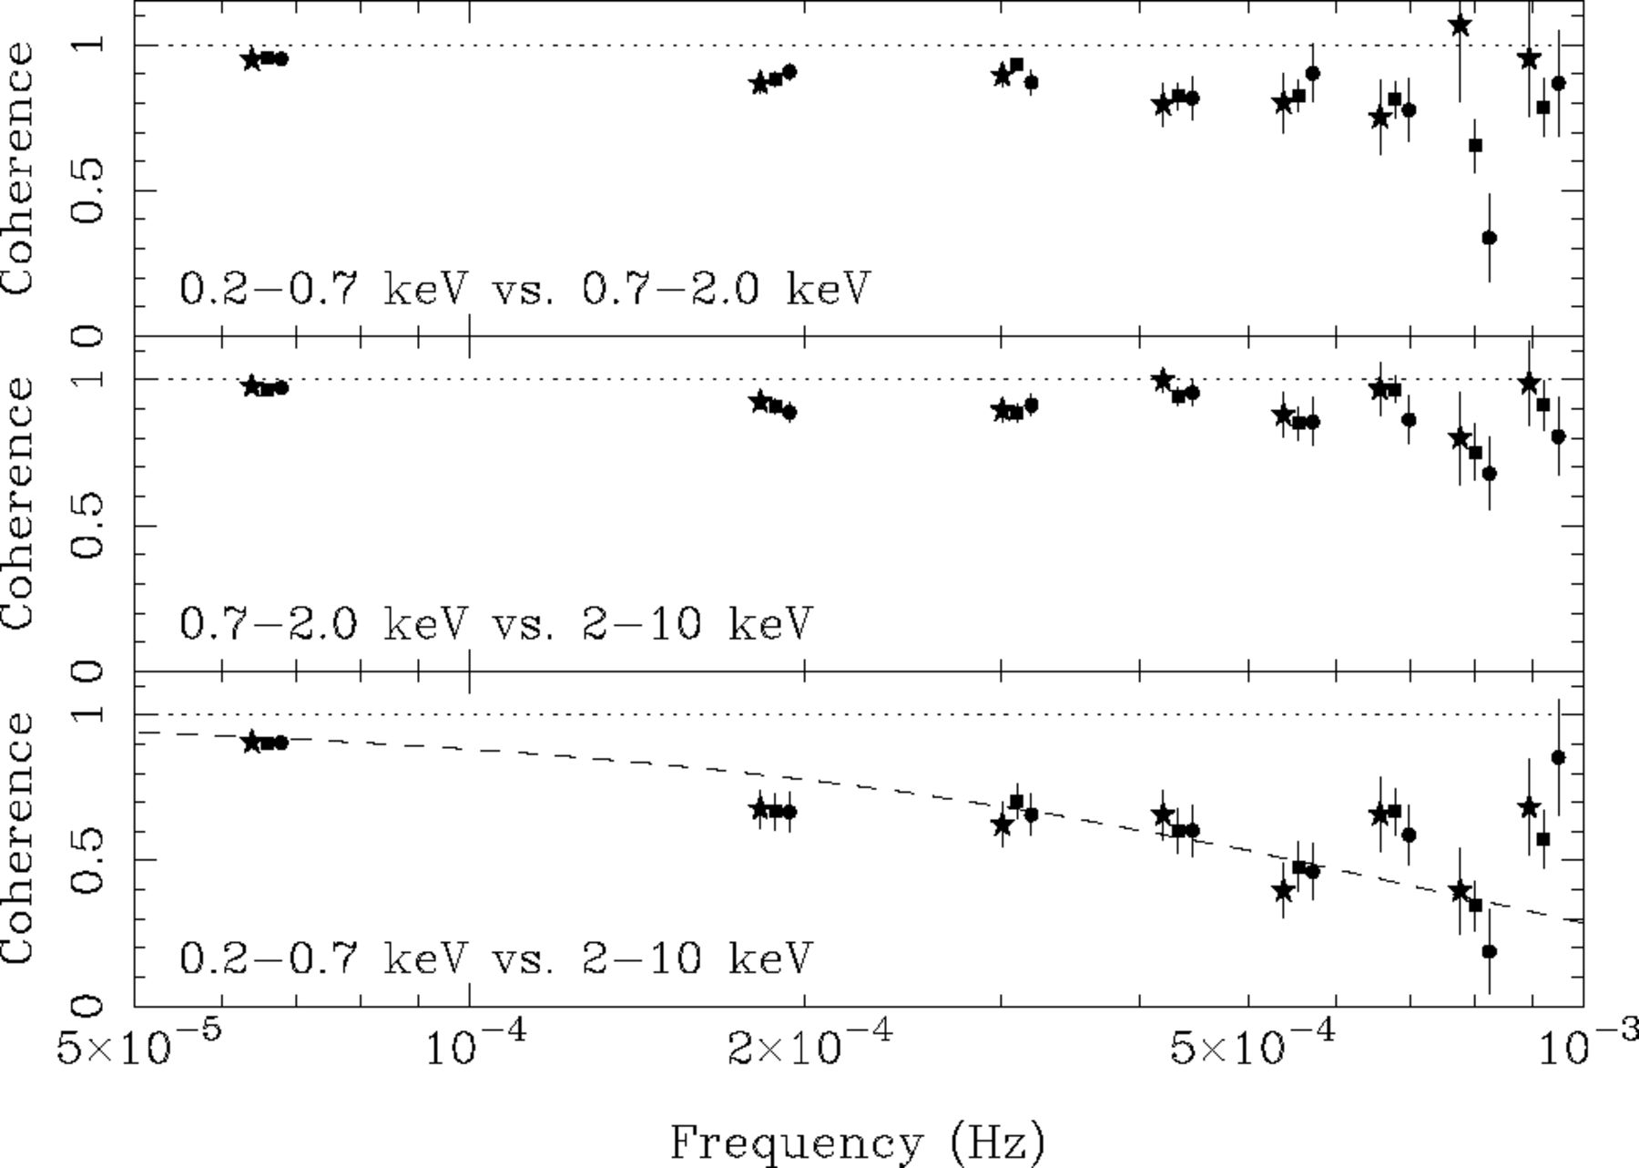
Figure 17 Coherence functions between light curves in the three energy bands. The different symbols mark the results ...
Notes:
Figure 17 Coherence functions between light curves in the three energy bands. The different symbols mark the results derived using light curves from the three EPIC detectors (squares mark pn, circles mark MOS1 and stars mark MOS2 data). The dotted line shows the function γ2(f) = exp(−f/8 × 10−4 Hz) discussed in the text. This figure can be seen in colour in the online version of the journal on Synergy.
Unless provided in the caption above, the following copyright applies to the content of this slide: © © 2003 RAS 2003

Slide 21
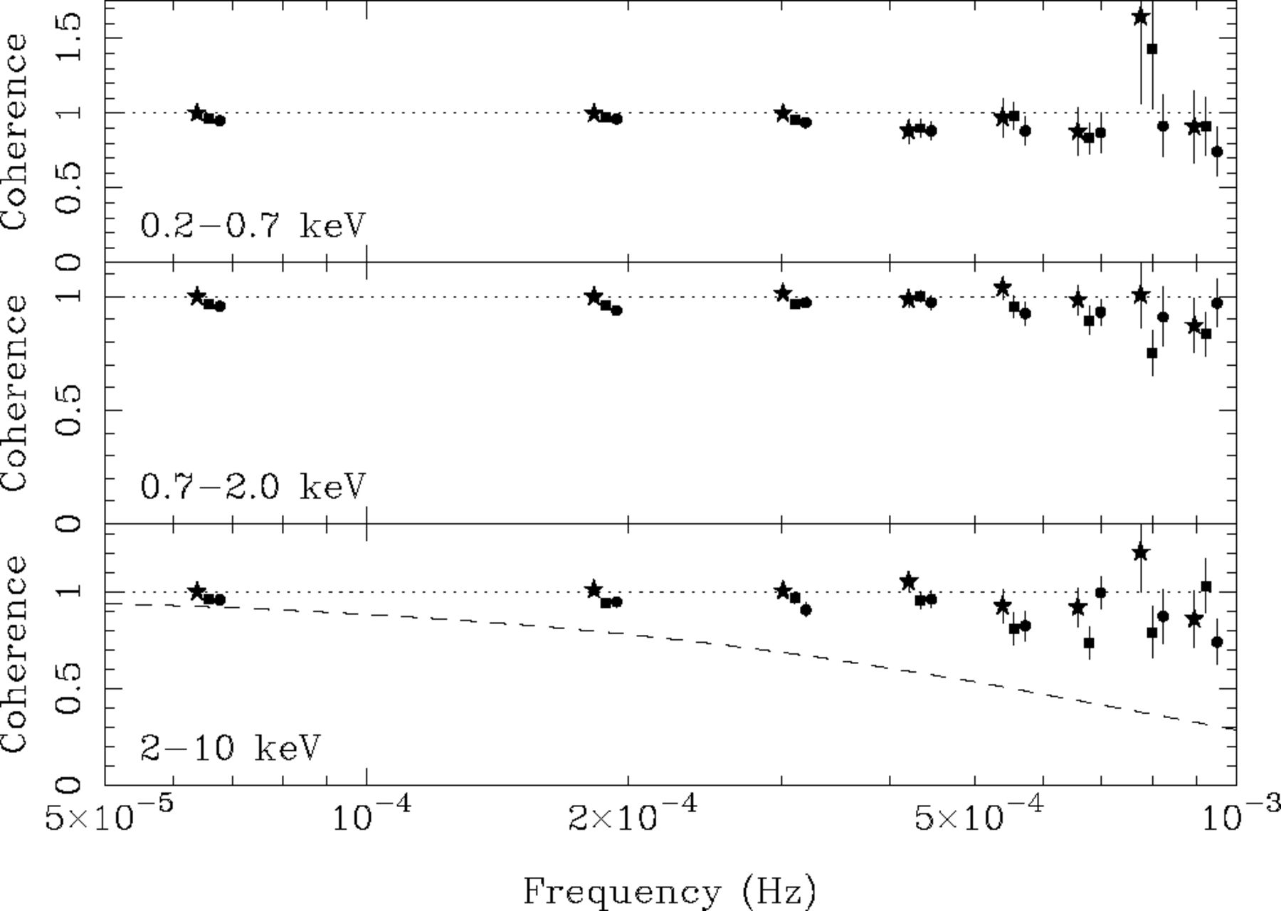
Figure 18 Coherence functions between light curves from different detectors in the same energy bands (squares mark pn ...
Notes:
Figure 18 Coherence functions between light curves from different detectors in the same energy bands (squares mark pn versus MOS1, circles mark pn versus MOS2 and stars mark MOS1 versus MOS2). As these were calculated between light curves from different detectors but identical energy ranges the intrinsic coherence is unity and deviations from unity are a result of Poisson noise. The dotted line shows the function plotted in Fig. 17 representing the loss of coherence observed between the energy bands. Clearly, this function shows a much more pronounced loss of coherence than that resulting from Poisson noise. This figure can be seen in colour in the online version of the journal on Synergy.
Unless provided in the caption above, the following copyright applies to the content of this slide: © © 2003 RAS 2003

Slide 22
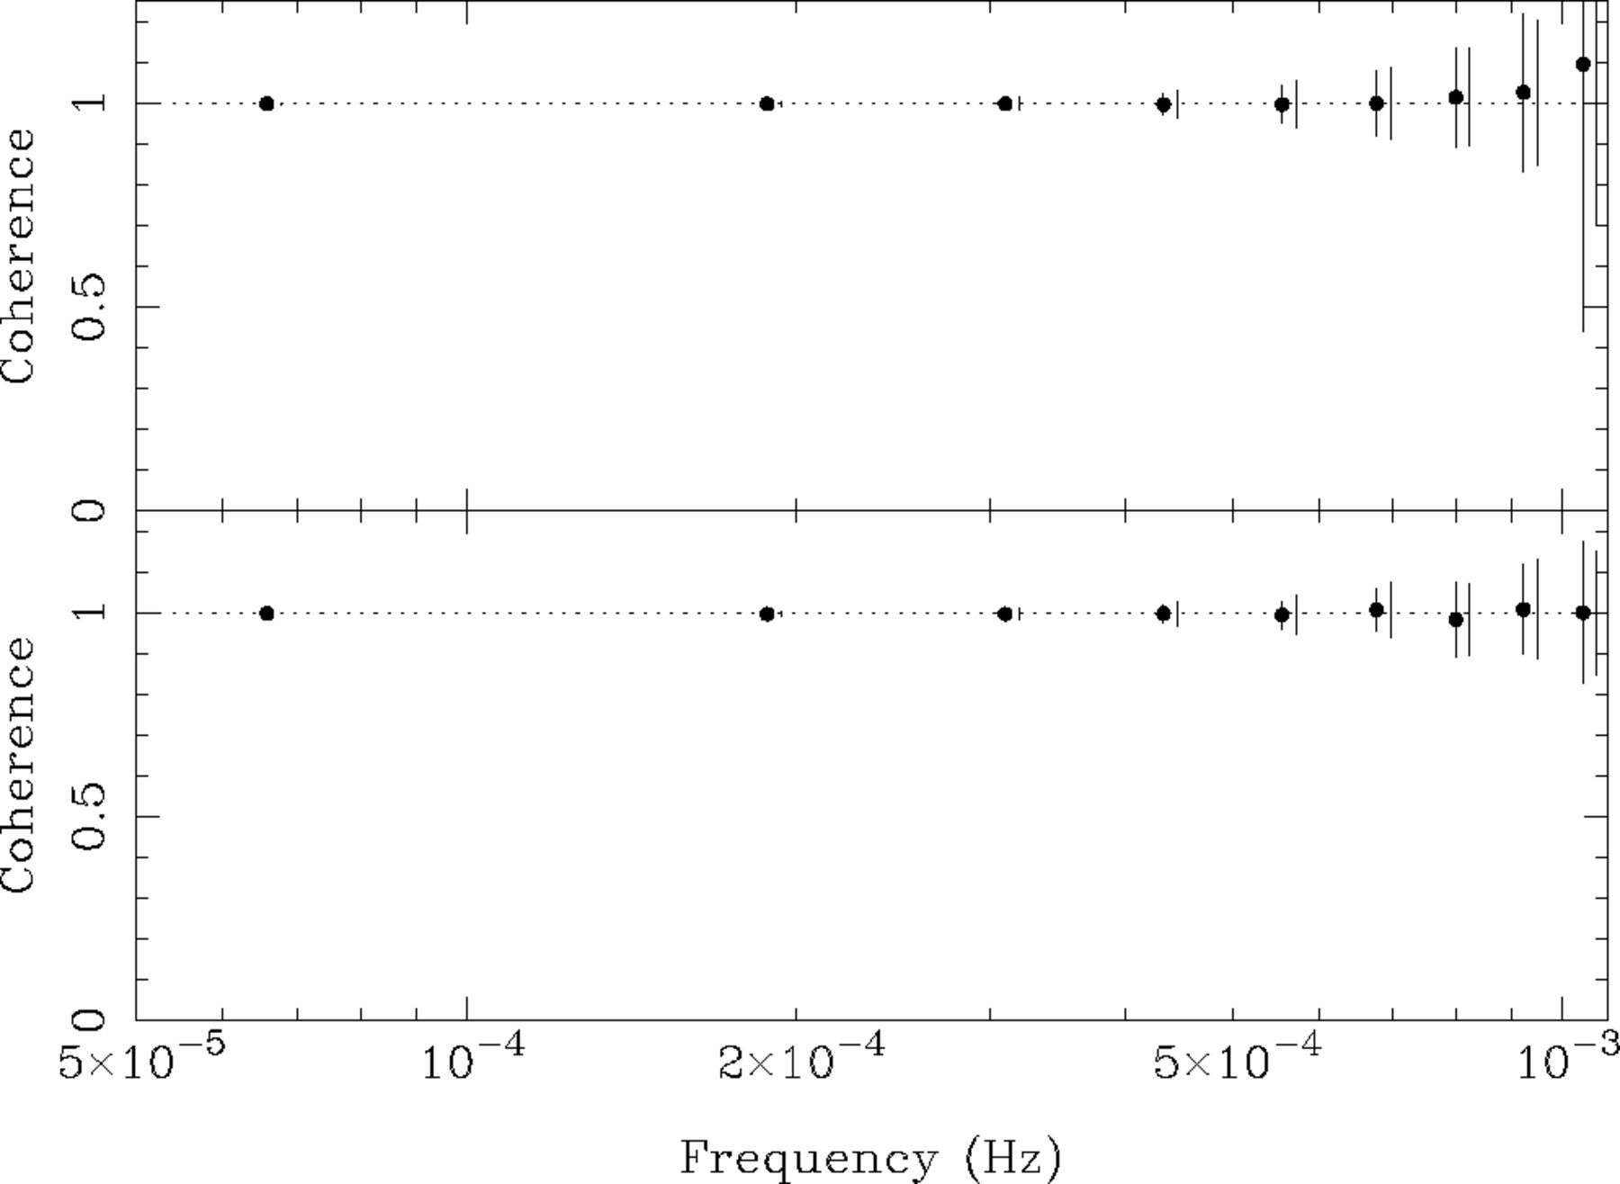
Figure 19 Average coherence function measured from (perfectly coherent) simulated data. The top panel shows results ...
Notes:
Figure 19 Average coherence function measured from (perfectly coherent) simulated data. The top panel shows results using light curves with identical PSDs, the bottom panel shows results when different PSDs are assumed for the two light curves. The error bars on the data points represent the standard deviation of the coherence estimates, and the lines without data points represent the average of the estimated error bars. Clearly, the coherence is close to unity and the error estimates are close to the expected scatter.
Unless provided in the caption above, the following copyright applies to the content of this slide: © © 2003 RAS 2003

Slide 23
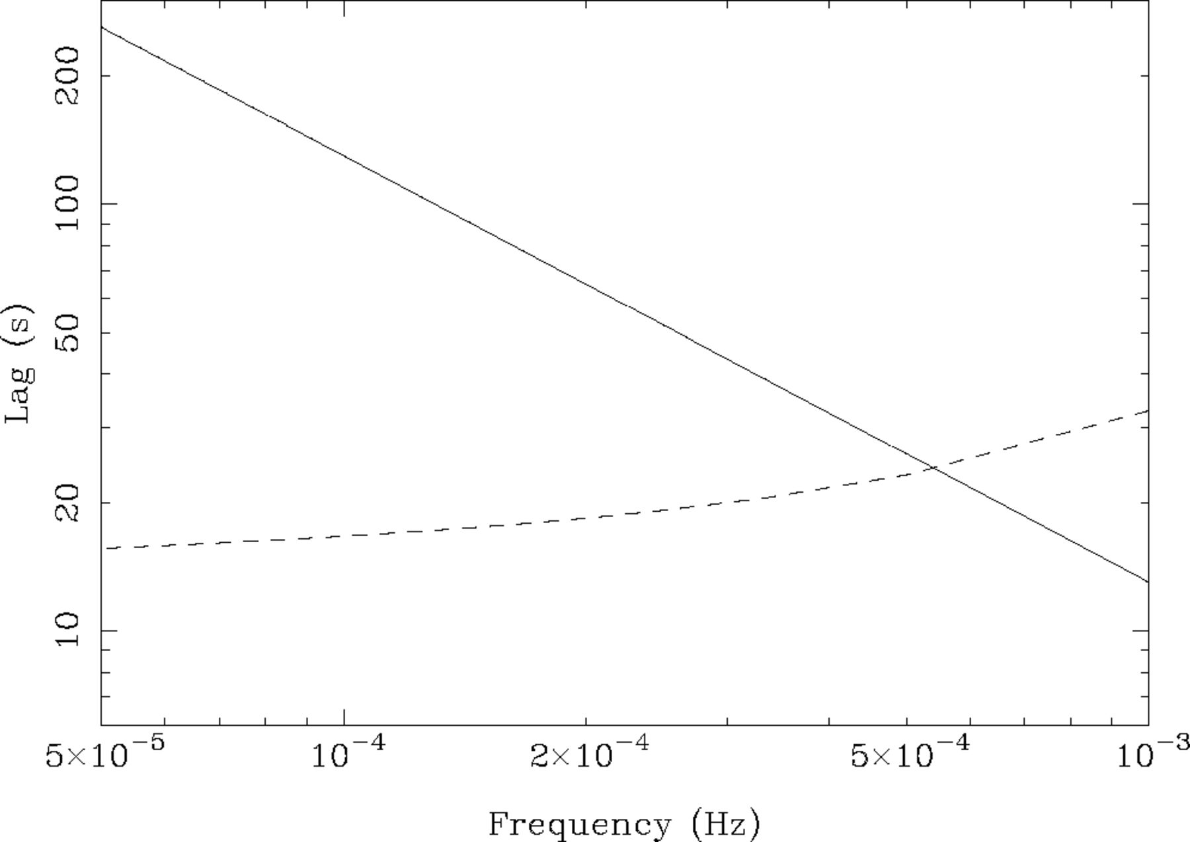
Figure 20 Estimate of the sensitivity level of time lag measurements. The dotted line shows the uncertainty in the time ...
Notes:
Figure 20 Estimate of the sensitivity level of time lag measurements. The dotted line shows the uncertainty in the time lag owing to Poisson noise and the solid line represents the approximate time lags measured, as described by the function given in Section 5.3.3. For frequencies above ≈6 × 10−4 Hz the time lags will not be recoverable from the Poisson noise.
Unless provided in the caption above, the following copyright applies to the content of this slide: © © 2003 RAS 2003

Slide 24
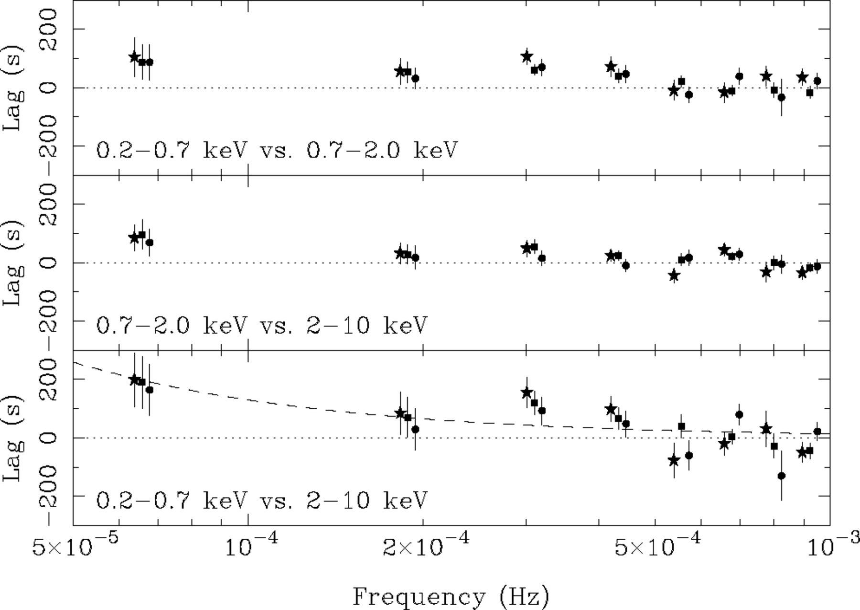
Figure 21 Time lags between light curves in the three energy bands. The symbols are as in Fig. 17. A positive lag ...
Notes:
Figure 21 Time lags between light curves in the three energy bands. The symbols are as in Fig. 17. A positive lag indicates that the first band leads the second one. The dotted line shows the function τ(f) = 0.013f−1 discussed in the text. This figure can be seen in colour in the online version of the journal on Synergy.
Unless provided in the caption above, the following copyright applies to the content of this slide: © © 2003 RAS 2003

Slide 25
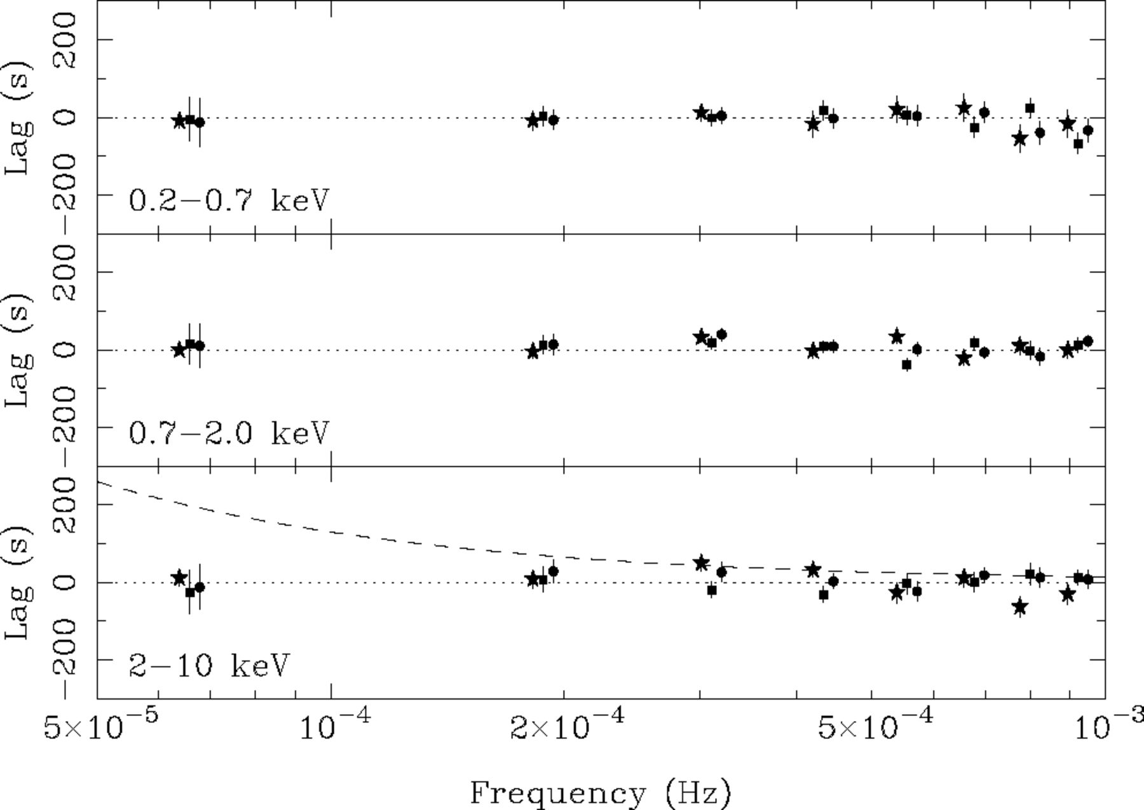
Figure 22 Time lags between light curves from different detectors in the same energy bands. Squares mark pn versus ...
Notes:
Figure 22 Time lags between light curves from different detectors in the same energy bands. Squares mark pn versus MOS1, circles mark pn versus MOS2 and stars mark MOS1 versus MOS2. As the light curves being compared cover identical energy ranges they should differ only as a result of Poisson noise and thus result in zero lag, any lags observed will be a result of Poisson noise. The dotted line shows the function plotted in Fig. 21. As can be seen, the observed lags between bands (Fig. 21) are much larger than those resulting from Poisson noise. This figure can be seen in colour in the online version of the journal on Synergy.
Unless provided in the caption above, the following copyright applies to the content of this slide: © © 2003 RAS 2003

Slide 26
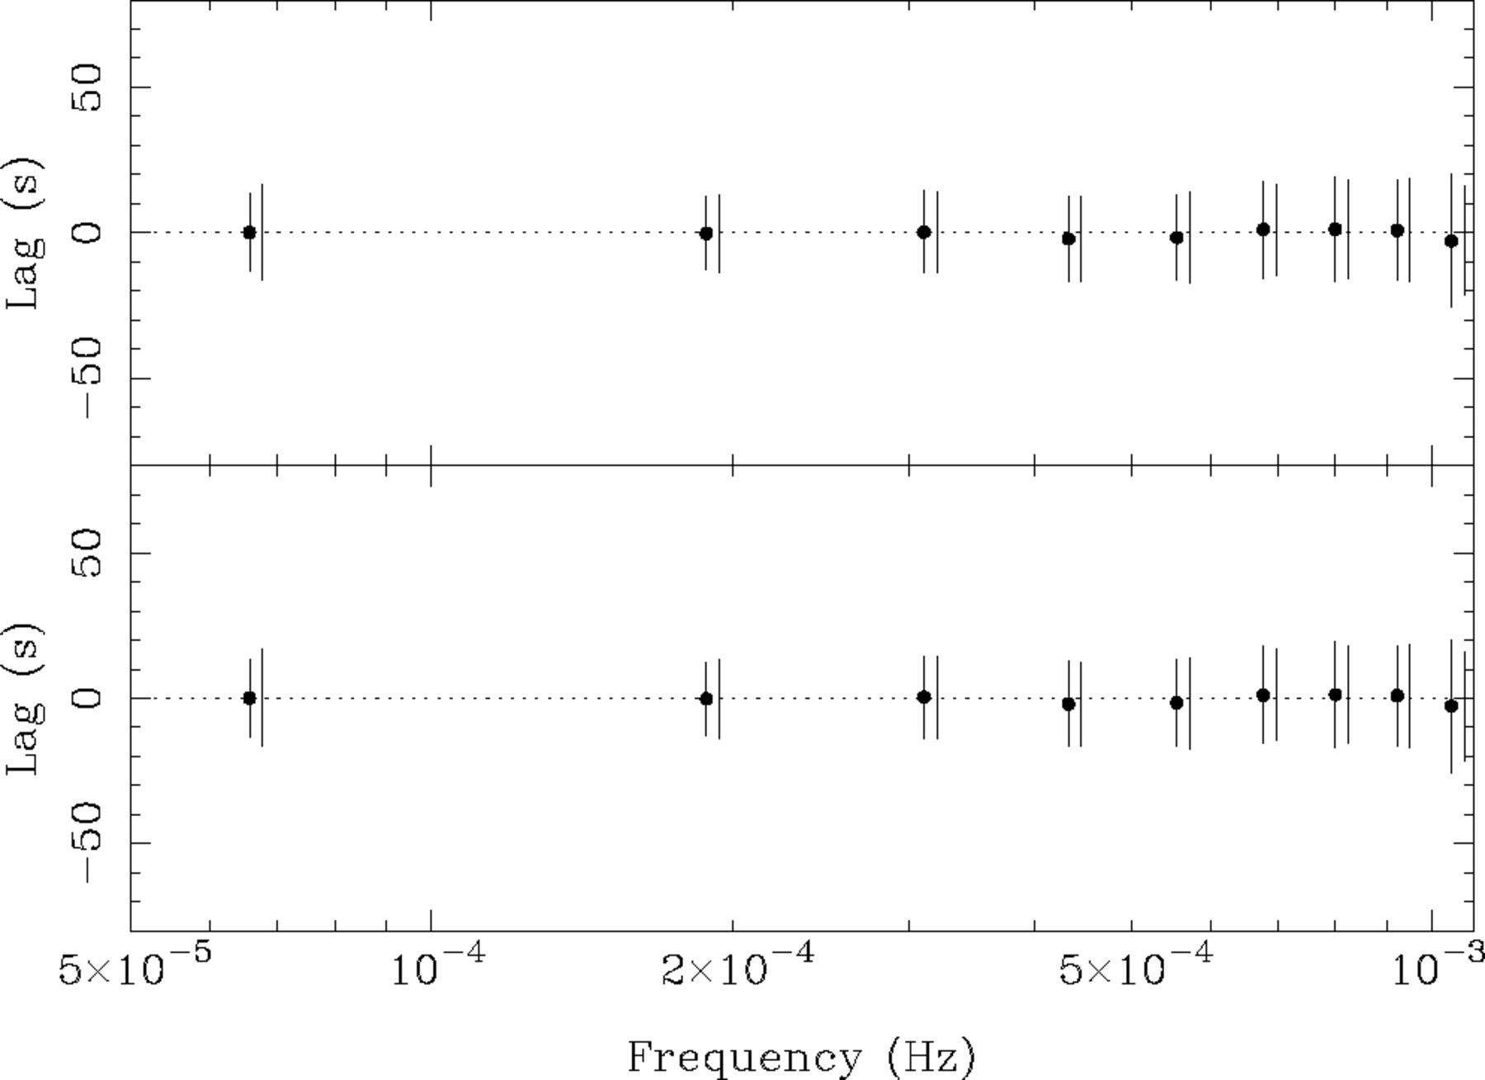
Figure 23 Average time delay measured from simulated data (with zero intrinsic delay). The top panel shows results ...
Notes:
Figure 23 Average time delay measured from simulated data (with zero intrinsic delay). The top panel shows results using light curves with identical PSDs, the bottom panel shows results when different PSDs are assumed for the two light curves. The error bars on the data points represent the standard deviation of the time-delay estimates and the lines without data points represent the average of the estimated error bars. The phase is close to zero and the error estimates are close to the expected scatter.
Unless provided in the caption above, the following copyright applies to the content of this slide: © © 2003 RAS 2003

Slide 27
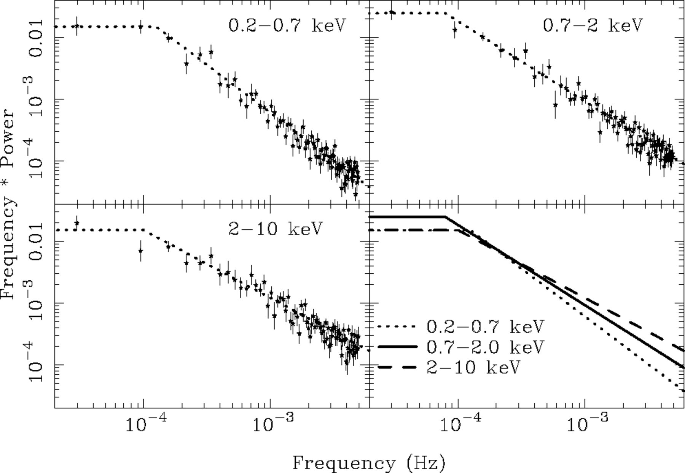
Figure 24 Power spectral data from the three energy bands shown in fP(f) units (dimensionless). The data have be ...
Notes:
Figure 24 Power spectral data from the three energy bands shown in fP(f) units (dimensionless). The data have be ‘unfolded’ using model 2 to better illustrate the shape of the underlying power spectra. The PSD models are shown with dotted lines, and the error bars show the data/model residuals multiplied by the unfolded PSD model. The bottom right-hand panel shows the three model PSDs overlaid. This figure can be seen in colour in the online version of the journal on Synergy.
Unless provided in the caption above, the following copyright applies to the content of this slide: © © 2003 RAS 2003

