Slide 1
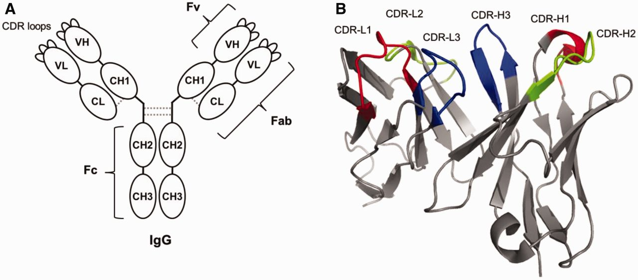
Fig. 1 Structure of immunoglobulin G. (A) Graphic model of IgG. Dotted grey lines are disulfide bonds formed between ...
Notes:
Fig. 1 Structure of immunoglobulin G. (A) Graphic model of IgG. Dotted grey lines are disulfide bonds formed between two domains. Fab, fragment of antigen binding region, Fc, fragment of crystallizable region, Fv, fragment of variable region, CDR, complementarity determining regions. (B) Three-dimensional structure of Fv. Coloured loops are CDRs. Redrawn from PDB ID: 1JV5.
Unless provided in the caption above, the following copyright applies to the content of this slide: © The Authors 2015. Published by Oxford University Press on behalf of the Japanese Biochemical Society. All rights reserved

Slide 2
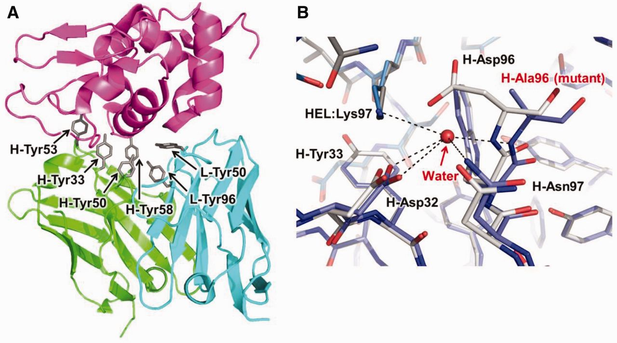
Fig. 2 (A) The complex structure of HyHEL-10 Fv and HEL (PDB ID: 2DQJ). Green, heavy chain variable region (VH); ...
Notes:
Fig. 2 (A) The complex structure of HyHEL-10 Fv and HEL (PDB ID: 2DQJ). Green, heavy chain variable region (VH); cyan, light chain variable region (VL); magenta, HEL. Tyrosine residues in the antibody–antigen interface are highlighted. (B) Superimposed interface structures of HyHEL-10 Fv–HEL complexes of the wild-type antibody (grey; PDB ID 1C08) and H-D96A mutant (blue; PDB ID 1IC5). Water-mediated hydrogen bonds in the mutant complex that form in place of the lost salt bridge are shown by dotted lines.
Unless provided in the caption above, the following copyright applies to the content of this slide: © The Authors 2015. Published by Oxford University Press on behalf of the Japanese Biochemical Society. All rights reserved

Slide 3
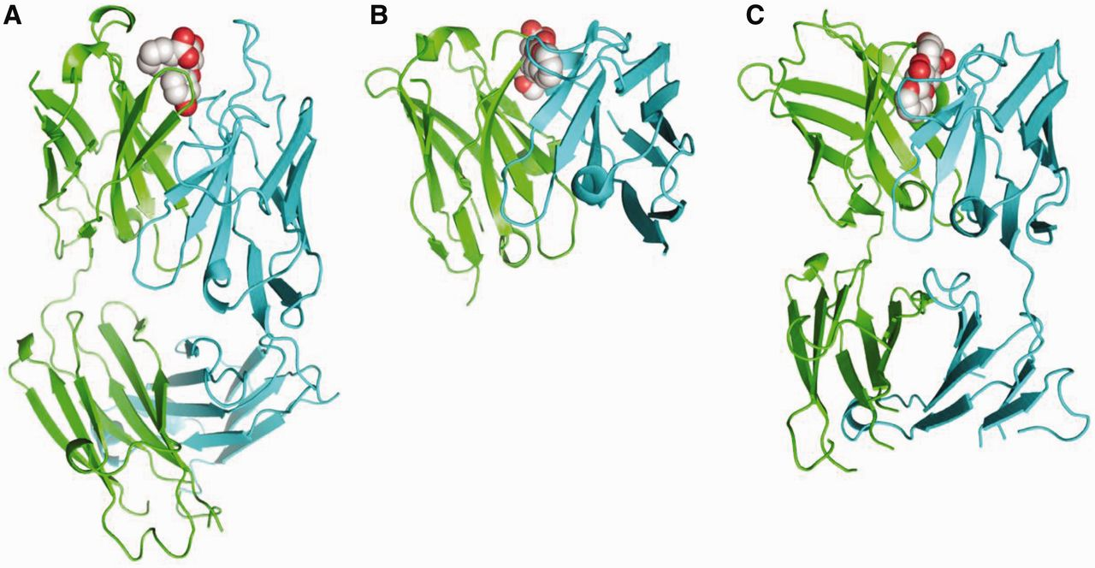
Fig. 3 Structure of the antibody fragments. (A) 4-4-20 Fab (PDB ID 1FLR), (B) 1C49 Fv (PDB ID 2E27) and (C) 10C9 Fab ...
Notes:
Fig. 3 Structure of the antibody fragments. (A) 4-4-20 Fab (PDB ID 1FLR), (B) 1C49 Fv (PDB ID 2E27) and (C) 10C9 Fab (PDB ID 2Z93) in complex with the respective antigen (A, fluorescein; B, C, CTC-3X fragments). Green, VH; cyan, VL; grey, small-molecule antigen.
Unless provided in the caption above, the following copyright applies to the content of this slide: © The Authors 2015. Published by Oxford University Press on behalf of the Japanese Biochemical Society. All rights reserved

Slide 4
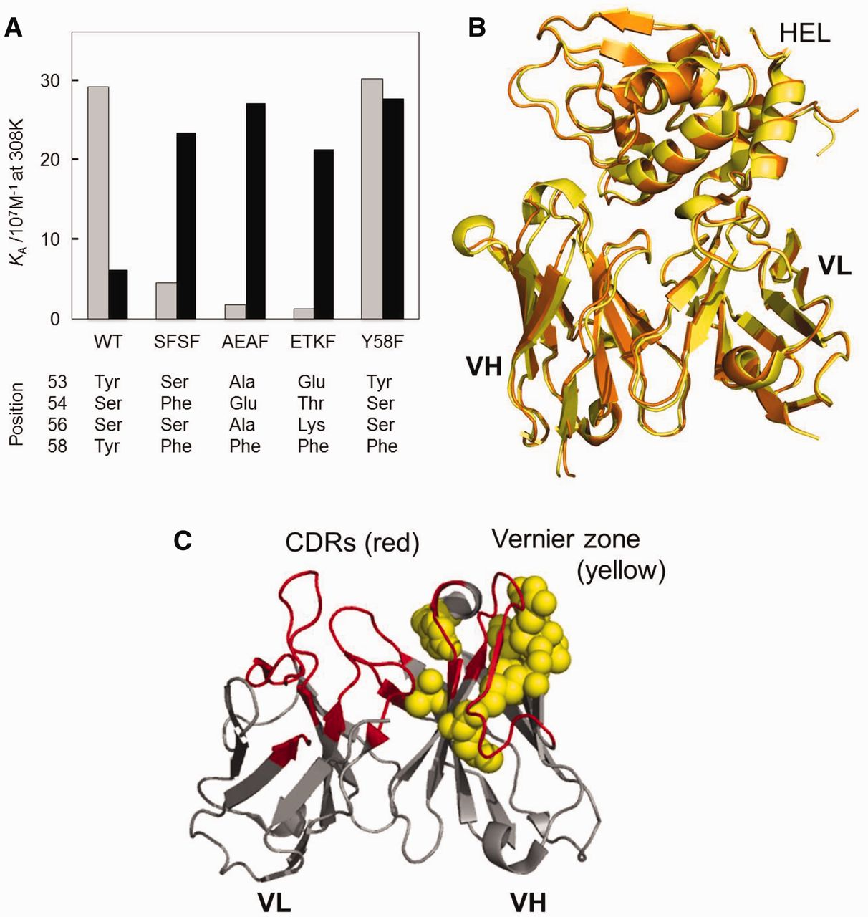
Fig. 4 (A) Affinity of HyHEL-10 and its mutants (SFSF, AEAF, ETKF and Y58F) to HEL (grey) and TEL (black) (56). ...
Notes:
Fig. 4 (A) Affinity of HyHEL-10 and its mutants (SFSF, AEAF, ETKF and Y58F) to HEL (grey) and TEL (black) (56). Amino acids indicated at the bottom are the partial sequence of CDR-H2 (H53-58) for each clone. (B) Superimposed structure of the humanized HyHEL-10 (yellow, PDB ID 2EKS) and the double mutant H-Q39K/W47Y (orange, PDB ID 2YSS) in complex with HEL. (C) Vernier zone residues that differ between the mouse 528 and humanized form (yellow) shown with CDR loops (red).
Unless provided in the caption above, the following copyright applies to the content of this slide: © The Authors 2015. Published by Oxford University Press on behalf of the Japanese Biochemical Society. All rights reserved

Slide 5
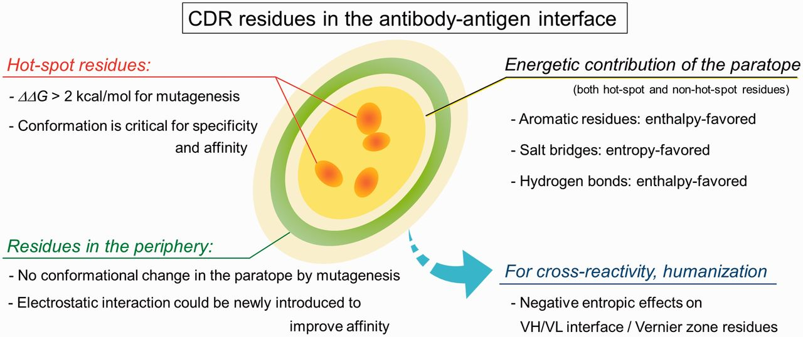
Fig. 5 Summary of the thermodynamic properties described in this review as well as an approach to improve affinity ...
Notes:
Fig. 5 Summary of the thermodynamic properties described in this review as well as an approach to improve affinity through mutagenesis in peripheral residues. The former includes the contribution of various paratope residues and the engineering approach for the introduction of cross-reactivity and humanization.
Unless provided in the caption above, the following copyright applies to the content of this slide: © The Authors 2015. Published by Oxford University Press on behalf of the Japanese Biochemical Society. All rights reserved

