Slide 1
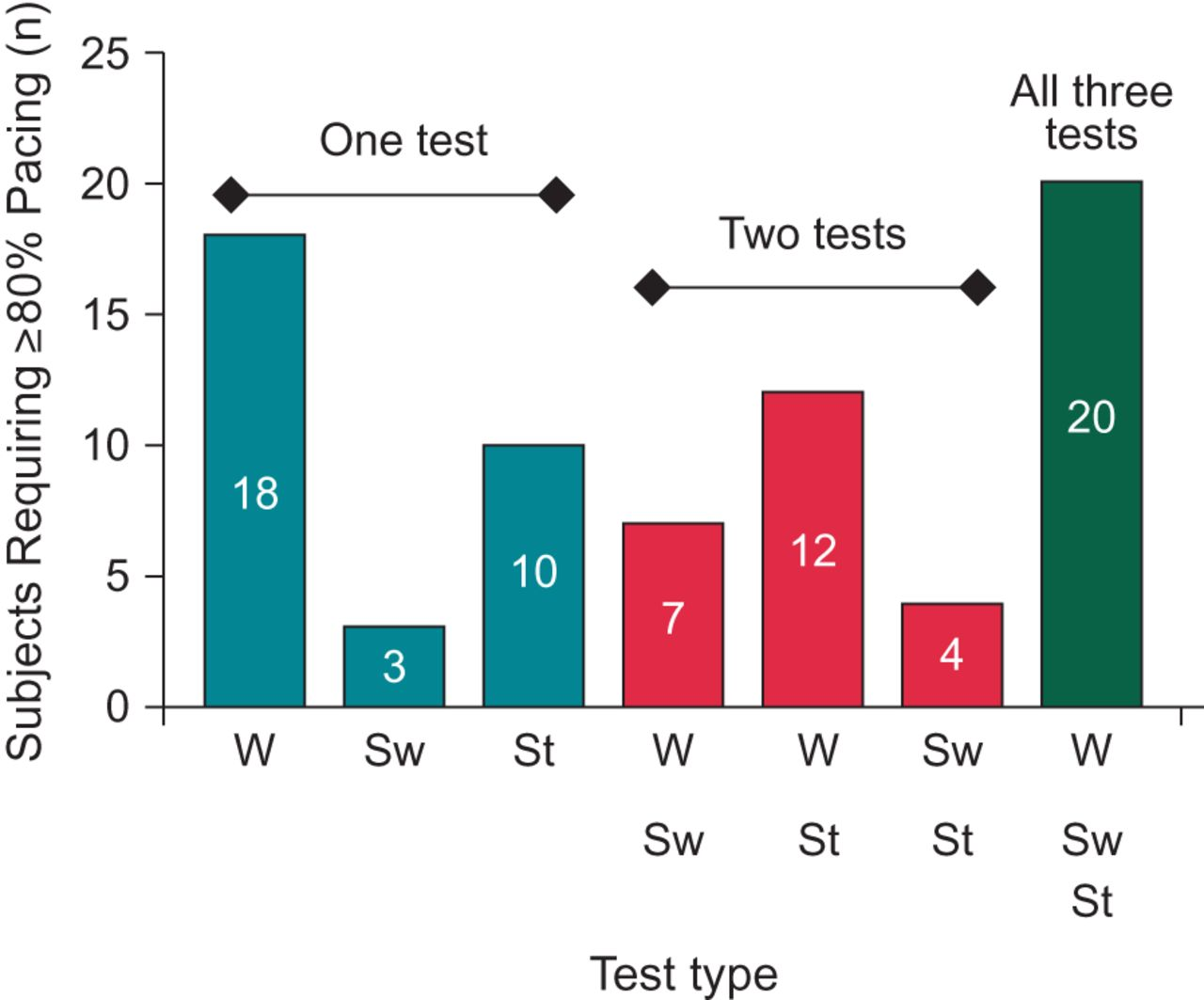
Figure 1 Subjects requiring ≥80% pacing during the walk, sweep, and stand-and-go tests. Subjects may have required ...
Notes:
Figure 1 Subjects requiring ≥80% pacing during the walk, sweep, and stand-and-go tests. Subjects may have required ≥80% pacing for one test only, two tests, or all three tests. W denotes the walk test, Sw denotes the sweep test, and St denotes the stand-and-go test.
Unless provided in the caption above, the following copyright applies to the content of this slide: © The Author 2013. Published by Oxford University Press on behalf of the European Society of Cardiology.This is an Open Access article distributed under the terms of the Creative Commons Attribution License (http://creativecommons.org/licenses/by-nc/3.0/), which permits non-commercial use, distribution, and reproduction in any medium, provided that the original authorship is properly and fully attributed; the Journal, Learned Society and Oxford University Press are attributed as the original place of publication with correct citation details given; if an article is subsequently reproduced or disseminated not in its entirety but only in part or as a derivative work this must be clearly indicated. For commercial re-use, please contact journals.permissions@oup.com

Slide 2
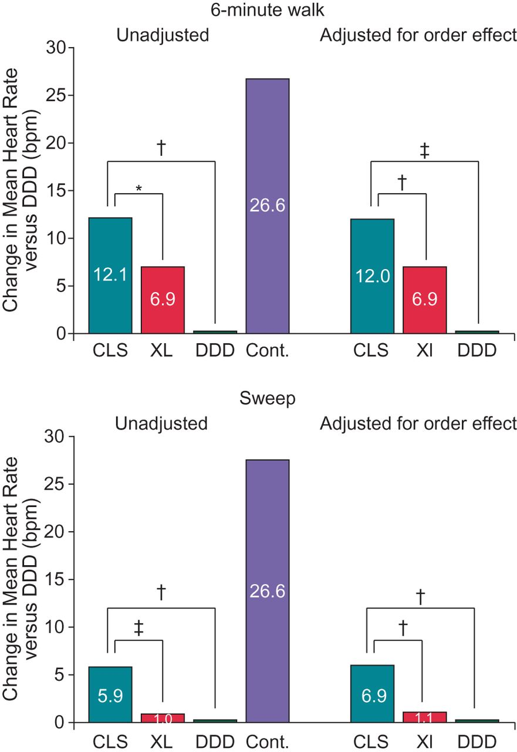
Figure 2 Change in mean heart rate from DDD during walk and sweep tests. Heart rate was lowest with DDD and highest ...
Notes:
Figure 2 Change in mean heart rate from DDD during walk and sweep tests. Heart rate was lowest with DDD and highest for the control groups. Mean heart rate data could not be digitized for four subjects in the walk group and one subject in the sweep group. *P value = 0.003. †P value < 0.0001. ‡P value = 0.001.
Unless provided in the caption above, the following copyright applies to the content of this slide: © The Author 2013. Published by Oxford University Press on behalf of the European Society of Cardiology.This is an Open Access article distributed under the terms of the Creative Commons Attribution License (http://creativecommons.org/licenses/by-nc/3.0/), which permits non-commercial use, distribution, and reproduction in any medium, provided that the original authorship is properly and fully attributed; the Journal, Learned Society and Oxford University Press are attributed as the original place of publication with correct citation details given; if an article is subsequently reproduced or disseminated not in its entirety but only in part or as a derivative work this must be clearly indicated. For commercial re-use, please contact journals.permissions@oup.com

Slide 3
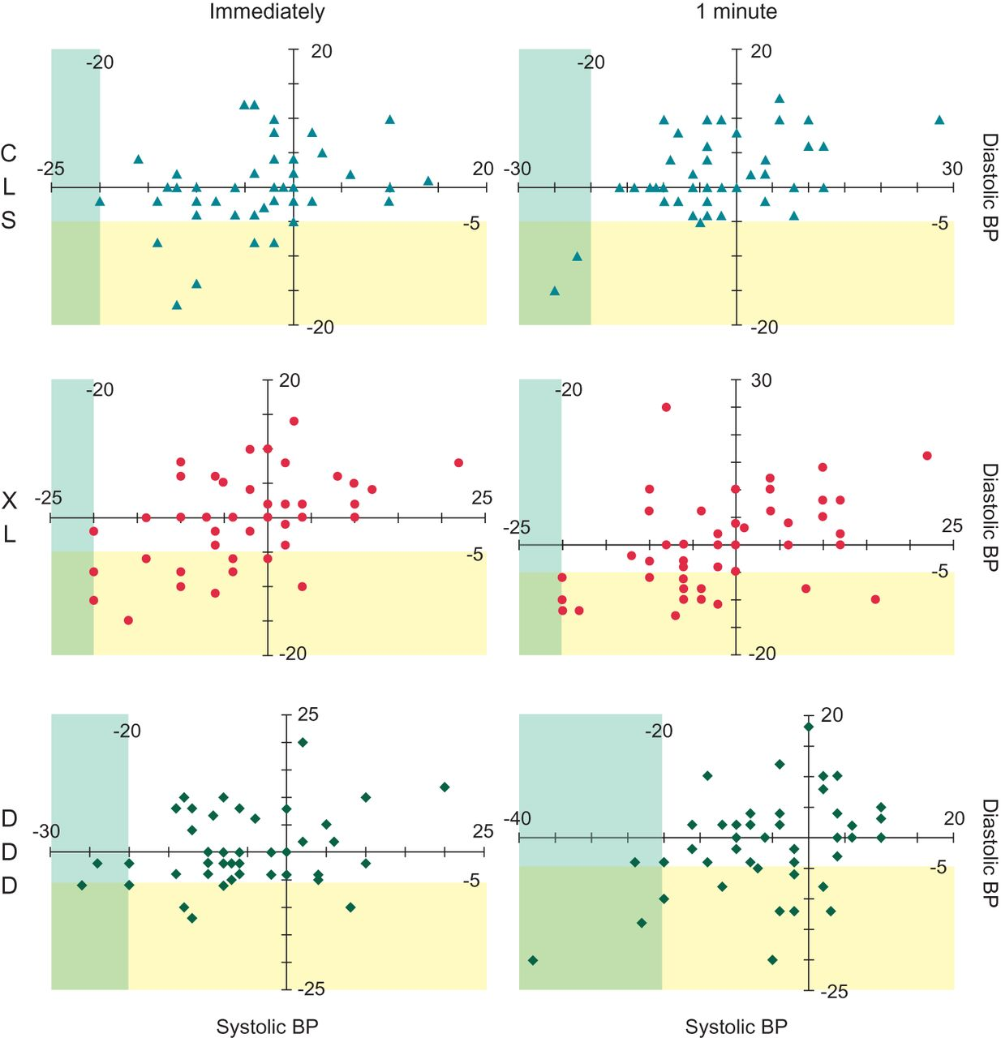
Figure 3 Change in blood pressure from baseline for each subject included in the stand-and-go test. Systolic blood ...
Notes:
Figure 3 Change in blood pressure from baseline for each subject included in the stand-and-go test. Systolic blood pressure is displayed on the x-axis, while diastolic blood pressure is displayed on the y-axis. The blue shading denotes the systolic blood pressure OH criteria of a decrease of ≥20 mmHg, while the yellow shading denotes the diastolic blood pressure OH criteria of a decrease of ≥5 mmHg.
Unless provided in the caption above, the following copyright applies to the content of this slide: © The Author 2013. Published by Oxford University Press on behalf of the European Society of Cardiology.This is an Open Access article distributed under the terms of the Creative Commons Attribution License (http://creativecommons.org/licenses/by-nc/3.0/), which permits non-commercial use, distribution, and reproduction in any medium, provided that the original authorship is properly and fully attributed; the Journal, Learned Society and Oxford University Press are attributed as the original place of publication with correct citation details given; if an article is subsequently reproduced or disseminated not in its entirety but only in part or as a derivative work this must be clearly indicated. For commercial re-use, please contact journals.permissions@oup.com

