Slide 1
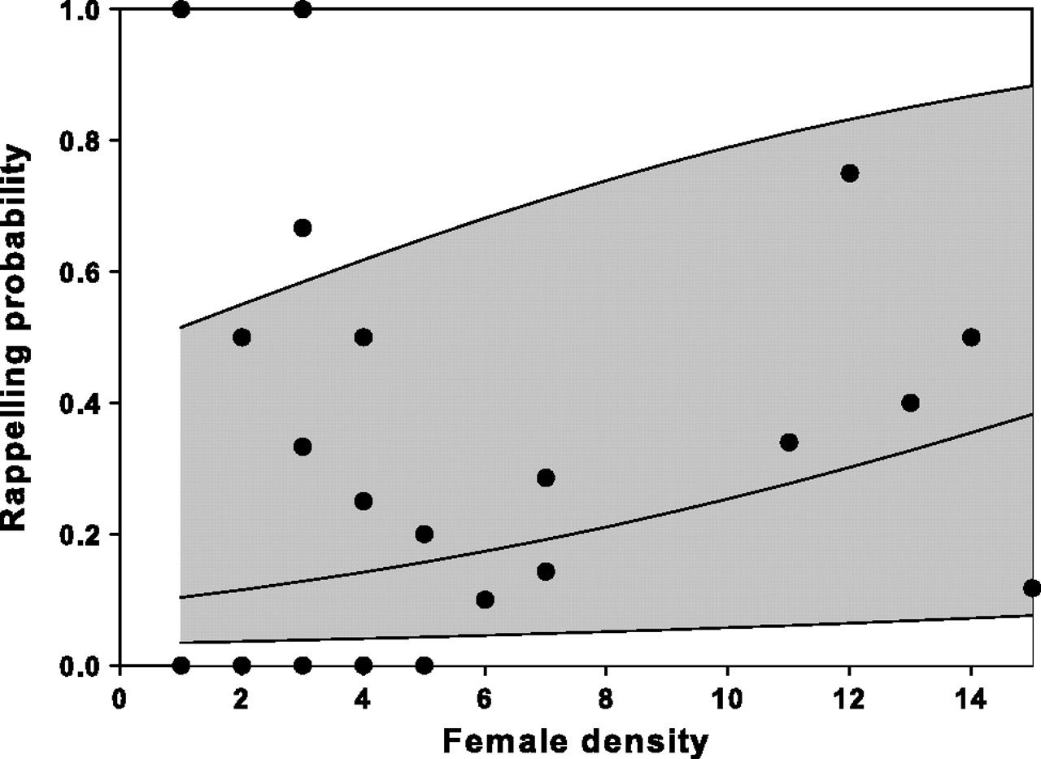
Figure 1 Probability of rappelling in females in relation to their experienced density of females (i.e., number of ...
Notes:
Figure 1 Probability of rappelling in females in relation to their experienced density of females (i.e., number of rappelling females/female density). Dots: observed proportions per line. The middle line depicts the expected average relationship and shaded areas depict the 95% confidence interval of the estimated trend.
Unless provided in the caption above, the following copyright applies to the content of this slide: © The Author 2010. Published by Oxford University Press on behalf of the International Society for Behavioral Ecology. All rights reserved. For permissions, please e-mail: journals.permissions@oxfordjournals.org

Slide 2
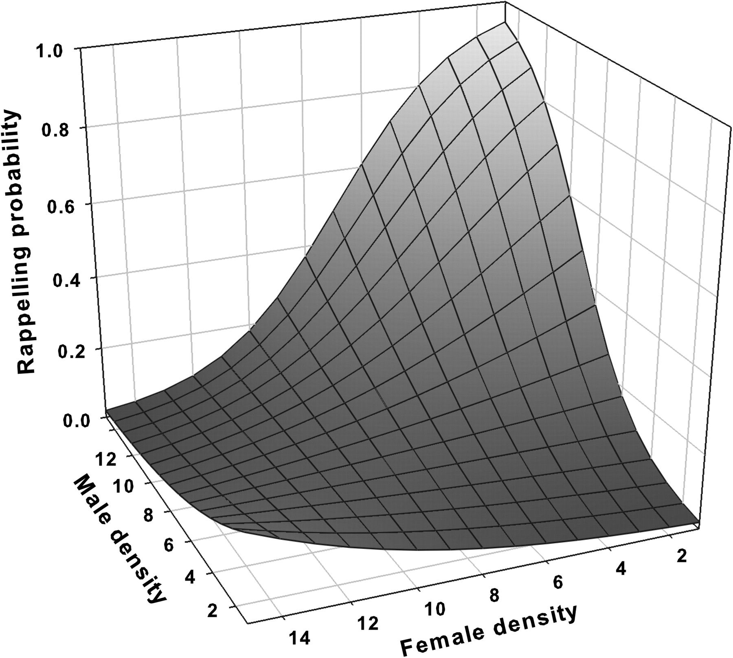
Figure 2 Estimated density-dependent rappelling in males according to their experienced density of male and female ...
Notes:
Figure 2 Estimated density-dependent rappelling in males according to their experienced density of male and female conspecifics.
Unless provided in the caption above, the following copyright applies to the content of this slide: © The Author 2010. Published by Oxford University Press on behalf of the International Society for Behavioral Ecology. All rights reserved. For permissions, please e-mail: journals.permissions@oxfordjournals.org

Slide 3
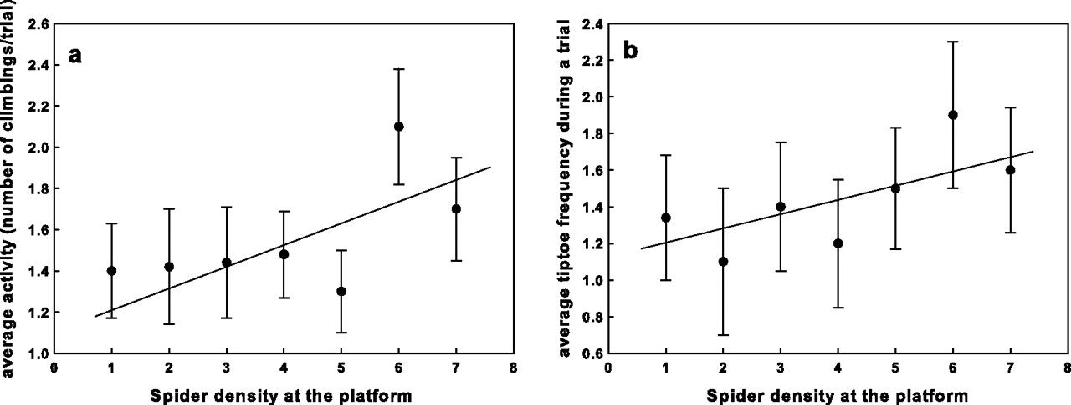
Figure 3 Effect of density during dispersal preparation on spider activity (3a, left) and spider tiptoe frequency (3b, ...
Notes:
Figure 3 Effect of density during dispersal preparation on spider activity (3a, left) and spider tiptoe frequency (3b, right). Mean values (±standard error) per manipulated density are depicted.
Unless provided in the caption above, the following copyright applies to the content of this slide: © The Author 2010. Published by Oxford University Press on behalf of the International Society for Behavioral Ecology. All rights reserved. For permissions, please e-mail: journals.permissions@oxfordjournals.org

Slide 4
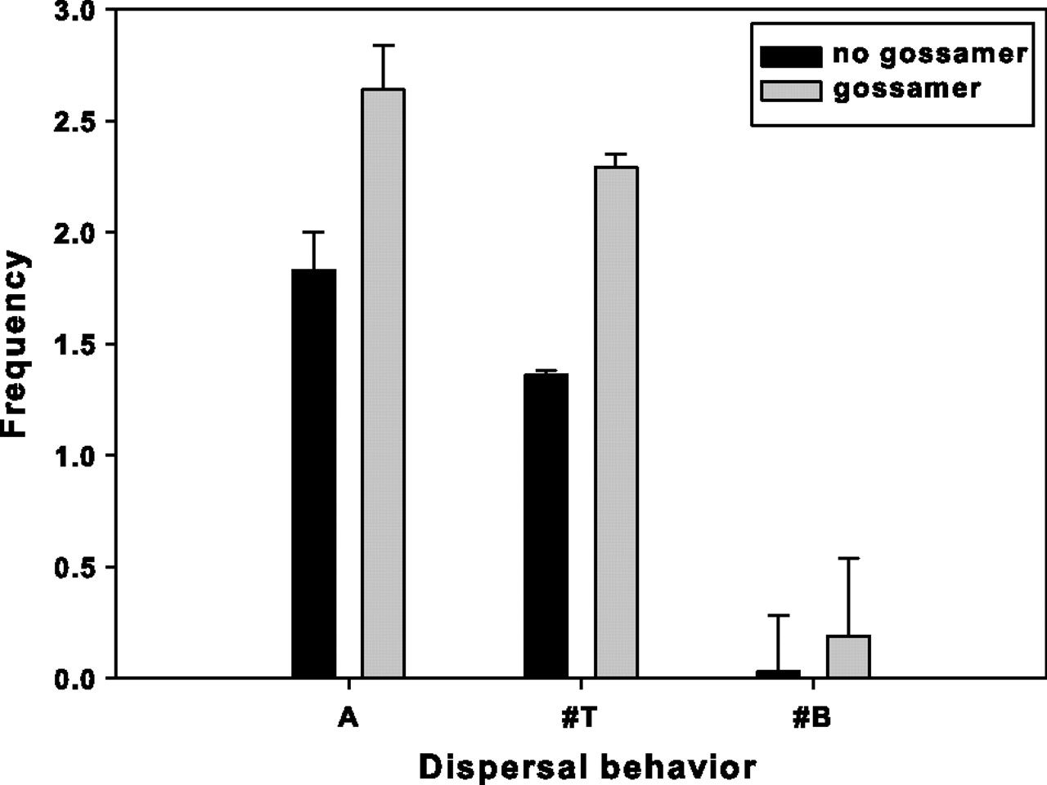
Figure 4 Changes in dispersal behavior between organisms in the presence and absence of silk threads. A: average ...
Notes:
Figure 4 Changes in dispersal behavior between organisms in the presence and absence of silk threads. A: average activity; #T: average tiptoe frequency; and #B: average number of ballooning events.
Unless provided in the caption above, the following copyright applies to the content of this slide: © The Author 2010. Published by Oxford University Press on behalf of the International Society for Behavioral Ecology. All rights reserved. For permissions, please e-mail: journals.permissions@oxfordjournals.org

Slide 5
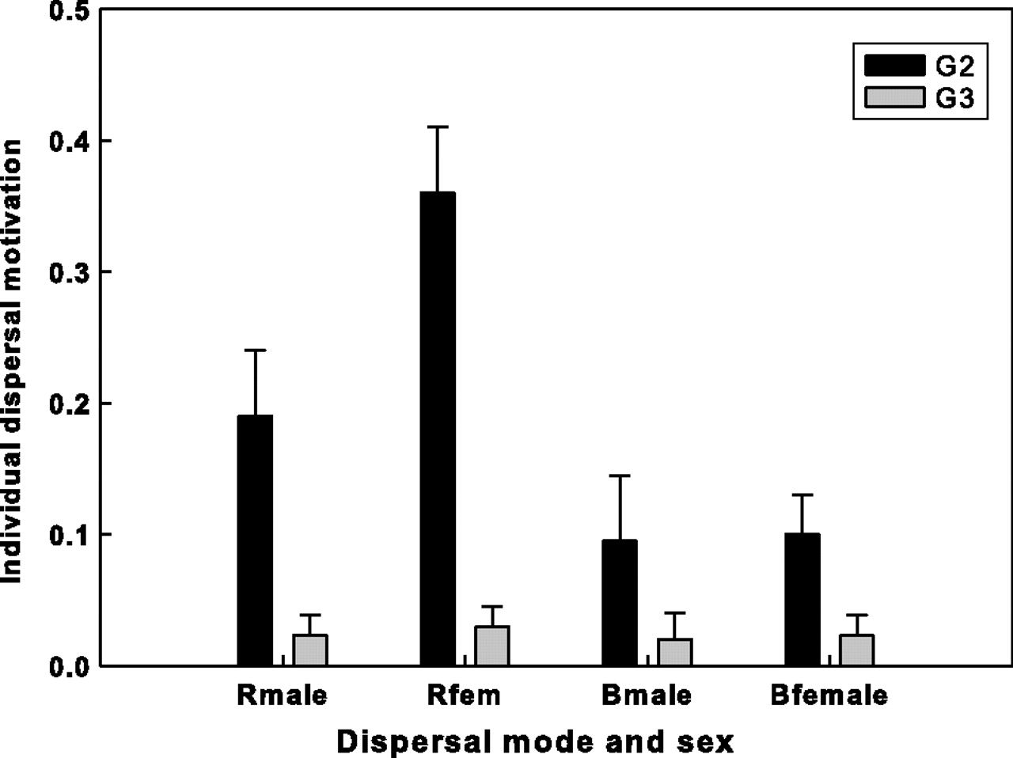
Figure 5 Changes in dispersal behavior between subsequent generations G2 and G3 in the artificial populations: ...
Notes:
Figure 5 Changes in dispersal behavior between subsequent generations G2 and G3 in the artificial populations: Rmale, Rfemale: rappelling in, respectively, males and females and Bmale and Bfemale: ballooning in, respectively, males and females. Average frequency during trials per population for average spider densities. Rappelling: all F > 30, P < 0.01. For ballooning, a decline in individual probability was only prevalent in females (F1,57 = 4.35; P = 0.045) but not in males (F1,36 = 1.15; P = 0.290).
Unless provided in the caption above, the following copyright applies to the content of this slide: © The Author 2010. Published by Oxford University Press on behalf of the International Society for Behavioral Ecology. All rights reserved. For permissions, please e-mail: journals.permissions@oxfordjournals.org

