Slide 1
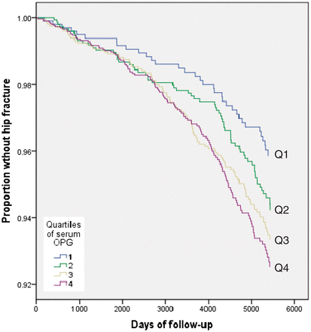
Figure 1 Estimated age- and gender-adjusted proportion of the cohort without a hip fracture as a function of follow-up ...
Notes:
Figure 1 Estimated age- and gender-adjusted proportion of the cohort without a hip fracture as a function of follow-up time
Unless provided in the caption above, the following copyright applies to the content of this slide: Published by Oxford University Press on behalf of the International Epidemiological Association © The Author 2012; all rights reserved.

