Slide 1
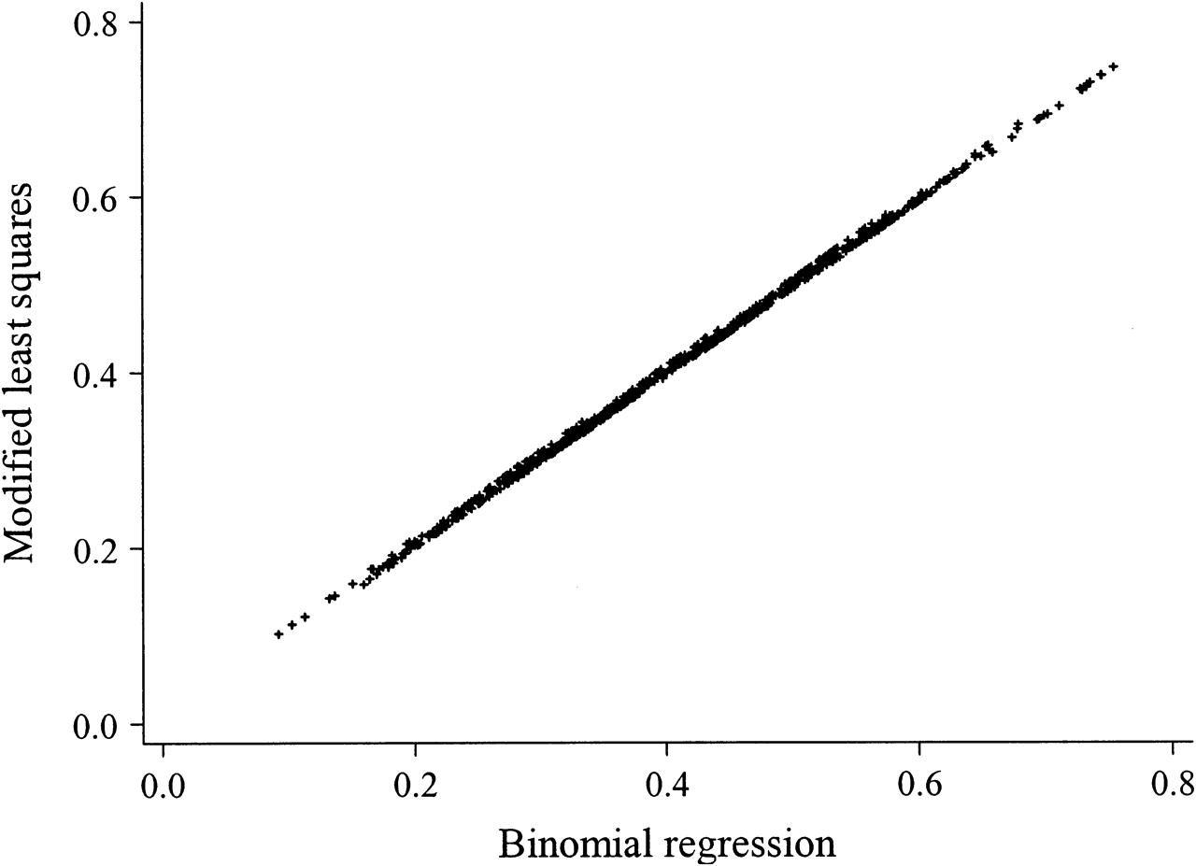
FIGURE 1. Risks of anxiety/depression predicted by modified least-squares and binomial regression models among 771 ...
Notes:
FIGURE 1. Risks of anxiety/depression predicted by modified least-squares and binomial regression models among 771 cancer patients in Singapore, 2004–2006. Intraclass correlation coefficient = 0.9994.
Unless provided in the caption above, the following copyright applies to the content of this slide: American Journal of Epidemiology © The Author 2007. Published by the Johns Hopkins Bloomberg School of Public Health. All rights reserved. For permissions, please e-mail: journals.permissions@oxfordjournals.org.

