Slide 1
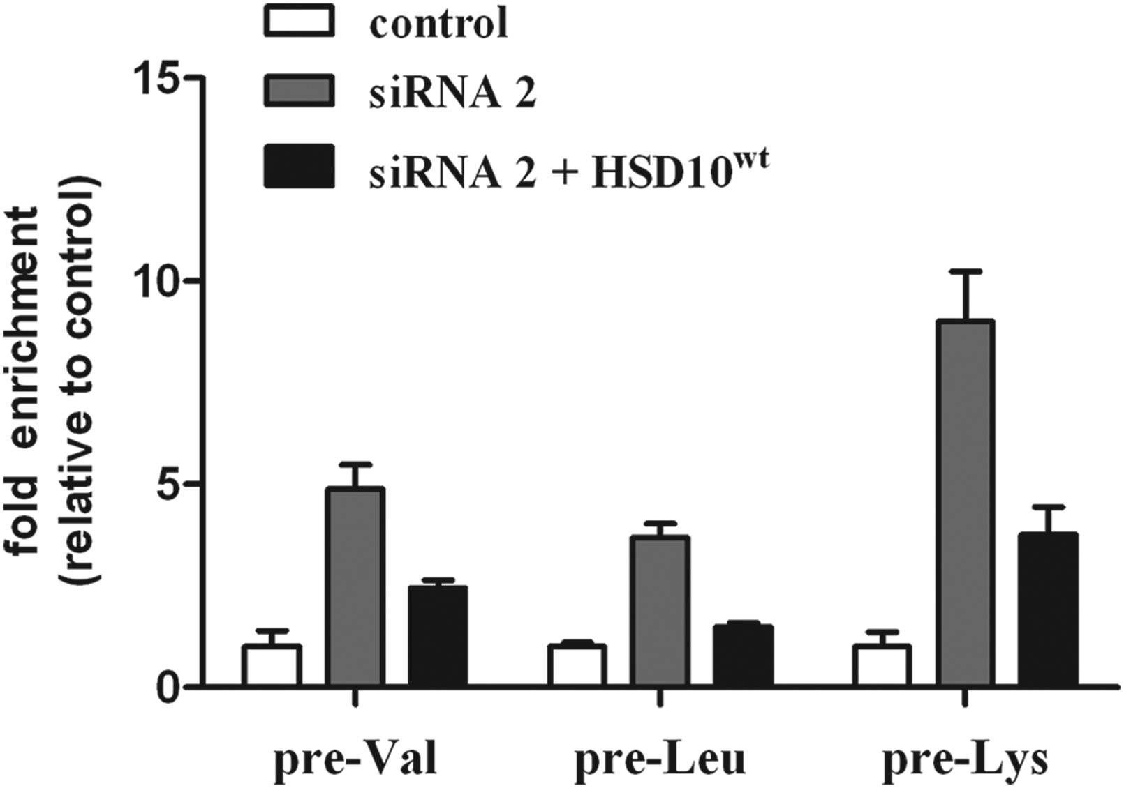
Figure 4. qRT-PCR analysis of three precursor tRNAs demonstrating that mt-tRNA processing can be partly rescued by the ...
Notes:
Figure 4. qRT-PCR analysis of three precursor tRNAs demonstrating that mt-tRNA processing can be partly rescued by the ectopic expression of HSD10wt. HSD10 knock-down increased expression of unprocessed pre-tRNAs pre-Val, pre-Leu and pre-Lys. After transfection of HSD10 knock-down cells with HSD10wt gene, the accumulation of unprocessed pre-tRNAs was ∼50% (pre-Val, pre-Leu) and 30% (pre-Lys) the amount of knock-down cells. The data demonstrated that HSD10wt expression restored at least in part RNase P function.
Unless provided in the caption above, the following copyright applies to the content of this slide: © The Author 2014. Published by Oxford University Press. All rights reserved. For Permissions, please email: journals.permissions@oup.com

Slide 2
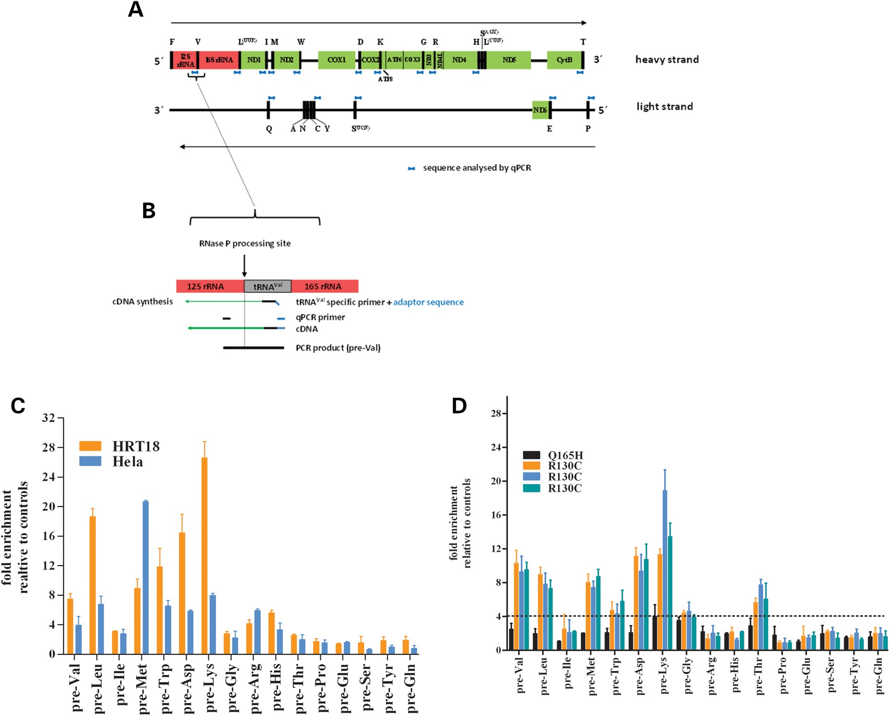
Figure 3. Effect of reduced HSD10 expression on mitochondrial tRNA processing. (A) Schematic representation of the ...
Notes:
Figure 3. Effect of reduced HSD10 expression on mitochondrial tRNA processing. (A) Schematic representation of the mitochondrial genome with coding regions presented as colored boxes and tRNAs as black boxes. The location of quantified gene-tRNA sequences are indicated in blue. (B) Schematic drawing of 12S rRNA-tRNAVal junction to illustrate the strand-specific quantification method. (C) Quantification of tRNA precursor transcripts in HSD10 knock-down HeLa and HRT18 cell lines. Accumulation of precursor transcripts was found for heavy strand but not for light strand transcripts, indicating that impaired processing by loss of HSD10 is strand specific. Furthermore the extent of precursor accumulation is different for each individual pre-tRNA transcript. (D) Quantification of pre-tRNA transcripts in fibroblasts with p.R130C and p.Q165H mutation, respectively. The pattern of accumulation of pre-tRNA transcripts is quite similar to HSD10 knock-down cell lines with enrichment of only heavy strand pre-tRNA transcripts. However, pre-tRNA processing of pre-Ile, pre-Arg and pre-His was not significantly different in patient fibroblasts compared with control cells. Dotted line represents cutoff.
Unless provided in the caption above, the following copyright applies to the content of this slide: © The Author 2014. Published by Oxford University Press. All rights reserved. For Permissions, please email: journals.permissions@oup.com

Slide 3
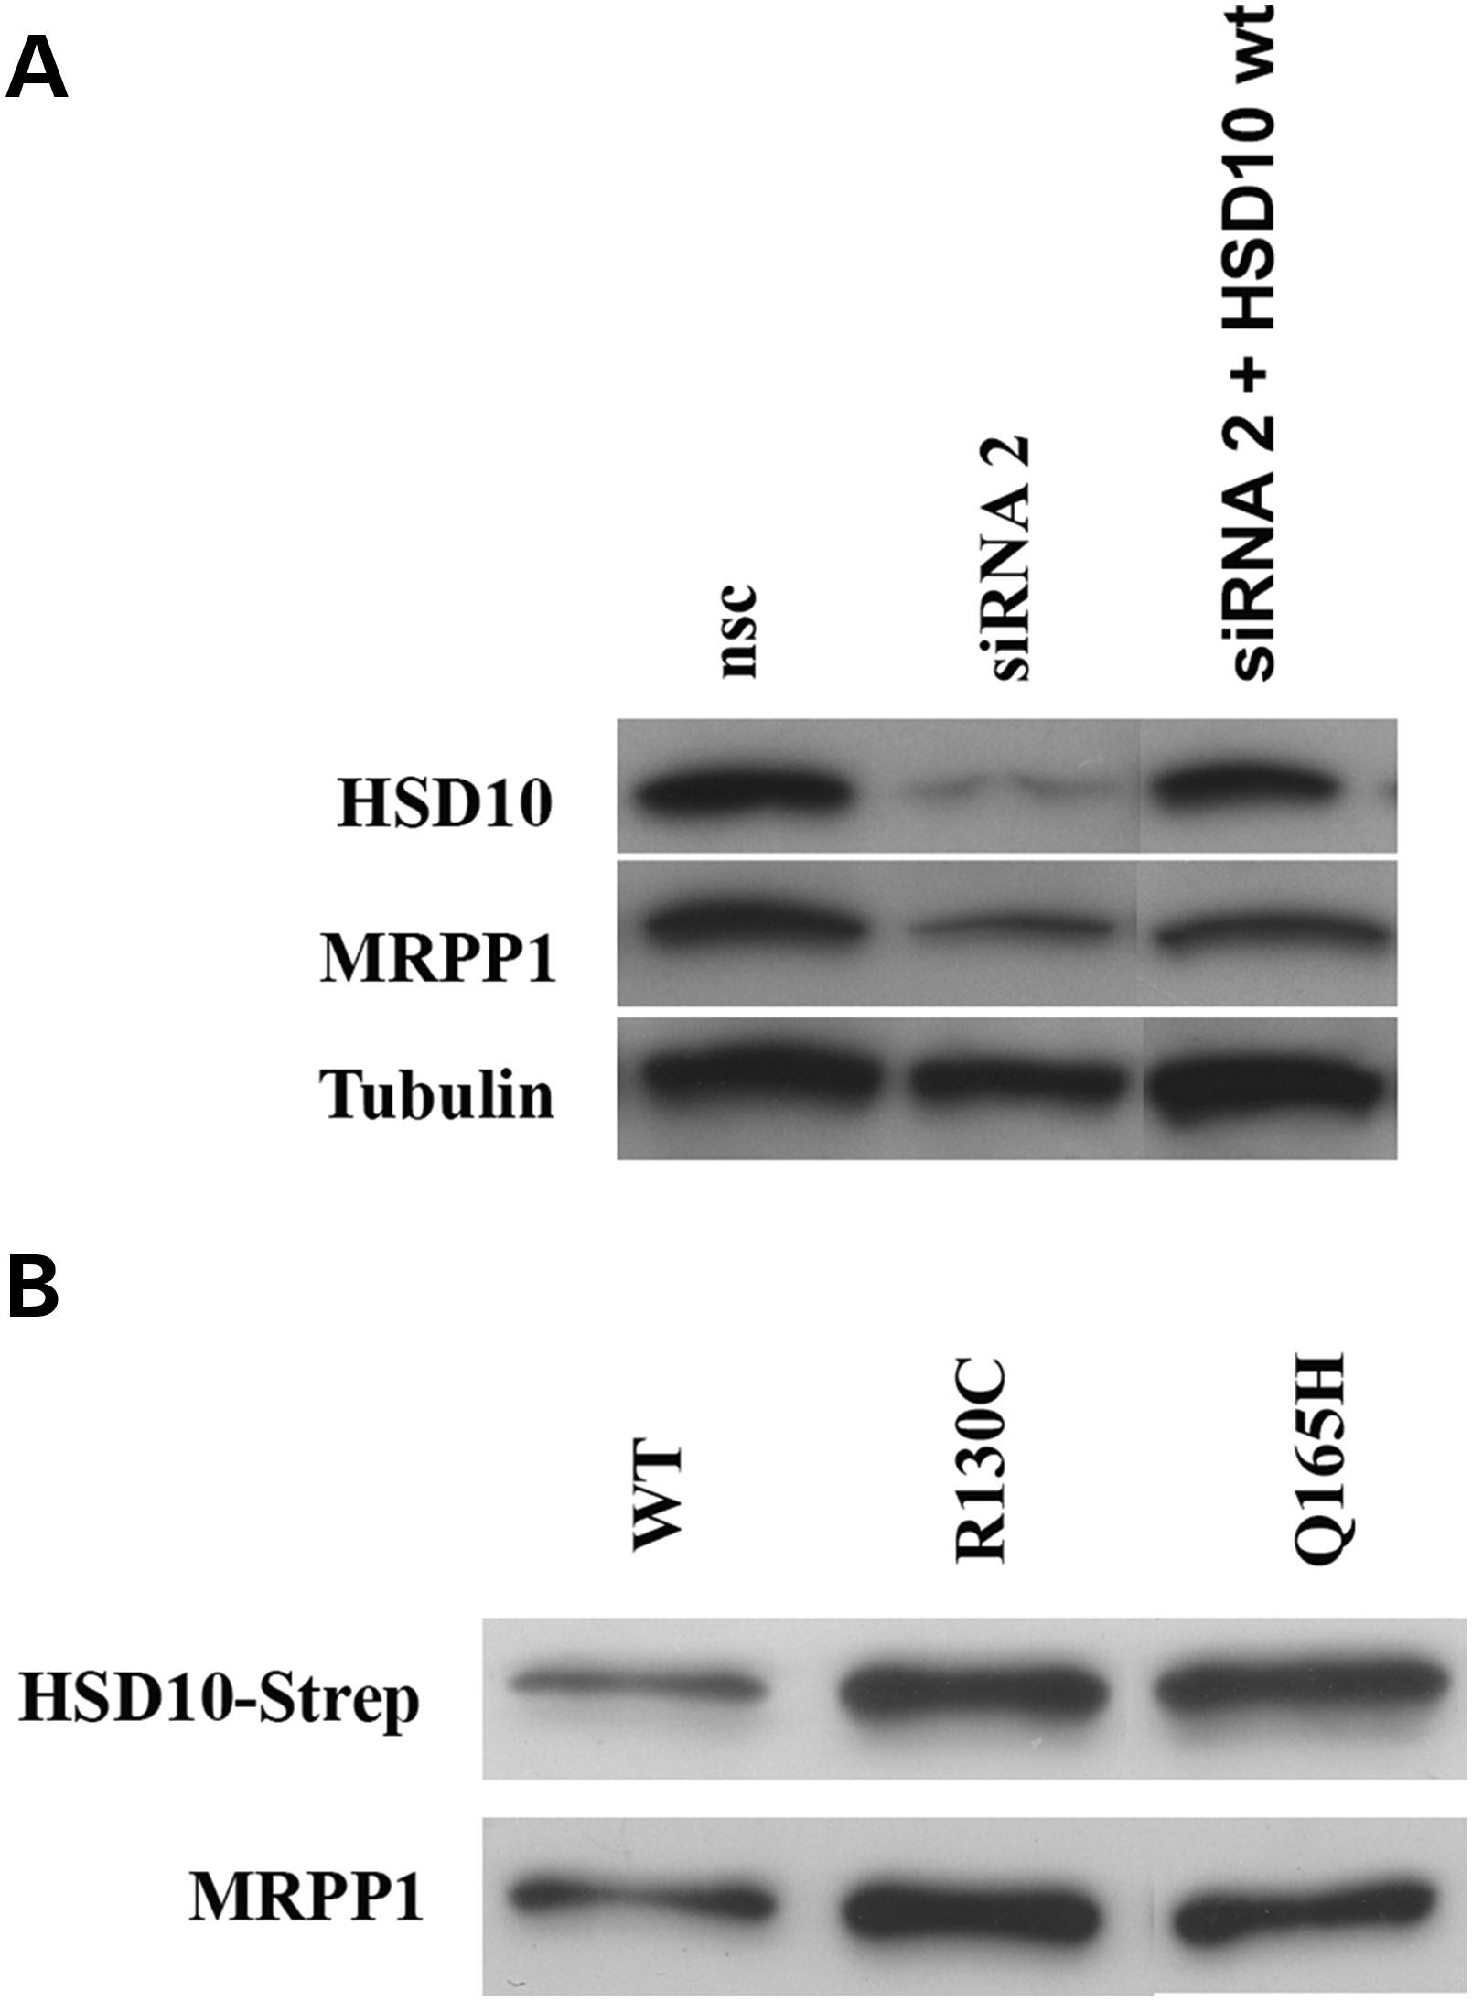
Figure 2. Ectopic expression of HSD10^{wt} partly restored MRPP1 protein level in human cells. (A) Expression ...
Notes:
Figure 2. Ectopic expression of HSD10wt partly restored MRPP1 protein level in human cells. (A) Expression of HSD10 and MRPP1 was significantly reduced in HSD10 knock-down cells. Ectopic expression of HSD10wt in knock-down cells partly restored expression of both proteins. (B) Co-immunoprecipitation of HSD10-strep and MRPP1 after transient transfection of strep-tagged HSD10 proteins (wt, p.R130C and p.Q165H). In each sample, expression of MRPP1 was of similar intensity than found for HSD10 Strep-tag protein, indicating that MRPP1 binding to HSD10 was not reduced by HSD10 mutations.
Unless provided in the caption above, the following copyright applies to the content of this slide: © The Author 2014. Published by Oxford University Press. All rights reserved. For Permissions, please email: journals.permissions@oup.com

Slide 4
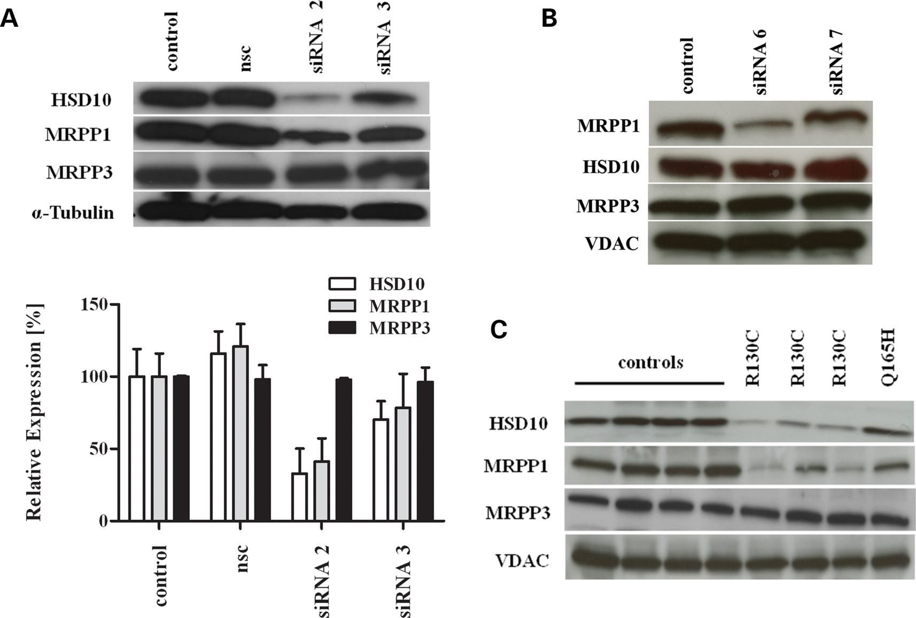
Figure 1. Loss of HSD10 protein causes loss of MRPP1 protein in human patient fibroblasts and HSD10 knock-down cells. ...
Notes:
Figure 1. Loss of HSD10 protein causes loss of MRPP1 protein in human patient fibroblasts and HSD10 knock-down cells. (A) Western blot analysis of RNase P proteins in HeLa cells treated with HSD17B10 siRNA 2 and 3 and a non-silencing control (nsc). siRNA 2 reduced HSD10 protein levels to 82% and was associated with a significant lower amount of MRPP1 protein. Expression of MRPP3 was not affected. Densiometric analysis of RNase P proteins normalized to α-Tubulin is shown below. (B) Analysis of RNase P proteins after MRPP1 knock-down demonstrated unaffected expression of HSD10 and MRPP3 protein, whereas MRPP1 expression was down-regulated by siRNA 6 targeting MRPP1. (C) Reduced expression of HSD10 and MRPP1 in patient fibroblasts bearing mutation p.R130C compared with mutation p.Q165H and control fibroblasts. α-Tubulin and voltage-dependent anion channel (VDAC) were used as loading controls.
Unless provided in the caption above, the following copyright applies to the content of this slide: © The Author 2014. Published by Oxford University Press. All rights reserved. For Permissions, please email: journals.permissions@oup.com

Slide 5
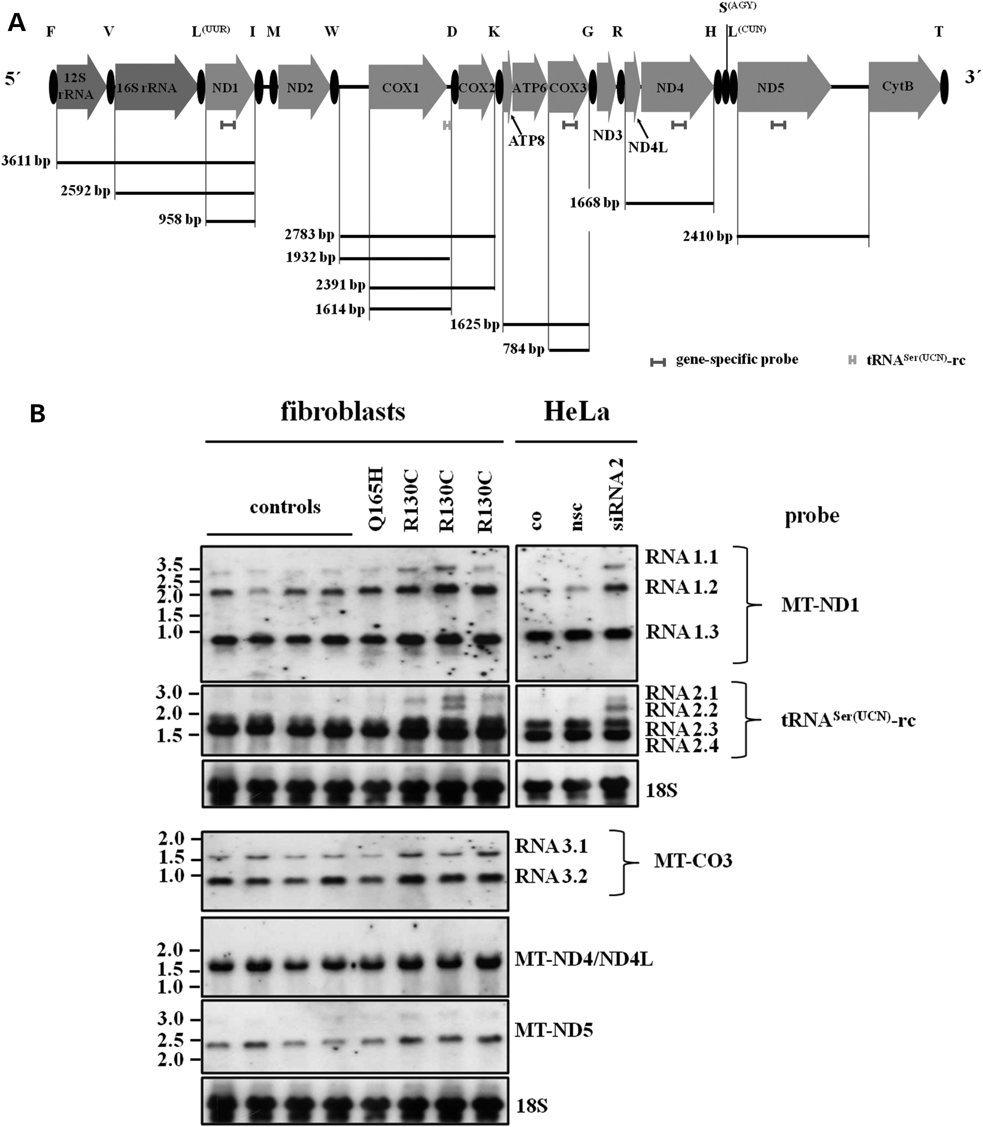
Figure 5. Northern blot analysis of mitochondrial transcripts in human fibroblasts and HSD10 knock-down HeLa cells. (A) ...
Notes:
Figure 5. Northern blot analysis of mitochondrial transcripts in human fibroblasts and HSD10 knock-down HeLa cells. (A) Schematic representation of the mitochondrial heavy strand genome. Indicated are the strand-specific probes for northern analysis and the predicted size of RNA molecules expected to detect on northern blots. (B) Expression pattern of RNA transcripts in human control fibroblasts (controls), in fibroblasts from HSD10 diseased patients and in HSD10 knock-down HeLa cells. An accumulation of larger RNA molecules was found in fibroblasts with HSD10R130C mutation and in HSD10 knock-down cells. Probing with MT-ND1 revealed an accumulation of a transcript of approx. 3.6 kb size (RNA 1.1) which covers (tRNAPhe) –12SrRNA–tRNAVal–16SrRNA–tRNALeu-ND1 indicating reduced processing of tRNAVal and tRNALeu as also found by real-time PCR. In a further analysis, we used a heavy strand-specific probe corresponding to light strand tRNASer(UCN) (tRNASer(UCN)-rc). The data demonstrated an accumulation of larger transcripts in HSD10R130C patient fibroblasts and HSD10 knock-down cells. These larger transcripts cover MT-CO1–tRNAAsp–MT-CO2 sequence with 5′-UTR of MT-CO1 (transcript at 2.6 kb, RNA 2.1) or without (transcript at 2.2 kb, RNA 2.2) and indicated an impaired tRNAAsp processing. Northern blots with strand-specific probes for MT-ND4, MT-CO3 and MT-ND5 revealed no accumulation of high molecular weight precursor transcripts in patient fibroblasts.
Unless provided in the caption above, the following copyright applies to the content of this slide: © The Author 2014. Published by Oxford University Press. All rights reserved. For Permissions, please email: journals.permissions@oup.com

