Slide 1
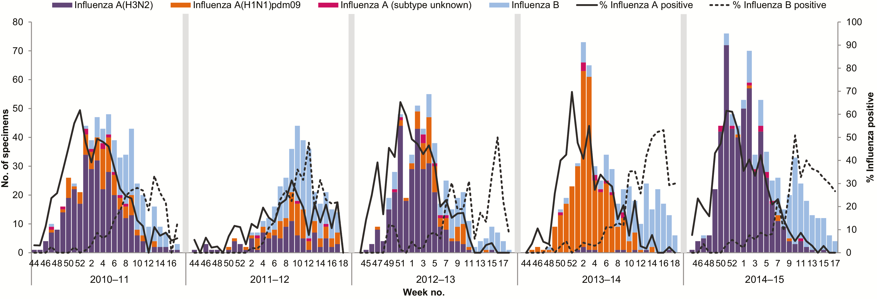
Figure 1. Epidemic curve of influenza detections by year and influenza type/subtype among Canadian Sentinel ...
Notes:
Figure 1. Epidemic curve of influenza detections by year and influenza type/subtype among Canadian Sentinel Practitioner Surveillance Network patients aged ≥9 years, 2010–2011 to 2014–2015.
Unless provided in the caption above, the following copyright applies to the content of this slide: © The Author 2017. Published by Oxford University Press for the Infectious Diseases Society of America. All rights reserved. For permissions, e-mail: journals.permissions@oup.com.

Slide 2
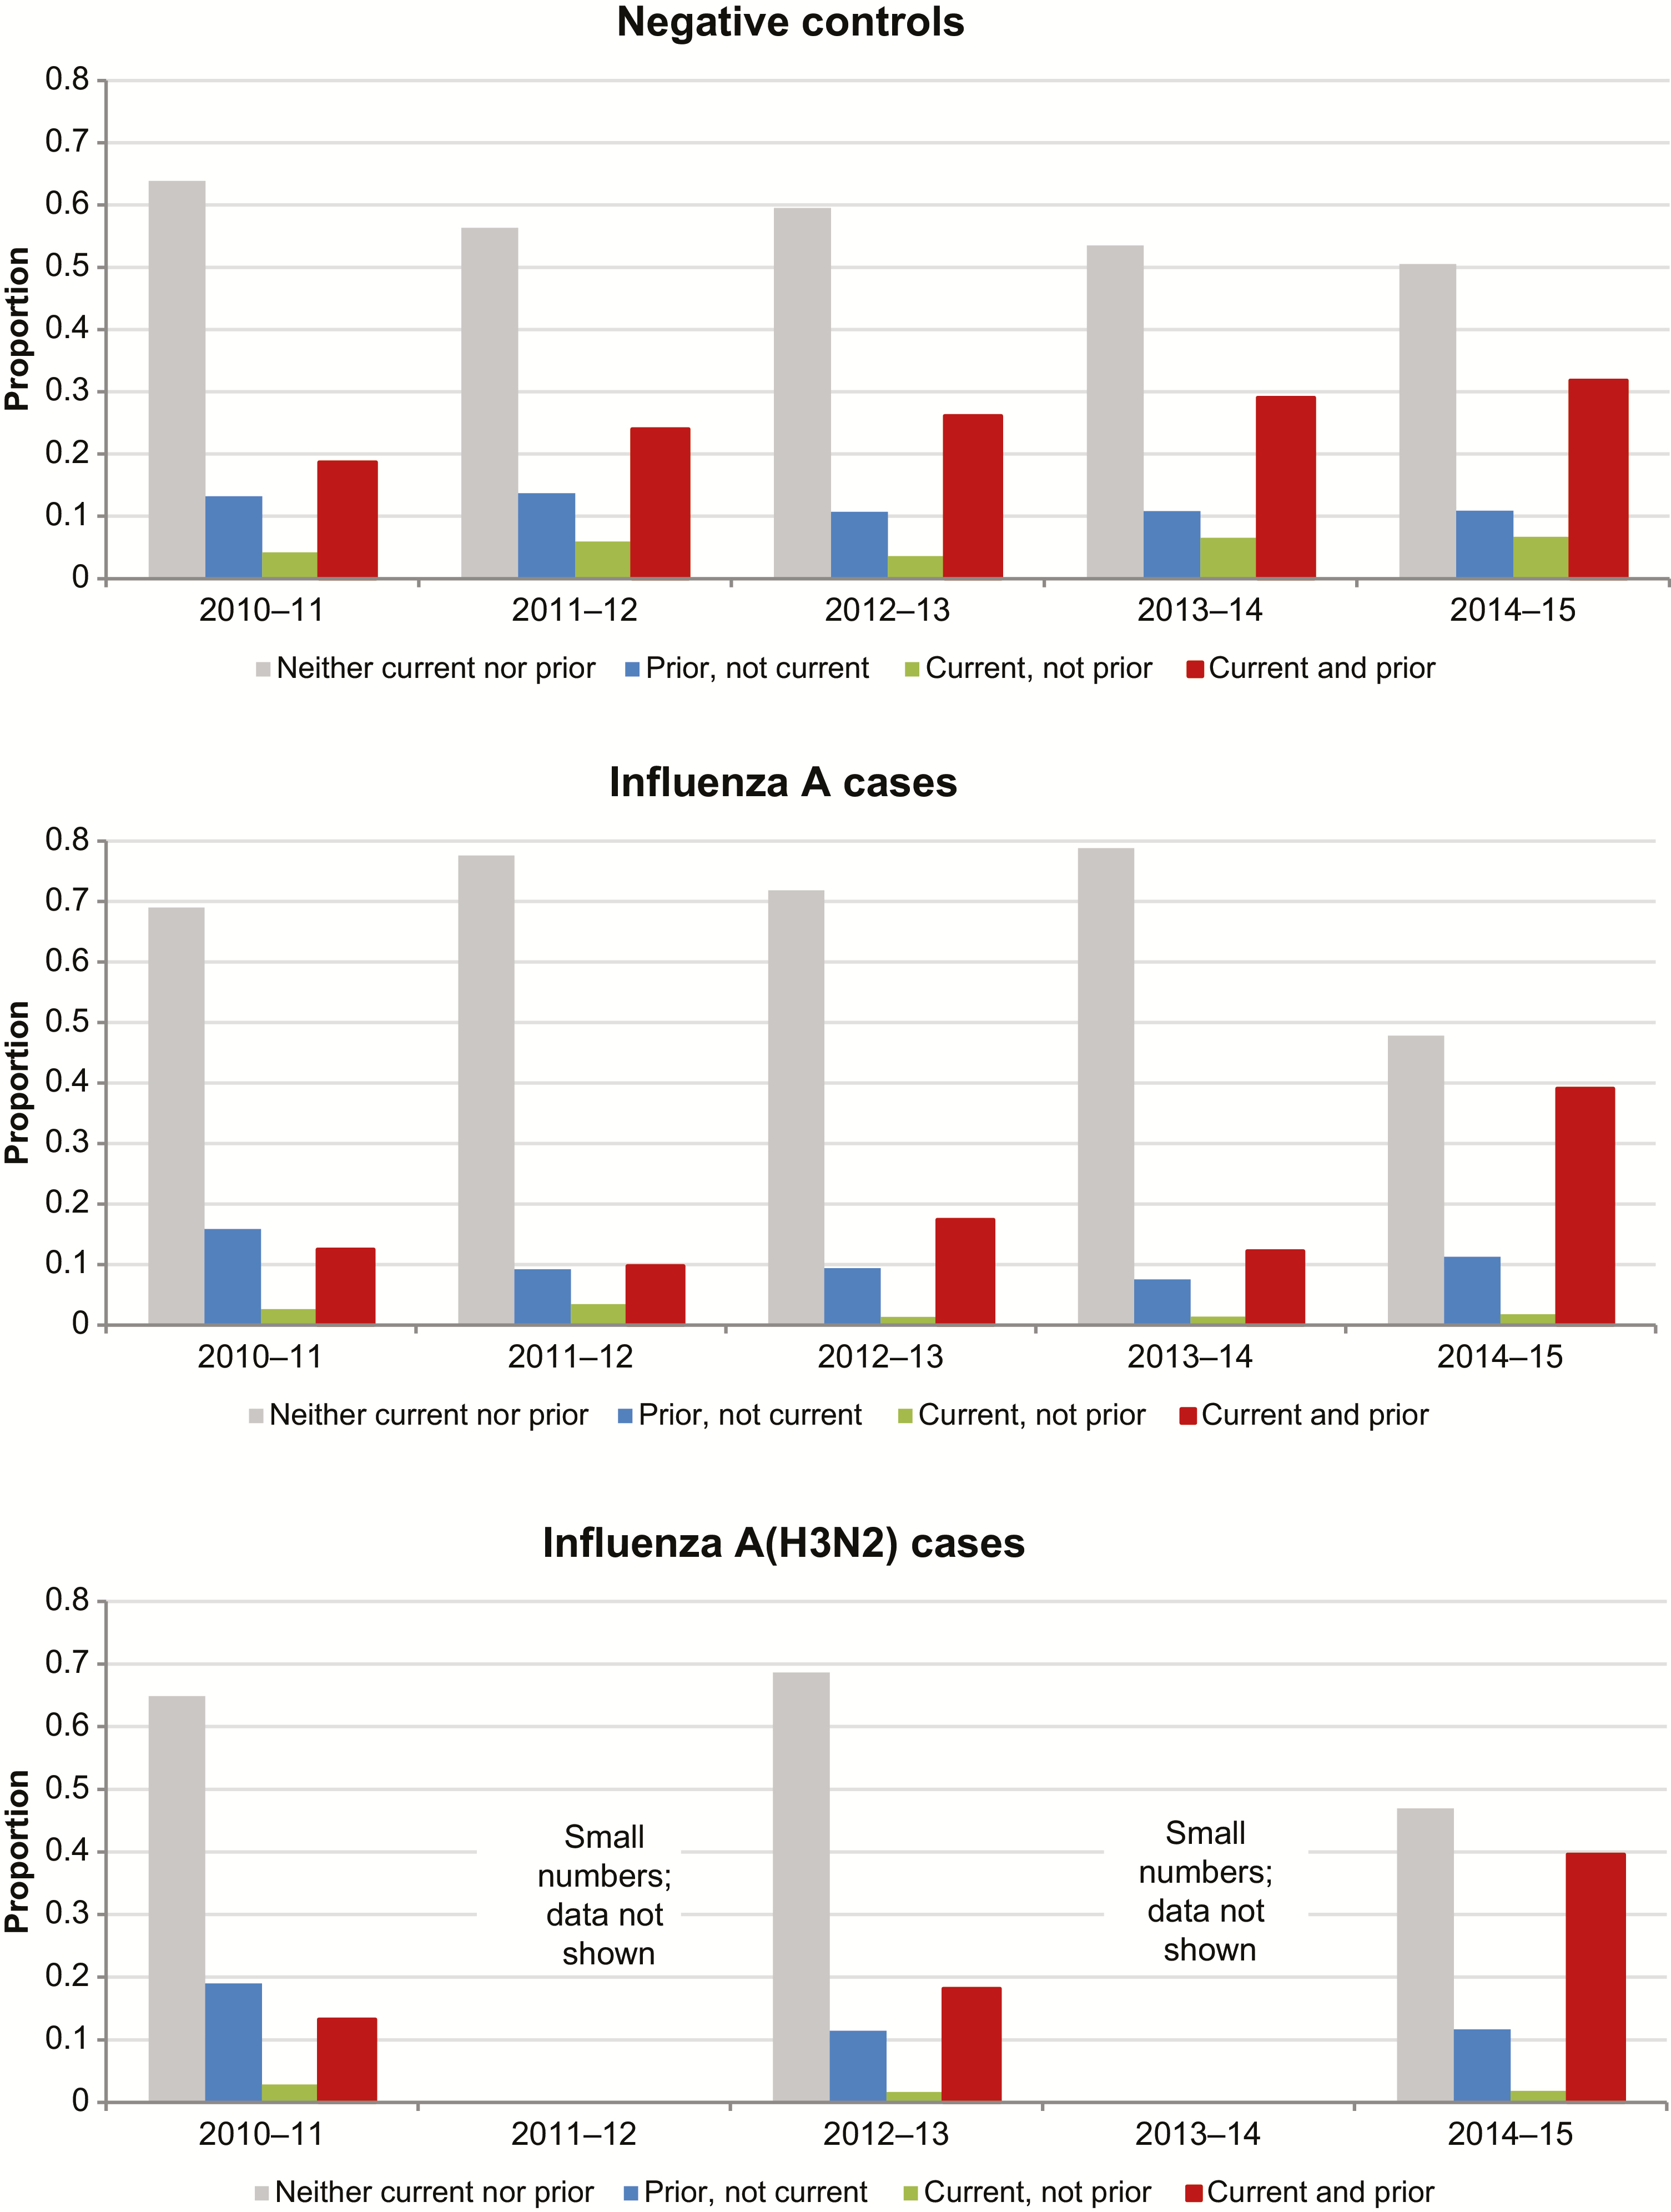
Figure 2. Prior vaccination (current and prior season) by year and case status among Canadian Sentinel Practitioner ...
Notes:
Figure 2. Prior vaccination (current and prior season) by year and case status among Canadian Sentinel Practitioner Surveillance Network patients aged ≥9 years, 2010–2011 to 2014–2015.
Unless provided in the caption above, the following copyright applies to the content of this slide: © The Author 2017. Published by Oxford University Press for the Infectious Diseases Society of America. All rights reserved. For permissions, e-mail: journals.permissions@oup.com.

Slide 3
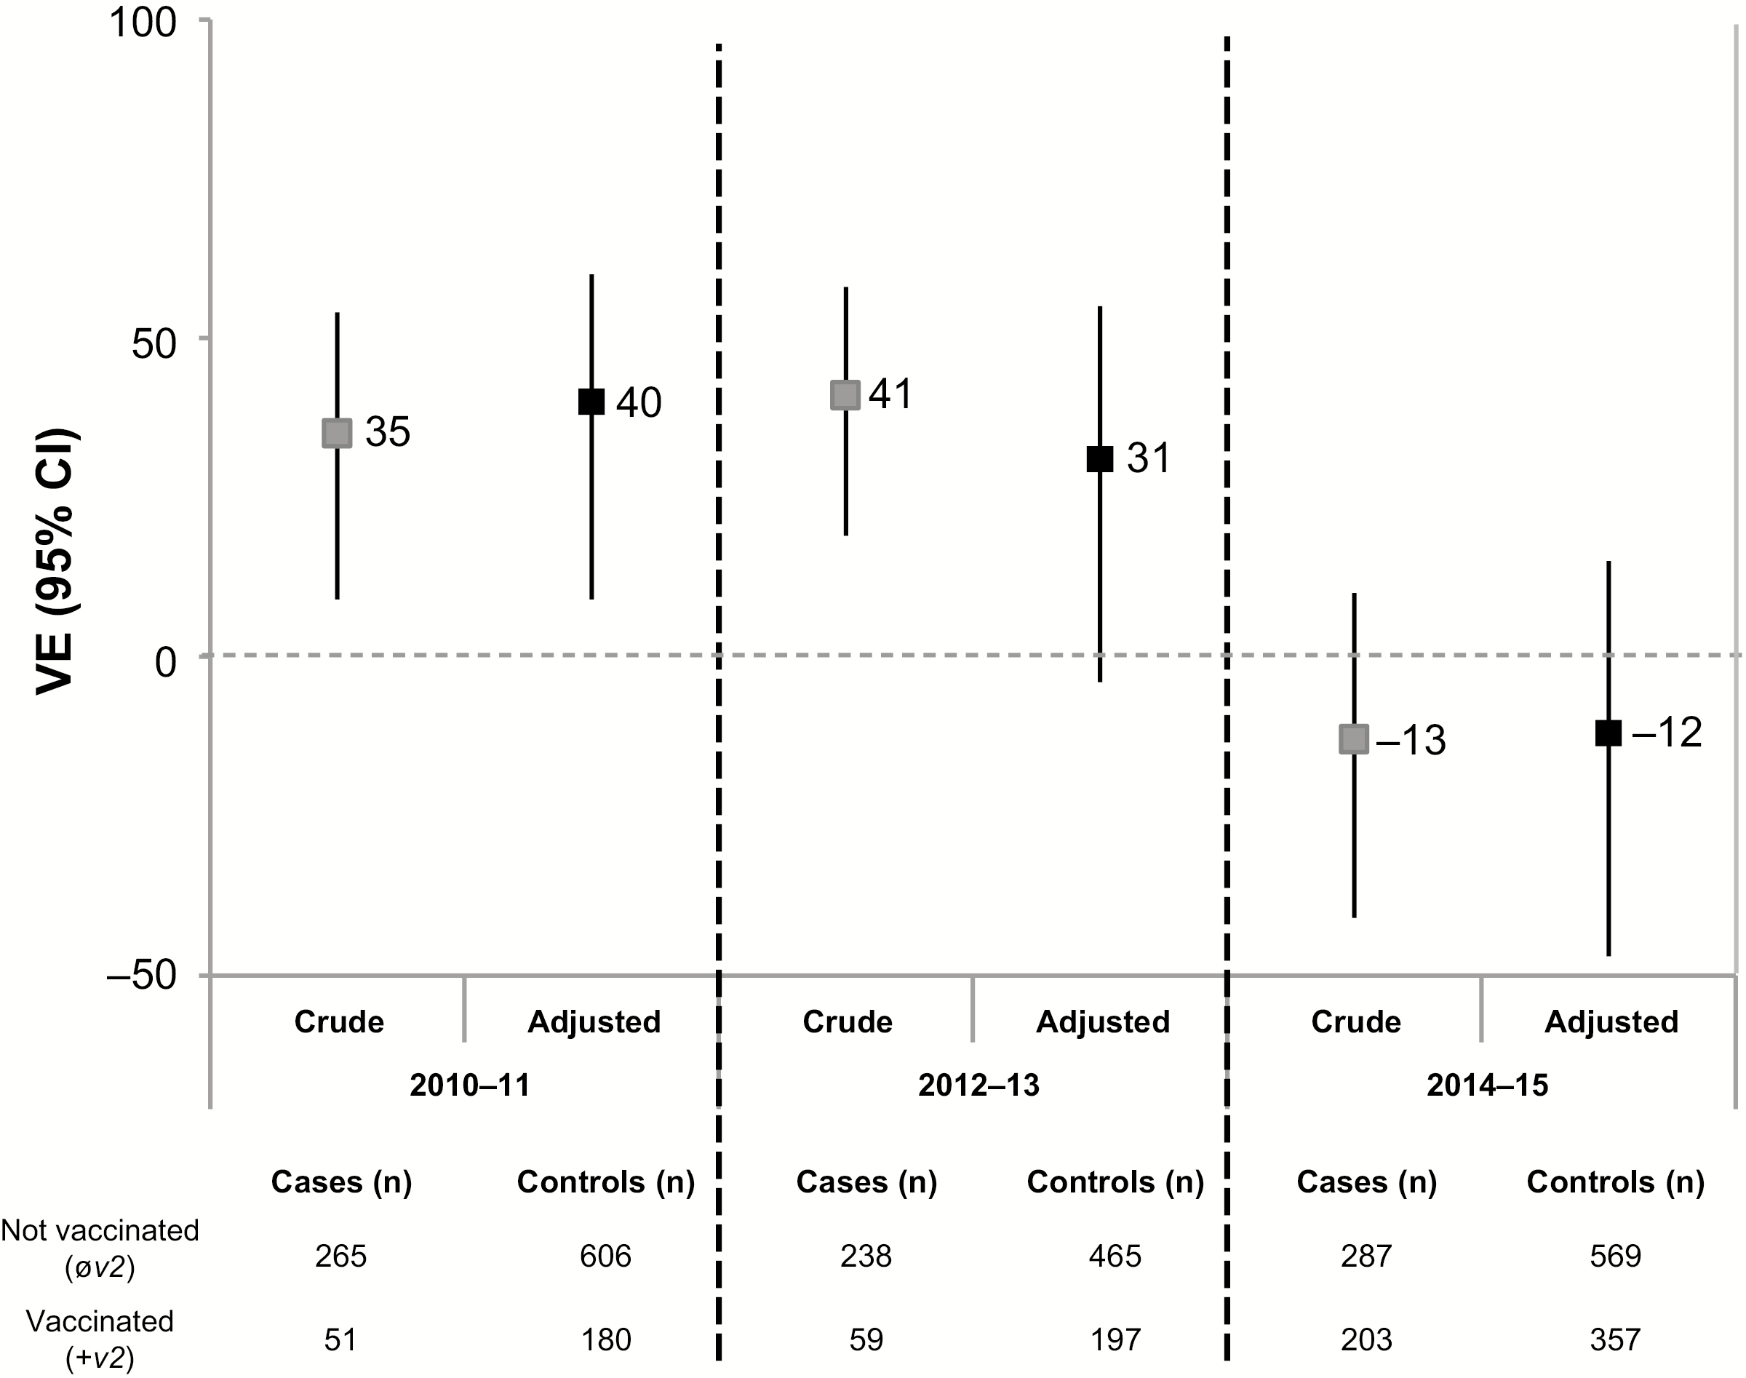
Figure 3. Crude and adjusted vaccine effectiveness (VE) estimates against influenza A(H3N2) among Canadian Sentinel ...
Notes:
Figure 3. Crude and adjusted vaccine effectiveness (VE) estimates against influenza A(H3N2) among Canadian Sentinel Practitioner Surveillance Network patients aged ≥9 years for current season’s vaccine (v2) regardless of prior season’s (±v1, ±v0) vaccination status, 2010–2011, 2012–2013, 2014–2015 seasons. The 2011–2012 and 2013–2014 seasons are excluded due to small number of A(H3N2) cases. Vaccine effectiveness is relative to participants not vaccinated in the current season (øv2, ±v1, ±v0) derived as (1 − odds ratio) × 100%. Analyses adjusted for age group, sex, comorbidity, province, collection interval, and week of specimen collection (cubic B-spline functions with 3 equal knots). Abbreviations: CI, confidence interval; VE, vaccine effectiveness; v0, vaccine of 2 prior season’s ago; v1, prior season’s vaccine; v2, current season’s vaccine.
Unless provided in the caption above, the following copyright applies to the content of this slide: © The Author 2017. Published by Oxford University Press for the Infectious Diseases Society of America. All rights reserved. For permissions, e-mail: journals.permissions@oup.com.

Slide 4
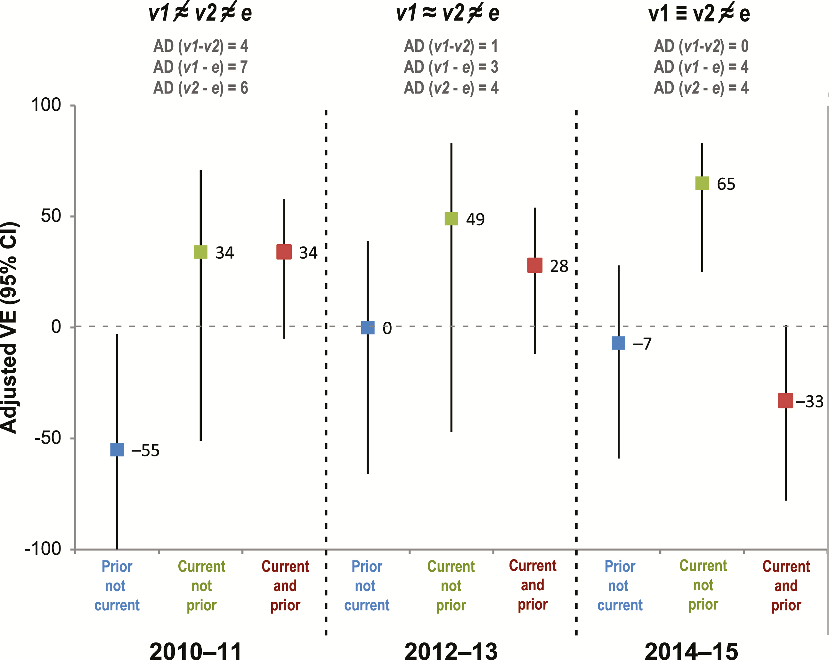
Figure 4. Adjusted vaccine effectiveness (VE) estimates against influenza A(H3N2) by current (v2) and/or prior (v1) ...
Notes:
Figure 4. Adjusted vaccine effectiveness (VE) estimates against influenza A(H3N2) by current (v2) and/or prior (v1) season’s vaccination history among Canadian Sentinel Practitioner Surveillance Network patients aged ≥9 years, specified by vaccine–virus relatedness conditions and season (2010–2011, 2012–2013, 2014–2015). The 2011–2012 and 2013–2014 seasons are excluded due to small number of A(H3N2) cases. Analyses adjusted for age group, sex, comorbidity, province, collection interval, and week of specimen collection (cubic B-spline functions with 3 equal knots). Vaccine effectiveness relative to participants not vaccinated in the current or prior season without taking into account vaccination status 2 prior seasons ago (øv2, øv1, ± v0). Abbreviations: AD, antigenic distance; CI, confidence interval; VE, vaccine effectiveness; v0, vaccine of 2 prior season’s ago; v1, prior season’s vaccine; v2, current season’s vaccine; ≈, antigenically related; ≠, not antigenically related; ≡, identical.
Unless provided in the caption above, the following copyright applies to the content of this slide: © The Author 2017. Published by Oxford University Press for the Infectious Diseases Society of America. All rights reserved. For permissions, e-mail: journals.permissions@oup.com.

