Slide 1
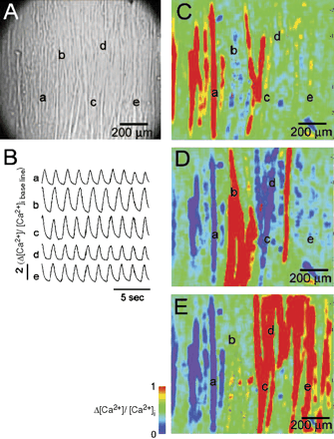
Fig. 2 Electrical compartmentation of SM sheets. (A) A light microscopic view of the matured SM (1 × 1 mm). The ...
Notes:
Fig. 2 Electrical compartmentation of SM sheets. (A) A light microscopic view of the matured SM (1 × 1 mm). The letters “a” to “e” correspond to the location of the intracellular Ca2+concentration ([Ca2+]i) estimation. (B) The [Ca2+]i was monitored following the addition of Fluo-3. Variations in the [Ca2+]i signal from “a” through to “e”, in panel A, were traced as the SM spontaneously contracted. Each signal at “a” and “b” displayed its own regular contracting rhythm, whereas signals traced from “c”, “d” and “e” had identical patterns of contraction. (C, D, E) Representative images of fluorescent signals for [Ca2+]i are shown. (C) An increase in [Ca2+]i was observed in the area surrounding area “a” when the other 4 spots were unexcited. (D) An increase in [Ca2+]i was noted only at “b” when “a”, “c”, ”d” and “e” were not excited. (E) The areas “c”, “d” and “e”, but not “a” and “b”, were excited. Note that “c”, “d” and “e” belonged to same syncytium, but “a” and “b” belonged to different syncytia. The SM cell sheet consisted of several compartments, and did not excite as a single tissue.
Unless provided in the caption above, the following copyright applies to the content of this slide: Copyright © 2005, European Society of Cardiology

Slide 2
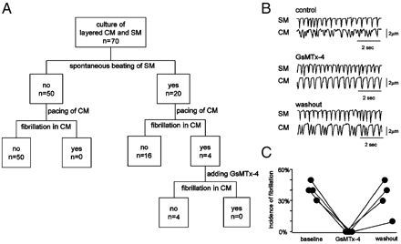
Fig. 7 Incidence of fibrillation-like contraction in CM and the effect of GsMTx-4. (A) Incidence of ...
Notes:
Fig. 7 Incidence of fibrillation-like contraction in CM and the effect of GsMTx-4. (A) Incidence of fibrillation-like contraction in CM sheets co-cultured with SM sheets. Fibrillation-like contraction was observed in 5.7% (4/70) of cases, and was always observed when the co-cultured SM sheets contracted spontaneously at the overlaid area. (B) Representative tracing of the fibrillation-like contraction in the co-culture system. The stretch-activated ion channel blocker GsMTx-4 abolished these arrhythmias. After removing GsMTx-4 by washing, the arrhythmia reappeared. (C) Effect of GsMTx-4 on the fibrillation-like contraction. GsMTx-4 completely abolished the arrhythmia in all four samples.
Unless provided in the caption above, the following copyright applies to the content of this slide: Copyright © 2005, European Society of Cardiology

Slide 3
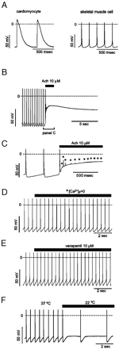
Fig. 1 Electrophysiological properties of skeletal muscle cells. (A) Typical action potentials of the cultured ...
Notes:
Fig. 1 Electrophysiological properties of skeletal muscle cells. (A) Typical action potentials of the cultured cardiomyocytes (CM) and skeletal muscle cells (SM). SM occasionally displays automaticity as shown in the right panel. (B,C) Acetylcholine (Ach) caused marked depolarization (upper panel) and extrasystolic activity (* in lower panel) in SM. (D, E) Extracellular Ca2+([Ca2+]o) was replaced with equimolar levels of Mg2+. The automaticity of SM was not affected by the absence of extracellular Ca2+([Ca2+]o=0) or by verapamil. (F) The cooling of the SM perfusate from 37 °C to 22 °C decreased the rate of the spontaneous rhythm without affecting slope of the pacemaker-like potential.
Unless provided in the caption above, the following copyright applies to the content of this slide: Copyright © 2005, European Society of Cardiology

Slide 4
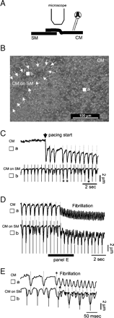
Fig. 3 Fibrillation-like contraction in the CM sheet co-cultured with the SM sheet. (A) Schematic illustration of ...
Notes:
Fig. 3 Fibrillation-like contraction in the CM sheet co-cultured with the SM sheet. (A) Schematic illustration of the observed area where a part of the CM sheet was laid on top of the SM sheet. (B) Light microscopic view of the overlapping area of the SM and CM sheets. The skeletal myotubes contracting spontaneously, were located at “b” under the CM sheet (enclosed by the white arrows). (C) The length of the movement of the cells at the marked points, “a” in the CM sheet and “b” in the overlaid CM and SM sheets, was traced using the video motion analyzer. Complete dissociation of the contracting rhythm between CM and SM was observed after pacing was initiated on the CM sheet. Increased movement of the cell (*) at the “b” was observed following coincidental simultaneous contraction of the SM and CM. (D) Twenty-eight seconds after the onset of pacing, fibrillation-like contraction was observed in the CM. (E) Magnification of the trace at the onset of fibrillation-like contraction. Spontaneous contraction of skeletal myotube occurred immediately after the third contraction of CM (*), and was then followed by fibrillation.
Unless provided in the caption above, the following copyright applies to the content of this slide: Copyright © 2005, European Society of Cardiology

Slide 5
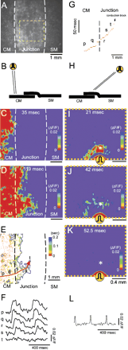
Fig. 4 Electrical disconnection between SM and CM sheets. (A) A representative light microscopic view of the ...
Notes:
Fig. 4 Electrical disconnection between SM and CM sheets. (A) A representative light microscopic view of the co-cultured CM and SM sheets at day 3 after manipulation. White dotted lines indicate the boundary between cell types, and the yellow dotted line indicates the observation area in experiment H to L. (B, H) Schematic illustration of the arrangement of the two sheets. The Yellow symbol denotes the pacing electrode. (C, D) Optical mapping of the action potential was recorded using di-4-ANEPPS. The edge of the CM sheet was paced, and sequential optical images of action potentials after 35 ms (C) and 119 ms (D) were shown. Propagation of the action potentials was blocked at the center of the junction. (E) Activation map of action potentials presented isochronally (the interval between each isochronal line denotes 7 ms). The red line with an arrowhead shows a trace of the excitation wave front. (F) The recorded electrical potentials of the points, “p” to “t” in Panel E. Wide duration of these action potentials indicated that the signals originated from CMs. (G) The sequence of impulse propagation along the excitation wave front. (I, J, K) Optical images of the yellow dotted box area in Panel A after pacing the surface of the SM sheet at 21 (I), 42.5 (J) and 52.5 (K) ms after pacing. The pacing electrode was located just above the excitation wave limit after CM pacing. (L) A typical narrow action potential was recorded at the point “*”, suggesting that this optical image was obtained from SM not CM.
Unless provided in the caption above, the following copyright applies to the content of this slide: Copyright © 2005, European Society of Cardiology

Slide 6
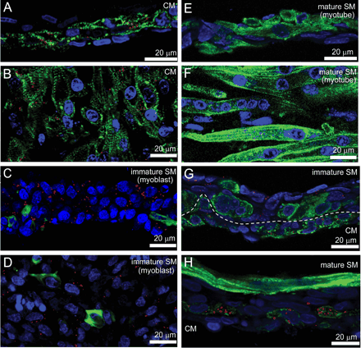
Fig. 5 Immunofluorescent staining of the CM and SM sheets. (A–F) Confocal laser microscopic images of the cardiac ...
Notes:
Fig. 5 Immunofluorescent staining of the CM and SM sheets. (A–F) Confocal laser microscopic images of the cardiac (A, B), immature skeletal (C, D) and mature skeletal (E, F) muscle cell sheet in cross-sectional views (A, C, E) and overhead views (B, D, F). Images show staining of α-actinin (green), connexin43 (red), and nuclei (blue). (A, B) Staining shows connexin43 expression at the boundary of each cardiomyocyte. (C, D) The immature SM sheet at day 1(mainly myoblasts), which expresses abundant connexin43. (E, F) Most SMs complete maturation at day 7. Mature SMs do not express connexin43. (G) Immunostaining after CM and SM sheets were overlaid for 3 days. Both mature and immature SMs are observed in the SM layer. The border between the CM and SM is morphologically distinguishable. (dotted line denotes the margin of CM and SM). Some cells in the immature SM area had differentiated into skeletal myotubes. Connexin43 is observed in the cells that do not express α-actinin, but not in differentiated SM. (H) Immunostaining at day 7. Long and multinuclear myotubes are observed in the SM layer. These cells do not express connexin43. The border between the CM and SM is easily distinguishable. There is no gap junction between CM and mature SM.
Unless provided in the caption above, the following copyright applies to the content of this slide: Copyright © 2005, European Society of Cardiology

Slide 7
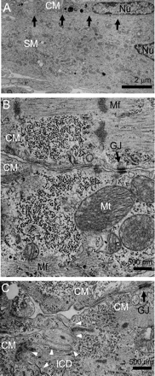
Fig. 6 Transmission electron micrographs of the 3-day-old co-cultured CM and SM sheets. (A) Low magnification ...
Notes:
Fig. 6 Transmission electron micrographs of the 3-day-old co-cultured CM and SM sheets. (A) Low magnification overview of a representative junction between CM and SM (arrows). No intercaleted disks or gap junctions are observed. Nu, nucleus. (B) Well-differentiated myofilaments (Mf) and abundant mitochonrdia (Mt) in the CM are shown. Gap junctions (GJ) are observed between CMs. (C) Intercalated disk (ICD) is observed between CMs (arrow heads).
Unless provided in the caption above, the following copyright applies to the content of this slide: Copyright © 2005, European Society of Cardiology

