Slide 1
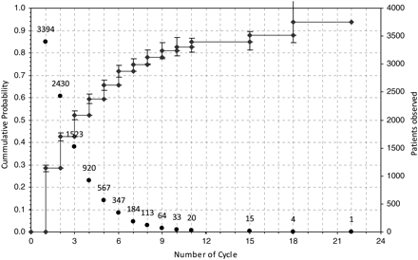
Figure 1 Overall CLBR (means ± 2 standard errors to give the 95% region) for all patients and age classes over the ...
Notes:
Figure 1 Overall CLBR (means ± 2 standard errors to give the 95% region) for all patients and age classes over the number of treatment cycles. For each cycle, the number of ‘patients observed’ up to this time is given.
Unless provided in the caption above, the following copyright applies to the content of this slide: © The Author 2011. Published by Oxford University Press on behalf of the European Society of Human Reproduction and Embryology. All rights reserved. For Permissions, please email: journals.permissions@oup.com

Slide 2
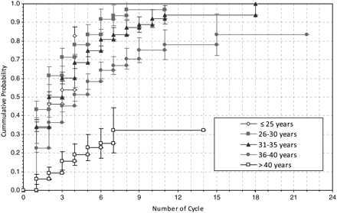
Figure 2 CLBRs (means ± 2 standard errors to give the 95% region) for all patients stratified for the different age ...
Notes:
Figure 2 CLBRs (means ± 2 standard errors to give the 95% region) for all patients stratified for the different age groups.
Unless provided in the caption above, the following copyright applies to the content of this slide: © The Author 2011. Published by Oxford University Press on behalf of the European Society of Human Reproduction and Embryology. All rights reserved. For Permissions, please email: journals.permissions@oup.com

Slide 3
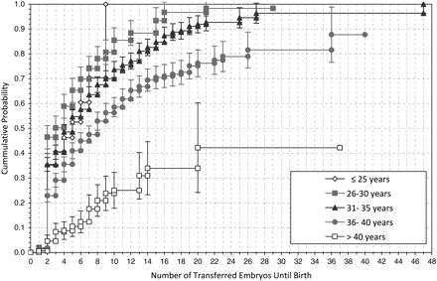
Figure 3 CLBRs (means ± 2 standard errors to give the 95% region) for all patients stratified for the different age ...
Notes:
Figure 3 CLBRs (means ± 2 standard errors to give the 95% region) for all patients stratified for the different age groups over the number of transferred embryos.
Unless provided in the caption above, the following copyright applies to the content of this slide: © The Author 2011. Published by Oxford University Press on behalf of the European Society of Human Reproduction and Embryology. All rights reserved. For Permissions, please email: journals.permissions@oup.com

Slide 4
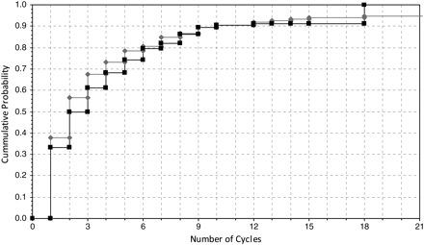
Figure 4 CPRs after ART (squares, 3394 patients) and CPRs in natural cycles [(Gnoth et al., 2003), diamonds, 340 ...
Notes:
Figure 4 CPRs after ART (squares, 3394 patients) and CPRs in natural cycles [(Gnoth et al., 2003), diamonds, 340 patients].
Unless provided in the caption above, the following copyright applies to the content of this slide: © The Author 2011. Published by Oxford University Press on behalf of the European Society of Human Reproduction and Embryology. All rights reserved. For Permissions, please email: journals.permissions@oup.com

