Slide 1
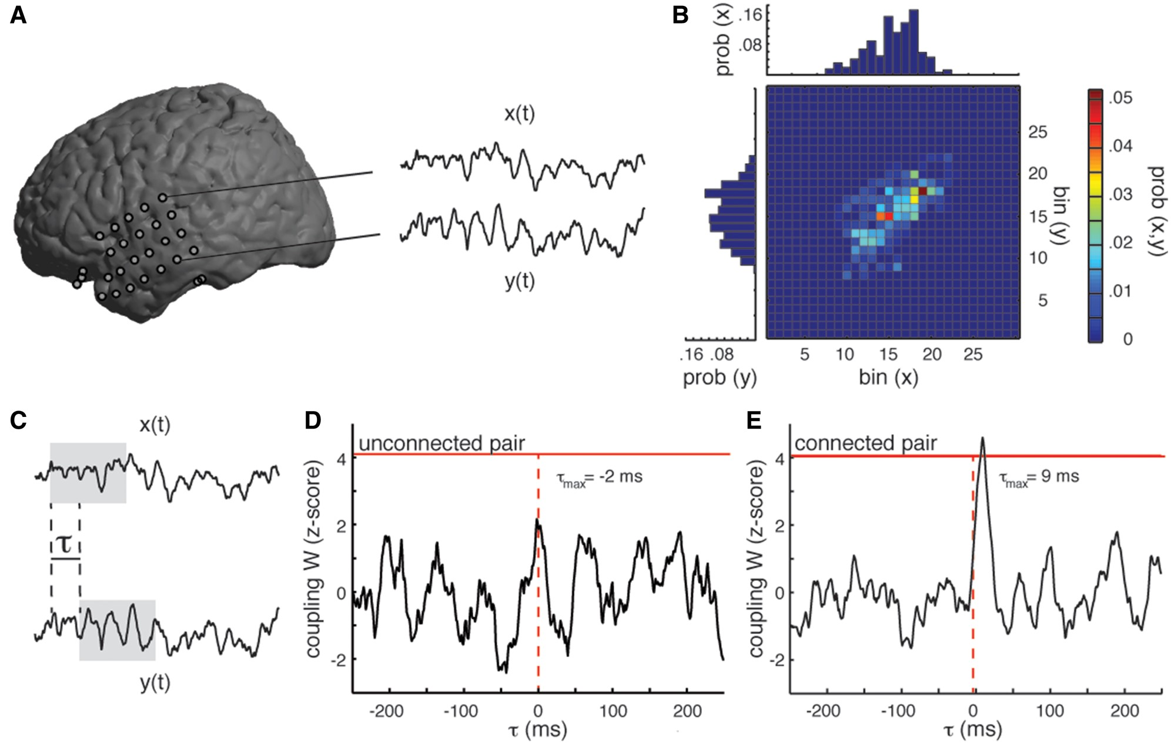
(1) Time-lagged mutual information as a measure of effective connectivity. (A) Local field potential signals, ...
Notes:
(1) Time-lagged mutual information as a measure of effective connectivity. (A) Local field potential signals, x(t) and y(t), are captured from two electrode contacts placed for seizure monitoring. (B) Joint and marginal probability distributions are estimated from discretized voltages from each time series. (C) The average mutual information between x(t) and y(t) is computed for every temporal offset, τ. (D) The relation between z-scored coupling W and temporal offset τ for an electrode pair that is not effectively connected. (E) The maximum coupling, W (τmax), for this electrode pair occurs at a time delay of 9 ms; it exceeds a global threshold, and so this electrode pair is considered to be effectively connected.
Unless provided in the caption above, the following copyright applies to the content of this slide: Published by Oxford University Press on behalf of the Guarantors of Brain 2017. This work is written by US Government employees and is in the public domain in the United States.

Slide 2
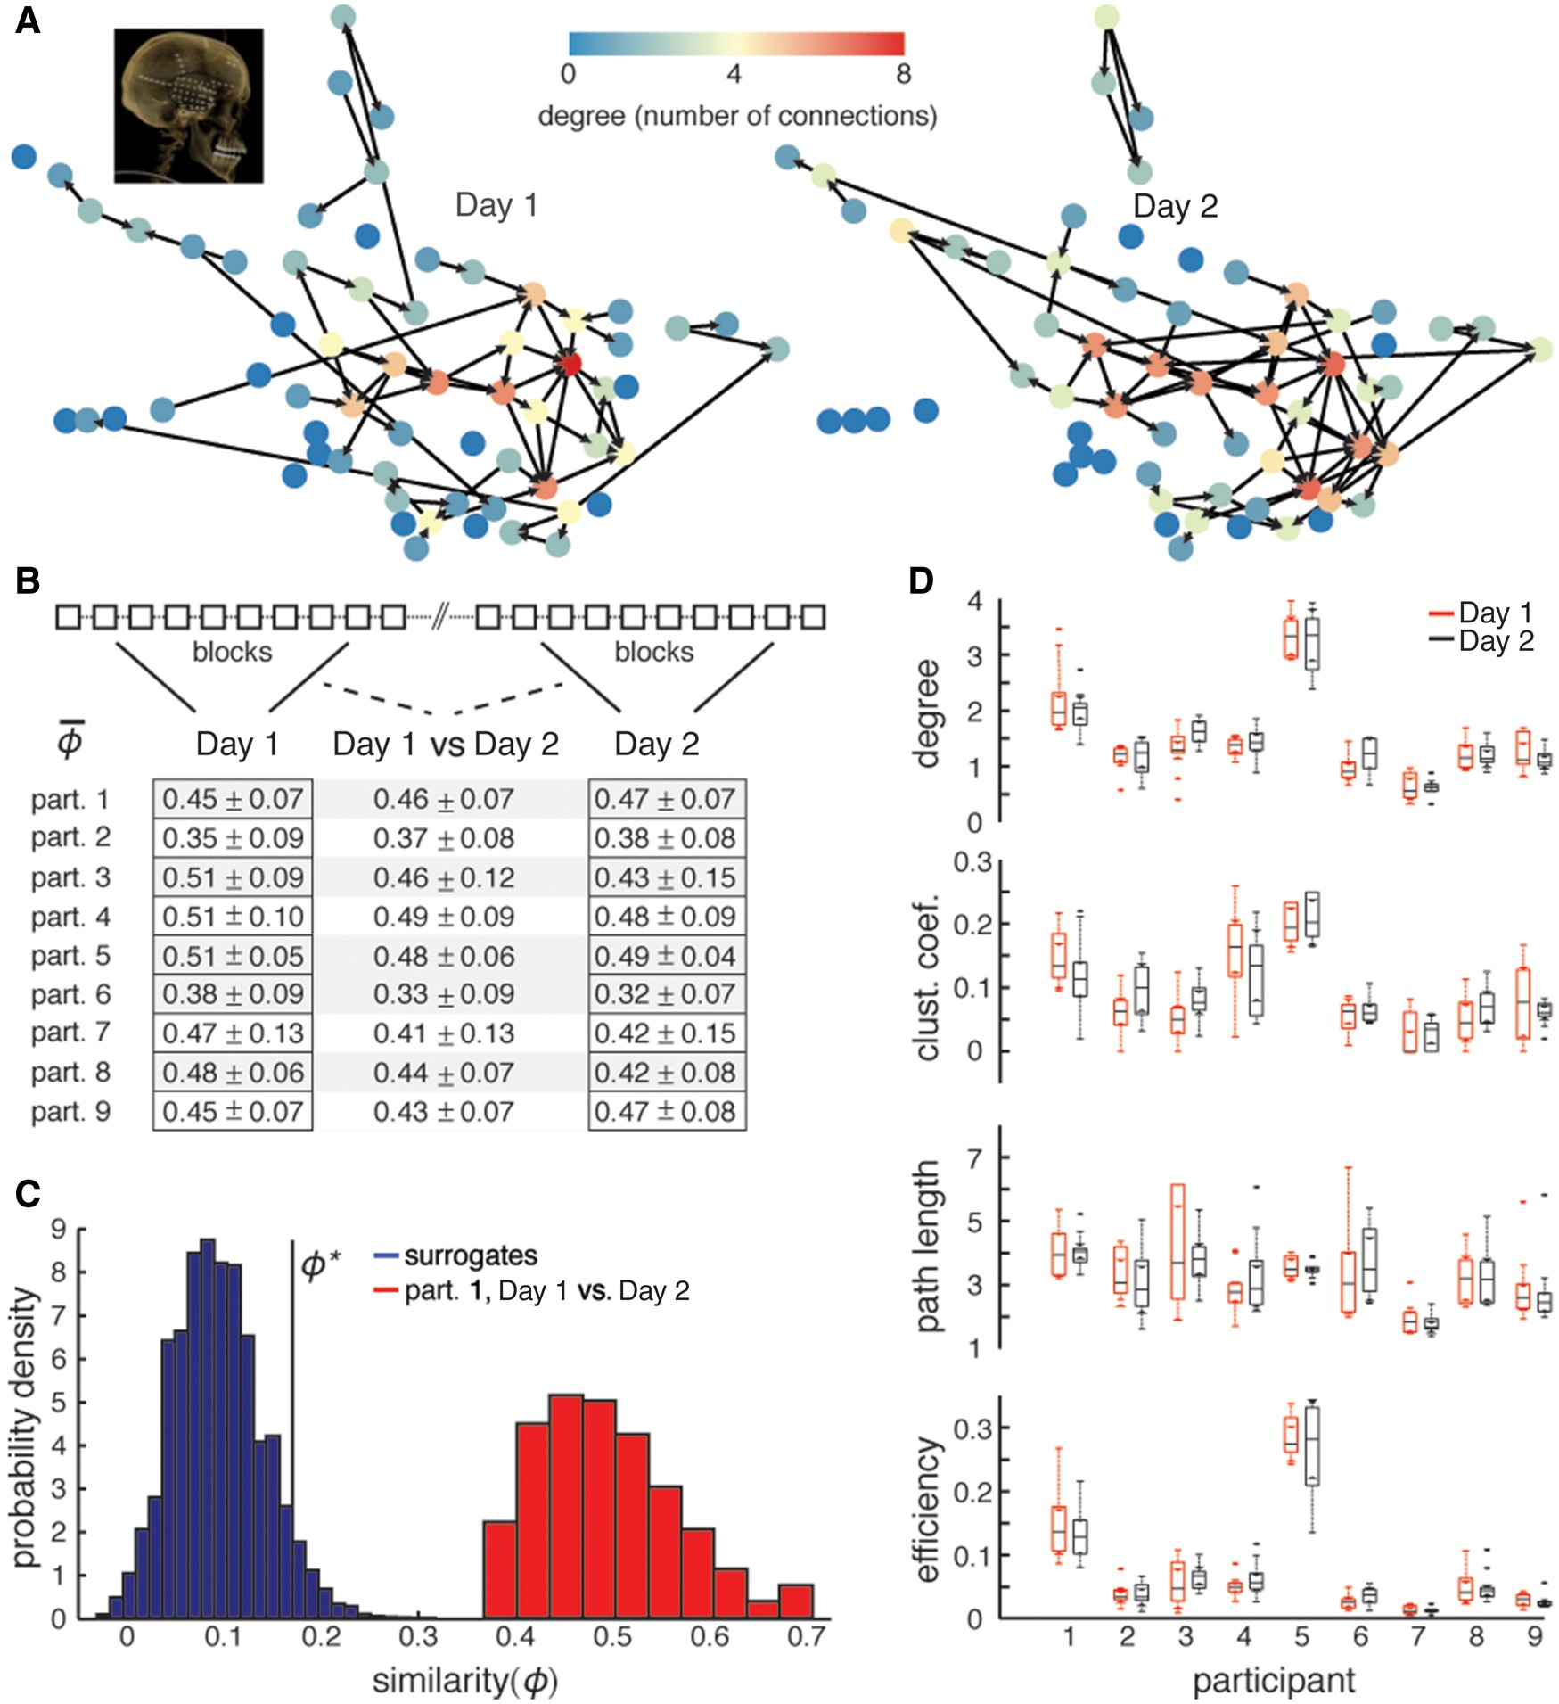
Figure 2 Stability of network connectivity and topology. (A) Functional networks calculated for a single participant ...
Notes:
Figure 2 Stability of network connectivity and topology. (A) Functional networks calculated for a single participant on different days exhibit similar profiles (inset, CT scan showing electrode locations). Nodes are placed according to 3D coordinates of the electrodes they represent, and each edge represents an effective connection. The colour of each node represents its degree. (B) The average similarity, ϕ- ?>, between networks from 10 blocks recorded in the same day, as well as between networks from different days, is significantly larger than zero for all participants (mean ± SD). (C) The probability densities of surrogate similarities and of Day 1 versus Day 2 similarities are shown in blue and red, respectively for Participant 1. The average similarity between networks from different days is significantly larger than the similarity between degree-matched surrogate networks. ϕ* represents P = 0.05. (D) The distributions of degree, characteristic clustering coefficient, characteristic path length, and global efficiency are not significantly different for each participant from day to day, but show differences between participants. Each pair of Tukey boxplots represents the distributions of network metrics for Day 1 (black) and Day 2 (red) for one participant. The whiskers cover points within 1.5 IQR of the first and third quartile (where IQR is the inter-quartile range); values outside of this range are considered outliers and are represented by individual points. The notches (triangles) are placed at the median ± 1.57 IQR/√n, where n is the number of networks from each day (n = 10).
Unless provided in the caption above, the following copyright applies to the content of this slide: Published by Oxford University Press on behalf of the Guarantors of Brain 2017. This work is written by US Government employees and is in the public domain in the United States.

Slide 3
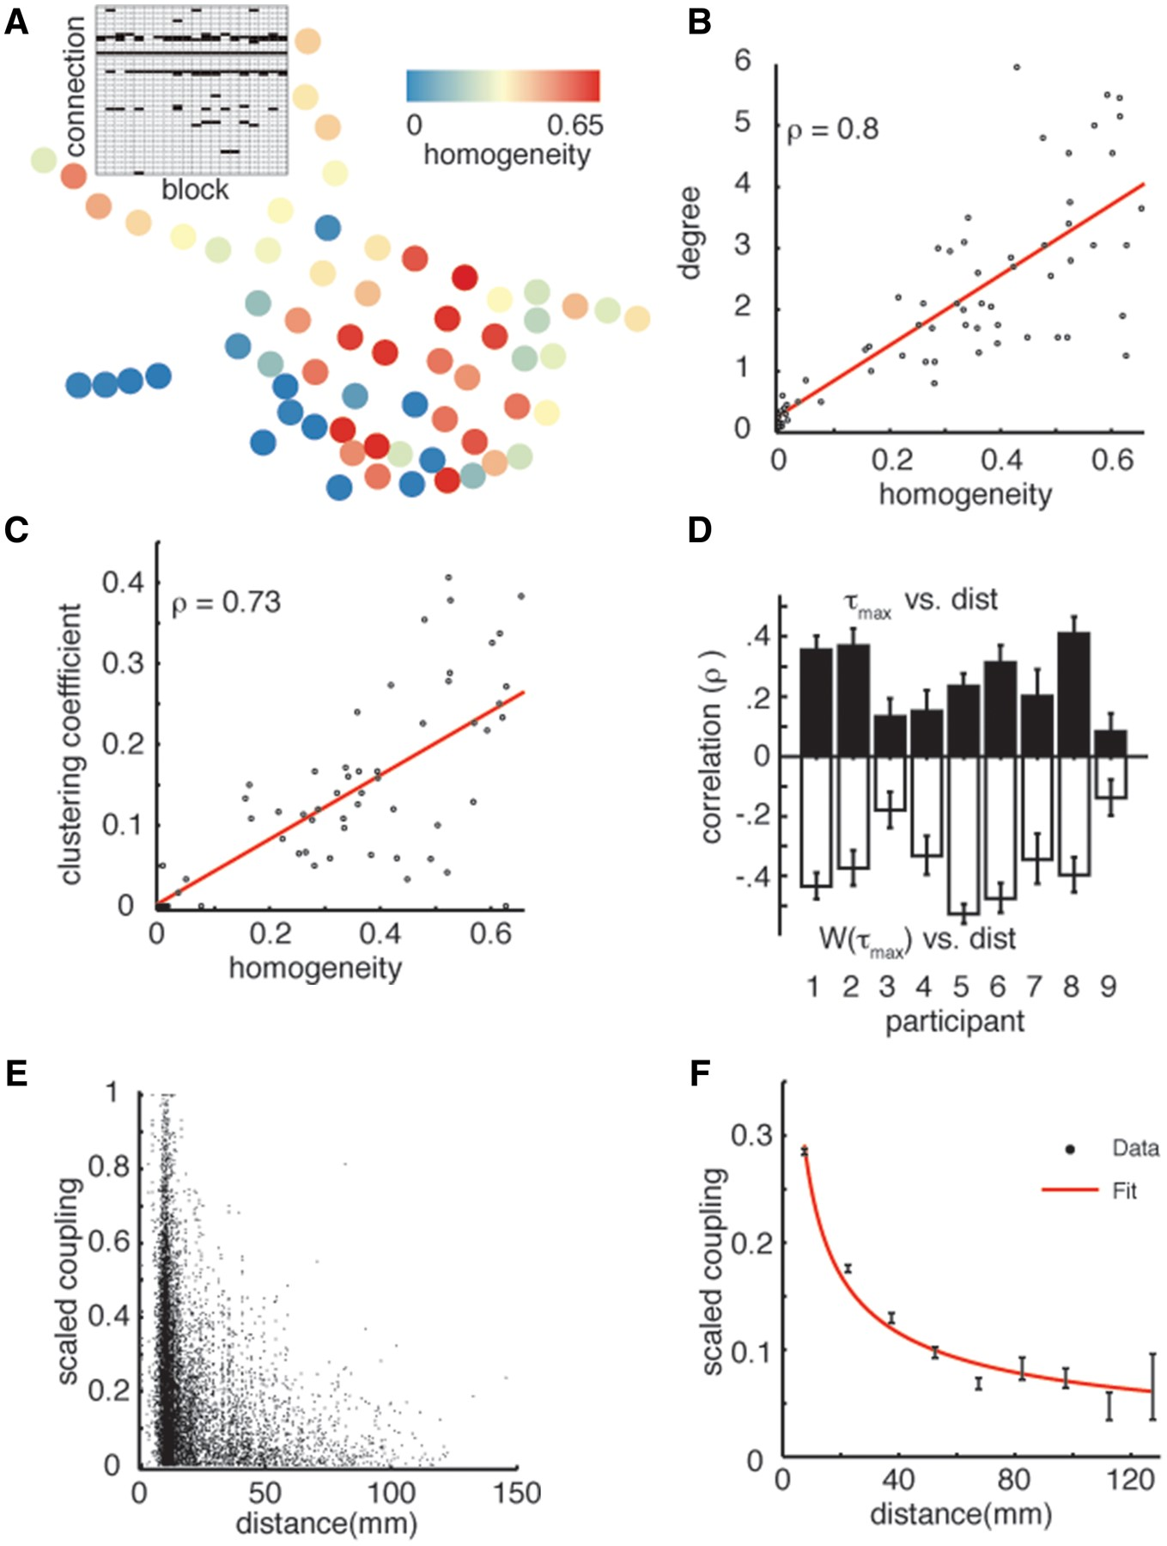
Figure 3 Contributions to stability. (A) The spatial distribution of homogeneity for all nodes in a single participant ...
Notes:
Figure 3 Contributions to stability. (A) The spatial distribution of homogeneity for all nodes in a single participant is not uniform. The connections for a single node during all data blocks can be represented by a connectivity matrix (inset). Every row represents a possible connection with another node, and every column represents a data block. Every black bar represents a functional connection. (B) The correlation between node homogeneity and its degree for all nodes in a single participant. (C) The correlation between node homogeneity and its clustering coefficient for all nodes in the same participant. (D) Correlations of latency (τmax, top) and coupling strength [W(τmax), bottom] to distance between electrodes for all participants. Error bars represent 95% confidence intervals across all data blocks. (E) Scatter plots of scaled coupling pooled across participants versus distance. (F) The black bars represent the mean and standard error in scaled coupling within 15 mm bins. The red curve is the fit of a power law model to the data (adjusted R2 = 0.97).
Unless provided in the caption above, the following copyright applies to the content of this slide: Published by Oxford University Press on behalf of the Guarantors of Brain 2017. This work is written by US Government employees and is in the public domain in the United States.

Slide 4
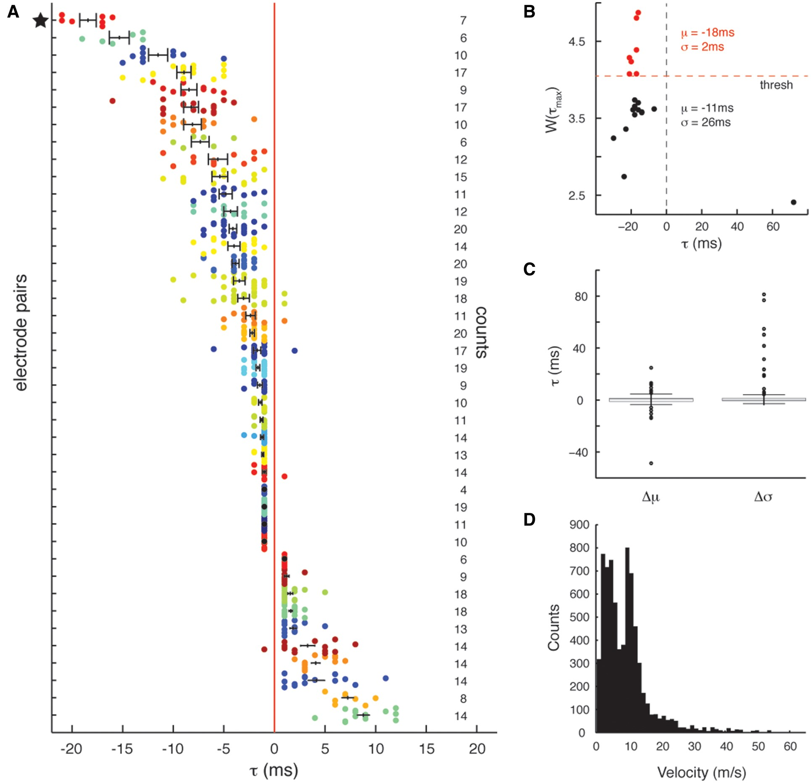
Figure 4 Stability of connection latencies. (A) Latencies for individual electrode pairs during different data blocks ...
Notes:
Figure 4 Stability of connection latencies. (A) Latencies for individual electrode pairs during different data blocks for Participant 1. Only electrode pairs for which the distribution of τ’s was significantly different from zero are shown (Bonferroni corrected). Each point represents the latency during a data block exhibiting significant coupling. Each row of points represents the latencies for a single electrode pair for blocks with significant coupling. Black bars represent the mean and standard error of the distribution of latencies for each electrode pair. The counts on the right represent the number of data blocks, out of 20 possible, in which that electrode pair exhibited an effective connection. (B) For one electrode pair (star symbol in A), the maximum coupling, W (τmax) and latency, τmax, are shown for all data blocks. Data blocks with significant (non-significant) coupling are shown in red (black). Only one data block, with a low maximum coupling strength, exhibited a noticeably different latency. (C) Tukey boxplots of the difference in mean (left) and standard deviation (right) of latencies between data blocks without and with significant coupling, pooled across all participants. The whiskers cover points within 1.5 IQR of the first and third quartile, and outliers are designated as individual points. (D) Distribution of conduction velocity estimates obtained by dividing interelectrode distance by the latency, τmax, for connections present in at least four blocks.
Unless provided in the caption above, the following copyright applies to the content of this slide: Published by Oxford University Press on behalf of the Guarantors of Brain 2017. This work is written by US Government employees and is in the public domain in the United States.

Slide 5
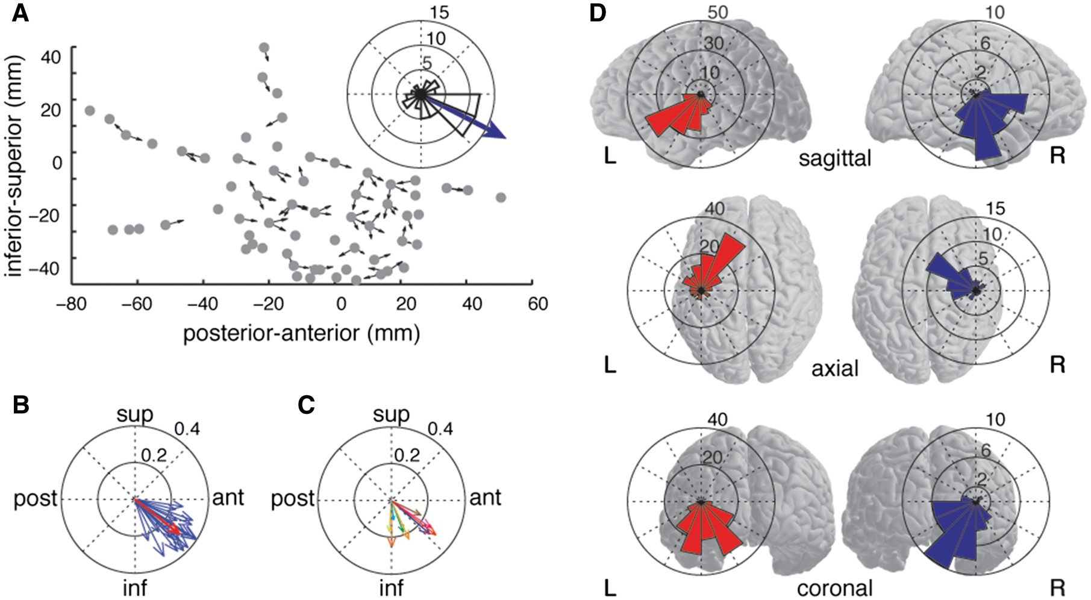
Figure 5 Network directionality. (A) Effective connections in an individual network in one participant can be ...
Notes:
Figure 5 Network directionality. (A) Effective connections in an individual network in one participant can be represented as unit vectors pointing from one electrode to the other, with the direction being determined by the sign of that connection’s latency (inset, histogram of directions and mean vector for a single network projected on to the sagittal plane). (B) Projection of the mean vector for all networks from one participant on to the sagittal plane (radial scale in millimetres). The red vector indicates the overall mean vector across all networks for this participant. (C) The overall mean vectors for all participants show a preferred posterior-superior to anterior-inferior direction. (D) Histograms of directions for mean network vectors for all participants projected onto the sagittal, axial, and coronal planes. Each participant contributes 20 vectors, corresponding to the functional networks computed for each data block. The left and right columns correspond to participants with electrodes placed over the left and right temporal lobes, respectively.
Unless provided in the caption above, the following copyright applies to the content of this slide: Published by Oxford University Press on behalf of the Guarantors of Brain 2017. This work is written by US Government employees and is in the public domain in the United States.

Slide 6
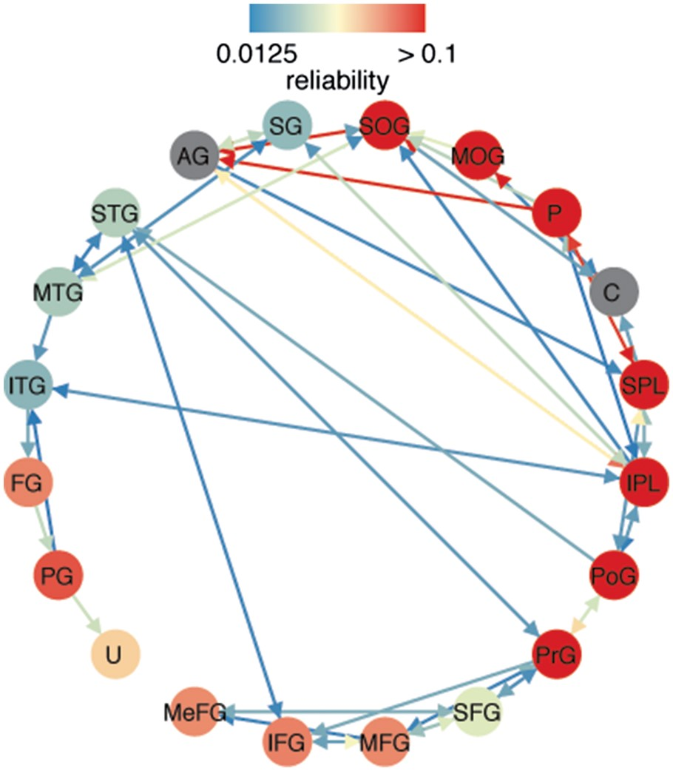
Figure 6 Anatomical network. Each node represents a distinct anatomical region containing electrode contacts from at ...
Notes:
Figure 6 Anatomical network. Each node represents a distinct anatomical region containing electrode contacts from at least three participants, and each edge represents a connection between two regions. The reliability of a connection between two regions is represented by the colour of the edge. We display edges only if the reliability of that connection was in the top 15% of all connections. Because most regions contain multiple electrodes, the reliability of connections within each region was calculated and is represented by the colour of each node. Nodes that are coloured grey did not have enough electrode coverage to compute the within region reliability. AG = angular gyrus; C = cuneus; FG = fusiform gyrus; IFG = inferior frontal gyrus; IPL = inferior parietal lobule; ITG = inferior temporal gyrus; MeFG = medial frontal gyrus; MGF = middle frontal gyrus; MOG = middle occipital gyrus; MTG = middle temporal gyrus; PG = parahippocampal gyrus; PoG = postcentral gyrus; PrG = precentral gyrus; P = precuneus; SFG = superior frontal gyrus; SOG = superior occipital gyrus; SPL = superior parietal lobule; STG = superior temporal gyrus; SG = supramarginal gyrus; U = uncus.
Unless provided in the caption above, the following copyright applies to the content of this slide: Published by Oxford University Press on behalf of the Guarantors of Brain 2017. This work is written by US Government employees and is in the public domain in the United States.

