Slide 1
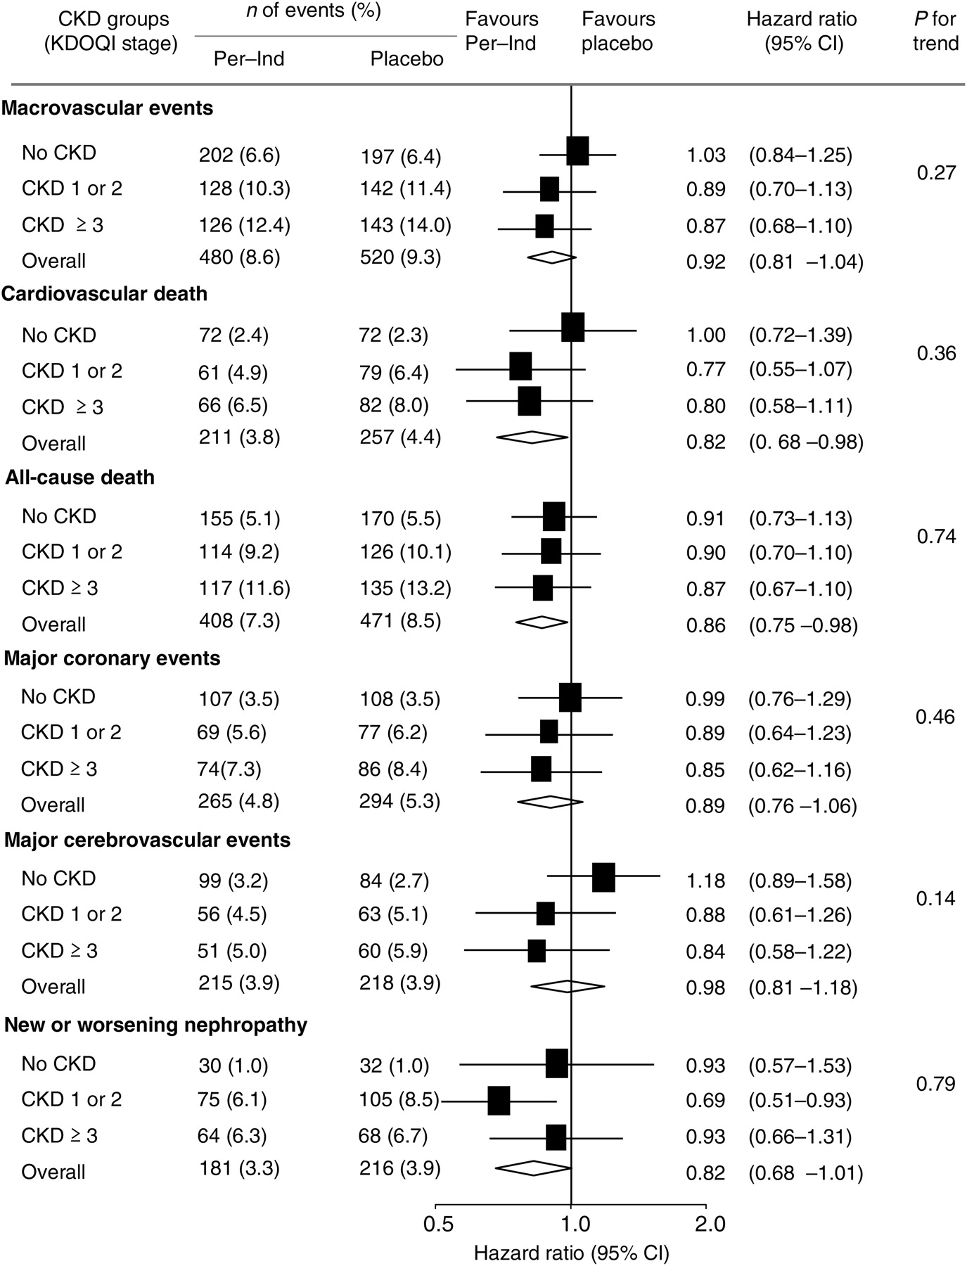
Figure 1 Effect of randomized treatment on the risk for cardiovascular or renal outcomes in patients according to ...
Notes:
Figure 1 Effect of randomized treatment on the risk for cardiovascular or renal outcomes in patients according to baseline KDOQI CKD stage. The centre of the diamond represents the overall estimate and the width its 95% confidence interval (CI) as previously reported by Patel et al.6 Solid boxes represent estimates of treatment effects in subgroups, and the horizontal line represents the 95% CI. The ‘P for trend’ tested the consistency of treatment effect in subgoups.
Unless provided in the caption above, the following copyright applies to the content of this slide: Published on behalf of the European Society of Cardiology. All rights reserved. © The Author 2010. For permissions please email: journals.permissions@oxfordjournals.org

Slide 2
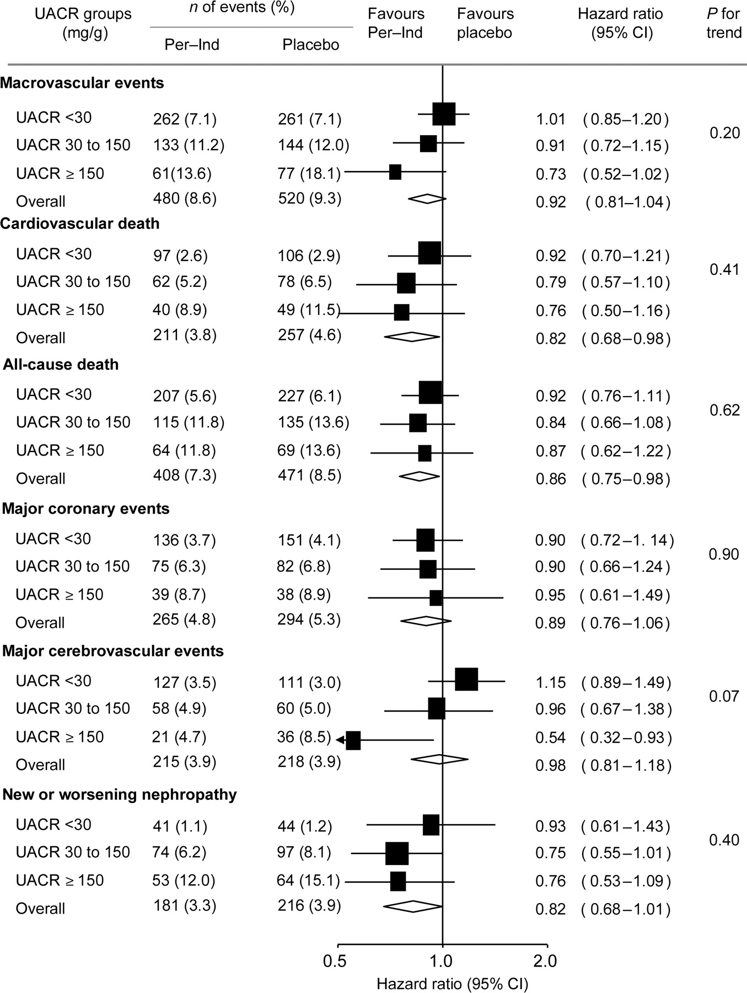
Figure 2 Effect of randomized treatment on the risk for cardiovascular or renal outcomes in patients according to ...
Notes:
Figure 2 Effect of randomized treatment on the risk for cardiovascular or renal outcomes in patients according to baseline UACR. The centre of the diamond represents the overall estimate and the width its 95% CI as previously reported by Patel et al.6 Solid boxes represent estimates of treatment effects in subgroups, and the horizontal line represents the 95% CI. The ‘P for trend’ tested the consistency of treatment effect in subgoups.
Unless provided in the caption above, the following copyright applies to the content of this slide: Published on behalf of the European Society of Cardiology. All rights reserved. © The Author 2010. For permissions please email: journals.permissions@oxfordjournals.org

Slide 3
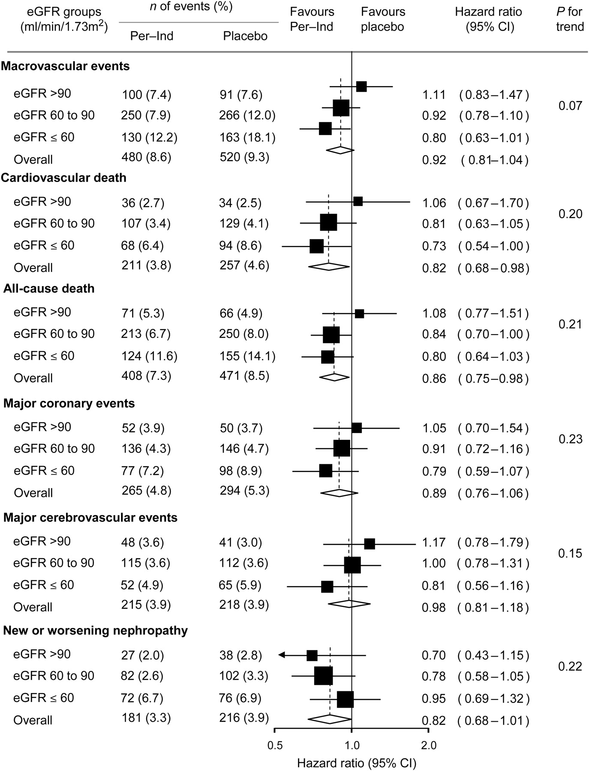
Figure 3 Effect of randomized treatment on the risk for cardiovascular or renal outcomes in patients according to ...
Notes:
Figure 3 Effect of randomized treatment on the risk for cardiovascular or renal outcomes in patients according to baseline eGFR. The centre of the diamond represents the overall estimate and the width its 95% CI as previously reported by Patel et al.6 Solid boxes represent estimates of treatment effects in subgroups, and the horizontal line represents the 95% CI. The ‘P for trend’ tested the consistency of treatment effect in subgoups.
Unless provided in the caption above, the following copyright applies to the content of this slide: Published on behalf of the European Society of Cardiology. All rights reserved. © The Author 2010. For permissions please email: journals.permissions@oxfordjournals.org

