Slide 1
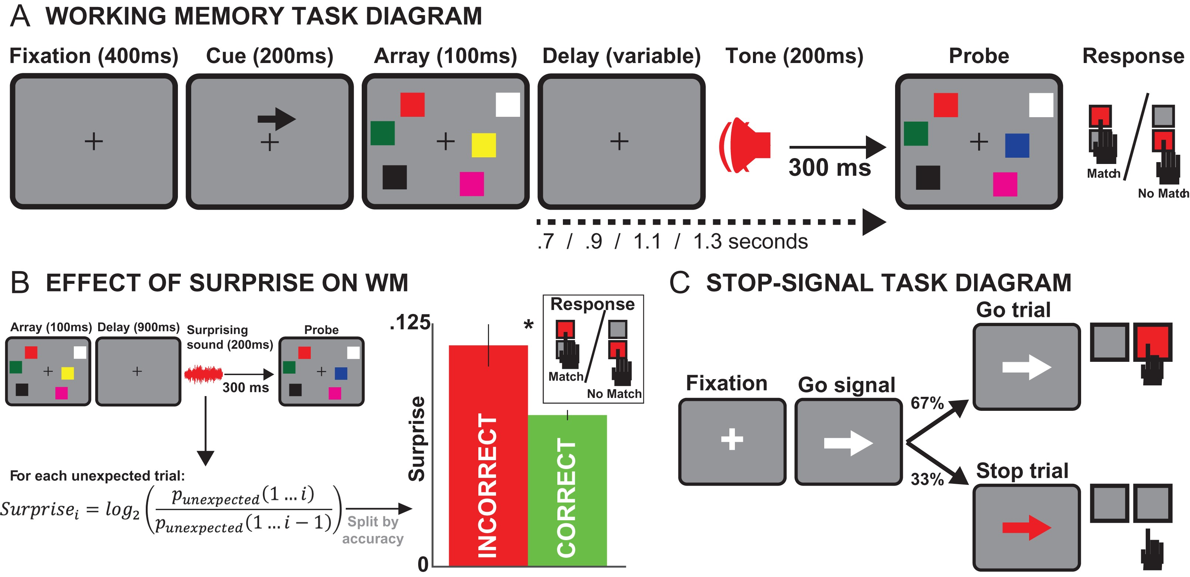
Figure 1. (A) Diagram of a single trial in the WM task. An initial fixation of 400 ms duration is followed by a cue ...
Notes:
Figure 1. (A) Diagram of a single trial in the WM task. An initial fixation of 400 ms duration is followed by a cue which indicates the side of the following array to attend to (200 ms), after which the WM array appears for 100 ms. The following delay interval varies in duration (0.7, 0.9, 1.1 or 1.3 s long). Of note, 300 ms before the end of the delay interval, a tone of 200 ms duration is played. On all trials with a delay interval of 0.7, 1.1, or 1.3 s, this tone was a sine wave tone (600 Hz). In the 0.9-s delay interval condition, a birdsong segment of equal volume and duration was played instead of the sine wave on half of the trials (overall probability across all trials: 1/6). At the end of the interval, a second array was presented, with identical positioning of the squares. However, on the cued side, in 50% of cases, one of the squares changed its color compared to the first array. Upon appearance of the second array (probe), participants had 2000 ms to indicate whether the 2 arrays were identical or not. After each response, the next trial began. (B) Behavioral analysis and results: For each surprising tone, we quantified the degree of surprise using a Bayesian equation, and then split the trials with surprising tones by response accuracy on the WM probe. We found that trials with erroneous responses on the WM probe (red bar) were associated with greater degrees of surprise than trials with correct responses (green bar). Error bar denotes 1 SEM. (C) SST diagram.
Unless provided in the caption above, the following copyright applies to the content of this slide: © The Author 2016. Published by Oxford University Press. All rights reserved. For Permissions, please e-mail: journals.permissions@oup.com

Slide 2
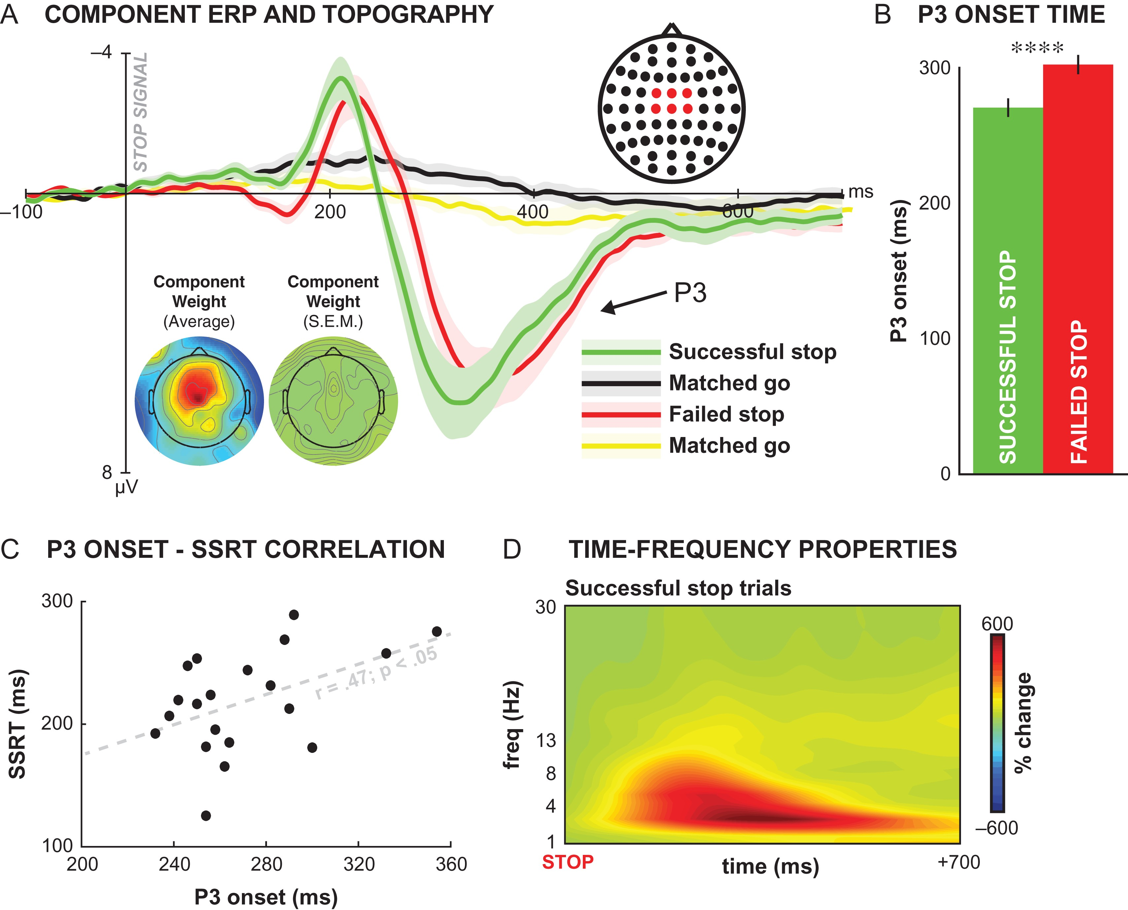
Figure 2. Summary of the MI-IC identified based on the SST. The components show the typical properties of the MI-IC ...
Notes:
Figure 2. Summary of the MI-IC identified based on the SST. The components show the typical properties of the MI-IC known from previous studies. (A) Grand-average ERP of each component, backprojected into channel-space, measured at fronto-central electrodes (FCz, FC1, FC2, Cz, C1, C2; see electrode location image in top right corner), separately for successful stop-trials (green), go-trials matched to successful stop-trials (go-trials for which the SSD staircase was at the same position, black), failed stop-trials (red) and go-trials matched to failed stop-trials (yellow). Transparent line denotes 1 SEM. Bottom left inlay shows the topographical distribution of the component weight maps (rectified to show positivity at Cz), alongside its SEM. (B) Participants’ P3 onset was earlier for successful compared with failed stop-trials, again replicating previous studies, P < 0.0001. (C) Correlation between the statistical onset of the P3 ERP for each participant and their SSRT (according to the block-wise integration method). Each participant is represented by a black dot. Replicating previous studies, the 2 measures correlated highly at r = 0.5, P < 0.05. (D) Time-frequency plot of the event-related spectral properties of the MI-IC; on successful stop-trials, oscillatory power was increased in the delta (1–4 Hz) and theta (5–8 Hz) frequency bands (again replicating previous studies). Power is displayed in units of percent change from baseline (i.e., the average activity in the 300 ms prior to the stop-signal).
Unless provided in the caption above, the following copyright applies to the content of this slide: © The Author 2016. Published by Oxford University Press. All rights reserved. For Permissions, please e-mail: journals.permissions@oup.com

Slide 3
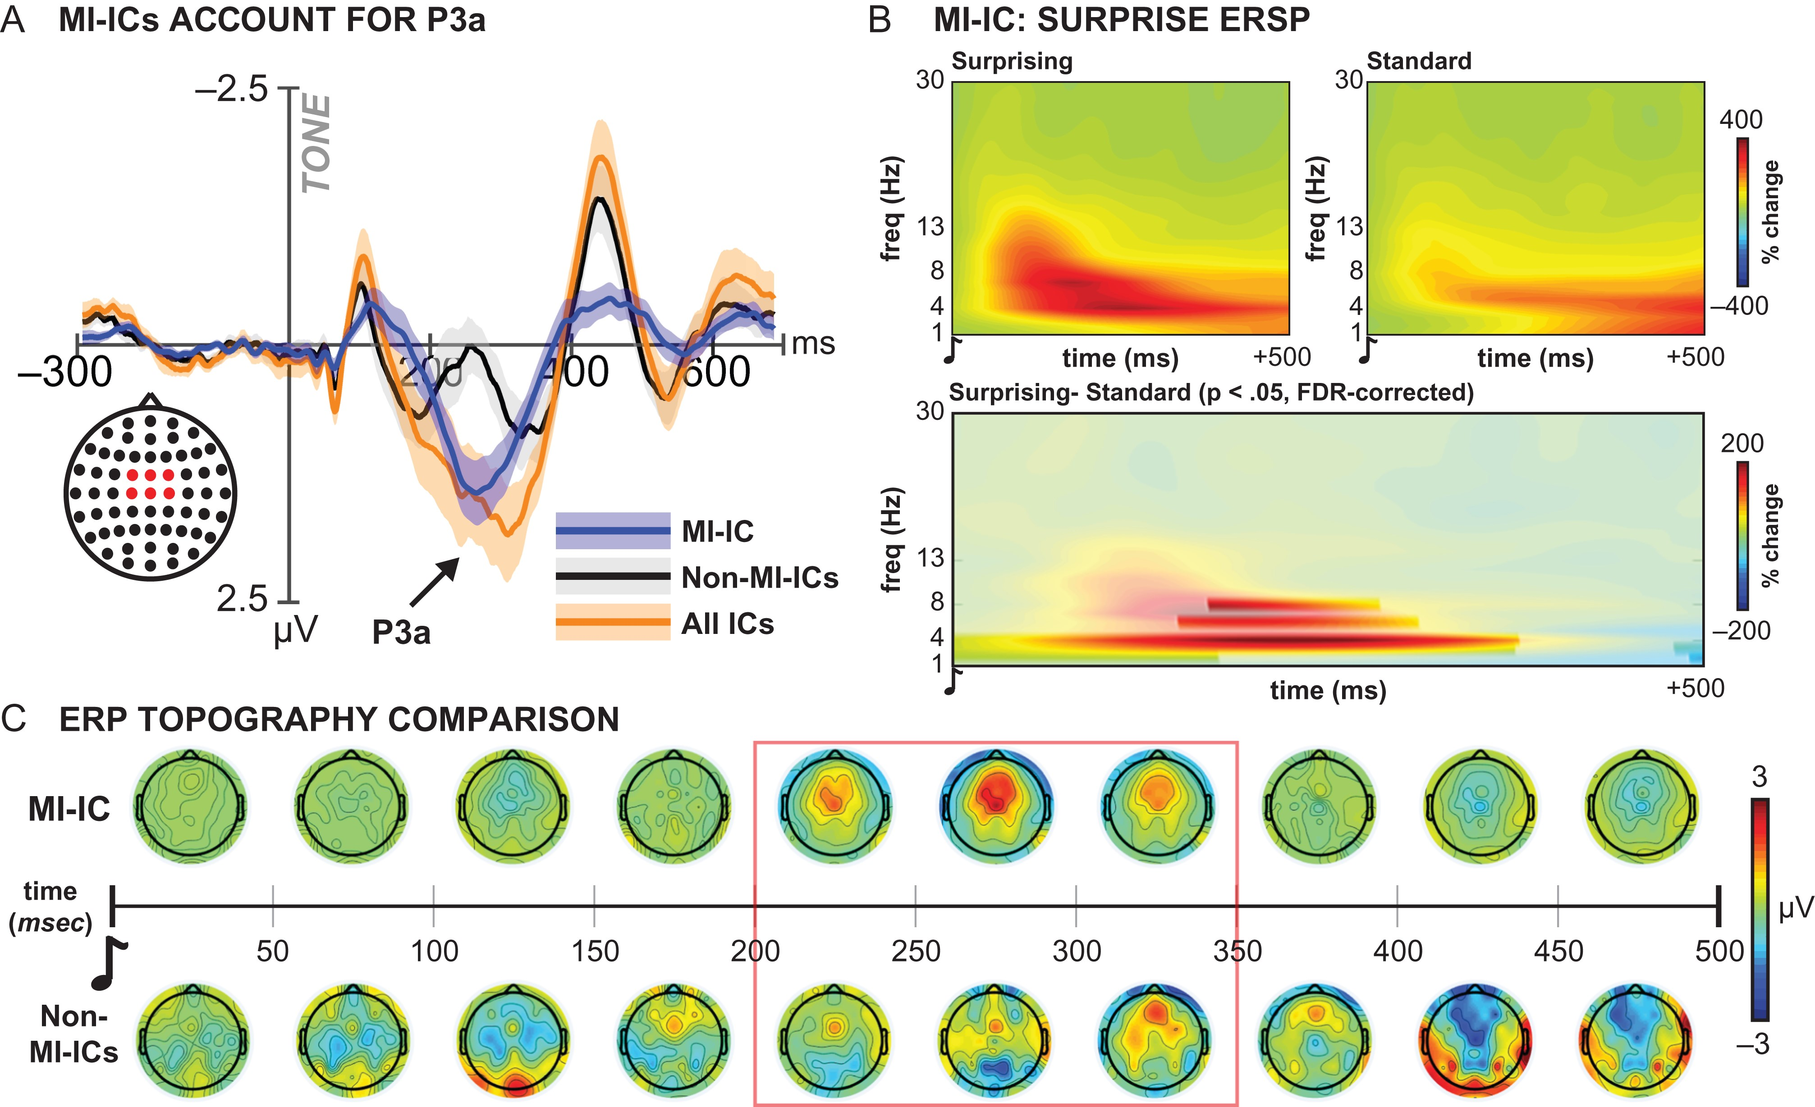
Figure 3. Relationship of the MI-IC to the occurrence of surprising tones in the WM task. Replicating past studies, the ...
Notes:
Figure 3. Relationship of the MI-IC to the occurrence of surprising tones in the WM task. Replicating past studies, the MI-IC accounts for the fronto-central P3a after surprising tones. (A) Breakdown of the MI-ICs’ contribution to the fronto-central P3a to surprising tones. Orange line depicts P3a based on all non-artifact ICs (including the MI-IC). The black line depicts the same ERP response to surprising tones, yet without the contribution of the MI-IC. Note that the black and orange curves are virtually identical, except for the P3a time-range (~200–400 ms). Finally, the blue line depicts the same ERP response to surprising tones, yet this time only the MI-ICs’ activity is depicted. It can be clearly seen the the P3a is almost entirely accounted for by the MI-IC. Shaded areas denote 1 SEM. (B) MI-IC ERSP following surprising events, in units of % change to pre-tone baseline. Top left: ERSP to surprising tones. Top right: ERSP to standard tones. Bottom: Difference between surprising and standard tones. Significant regions at P < 0.05 (FDR-corrected) are highlighted by full opacity. The plot shows significantly increased MI-IC activity to surprising events in the delta (1–4 Hz) and theta (5–8 Hz) frequency bands. (C) Topographical representation of the contribution of the MI-IC to the P3a over time from tone-onset. Individual topographical plots show average voltage distribution in incremental time-windows of 50 ms, starting at the onset of the tone. Top row shows MI-IC activity, showing a highly specific response in the P3a time-window (~200–350 ms, highlighted by red box), which is furthermore spatially specific to the fronto-central cluster. In contrast, the response of all non-MI-ICs shows an absence of fronto-central activity in the P3a window, again underlining that the P3a is completely accounted for by the MI-IC.
Unless provided in the caption above, the following copyright applies to the content of this slide: © The Author 2016. Published by Oxford University Press. All rights reserved. For Permissions, please e-mail: journals.permissions@oup.com

Slide 4
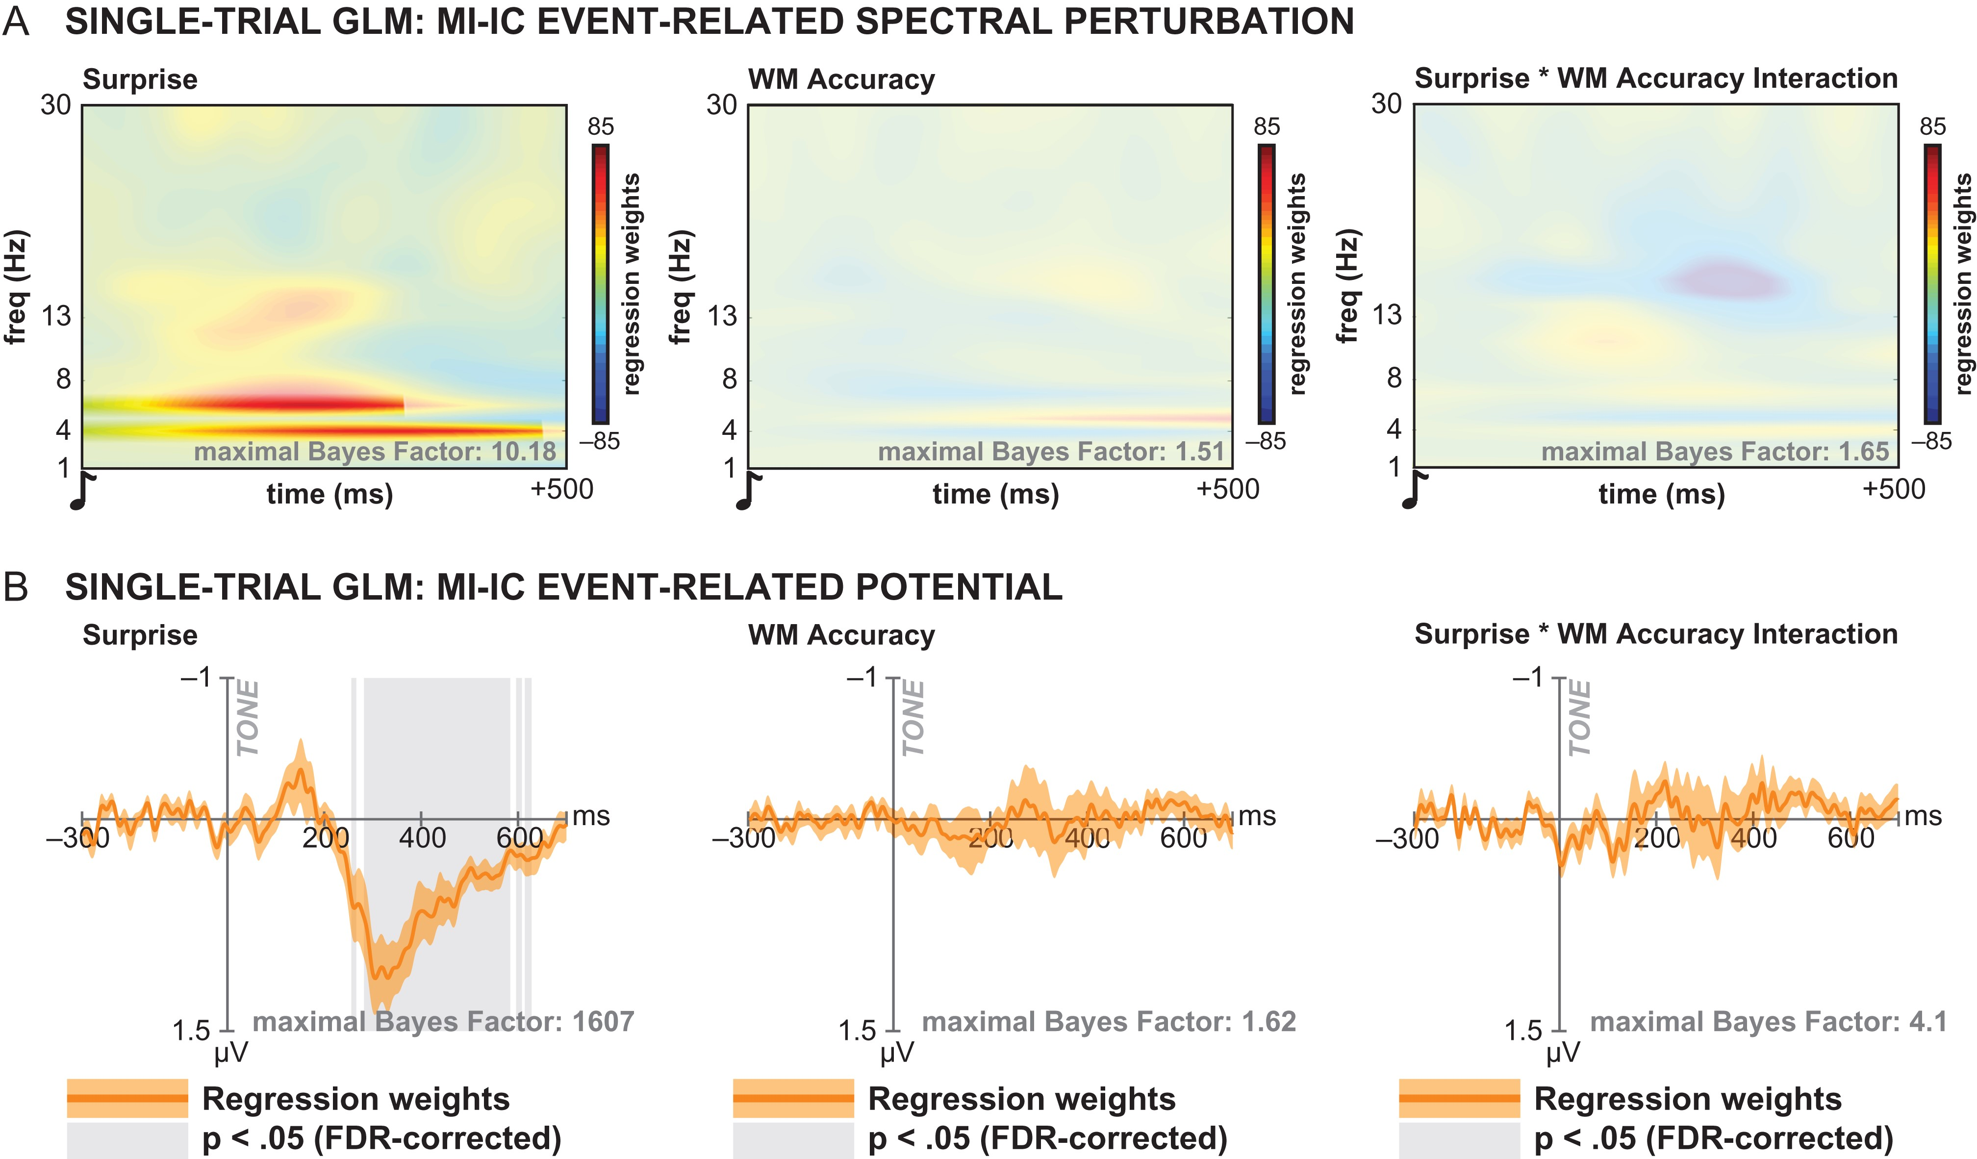
Figure 4. Results from the single-trial GLM analysis relating the ERP and ERSP activity of the MI-IC to participants’ ...
Notes:
Figure 4. Results from the single-trial GLM analysis relating the ERP and ERSP activity of the MI-IC to participants’ performance on the WM task. (A) Single-trial ERSP GLM. Each sample point in the time-frequency spectrum represents the averaged regression weight from each individual participants’ single-trial GLM, in which activity at said sampling point was related to the degree of surprise of each surprising tone (left panel), the accuracy on the WM probe (middle panel), and the interaction between the 2. The plots show that only the degree of surprise was significantly related to the MI-IC activity (significance at P < 0.05, FDR-corrected, highlighted by full opacity). This relationship was exclusive to frequencies in the delta (4 Hz) and theta (6 Hz) bands. (B) Single-trial ERP GLM. Each sample point represents the average regression weights from the same GLM as described in A, yet applied to the ERP instead of the ERSP. Similar as in A, the activity of the MI-IC after surprising tones was exclusively related to the degree of surprise (P < 0.05, FDR-corrected areas highlighted in gray).
Unless provided in the caption above, the following copyright applies to the content of this slide: © The Author 2016. Published by Oxford University Press. All rights reserved. For Permissions, please e-mail: journals.permissions@oup.com

Slide 5
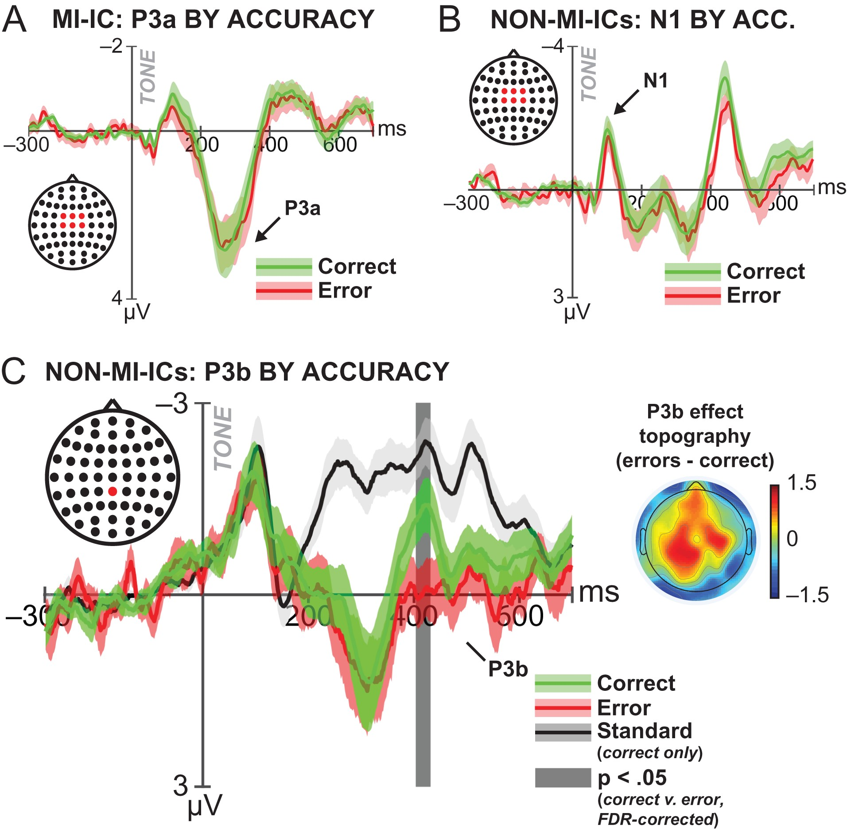
Figure 5. Analysis of ERPs that could potentially be related to WM accuracy. (A) MI-IC P3a wave after surprising tones, ...
Notes:
Figure 5. Analysis of ERPs that could potentially be related to WM accuracy. (A) MI-IC P3a wave after surprising tones, split by WM accuracy (red = error, green = correct; shaded areas = 1 SEM). As to be expected based on the single-trial GLM analysis (Fig. 4B, middle panel), the amplitude of the MI-IC P3a (or any earlier or later fronto-central ERP activity of the MI-IC) is unrelated to the accuracy on the WM probe. (B) Non-MI-IC N1 wave, split by WM accuracy. This plot shows that fronto-central activity that is not part of the MI-IC is also unrelated to WM accuracy, including the early fronto-central auditory N1 (highlighted). (C) Non-MI-IC P3b wave, split by WM accuracy. Centro-parietal P3b activity of the non-MI-ICs relates to WM accuracy. ERP response to standard tones displayed in black to illustrate the presence of a P3b wave on surprising trials. On surprising tones followed by incorrect WM responses (red line), the P3b wave was significantly increased compared with surprising tones followed by correct WM responses (green line; P < 0.05, FDR-corrected, significant time periods highlighted in dark gray). The right panel shows the topographical representation of the P3b effect (errors – correct trials) in the significant time range, confirming the typical P3b distribution of the effect.
Unless provided in the caption above, the following copyright applies to the content of this slide: © The Author 2016. Published by Oxford University Press. All rights reserved. For Permissions, please e-mail: journals.permissions@oup.com

