Slide 1
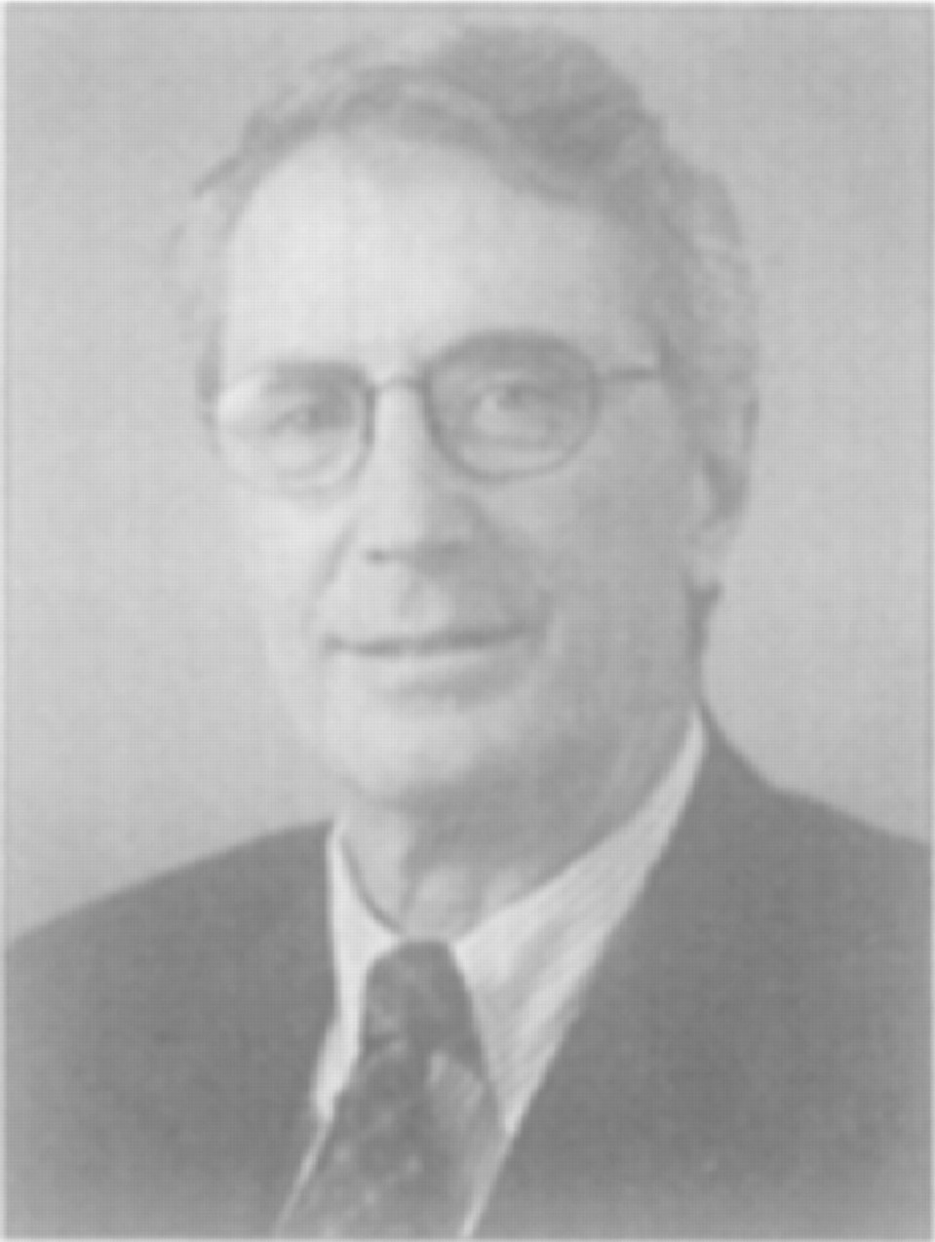
T. Roderick Hester, Jr., MD, Atlanta, GA, is a board-certified plastic surgeon and an ASAPS member.
Notes:
T. Roderick Hester, Jr., MD, Atlanta, GA, is a board-certified plastic surgeon and an ASAPS member.
Unless provided in the caption above, the following copyright applies to the content of this slide: © 1998 American Society for Aesthetic Plastic Surgery

Slide 2
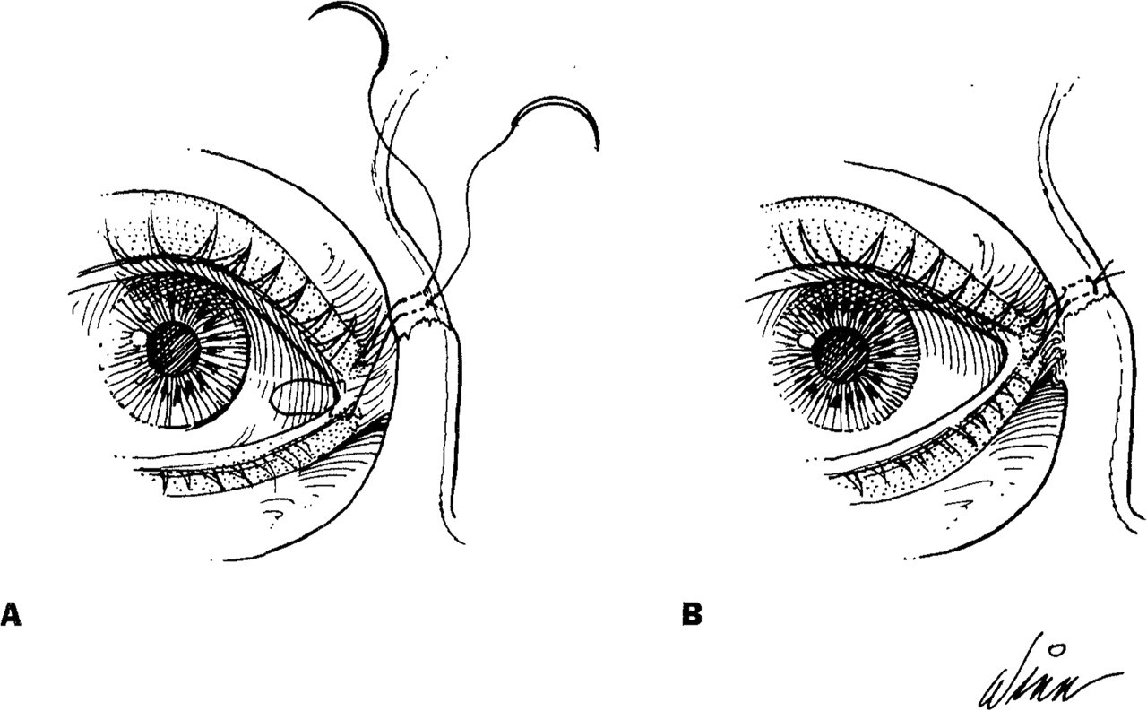
Figure 1 Technique of canthopexy. A, The mattress suture includes all layers except the skin and traverses the inside ...
Notes:
Figure 1 Technique of canthopexy. A, The mattress suture includes all layers except the skin and traverses the inside of the lid. B, The suture is tightened and tied beneath the skin.
Unless provided in the caption above, the following copyright applies to the content of this slide: © 1998 American Society for Aesthetic Plastic Surgery

Slide 3
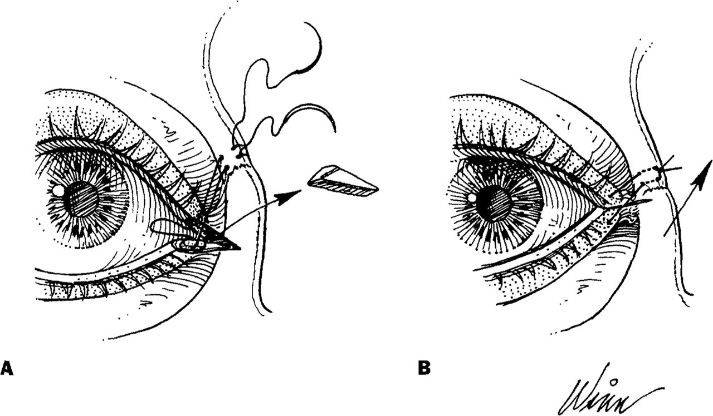
Figure 2 The technique of canthopexy is the same as in Figure 1, but can include an excision of 3 to 5 mm of skin to ...
Notes:
Figure 2 The technique of canthopexy is the same as in Figure 1, but can include an excision of 3 to 5 mm of skin to correct horizontal lower lid laxity.
Unless provided in the caption above, the following copyright applies to the content of this slide: © 1998 American Society for Aesthetic Plastic Surgery

Slide 4
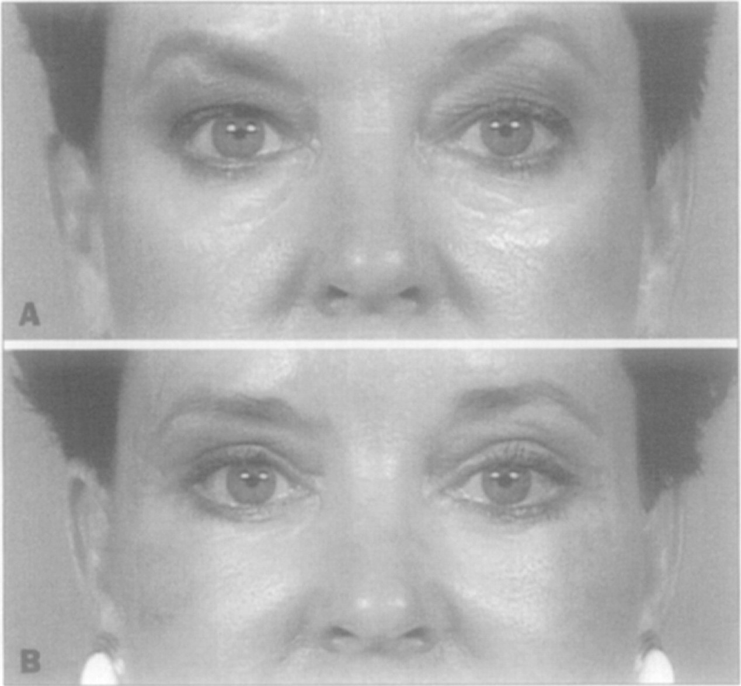
Figure 3 A 52-year-old woman with EOM 21 mm prominent globes. A, Preoperative view. B, Postoperative view at 4 weeks ...
Notes:
Figure 3 A 52-year-old woman with EOM 21 mm prominent globes. A, Preoperative view. B, Postoperative view at 4 weeks after transblepharoplasty lower lid and midface rejuvenation demonstrating maintenance of lower lid position with canthopexy.
Unless provided in the caption above, the following copyright applies to the content of this slide: © 1998 American Society for Aesthetic Plastic Surgery

Slide 5
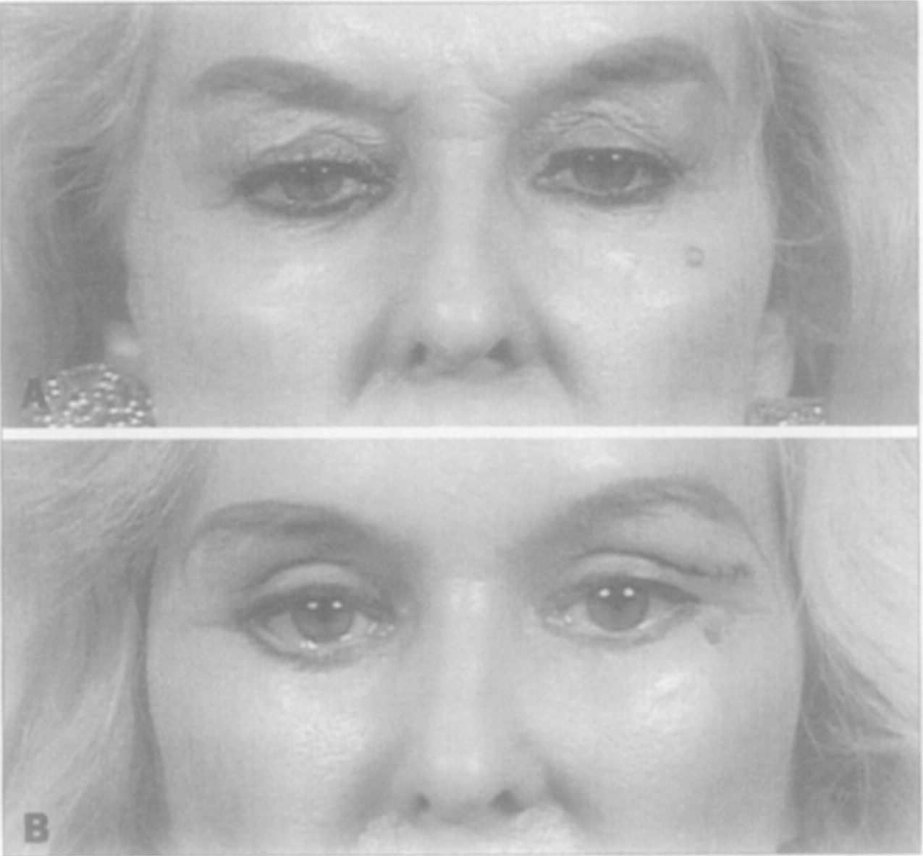
Figure 4 A 63-year-old woman with EOM 16 mm nonprominent globes and horizontal laxity. A, Preoperative view. B, ...
Notes:
Figure 4 A 63-year-old woman with EOM 16 mm nonprominent globes and horizontal laxity. A, Preoperative view. B, Postoperative view at 4 weeks after trans-blepharoplasty lower lid and midface rejuvenation demonstrating failure of canthopexy to maintain functional position of right lower lid in the presence of horizontal laxity and nonprominent globes.
Unless provided in the caption above, the following copyright applies to the content of this slide: © 1998 American Society for Aesthetic Plastic Surgery

