Slide 1
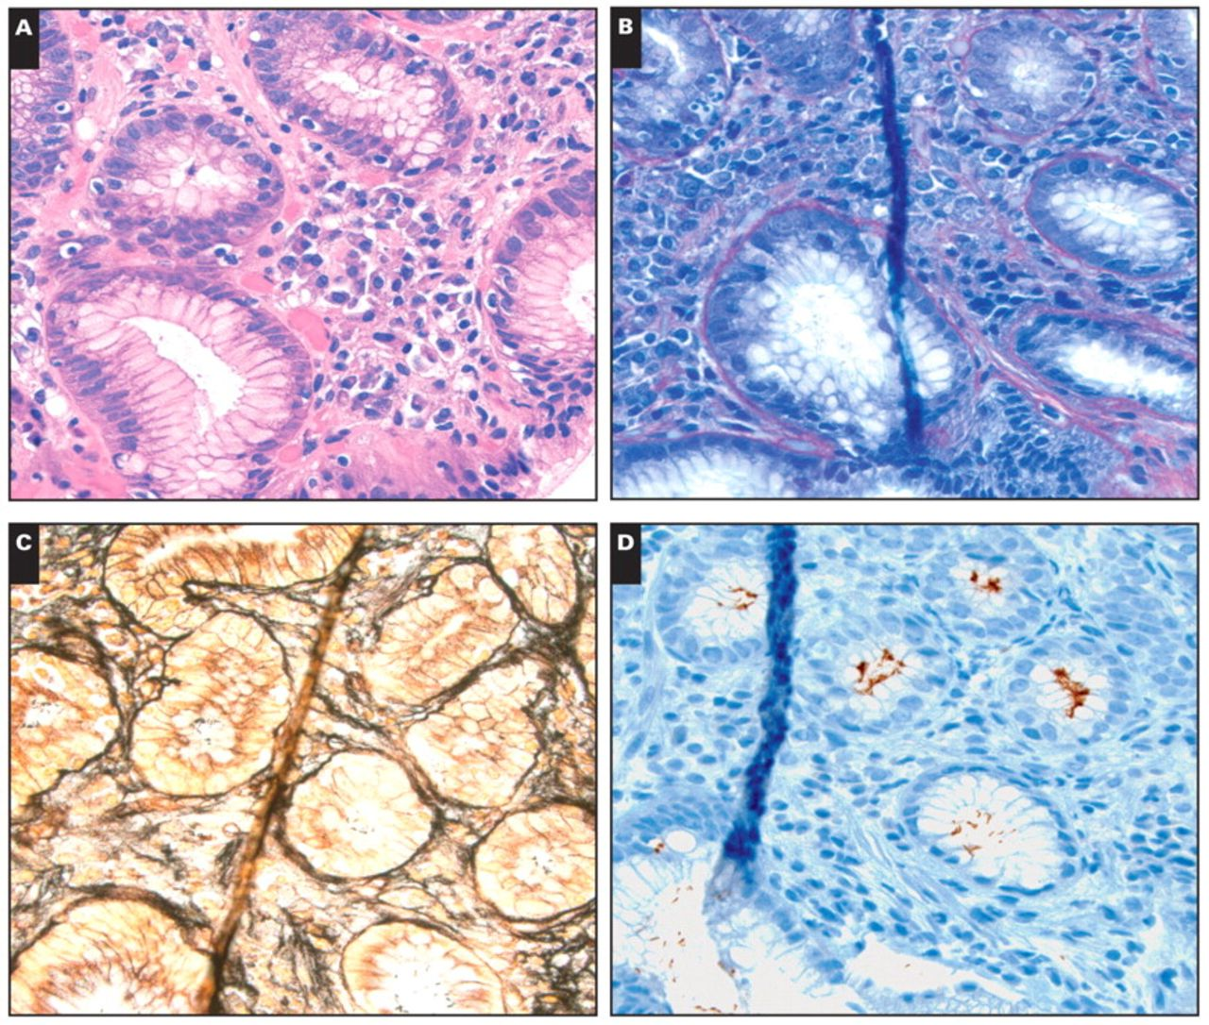
Image 1 A, Helicobacter organisms (H&E, ×600). B–D, Same section stained by Giemsa (B, ×600), Warthin-Starry (C, ...
Notes:
Image 1 A, Helicobacter organisms (H&E, ×600). B–D, Same section stained by Giemsa (B, ×600), Warthin-Starry (C, ×600), and polyclonal Helicobacter immunostain (D, ×600). Note characteristic superficial chronic gastritis characterized by numerous plasma cells.
Unless provided in the caption above, the following copyright applies to the content of this slide: © American Society for Clinical Pathology

Slide 2
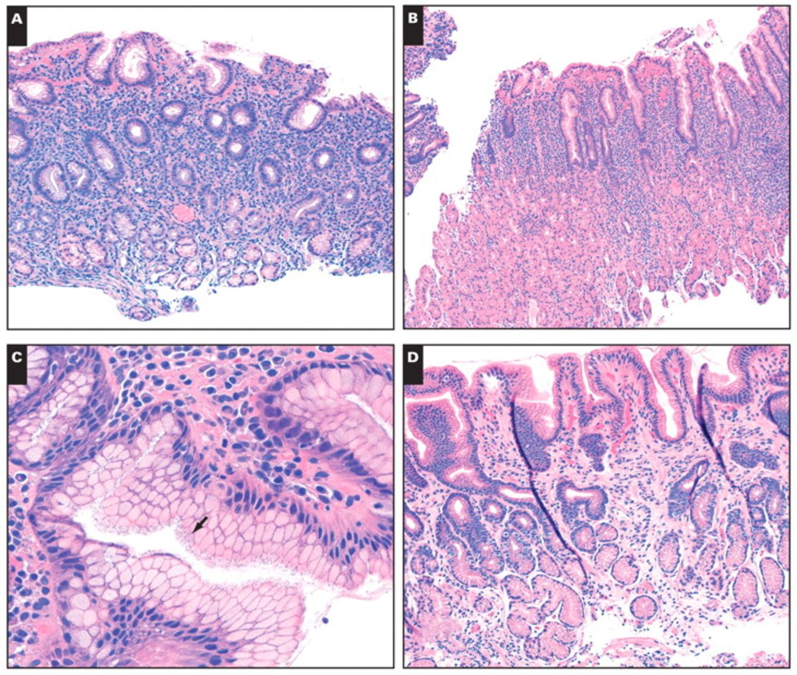
Image 2 A, Antral biopsy specimen with moderate gastritis (H&E, ×200). B, Oxyntic mucosa with moderate gastritis ...
Notes:
Image 2 A, Antral biopsy specimen with moderate gastritis (H&E, ×200). B, Oxyntic mucosa with moderate gastritis (H&E, ×100). C, Helicobacter organisms (indicated by arrow) (H&E, ×600). Both the antral and body/fundus biopsy specimens were positive for H pylori. D, Antral biopsy specimen with mild gastritis (H&E, ×200).
Unless provided in the caption above, the following copyright applies to the content of this slide: © American Society for Clinical Pathology

