Slide 1
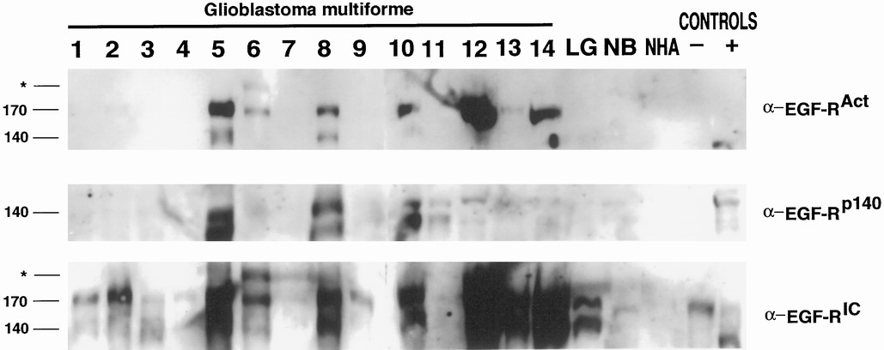
FIGURE 1. Western blots of 15 tumor samples and control specimens. Samples 1 to 14 represent World Health Organization ...
Notes:
FIGURE 1. Western blots of 15 tumor samples and control specimens. Samples 1 to 14 represent World Health Organization Grade IV tumor samples; Cases 2 and 13 contain sarcomatous elements. LG, Grade II LGA. Lysates from normal brain (NB) tissue and cultured normal human astrocytes (NHA) (Clonetics) were used as negative control samples. U118 cell lines expressing only the wild-type EGFR (negative control) or both the wild-type EGFR and EGFRvIII (positive control) were also probed. Upper, 300 μg of lysate, separated by sodium dodecyl sulfate-polyacrylamide gel electrophoresis and probed with an activation-specific mouse monoclonal antibody (Transduction Laboratories). Middle and lower, 100 μg of lysate, separated by sodium dodecyl sulfate-polyacrylamide gel electrophoresis and probed with a polyclonal rabbit antibody specific for EGFRvIII (middle) or with a polyclonal pan-EGFR antibody that recognizes both the wild-type and truncated receptors (lower). 170 and 140, positions of the wild-type and truncated receptors, respectively. Asterisks, locations of an aberrant EGFR of approximately Mr 190,000, which seems to be constitutively activated in Case 6 (upper).
Unless provided in the caption above, the following copyright applies to the content of this slide:

Slide 2
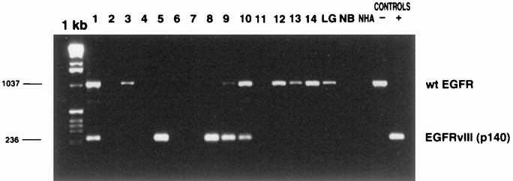
FIGURE 2. Polyacrylamide gel electrophoresis-separated PCR products after RT-PCR assays for wild-type (wt) and ...
Notes:
FIGURE 2. Polyacrylamide gel electrophoresis-separated PCR products after RT-PCR assays for wild-type (wt) and truncated receptor mRNA expression. Tumors are labeled as in Figure 1. The negative control was the U118 astrocytoma cell line expressing only wild-type EGFR. The positive control was a U118 astrocytoma cell line expressing both the wild-type EGFR and EGFRvIII. Note the inability of this assay to amplify the larger wild-type EGFR when the two receptors are coexpressed. The integrity of the RNA samples and the efficacy of first-strand synthesis were confirmed for all samples using PCR assays for a housekeeping gene (glyceraldehyde-3-phosphate dehydrogenase; data not shown). The RT-PCR assays were repeated three times, with identical results.
Unless provided in the caption above, the following copyright applies to the content of this slide:

Slide 3
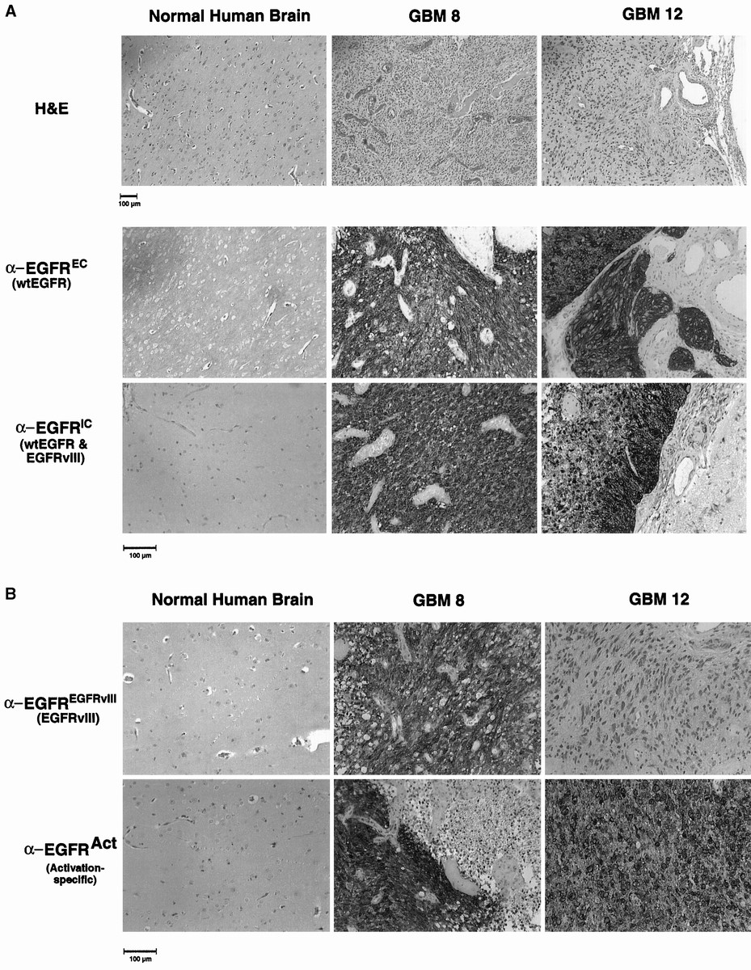
FIGURE 3. Representative sections from IHC analyses, demonstrating staining for a normal brain specimen and GBM Cases 8 ...
Notes:
FIGURE 3. Representative sections from IHC analyses, demonstrating staining for a normal brain specimen and GBM Cases 8 and 12. A, hematoxylin and eosin (H&E) staining was used to confirm the pathological diagnosis (upper). Both tumors exhibited intensely positive staining for the wild-type EGFR, either with an antibody that specifically recognizes the wild-type EGFR (anti-EGFREC mouse monoclonal antibody; Novocastra) (middle) or with a pan-EGFR antibody that recognizes both wild-type and truncated receptors (mouse monoclonal anti-EGFRIC; Transduction Laboratories) (lower). Note the specificity of these antibodies, as demonstrated by negative staining for blood vessels. Note also the presence of tumor heterogeneity (anti-EGFRIC, GBM 12). B, specific expression of EGFRvIII was determined using a mouse monoclonal antibody (clone DH8.3; Novocastra), which demonstrated staining for EGFRvIII in GBM 8 and only weak staining for EGFRvIII in GBM 12 (upper). The specificity of the activation-specific antibody (Transduction Laboratories) and the presence of tumor heterogeneity were also demonstrated (lower).
Unless provided in the caption above, the following copyright applies to the content of this slide:

Slide 4
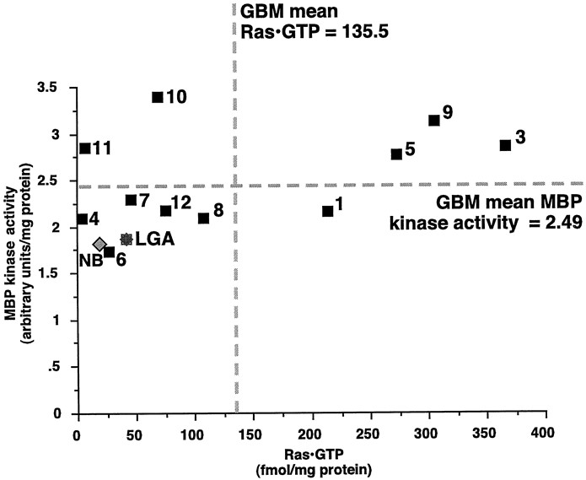
FIGURE 4. Correlation between Ras·GTP levels and MAPK kinase activities in specimens for which both assays could be ...
Notes:
FIGURE 4. Correlation between Ras·GTP levels and MAPK kinase activities in specimens for which both assays could be performed (11 GBM specimens, 1 low-grade glioma sample, and the mean of the non-neoplastic normal control samples). Normal brain (NB) and LGA specimens expressed low levels of activated Ras and activated MAPK, whereas the majority of GBM specimens expressed much higher levels of activated Ras and MAPK. Tumors containing very high levels of activated Ras·GTP (Cases 1, 3, 5, and 9) also contained very high levels of activated MAPK, whereas all cases with low MAPK activity also demonstrated low Ras·GTP activity (Cases 4, 6, 7, 8, and 12). Two cases (Cases 10 and 11) demonstrated low levels of activated Ras·GTP but high levels of MAPK kinase activity, suggesting an alternate, non-Ras-mediated, mechanism for MAPK activation in these tumors.
Unless provided in the caption above, the following copyright applies to the content of this slide:

Slide 5
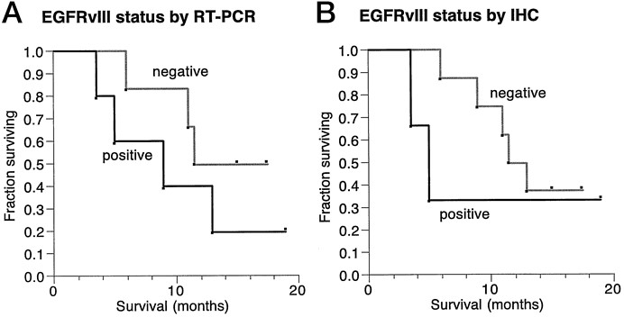
FIGURE 5. Kaplan-Meier survival curves, grouped on the basis of EGFRvIII expression status. Only the GBM cases were ...
Notes:
FIGURE 5. Kaplan-Meier survival curves, grouped on the basis of EGFRvIII expression status. Only the GBM cases were included, to remove the effect of tumor grade on survival times. EGFRvIII expression assessed using RT-PCR demonstrated moderate prognostic value (A), whereas EGFRvIII status determined in IHC analyses yielded more convincing evidence for EGFRvIII as a prognostic marker (B). Note that RT-PCR assays did not detect tumors that expressed low levels of EGFRvIII. In addition, some IHC analyses demonstrated only very weak immunopositivity for EGFRvIII. Cases were thus classified as negative for EGFRvIII by IHC analysis if they did not exhibit staining or exhibited only weak (trace) staining for EGFRvIII. Only clearly positive cases were classified as positive for the survival analysis. Log-rank testing did not demonstrate statistical significance, because of the small sample size.
Unless provided in the caption above, the following copyright applies to the content of this slide:

