Slide 1
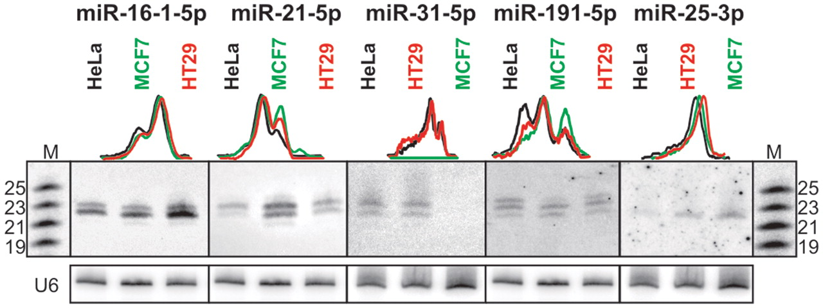
Figure 1. miRNA length heterogeneity is a frequent phenomenon. RNA (40 µg) isolated from different cell lines was ...
Notes:
Figure 1. miRNA length heterogeneity is a frequent phenomenon. RNA (40 µg) isolated from different cell lines was analysed by northern blot using specific probes complementary to miRNAs (indicated above), as described in ‘Materials and Methods’ section. Quantitative representations of the miRNA length variants are shown using the peaks obtained from the phosphoimaging analysis. M denotes the 19–25-nt RNA size marker. U6 is the hybridization control.
Unless provided in the caption above, the following copyright applies to the content of this slide: © The Author(s) 2010. Published by Oxford University Press.This is an Open Access article distributed under the terms of the Creative Commons Attribution Non-Commercial License (http://creativecommons.org/licenses/by-nc/2.5), which permits unrestricted non-commercial use, distribution, and reproduction in any medium, provided the original work is properly cited.

Slide 2
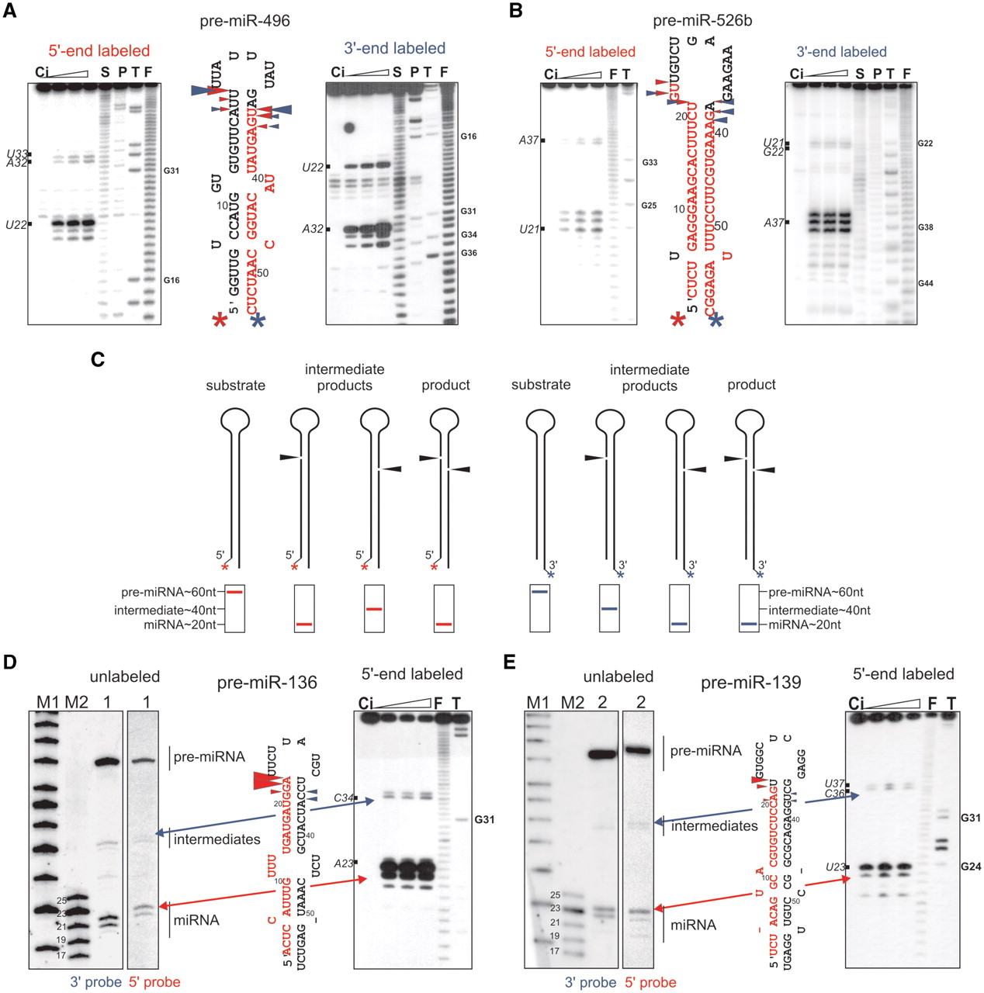
Figure 2. Different experimental systems used to analyse Dicer cleavage products. A comparative analyses of the ...
Notes:
Figure 2. Different experimental systems used to analyse Dicer cleavage products. A comparative analyses of the cleavage patterns generated by recombinant Dicer (Ambion) in a time-dependent reaction: 1, 2 and 5 min for pre-miR-496 ( A ) and pre-miR-526b ( B ) labelled at the 5′- (left panel) or 3′-end (right panel). Lane Ci, incubation control without Dicer; lane S, S1 ladder; lane P, P1 ladder; lane T, guanine-specific ladder; lane F, formamide ladder. The positions of the selected cleavage sites (marked with black boxes) and G-residues were counted from the 5′-end of the precursors in all autoradiograms. In the middle, the structures of these precursors are shown. Asterisks represent the labeling site on the 5′-end (red) and the 3′-end (blue). The Dicer cleavage sites (marked with red arrowheads in the precursor labelled at the 5′-end or blue arrowheads in the 3′-end-labelled precursor, the size of which is proportional to the radioactive signal intensity: very strong, strong, medium and weak) are shown in the secondary structure models, where the reported miRNA sequences are marked in red. ( C ) The scheme of pre-miRNA processing by recombinant Dicer labelled at the 5′- (left, red) and 3′-end (right, blue). From left to right: unprocessed precursor (substrate); single-nick intermediate products; precursor that is cleaved in both arms (product). The expected electrophoretic band migrations of the Dicer cleavage products that were labelled at either 5′- or 3′-ends are shown schematically below. ( D and E ) The products of the Dicer cleavage assay of the unlabelled pre-miR-136 (D) and pre-miR-139 (E) were subjected to northern blot with specific 5′- or 3′-end probes detecting miRNA derived from 5′- or 3′-arm, respectively (lanes 1 and 2 for pre-miR-136 and pre-miR-139, respectively). For comparison, on the right, the structure of the pre-miRNA and the result of the Dicer in vitro cleavage assay of the labelled precursors are shown. The blue arrowheads represent the cleavages by Dicer in the 3′-arm being only primary cuts. The red arrowheads mark the cleavages in the 5′ precursor arm (the sum of primary and secondary cuts). The blue and red arrows indicate the corresponding cleavage sites. The migration of the miRNA, intermediates and pre-miRNA in the northern blot are represented with black lines on the right side. M1 denotes the Low Molecular Weight Marker (USB Corp.); M2 denotes the 17–25 nt RNA marker. Other designations are the same as in (A) and (B).
Unless provided in the caption above, the following copyright applies to the content of this slide: © The Author(s) 2010. Published by Oxford University Press.This is an Open Access article distributed under the terms of the Creative Commons Attribution Non-Commercial License (http://creativecommons.org/licenses/by-nc/2.5), which permits unrestricted non-commercial use, distribution, and reproduction in any medium, provided the original work is properly cited.

Slide 3
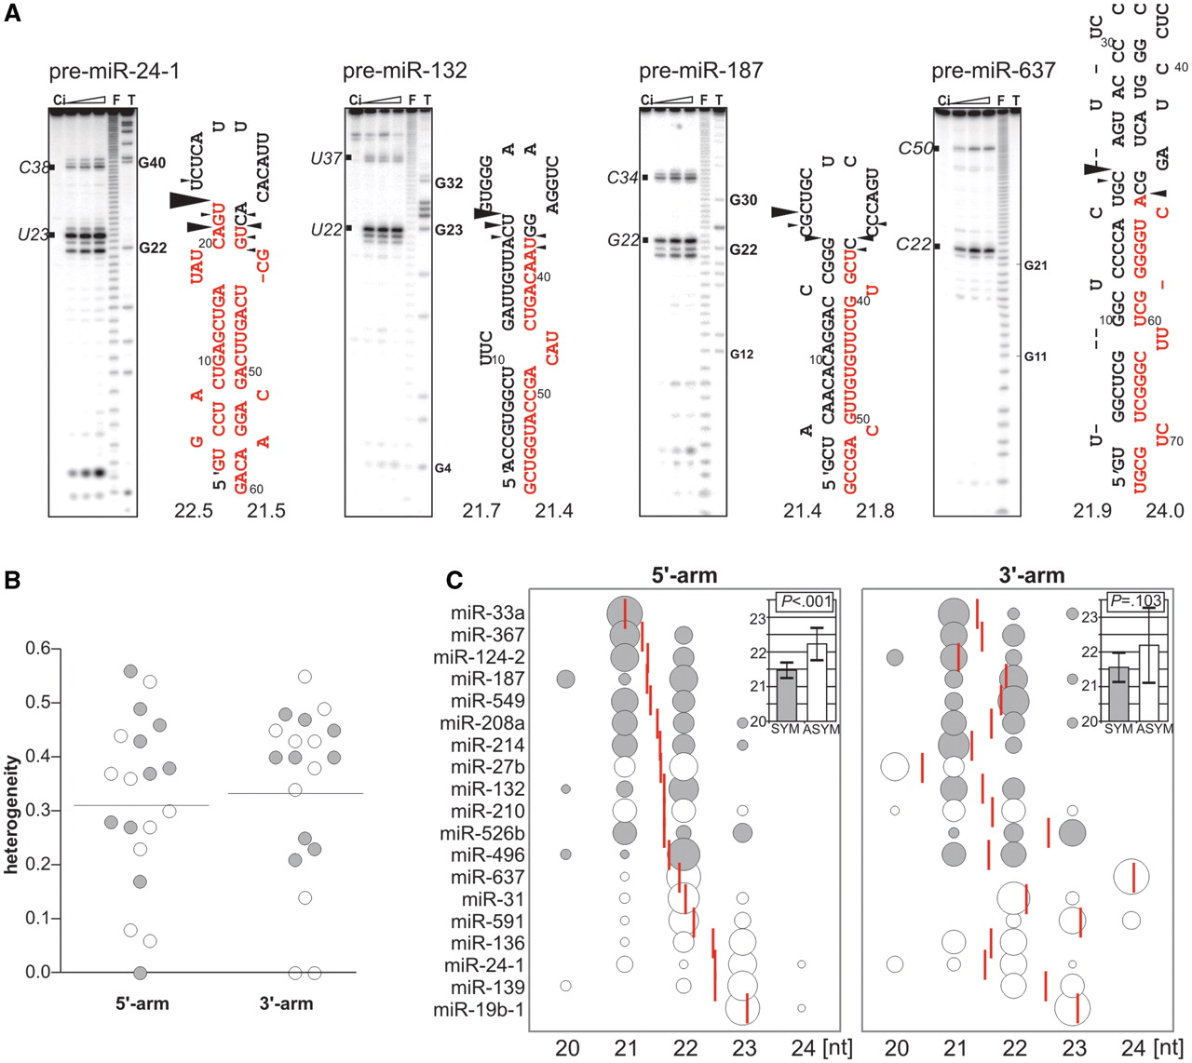
Figure 3. Dicer generates heterogeneous products of diverse lengths. ( A ) An analysis of Dicer cleavages in selected ...
Notes:
Figure 3. Dicer generates heterogeneous products of diverse lengths. ( A ) An analysis of Dicer cleavages in selected 5′-end-labelled pre-miRNAs that were incubated with recombinant Dicer (Ambion) for 1, 2 and 5 min. Below each precursor arm, the WALDI parameter is presented for the Dicer cleavage products generated from this arm. The designations are the same as in Figure 2 A and B. ( B ) The heterogeneity of the products that were generated from the 5′-end-labelled precursors from the 5′ (the sum of primary and secondary cleavages) and 3′-arms (primary cleavages) was calculated based on the data presented in Figures 2 , 3 A, 4 and Supplementary Figure S5A as described in ‘Materials and Methods’ section. Dots and horizontal lines indicate the individual and average values of miRNA heterogeneity, respectively. Grey dots represent the heterogeneity of products generated from symmetrical precursors, while white dots represent those generated from asymmetrical precursors. Signals that accounted for <5% of all the cleavage products were not considered in the analysis. ( C ) A bubble-chart (MS Excel) depicting the fractions of cleavage products that were generated by Dicer in the 5′-arm (left-hand side) and 3′-arm (right-hand side) of the 5′-end-labelled precursors analysed ( y -axis). Note that the left diagram represents the sum of the primary and secondary cleavage products, while the right diagram shows the primary cleavage products only. The x -axis represents the lengths of the products, and the bubble size (area) represents the fraction of the product that was generated from a given arm (as calculated from the densitometric analysis of the results presented in Figures 2 , 3 A, 4 and Supplementary Figure S5A ). The values of WALDI parameter from the 5′- and 3′-arms are shown as red vertical lines. The precursors were sorted according to the increasing value of the WALDI parameter generated from the 5′-arm. White and grey bubbles indicate products that were diced from the ‘asymmetrical’ (i.e. including at least one asymmetrical motif in the stem; labelled ASYM) and ‘symmetrical’ precursors (labelled SYM), respectively. The insets (i.e. the bar charts) present average WALDI values for the ‘symmetrical’ and ‘asymmetrical’ precursors with error-bars representing the standard deviation (SD). These values were formally compared using a Student's t -test with Welch's correlation for unequal variance, and the P -values are shown in the insets. Signals that accounted for <5% of all the cleavage products were not considered in graph (C).
Unless provided in the caption above, the following copyright applies to the content of this slide: © The Author(s) 2010. Published by Oxford University Press.This is an Open Access article distributed under the terms of the Creative Commons Attribution Non-Commercial License (http://creativecommons.org/licenses/by-nc/2.5), which permits unrestricted non-commercial use, distribution, and reproduction in any medium, provided the original work is properly cited.

Slide 4
Figure 4. In vitro Dicer cleavages in the pre-miRNAs and their mutants. Cleavages by recombinant Dicer of the ...
Notes:
Figure 4. In vitro Dicer cleavages in the pre-miRNAs and their mutants. Cleavages by recombinant Dicer of the 5′-end-labelled pre-miR-19b-1, pre-miR-33a, pre-miR-136, pre-miR-549 and the mutant variants. The sequences that were mutated in the precursors are marked with rectangles. Below each precursor arm, the WALDI parameter is presented for Dicer cleavage products generated from this arm. Other designations and symbols are the same as in Figure 2 .
Unless provided in the caption above, the following copyright applies to the content of this slide: © The Author(s) 2010. Published by Oxford University Press.This is an Open Access article distributed under the terms of the Creative Commons Attribution Non-Commercial License (http://creativecommons.org/licenses/by-nc/2.5), which permits unrestricted non-commercial use, distribution, and reproduction in any medium, provided the original work is properly cited.

Slide 5
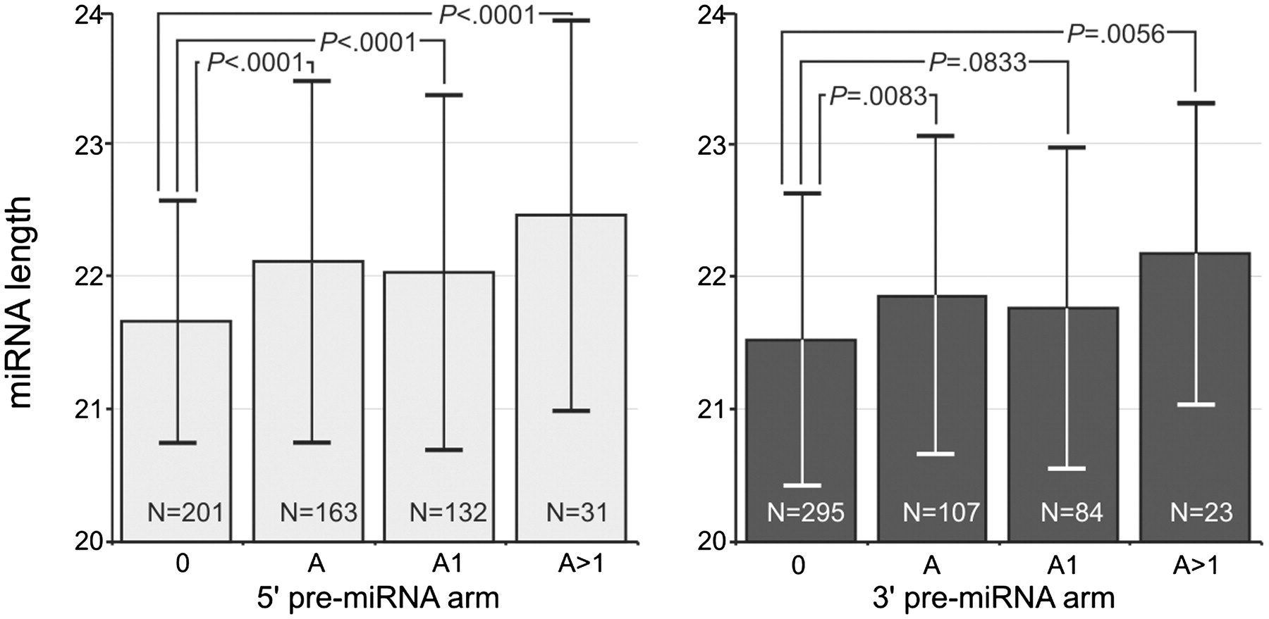
Figure 5. The correlation between miRNA lengths and the presence of excessive nucleotides in pre-miRNA arms. The ...
Notes:
Figure 5. The correlation between miRNA lengths and the presence of excessive nucleotides in pre-miRNA arms. The lengths of miRNAs generated from the pre-miRNA arms that did not contain asymmetrical motifs (0) compared to the lengths of miRNA generated from pre-miRNA arms containing at least one asymmetrical motif (A), containing one asymmetrical motif (A1) and containing more than one asymmetrical motif (A > 1). The results are shown separately for the 5′- and 3′-arms. N , number of analysed miRNAs; the Mann–Whitney test P -values are indicated in the graphs. Standard deviations are shown as error bars. The results are based on a bioinformatics analysis of 721 human miRNA sequences and pre-miRNA structures.
Unless provided in the caption above, the following copyright applies to the content of this slide: © The Author(s) 2010. Published by Oxford University Press.This is an Open Access article distributed under the terms of the Creative Commons Attribution Non-Commercial License (http://creativecommons.org/licenses/by-nc/2.5), which permits unrestricted non-commercial use, distribution, and reproduction in any medium, provided the original work is properly cited.

Slide 6
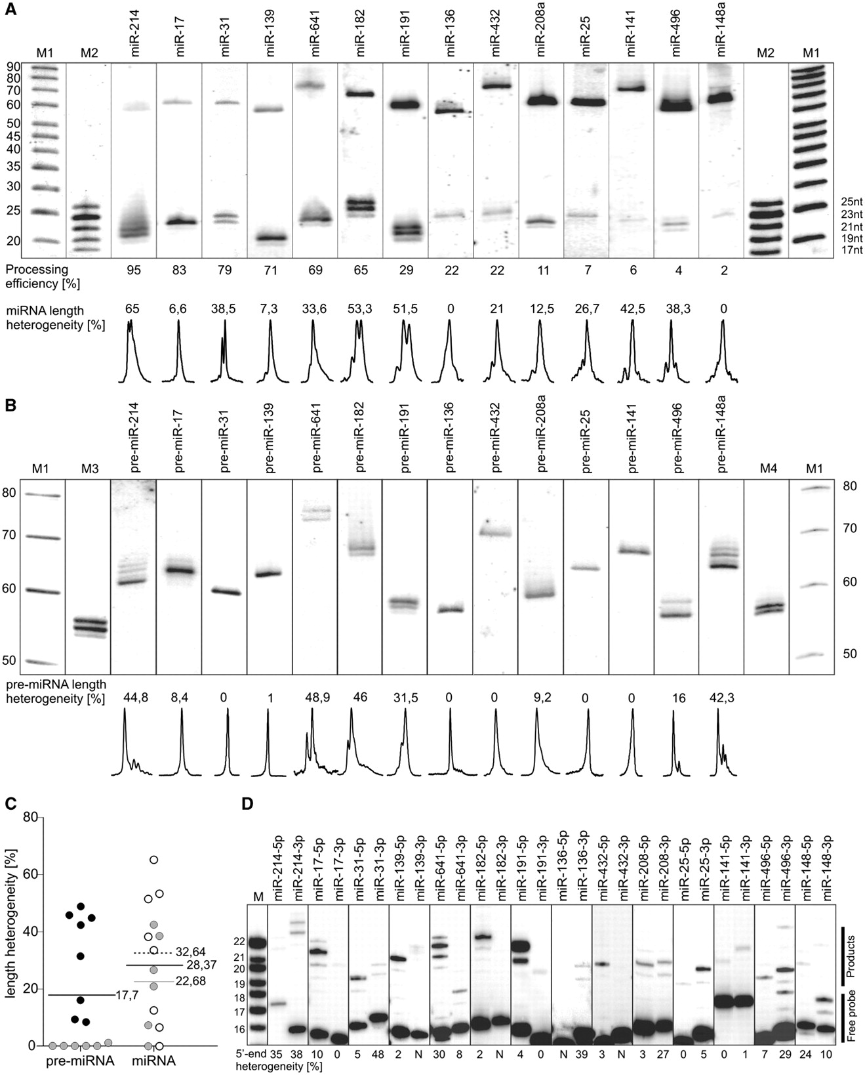
Figure 6. Analysis of the length heterogeneity of miRNAs and pre-miRNAs. ( A ) Northern blots showing the efficiency ...
Notes:
Figure 6. Analysis of the length heterogeneity of miRNAs and pre-miRNAs. ( A ) Northern blots showing the efficiency of precursor processing and the length variation of the miRNAs. RNA (30 μg) that was isolated from HEK293T cells after transfection with different plasmid-encoded pri-miRNAs (indicated above the gel) was analysed in the blot. We analysed the total miRNA fraction in the total northern blot hybridization signals (miRNA and pre-miRNA fraction) quantitatively, and the result is shown below the gel (calculated as the processing efficiency in percent). The fraction of the miRNA variants other than the most abundant miRNA (i.e. the miRNA length heterogeneity) was calculated as in the Figure 3 B, and the results are presented below the gel. A quantitative representation of the miRNA length variants is shown using the peaks obtained from the phosphoimaging analysis; M1 denotes the Low Molecular Weight Marker (USB Corp.); M2 denotes the 17–25 nt RNA marker. ( B ) Northern blots presenting the length variation of the pre-miRNAs. The experiments were performed as in (A), but longer electrophoretic runs were applied. The fractions of the pre-miRNA variants other than the most abundant pre-miRNA were determined as in Figure 3 B and are shown below the gel. The quantitative representation of the pre-miRNA length variants is shown using the peaks obtained from the phosphoimaging analysis. M1 denotes the Low Molecular Weight Marker (USB Corp.) M3 and M4 denote markers of the same sequence but differ in length by 1 nt (53 and 54 nt, and 58 and 59 nt, respectively). ( C ) Dots and black horizontal lines indicate the individual and average values of the length heterogeneity of all pre-miRNAs and miRNAs, respectively. The numbers represent the average length heterogeneity. The black dots represent pre-miRNAs that are heterogeneous in length. The grey dots represent either precursors that were homogeneous in length or miRNAs that were generated from these precursors. The grey line represents the average values of the miRNA length heterogeneity for those miRNAs that were generated from the homogeneous in length pre-miRNAs. The white dots show miRNAs that were generated from heterogeneous precursors. The dotted line represents the average value of the length heterogeneity of the miRNAs that were generated from heterogeneous precursors. ( D ) Primer extension analyses of RNA isolated from cells that had been transfected with the same plasmid-encoded pri-miRNAs as in Figure 6 A. Oligodeoxynucleotide primers ( Supplementary Table S4 ) complementary to either the miRNA or miRNA* sequences (which detect miRNAs derived from the 5′-arm-5p or the 3′-arm-3p) were annealed to the RNA (10 µg). M denotes the 16–22 nt DNA marker. The fraction of miRNA 5′-end variants other than the most abundant primer extension product was calculated, and the result is shown below the gel. N , products not detected or detected at level too low to analyse. The migration of the free probe and a fraction of the extended products are represented by black lines on the right side.
Unless provided in the caption above, the following copyright applies to the content of this slide: © The Author(s) 2010. Published by Oxford University Press.This is an Open Access article distributed under the terms of the Creative Commons Attribution Non-Commercial License (http://creativecommons.org/licenses/by-nc/2.5), which permits unrestricted non-commercial use, distribution, and reproduction in any medium, provided the original work is properly cited.

Slide 7
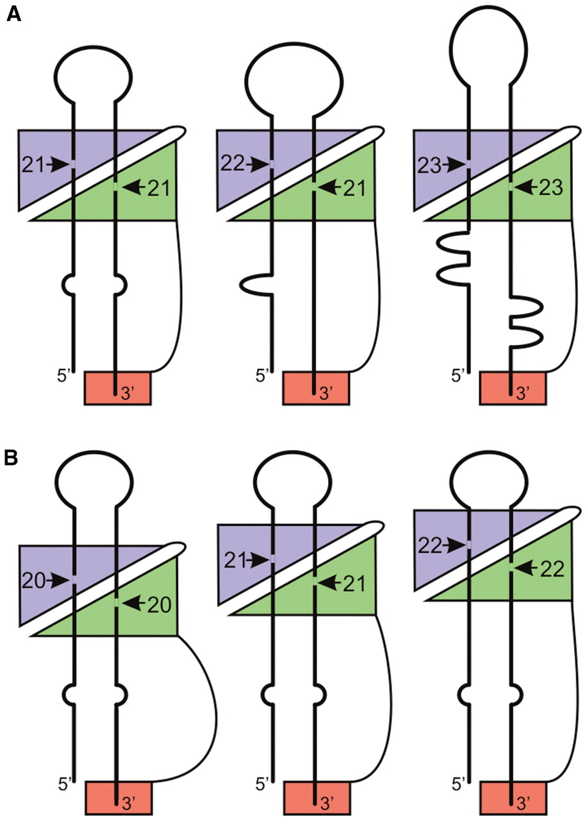
Figure 7. Schematic representations of the different phenomena involved in creating miRNA length variation. ( A ) ...
Notes:
Figure 7. Schematic representations of the different phenomena involved in creating miRNA length variation. ( A ) miRNA length diversity—miRNAs of diverse lengths are generated from different precursors. Symmetrical or asymmetrical structural motifs in pre-miRNA precursor are represented by single base mismatch or bulges, respectively. Dicer RNaseIII domain A (RIIIA) is indicated using a green triangle, and domain B (RIIIB) is indicated using a violet triangle. The PAZ domain is shown as a red rectangle. The arrows and numbers represent the Dicer cleavage sites and the lengths of the Dicer products, respectively. ( B ) miRNA length heterogeneity—miRNAs of heterogeneous lengths are generated from individual precursor. All representations and symbols are the same as in (A). For simplicity, the pre-miRNA is shown as flexible in generating length diversity (A), and Dicer is shown as flexible in generating miRNA length heterogeneity (B).
Unless provided in the caption above, the following copyright applies to the content of this slide: © The Author(s) 2010. Published by Oxford University Press.This is an Open Access article distributed under the terms of the Creative Commons Attribution Non-Commercial License (http://creativecommons.org/licenses/by-nc/2.5), which permits unrestricted non-commercial use, distribution, and reproduction in any medium, provided the original work is properly cited.

