Slide 1
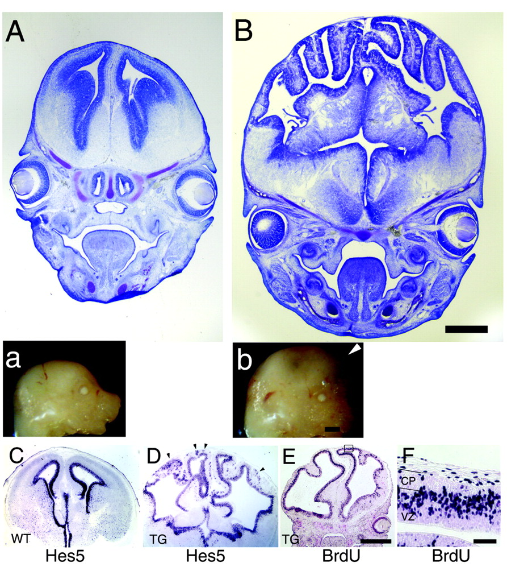
Figure 1. Enlarged brains and heads of β-catenin transgenic animals with horizontal expansion of precursor population. ...
Notes:
Figure 1. Enlarged brains and heads of β-catenin transgenic animals with horizontal expansion of precursor population. Mid-coronal section through the forebrain stained with cresyl violet of an embryonic day 15.5 wild-type littermate control (A) and comparable section of a transgenic animal (B) expressing a Δ90β-catenin–GFP fusion protein in neural precursors. The forebrain of transgenic animals is enlarged overall, with increased surface area and folding of the epithelial surface. Bar, 1 mm. Insets: Images of wild-type (a) and of transgenic (b) head reveals gross enlargement of the skull and forebrain vesicles protruding anteriorly (arrowhead) over the face of the embryo. Bar, 2 mm. (C, D) In situ hybridization for Hes5 in comparable coronal sections through wild-type littermate control (C) and transgenic brain (D). Hes5 is expressed in progenitor cells of in the ventricular zone of wild-type and transgenic brains. Additional areas of Hes5-expressing cells are located in ectopic regions away from the ventricular lumen in transgenic animals (arrowheads). Bar, 1 mm. (E, F) BrdU labeled cells in transgenic animals after 30 min exposure to BrdU. BrdU labels the same cells as the progenitor markers Hes5 and Hes1. (F) Higher magnification image reveals overall organization of ventricular zone of transgenic animals is preserved, with S-phase progenitors occupying the outer half of the ventricular zone, similar to wild-type progenitors. Bar, 1 mm (E), 200 μm (F). This figure is reproduced from Chenn and Walsh (Chenn and Walsh, 2002) with permission.
Unless provided in the caption above, the following copyright applies to the content of this slide: © Oxford University Press

Slide 2
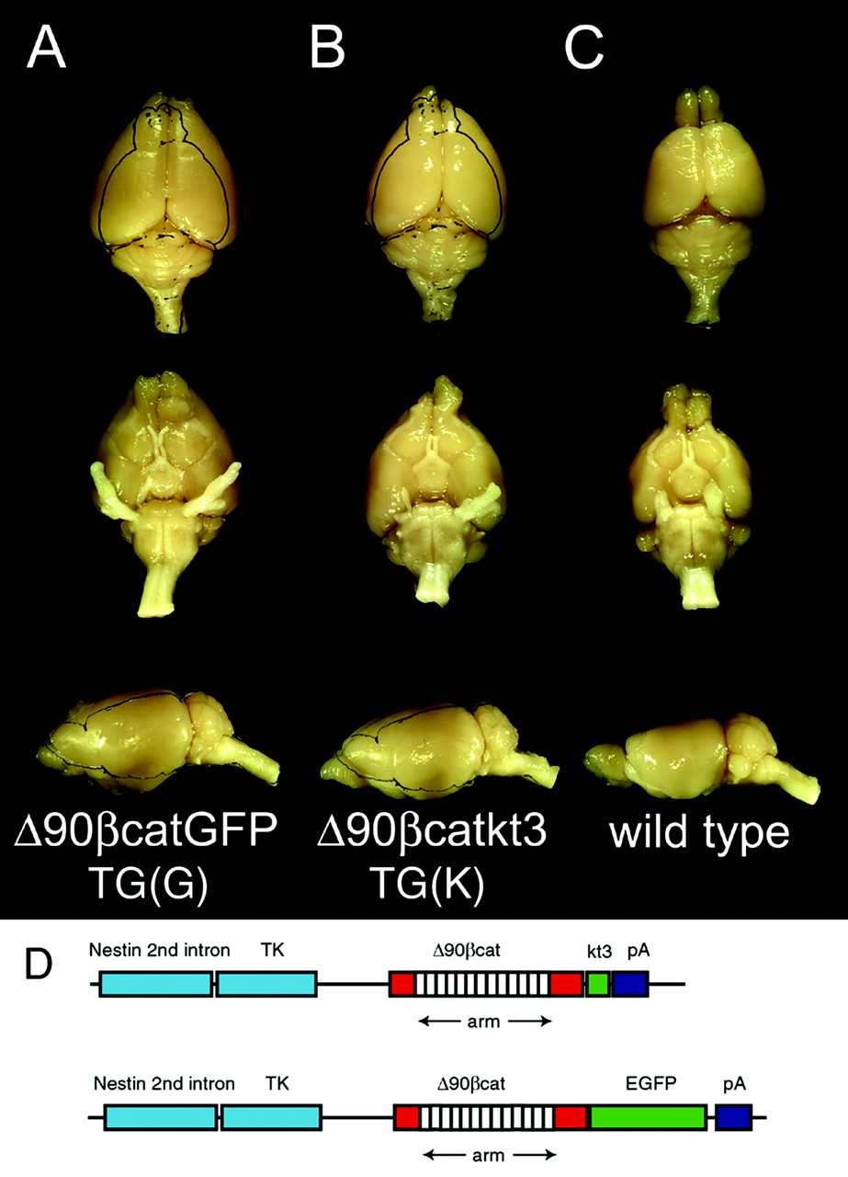
Figure 2. Images of adult (15 months) transgenic mouse brains overexpressing a stabilized form of β-catenin, compared ...
Notes:
Figure 2. Images of adult (15 months) transgenic mouse brains overexpressing a stabilized form of β-catenin, compared with a wild-type, age-matched control brain. Δ90β-catenin transgenic brains are enlarged compared with normal. (A) Δ90β-catenin–GFP transgenic brain and (B) Δ90β-catenin–kt3 transgenic brain compared with (C) wild-type age-matched control brain. The brain weights were 867 mg (A), 780 mg (B) and 551 mg (C), respectively. The increase in size of the brains is due primarily to expansion of the forebrain, and the remainder of the brains exhibit no overt abnormalities. In these two examples, the olfactory bulbs were damaged in dissection, but other enlarged transgenic brains examined had normal sized olfactory bulbs (not shown). (D) Transgenic constructs used to generate long-survival transgenic animals. Constructs removing the NH2 terminal amino acids of mouse β-catenin are fused either to EGFP or the kt3 epitope tag. The constructs used for adult transgenic animals remove the intron from the rat insulin II gene from the construct used previously (Chenn and Walsh, 2002) and hence provide less intense overexpression of the truncated form of β-catenin.
Unless provided in the caption above, the following copyright applies to the content of this slide: © Oxford University Press

Slide 3
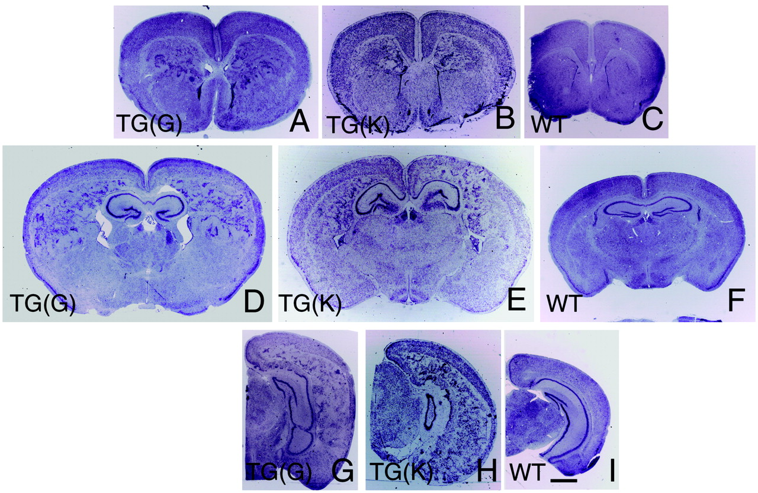
Figure 3. Sections through Δ90β-catenin transgenic brains. Coronal sections through forebrains of ntk3Δ90β-catenin GFP ...
Notes:
Figure 3. Sections through Δ90β-catenin transgenic brains. Coronal sections through forebrains of ntk3Δ90β-catenin GFP transgenic (A, D, G), ntk3Δ90β-cateninkt3 transgenic (B, E, H) versus wild-type mice (C, F, I). (A, B, C) Sections through rostral forebrain reveal relatively normal appearing overlying cortex superficial to large aggregates of neurons expanding the subventricular zone adjacent to the lateral ventricles. (D, E, F) Sections through mid-forebrain reveal similar accumulations of neurons in the subventricular zone. The cortical surface is thin and expanded; in areas, cells from the underlying subventricular zone invade the cortex. The lateral ventricles are enlarged, and the neuronal cell layer of the dentate gyrus is expanded. (G, H, I) Sections through caudal forebrain highlight more severe cortical thinning superficial to the expanded subventricular zone. Bar = 1 mm.
Unless provided in the caption above, the following copyright applies to the content of this slide: © Oxford University Press

Slide 4
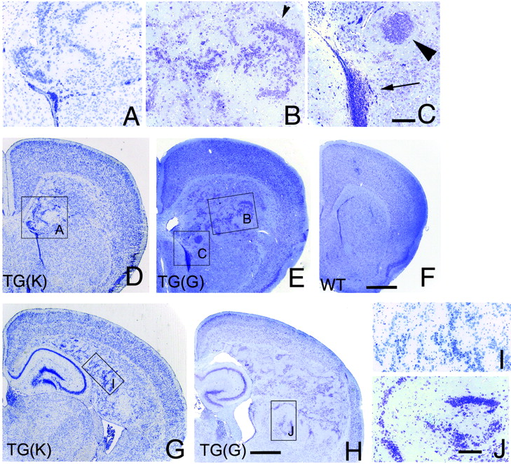
Figure 4. Images of rostral and mid forebrain in β-catenin overexpressing transgenic mice. Subventricular zone in ...
Notes:
Figure 4. Images of rostral and mid forebrain in β-catenin overexpressing transgenic mice. Subventricular zone in rostral forebrain is greatly expanded (D, E). Higher power images (A, B, C) reveal a variety of neuronal morphologies, including small precursor-like cells localized adjacent to ventricle (arrow, C), medium and larger neurons in laminar structures (arrowhead, B), and tight clusters (arrowhead, C). Mid-forebrain sections reveal the expanded subventricular zone evident in low power (G, H). The cortex in G appears morphologically normal, with all cortical layers distinct and normal in thickness (higher power in Fig. 5). In contrast, cortex in (H) is thin in areas, and disorganized. Higher power of subventricular zone (I, J) reveals streams of variably sized neurons in linear aggregates that sometimes resemble the layering pattern of the hippocampus and dentate gyrus. Bar = 1 mm (D, E, G, H) and 200 μm (A–C, I, J).
Unless provided in the caption above, the following copyright applies to the content of this slide: © Oxford University Press

Slide 5
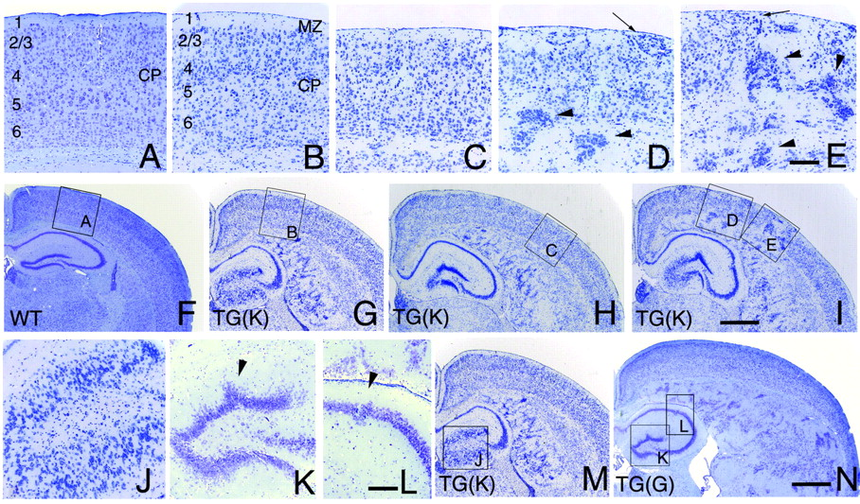
Figure 5. Cortical and hippocampal abnormalities in β-catenin overexpressing transgenic brains. Compared with wild-type ...
Notes:
Figure 5. Cortical and hippocampal abnormalities in β-catenin overexpressing transgenic brains. Compared with wild-type cortex from a similar rostral–caudal plane (A), the cortex of transgenic animal K is highly variable in composition. In mildly affected areas (B), cortical layers were definable but less precise than normal in some cases. In other areas (C), the cortex was thinner than normal but with some remaining lamination definable. In the most severely affected areas (D, E) cortical architecture was severely disrupted, with poor lamination and multiple neuronal hetertopias (arrowheads in D, E), and invasion of the normally cell sparse layer one with neurons (arrowhead, D). The architecture is highly variable in transgenic brains, even within adjacent areas of the cortex. Areas of transgenic animal G are similarly variable (for example, see 4E versus 5H). Hippocampal architecture is variably distorted in transgenic brains. Transgenic animal K has marked thickening of the dentate gyrus (J). Sections through transgenic animal G also reveal alterations in dentate gyrus morphology (K), with poorly organized lamination, and abnormal shape (arrowhead, K). The CA fields appear less affected, but show characteristic break (arrowhead, L; see also Fig. 3G, in caudal hippocampus, and I). Bar = 200 μm (A–E, J–L) and 1 mm (F–I, M, N).
Unless provided in the caption above, the following copyright applies to the content of this slide: © Oxford University Press

Slide 6
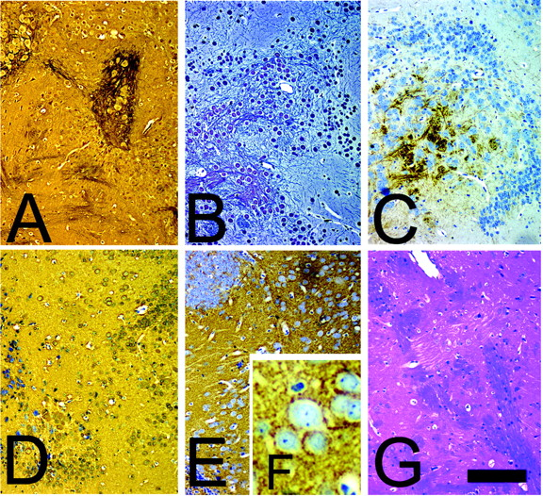
Figure 6. Histologic stains of cells from transgenic brains. Bielschowsky silver staining (A), Bodian silver staining ...
Notes:
Figure 6. Histologic stains of cells from transgenic brains. Bielschowsky silver staining (A), Bodian silver staining (B), neurofilament immunohistochemistry (C), immunohistochemical labeling of NSE (D), and synaptophysin staining (E) highlight large neurons in the forebrains of adult transgenic brains. (F) Inset of higher power synaptophysin staining reveals punctate accumulation characteristic of synapses. (G) Luxol Fast Blue stain for myelin highlights the presence of myelin in transgenic brains. Bar = 200 μm (A–E, G) and 50 μm (F).
Unless provided in the caption above, the following copyright applies to the content of this slide: © Oxford University Press

