Slide 1
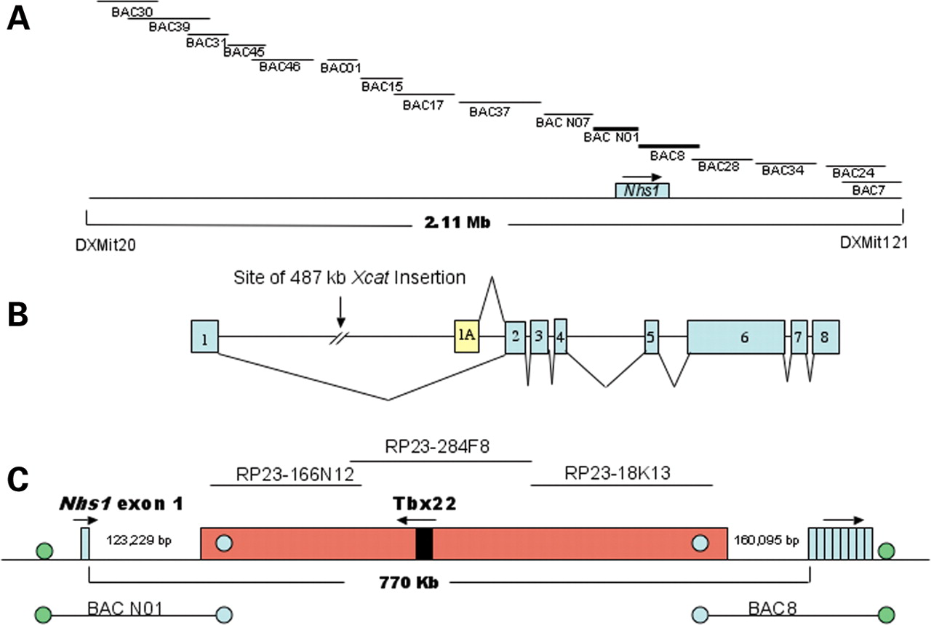
Figure 1. Gene structure of Nhs1 in normal and Xcat. (A) Schematic map of the Xcat critical region between ...
Notes:
Figure 1. Gene structure of Nhs1 in normal and Xcat. (A) Schematic map of the Xcat critical region between DXMit121 and DXMit20 as well as the position of Nhs1. BAC contig constituting the minimal tiling path is displayed within the critical region. The position of Nhs1 lies within both BAC N01 and BAC 8. All BAC clones were derived from Xcat genomic DNA and end-sequenced to position them within the Xcat critical region. (B) Mouse Nhs1 gene structure showing relative positions of exons 1 and 1A and location of the 487 kb insert within intron 1. (C) Location of the 487 kb insert within intron 1 with respect to overlapping BACs. The BAC ends from BAC 8 and BAC N01 contain sequence from the translocated insert as well as the normal sequence from the critical region. Three BACs, RP23-166N12, RP23-284F8 and RP23-18K13, map to the 487 kb insert and were used as probes in the FISH experiments. Note that the Tbx22 gene is located within the 487 kb insert.
Unless provided in the caption above, the following copyright applies to the content of this slide: © The Author 2005. Published by Oxford University Press. All rights reserved. For Permissions, please email: journals.permissions@oxfordjournals.org

Slide 2
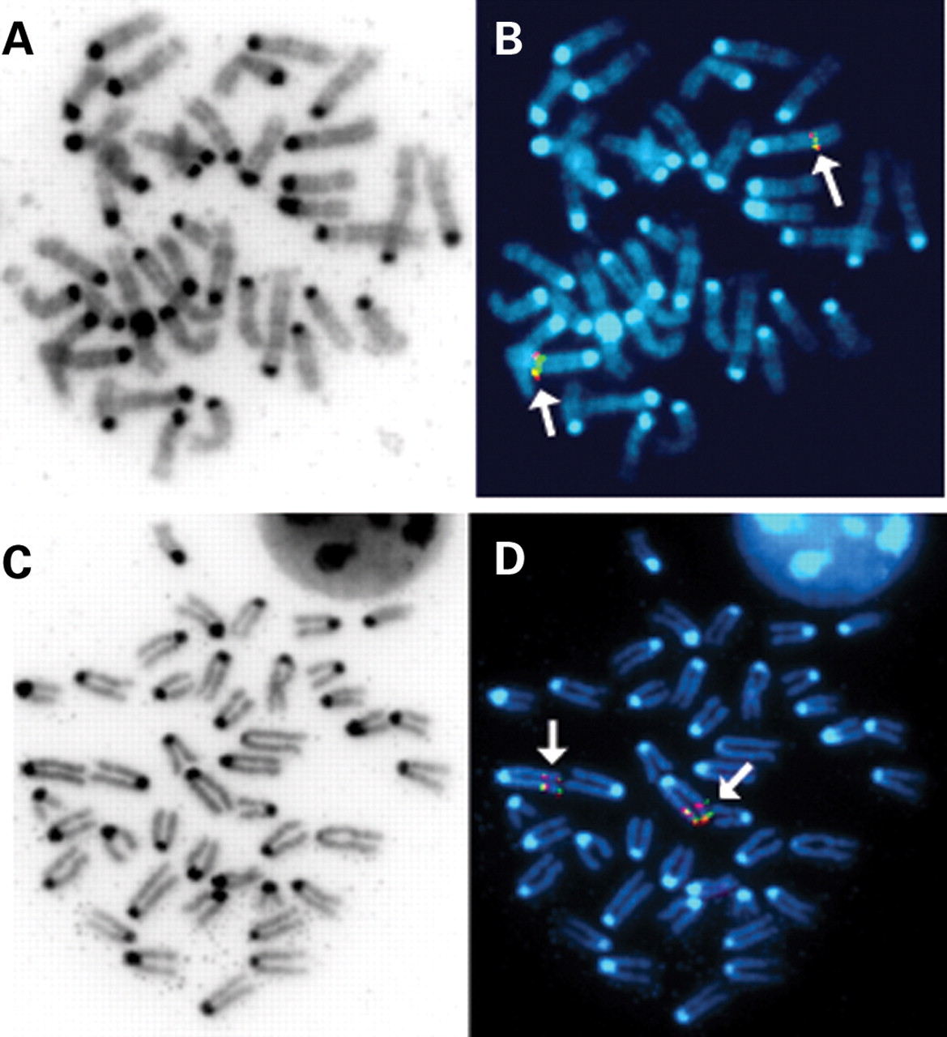
Figure 2. BAC FISH analysis of female X-chromosomes showing duplication in Xcat. BAC clones RP23-284F8, ...
Notes:
Figure 2. BAC FISH analysis of female X-chromosomes showing duplication in Xcat. BAC clones RP23-284F8, RP23-166N12 and RP23-18K13, which map to the 487 kb insert were labeled and used to probe normal (A and B) and Xcat (C and D) chromosomes. The hybridized regions appear red (arrow). Identical results were obtained using all three clones and results from RP23-166N12 are shown. Note the double signal signifying the duplication in Xcat when compared with that in normal.
Unless provided in the caption above, the following copyright applies to the content of this slide: © The Author 2005. Published by Oxford University Press. All rights reserved. For Permissions, please email: journals.permissions@oxfordjournals.org

Slide 3
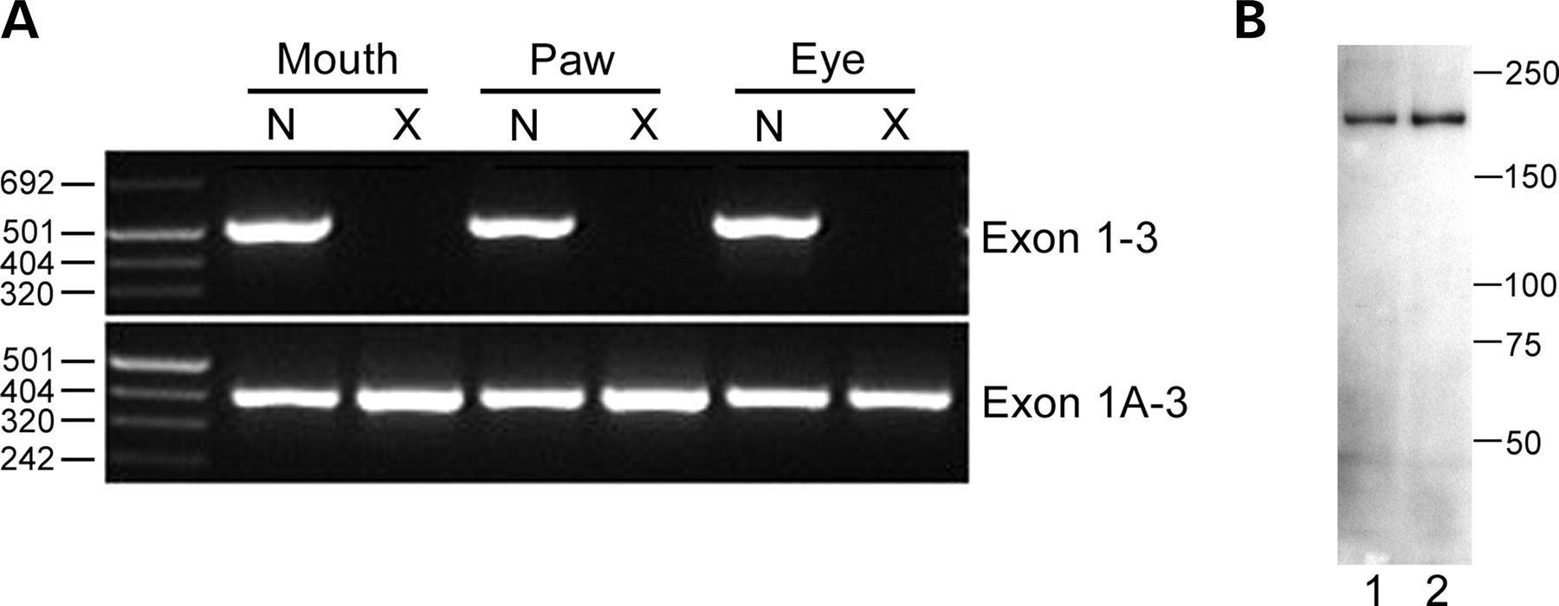
Figure 3. (A) Different expression of Nhs1 isoforms in normal and Xcat tissue. RT–PCR products generated from ...
Notes:
Figure 3. (A) Different expression of Nhs1 isoforms in normal and Xcat tissue. RT–PCR products generated from E14.5 mouth, paw and whole eye cDNA using primers specific for exons 1, 1A and 3 were analyzed by agarose gel electrophoresis. Product representing exons 1–3 was amplified in normal but not in Xcat cDNA, whereas exons 1A–3 product was amplified in both normal and Xcat. (B) Western blot analysis for Nhs1 performed on total extracted proteins from P0 WT kidney and liver. Lane 1 is kidney and lane 2 is liver.
Unless provided in the caption above, the following copyright applies to the content of this slide: © The Author 2005. Published by Oxford University Press. All rights reserved. For Permissions, please email: journals.permissions@oxfordjournals.org

Slide 4
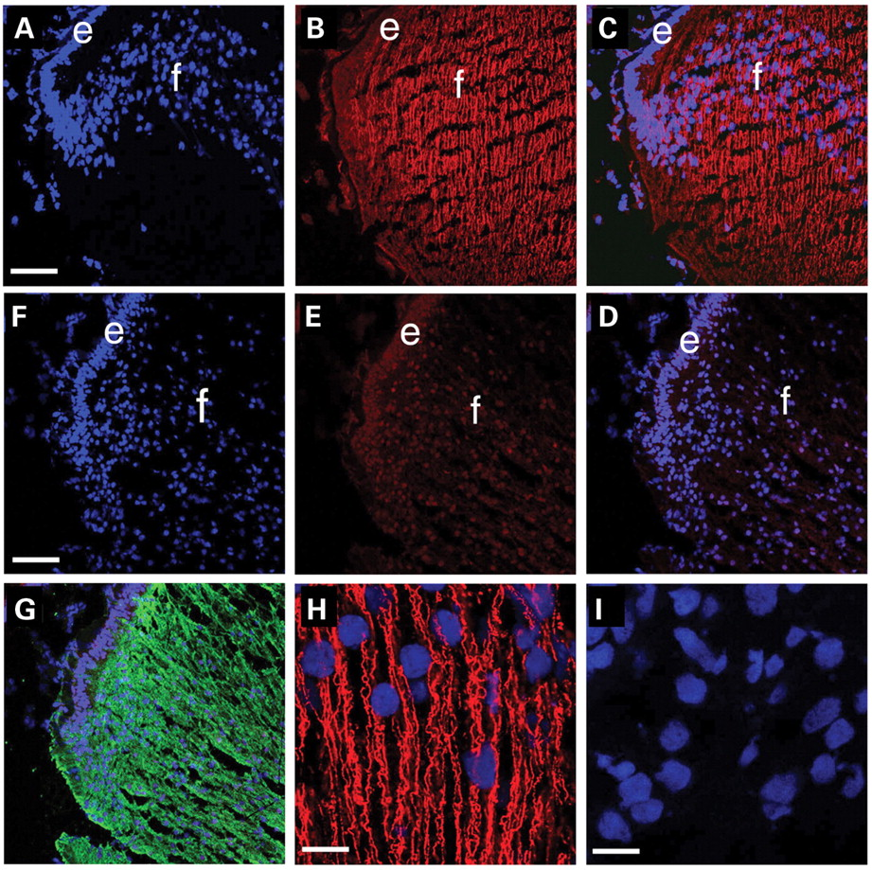
Figure 4. Immunohistochemistry of newborn lenses from WT and Xcat mice. Transverse sections from WT (A–C) and ...
Notes:
Figure 4. Immunohistochemistry of newborn lenses from WT and Xcat mice. Transverse sections from WT (A–C) and Xcat mouse lenses (D–F) were stained for Nhs1 (red) and counterstained with ToPro3 which detects cell nuclei (blue). Merged images are shown in (C) and (F). Nhs1 staining is found at moderate levels in the lens epithelium (e) and higher levels are found in lens fiber cells (f) in a filamentous distribution running parallel to their long axis in WT mice (B, C and H). However, this staining pattern is absent from lenses of Xcat mice (E, F and I). Staining of Xcat lens with aquaporin O (G, green) demonstrates intense staining, suggesting that protein synthesis is not generally depressed. High power view of Nhs staining in WT lens fibers (H) and its absence in the fibers of the Xcat lens (I). (A–G) are 200× magnification (bar=77 µm) and (H) and (I) are approximately 1200× magnification (bar=13 µm).
Unless provided in the caption above, the following copyright applies to the content of this slide: © The Author 2005. Published by Oxford University Press. All rights reserved. For Permissions, please email: journals.permissions@oxfordjournals.org

Slide 5
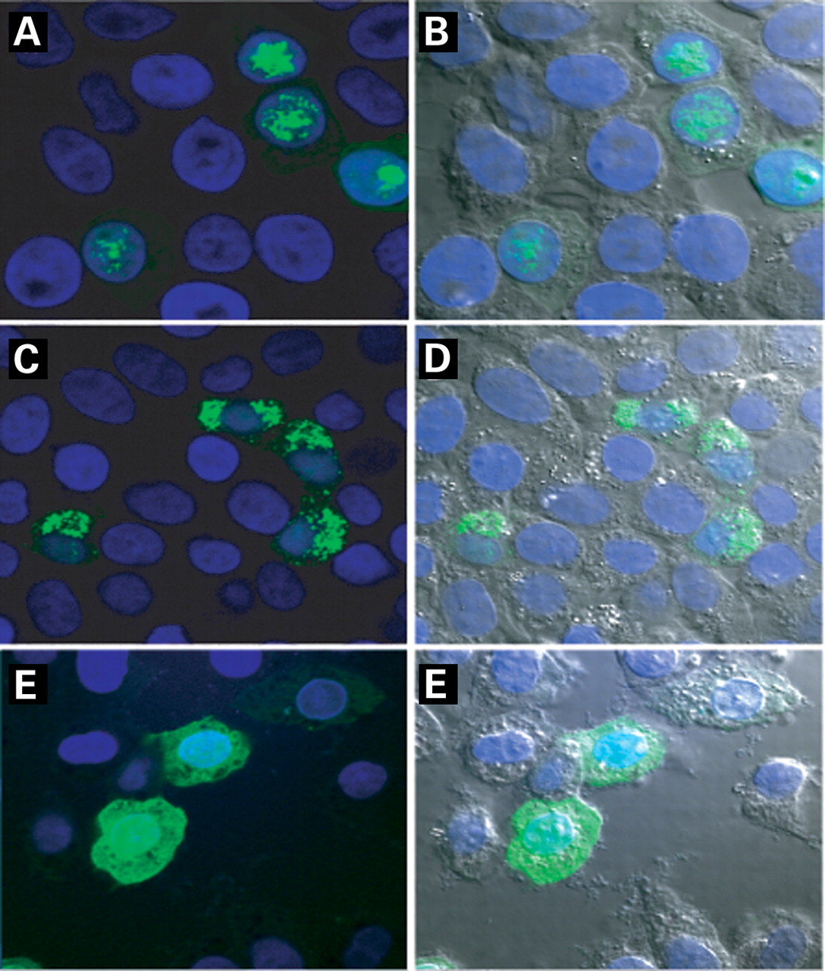
Figure 5. Confocal fluorescence microscopy of transfected CHO cells showing subcellular localization of ...
Notes:
Figure 5. Confocal fluorescence microscopy of transfected CHO cells showing subcellular localization of Nhs1–GFP and fusion proteins. Nhs1 exons 1 through 5 or 1A through 5 were cloned in frame to the 5′ end (N-terminus) of GFP. The resultant vectors were transfected into CHO cells and the localization of the Nhs1–GFP fusion proteins was examined. CHO cells expressing protein from exons 1to 5 constructs display a cytoplasmic expression pattern, whereas cells expressing protein from exons 1A to 5 display nuclear expression. (A and B) are the fluorescence and DIC micrograph of fusion proteins constructed from exons 1A to 5. (C and D) are the representative micrographs of fusion proteins constructed from exons 1 to 5 and (E and F) represent the GFP vector without insert (green, GFP, blue, DAPI nuclear staining).
Unless provided in the caption above, the following copyright applies to the content of this slide: © The Author 2005. Published by Oxford University Press. All rights reserved. For Permissions, please email: journals.permissions@oxfordjournals.org

