Slide 1
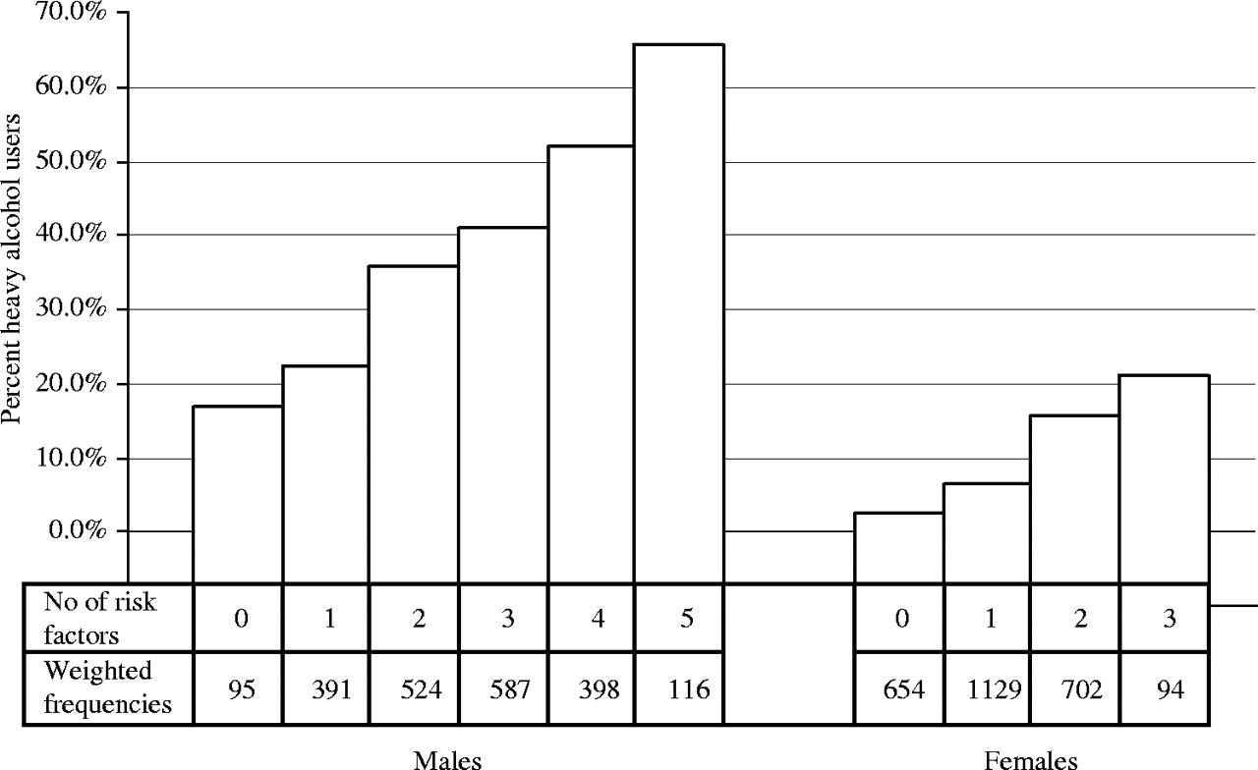
Fig. 2. Relationship of number of risk factors to heavy alcohol use (Tests for linear trend: men (F = 73.6, P < ...
Notes:
Fig. 2. Relationship of number of risk factors to heavy alcohol use (Tests for linear trend: men (F = 73.6, P < 0.001); women (F = 69.3, P < 0.001).
Unless provided in the caption above, the following copyright applies to the content of this slide: © The Author 2005. Published by Oxford University Press on behalf of the Medical Council on Alcohol. All rights reserved

Slide 2
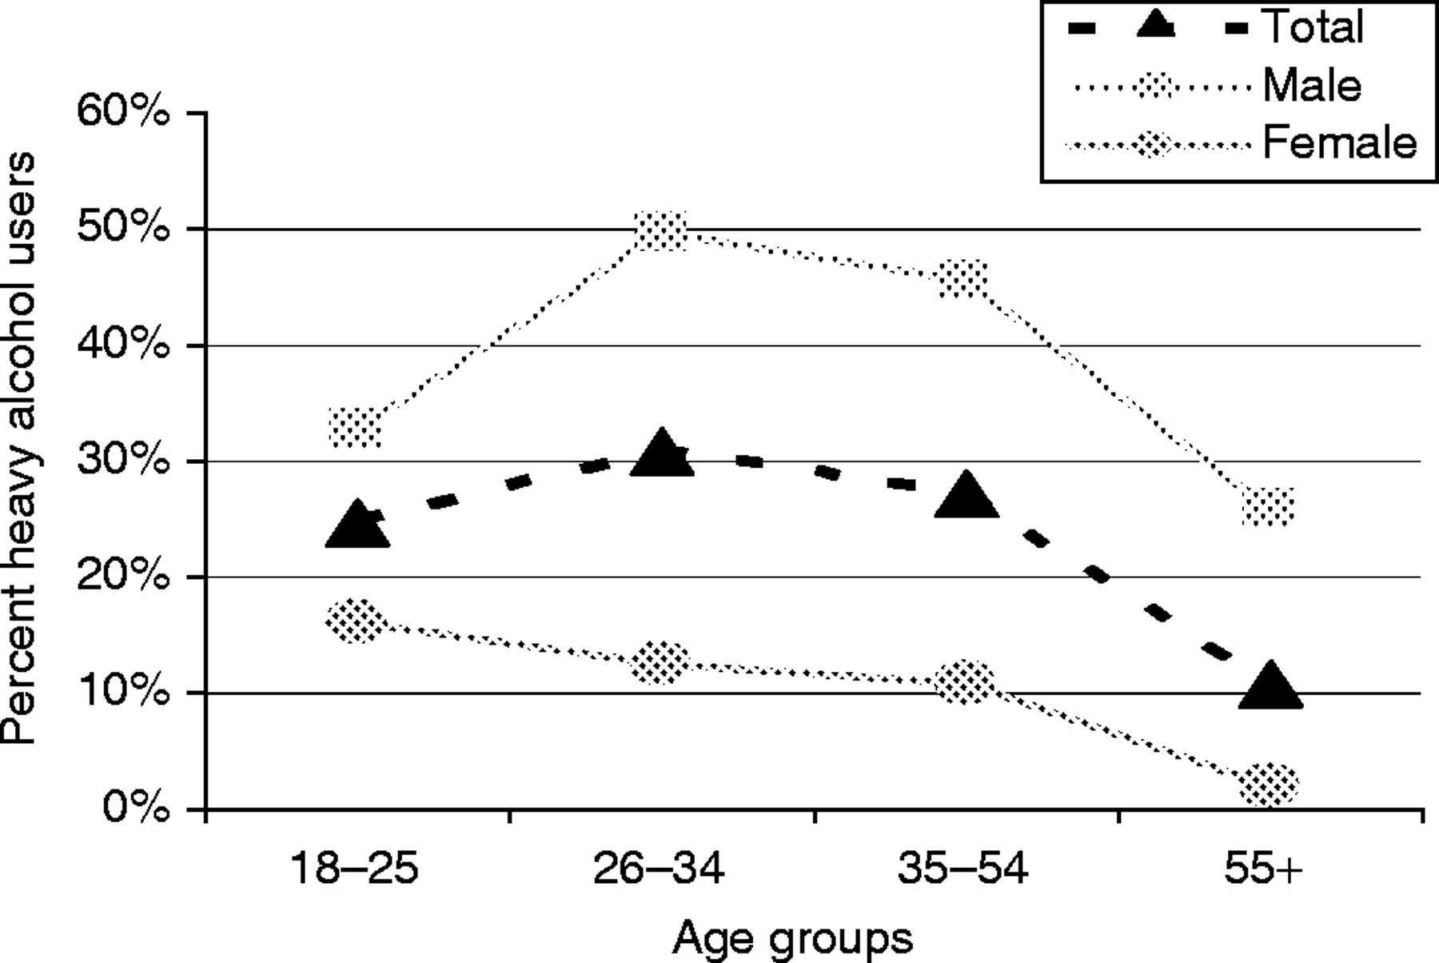
Fig. 1. Relationship of gender and age to heavy alcohol use in Ukraine.
Notes:
Fig. 1. Relationship of gender and age to heavy alcohol use in Ukraine.
Unless provided in the caption above, the following copyright applies to the content of this slide: © The Author 2005. Published by Oxford University Press on behalf of the Medical Council on Alcohol. All rights reserved

