Slide 1
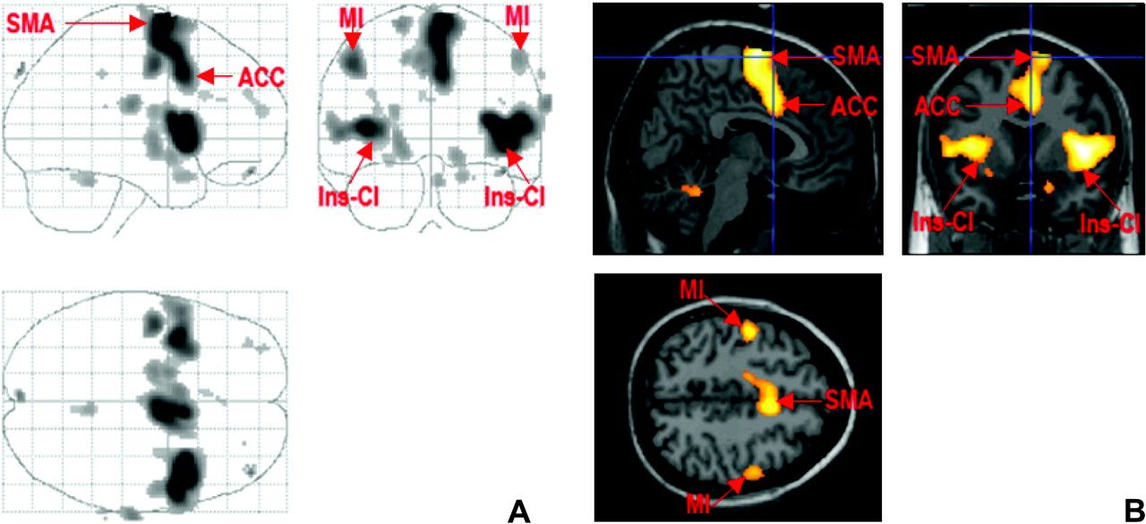
Figure 1. Panel (A): glass brain shows all brain areas activated during suppression of blinking (contrast: suppression ...
Notes:
Figure 1. Panel (A): glass brain shows all brain areas activated during suppression of blinking (contrast: suppression minus spontaneous blinking). Panel (B): suppression of blinking: activations are seen in bilateral insular-claustrum regions (Ins-CL), right more than left; ACC, area 24, bilateral primary motor cortex, face area (M1), and SMA.
Unless provided in the caption above, the following copyright applies to the content of this slide: Published by Oxford University Press 2008.

Slide 2
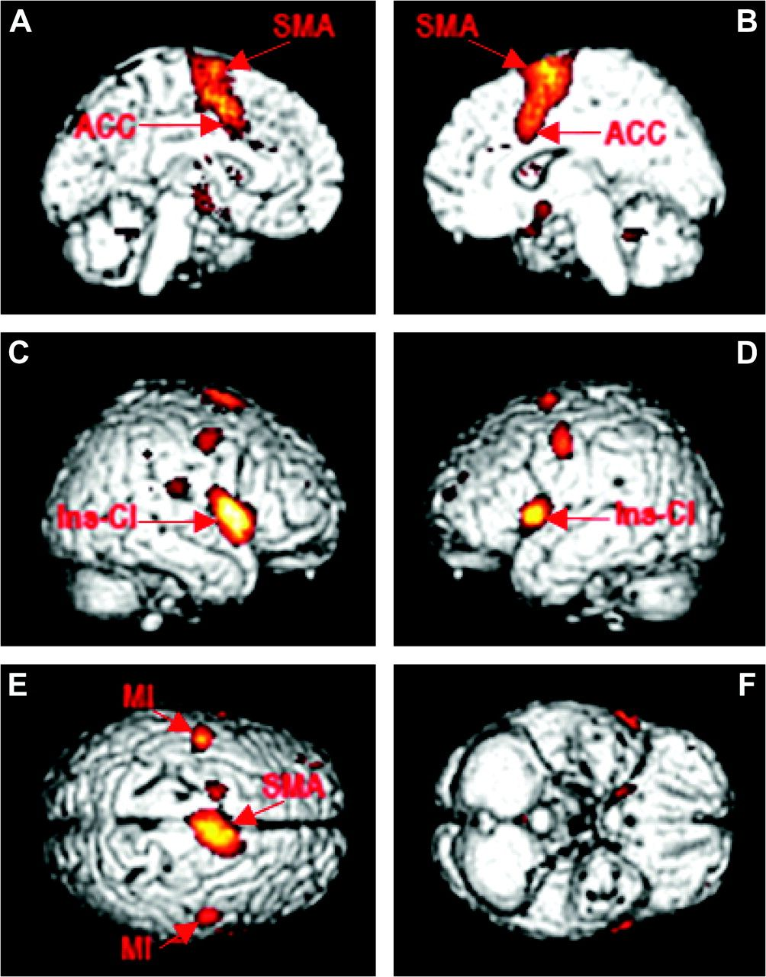
Figure 2. The panels (A–F) show cortical areas activated during suppression of blinking: left and right anterior ...
Notes:
Figure 2. The panels (A–F) show cortical areas activated during suppression of blinking: left and right anterior cingulate and SMA (panel A and B), left and right insula-claustrum and primary motor cortex (panel C and D); SMA and both motor areas M1 (panel E). For both Figures 1 and 2, activations are statistically significant at P = 0.05 false discovery rate corrected for multiple comparison.
Unless provided in the caption above, the following copyright applies to the content of this slide: Published by Oxford University Press 2008.

