Slide 1
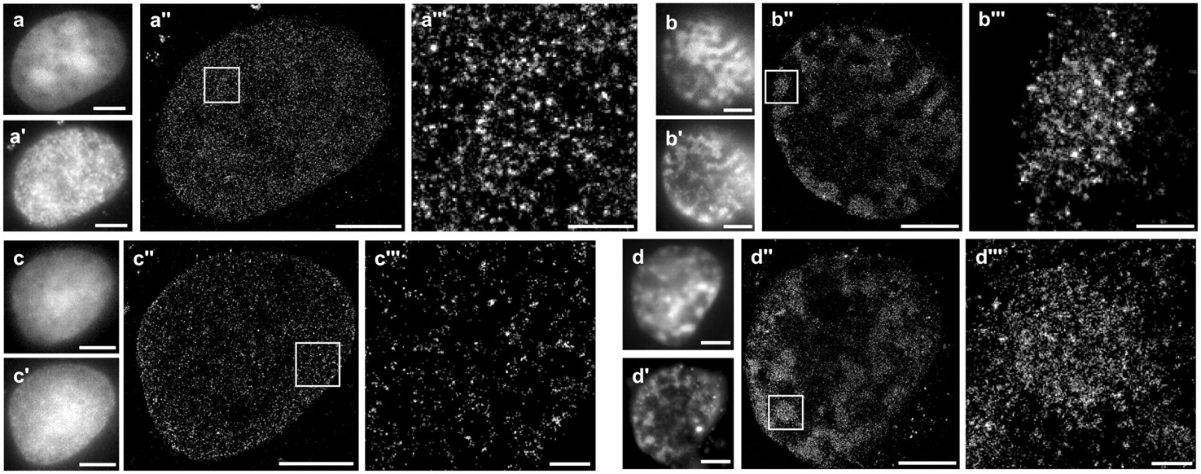
Figure 1. d STORM pictures acquired from Cos-7 cells transfected with HMGA1a-eGFP. Widefield microscopy was used to ...
Notes:
Figure 1. d STORM pictures acquired from Cos-7 cells transfected with HMGA1a-eGFP. Widefield microscopy was used to select cells with either low HMGA1a-eGFP expression (no chromatin clustering; a and c) or high HMGA1a-eGFP expression (chromatin clustering; b and d). Widefield fluorescence images of immunostainings using HMGA1 and DNA antibodies are shown in a′ and b′ (HMGA1) and c′ and d′ (DNA). Note that in a′ both endogenous HMGA1 and the fusion protein are detected by the immunostaining. Corresponding d STORM images are shown in a″–d″. Highlighted boxes are shown in a″′–d″′. Scale bars are 5 µm in a–d″ or 500 nm in a″′–d″′. Note the localization of HMGA1 in defined domains.
Unless provided in the caption above, the following copyright applies to the content of this slide: © The Author(s) 2011. Published by Oxford University Press.This is an Open Access article distributed under the terms of the Creative Commons Attribution Non-Commercial License (http://creativecommons.org/licenses/by-nc/3.0), which permits unrestricted non-commercial use, distribution, and reproduction in any medium, provided the original work is properly cited.

Slide 2
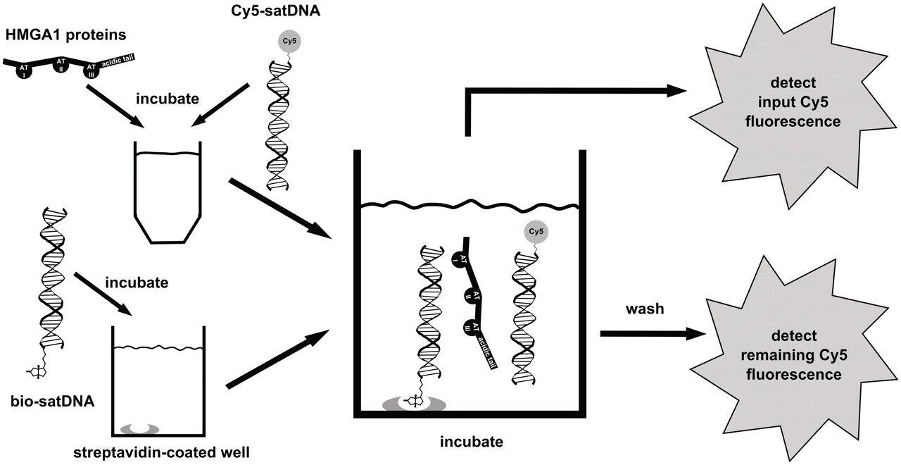
Figure 2. Principle of the DNA cross-linking assay. Streptavidin pre-coated wells are loaded with bio-satDNA. A ...
Notes:
Figure 2. Principle of the DNA cross-linking assay. Streptavidin pre-coated wells are loaded with bio-satDNA. A protein/Cy5-satDNA solution is incubated. Input Cy5 fluorescence and, after intensive washing steps, remaining Cy5 fluorescence is detected. The ratio of nput / remaining Cy5 fluorescence ×100% was defined as RCE.
Unless provided in the caption above, the following copyright applies to the content of this slide: © The Author(s) 2011. Published by Oxford University Press.This is an Open Access article distributed under the terms of the Creative Commons Attribution Non-Commercial License (http://creativecommons.org/licenses/by-nc/3.0), which permits unrestricted non-commercial use, distribution, and reproduction in any medium, provided the original work is properly cited.

Slide 3
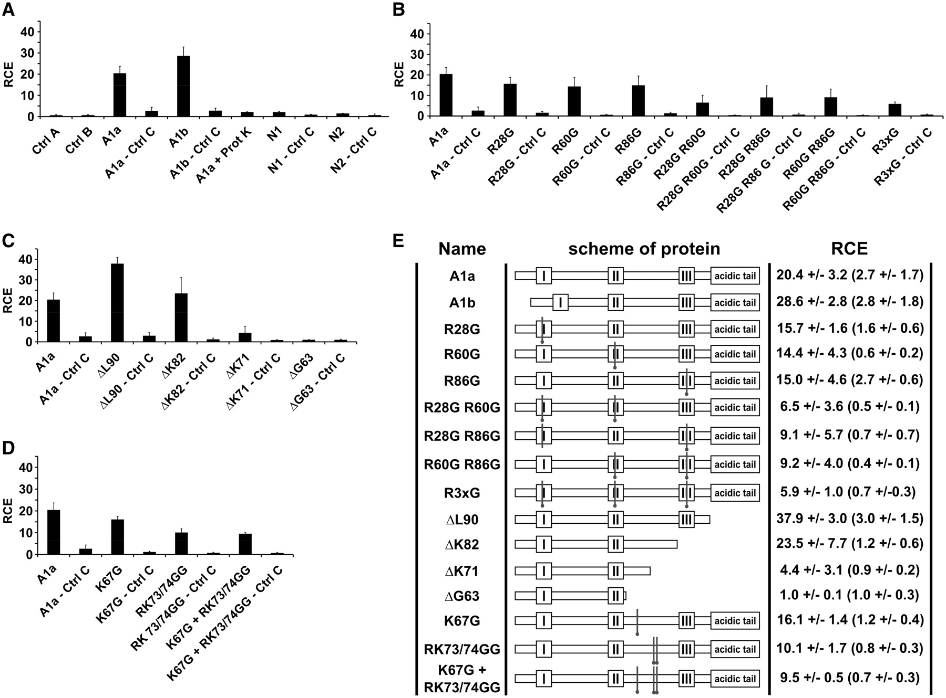
Figure 3. Results of DNA cross-linking assays. Bar charts of cross-linking assays showing RCE in ( A–D ). Standard ...
Notes:
Figure 3. Results of DNA cross-linking assays. Bar charts of cross-linking assays showing RCE in ( A–D ). Standard deviations are included. (A) Specific cross-linking of DNA through HMGA1 proteins (A1a, A1b). Controls to exclude non-specific binding are shown with Cy5-satDNA in wells without precoupled bio-satDNA (Ctrl A), in wells containing precoupled bio-satDNA (Ctrl B) or without precoupled bio-satDNA incubated with protein and Cy5-satDNA (protein—Ctrl C). RCEs of HMG proteins N1 and N2 reveal no DNA cross-linking (N1—Ctrl C, N2 Ctrl C). Proteinase K treatment (A1a + Prot K) disrupts DNA cross-linking to 98%. (B) Cross-linking efficiencies of HMGA1a-AT-hook mutants. Compared to HMGA1a (A1a) single point mutations of one AT-hook (R28G; R60G; R86G) show significantly reduced RCEs. Double-mutants of two AT-hooks (R28G R60G, R28 R86G, R60G R86G) cross-link DNA with further diminished RCEs. Note that R28G R60G mutant has the lowest RCE. Triple-point mutation of all three AT-hooks (R3xG) again shows low RCEs. Corresponding controls without precoupled bio-satDNA incubated with protein and Cy5-satDNA (protein—Ctrl C) are given. (C) Cross-linking efficiencies of C-terminal truncated HMGA1a proteins suggest the requirement of a cross-linking domain between AT-hooks II and III. Deletion of the acidic tail (ΔL90) of HMGA1a leads to an increased RCE compared to the wild-type protein (A1a). Further deletion of A1a including the third AT-hook (ΔK82) gives RCEs again to wild-type levels (A1a). Further truncation decreases the RCE dramatically (ΔK71). Further truncation up to the second AT-hook (ΔG63) diminishes the RCE to background level. Corresponding controls without precoupled bio-satDNA incubated with protein and Cy5-satDNA (protein—Ctrl C) are given. (D) Point mutations in conserved amino acids between the second and the third AT-hook reduce DNA cross-linking. The point mutation K67G leads to a slightly decreased RCE compared to wild-type protein. Compared to wild-type protein the RCE of the RK73/74GG double mutant drops 50%. A triple-point mutated protein K67G + RK73/74GG shows a similar RCE as the double-point mutant RK73/74GG alone. Corresponding controls without precoupled bio-satDNA incubated with protein and Cy5-satDNA (protein—Ctrl C) were at background levels. This shows that the amino-acids R73 and K74 are essential for efficient DNA cross-linking. ( E ) Schemes of HMGA1 proteins and summary of RCE. Sites of point mutations are indicated. RCE values and SDs are listed accordingly. RCEs of corresponding controls without bio-satDNA, but incubated with protein and Cy5-satDNA (protein—Ctrl C) are given in brackets.
Unless provided in the caption above, the following copyright applies to the content of this slide: © The Author(s) 2011. Published by Oxford University Press.This is an Open Access article distributed under the terms of the Creative Commons Attribution Non-Commercial License (http://creativecommons.org/licenses/by-nc/3.0), which permits unrestricted non-commercial use, distribution, and reproduction in any medium, provided the original work is properly cited.

Slide 4
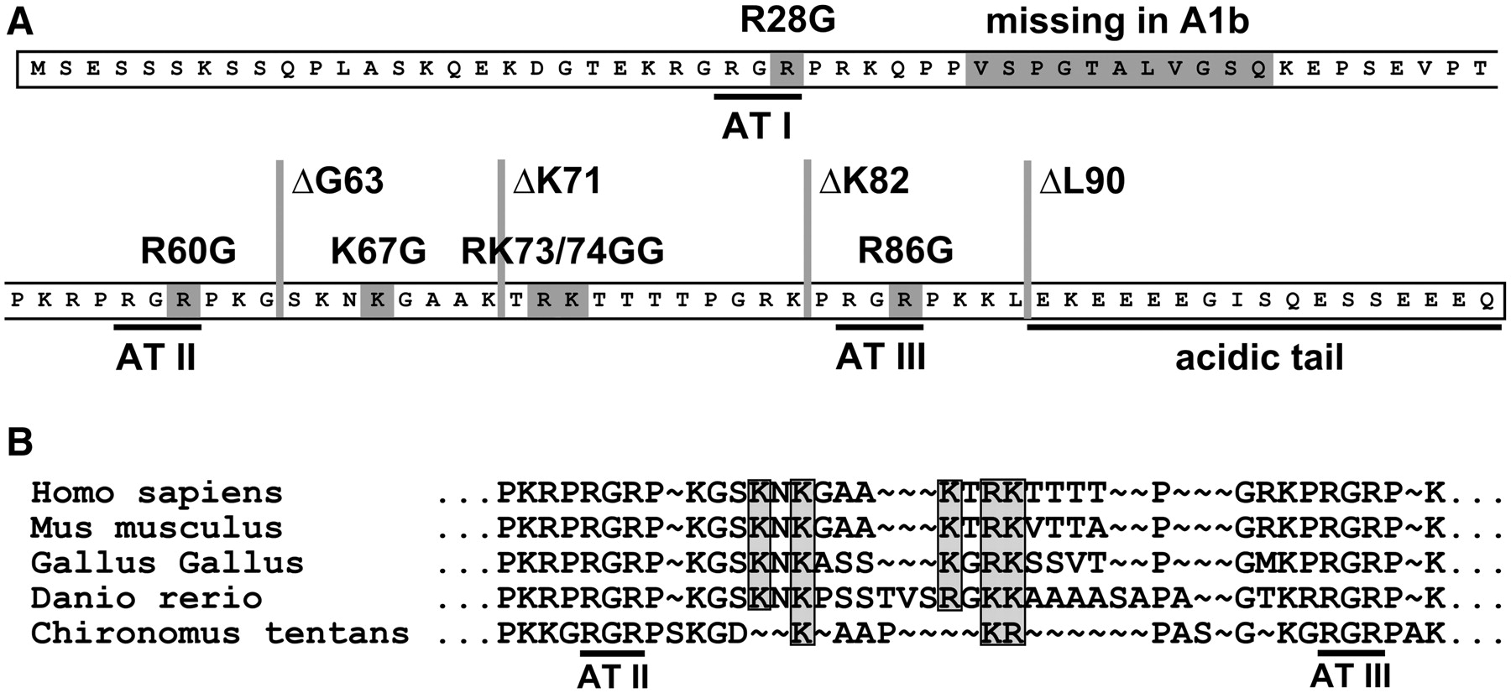
Figure 4. ( A ) HMGA1 mutations used indicated on the level of the amino acid sequence. ( B ) Species alignment of ...
Notes:
Figure 4. ( A ) HMGA1 mutations used indicated on the level of the amino acid sequence. ( B ) Species alignment of HMGA1 amino acid sequences of the region between AT-hooks II and III. Conserved amino acids are indicated (grey boxes). Compared are sequences from human (homo sapiens, CAI14992), mouse (mus musculus, NP_057869), chicken (gallus gallus, NP_989700), zebra fish (danio rerio, NP_998333) and midge (chironomus tentans, CAA85365).
Unless provided in the caption above, the following copyright applies to the content of this slide: © The Author(s) 2011. Published by Oxford University Press.This is an Open Access article distributed under the terms of the Creative Commons Attribution Non-Commercial License (http://creativecommons.org/licenses/by-nc/3.0), which permits unrestricted non-commercial use, distribution, and reproduction in any medium, provided the original work is properly cited.

Slide 5
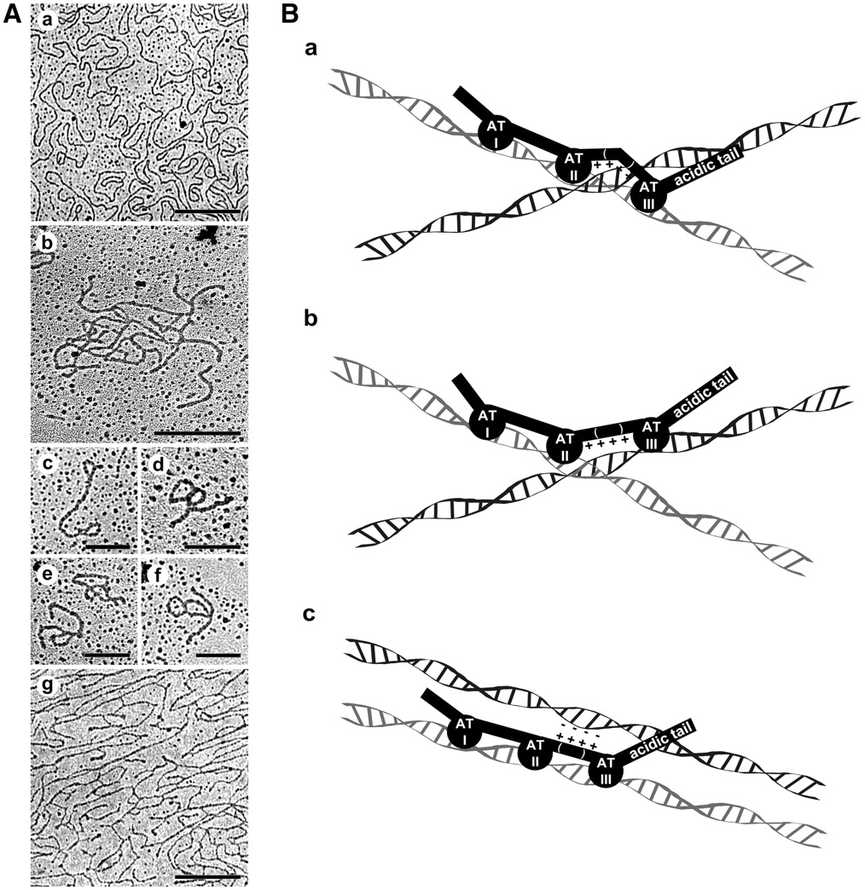
Figure 5. ( A ) Electron microscopic analysis of HMGA1–DNA interaction using DNA spread preparations. Naked DNA is ...
Notes:
Figure 5. ( A ) Electron microscopic analysis of HMGA1–DNA interaction using DNA spread preparations. Naked DNA is shown in a. DNA incubated with HMGA1a is presented in pictures b–f. Note the DNA cross-linking in b and loops and coils in c–f. DNA incubated with the R3xG AT-hook triple mutant is shown in g. Low DNA binding and an intact region between AT-hooks II and III are sufficient to create a DNA network. Bars in a, b and g are 500 nm. Bars in c–f are 250 nm. ( B ) Models of DNA cross-linking through HMGA1. Either a clamp- or a push-button model is conceivable. In the clamp-model HMGA1 molecules bind to DNA with their AT-hooks, whereas the cross-linking domain-containing R73 and K74 overstretches an adjacent DNA fiber (a and b). The third AT-hook either contacts the same DNA molecule than AT hooks I and II (a) or contacts the second DNA molecule (b). In the push-button model, the cross-linking domain contacts a neighboring DNA fiber (c).
Unless provided in the caption above, the following copyright applies to the content of this slide: © The Author(s) 2011. Published by Oxford University Press.This is an Open Access article distributed under the terms of the Creative Commons Attribution Non-Commercial License (http://creativecommons.org/licenses/by-nc/3.0), which permits unrestricted non-commercial use, distribution, and reproduction in any medium, provided the original work is properly cited.

