Slide 1
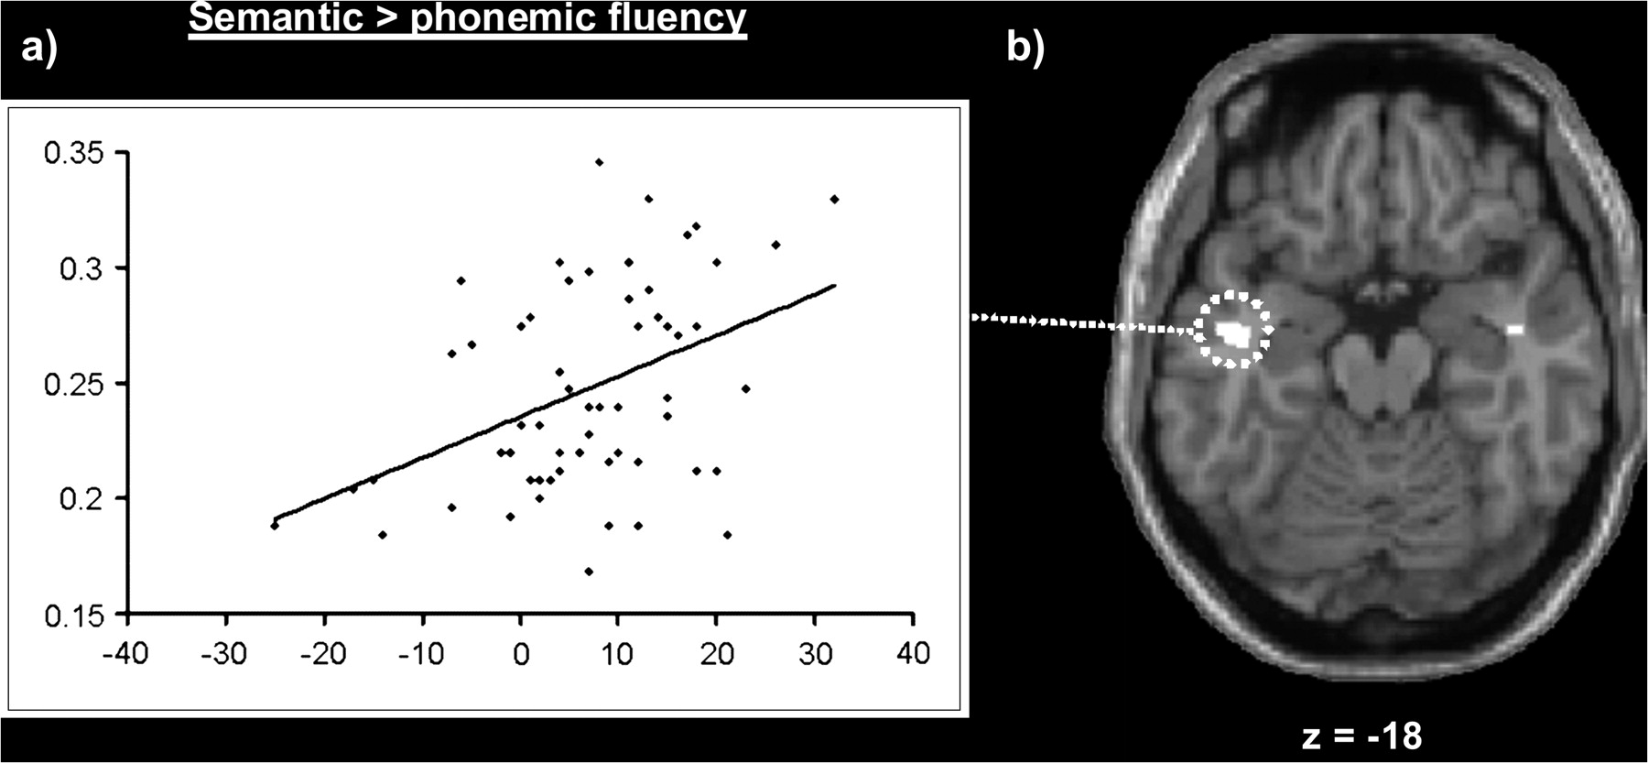
Figure 1. Gray matter correlations with semantic more than phonemic fluency. (a) Positive correlation between gray ...
Notes:
Figure 1. Gray matter correlations with semantic more than phonemic fluency. (a) Positive correlation between gray matter density, measured as cubic millimeters of gray matter per voxel, and semantic relative to phonemic fluency scores in the left inferior temporal region (x = −44, y = −10, z = −18). (b) The location of this effect in the left inferior temporal lobe on an axial slice of the canonical brain in Montreal Neurological Institute space using a threshold of P <0.01 (to show all effects). A corresponding effect in the right inferior temporal lobe (P < 0.001 uncorrected) can also been seen.
Unless provided in the caption above, the following copyright applies to the content of this slide: © 2009 The AuthorsThis is an Open Access article distributed under the terms of the Creative Commons Attribution Non-Commercial License (http://creativecommons.org/licenses/by-nc/2.0/uk/) which permits unrestricted non-commercial use, distribution, and reproduction in any medium, provided the original work is properly cited.

Slide 2
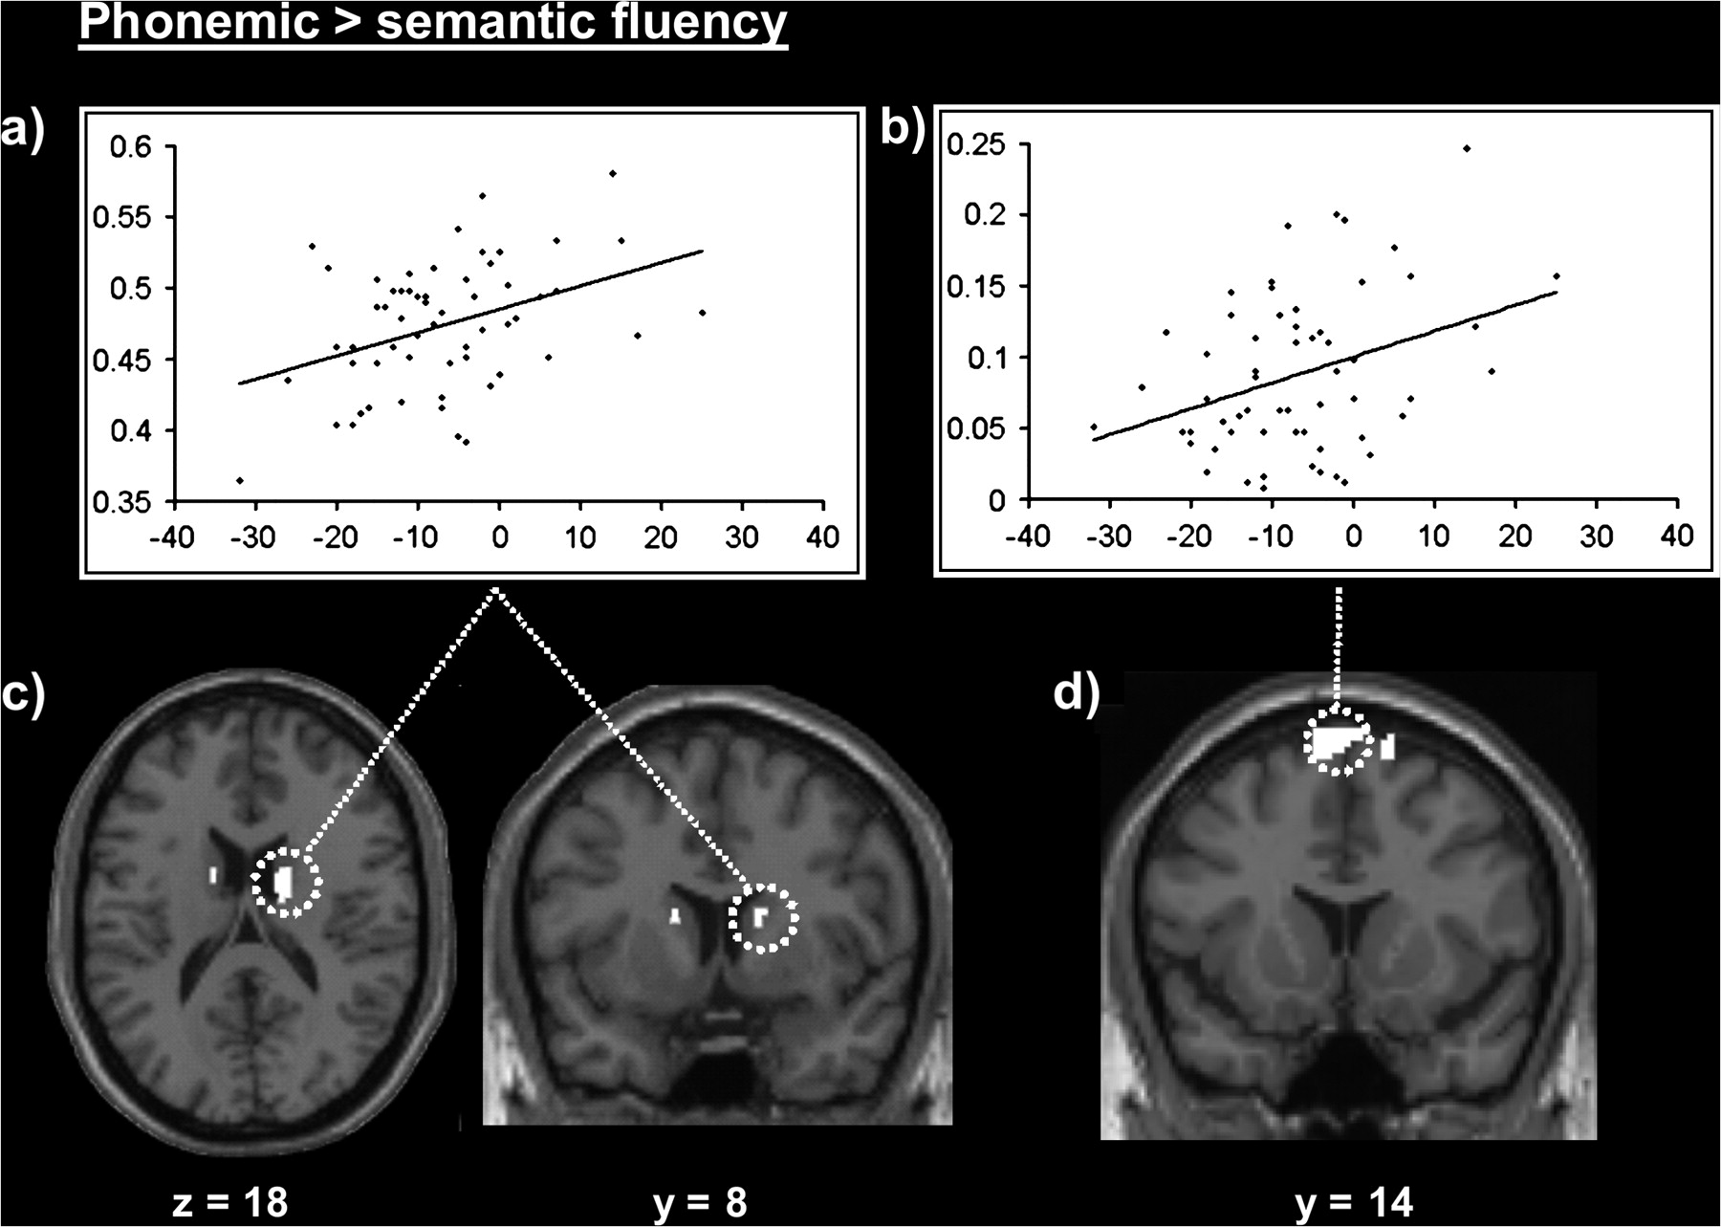
Figure 2. Gray matter correlations with phonemic more than semantic fluency. Above: positive correlation between gray ...
Notes:
Figure 2. Gray matter correlations with phonemic more than semantic fluency. Above: positive correlation between gray matter density, measured as cubic millimeters of gray matter per voxel, and phonemic relative to semantic fluency scores in the (a) right head of caudate (x = 14, y = 0, z = 16) and (b) the left pre-SMA (x = −4, y = 14, z = 74). Below: the location of the effects in (c) the right and left caudate on axial and coronal slices and (d) bilateral pre-SMA, using a threshold of P <0.01 (to show all effects).
Unless provided in the caption above, the following copyright applies to the content of this slide: © 2009 The AuthorsThis is an Open Access article distributed under the terms of the Creative Commons Attribution Non-Commercial License (http://creativecommons.org/licenses/by-nc/2.0/uk/) which permits unrestricted non-commercial use, distribution, and reproduction in any medium, provided the original work is properly cited.

