Slide 1
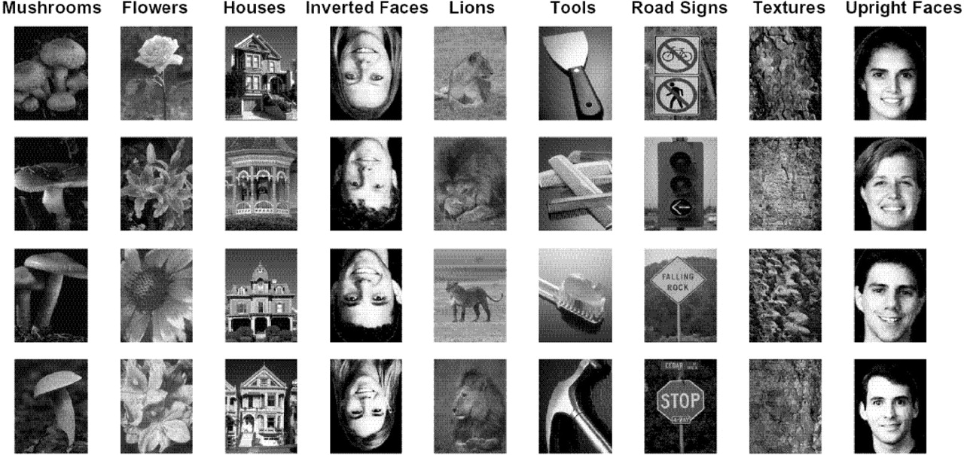
Figure 1. Examples of stimuli from the nine categories used in the experiment.
Notes:
Figure 1. Examples of stimuli from the nine categories used in the experiment.
Unless provided in the caption above, the following copyright applies to the content of this slide:

Slide 2
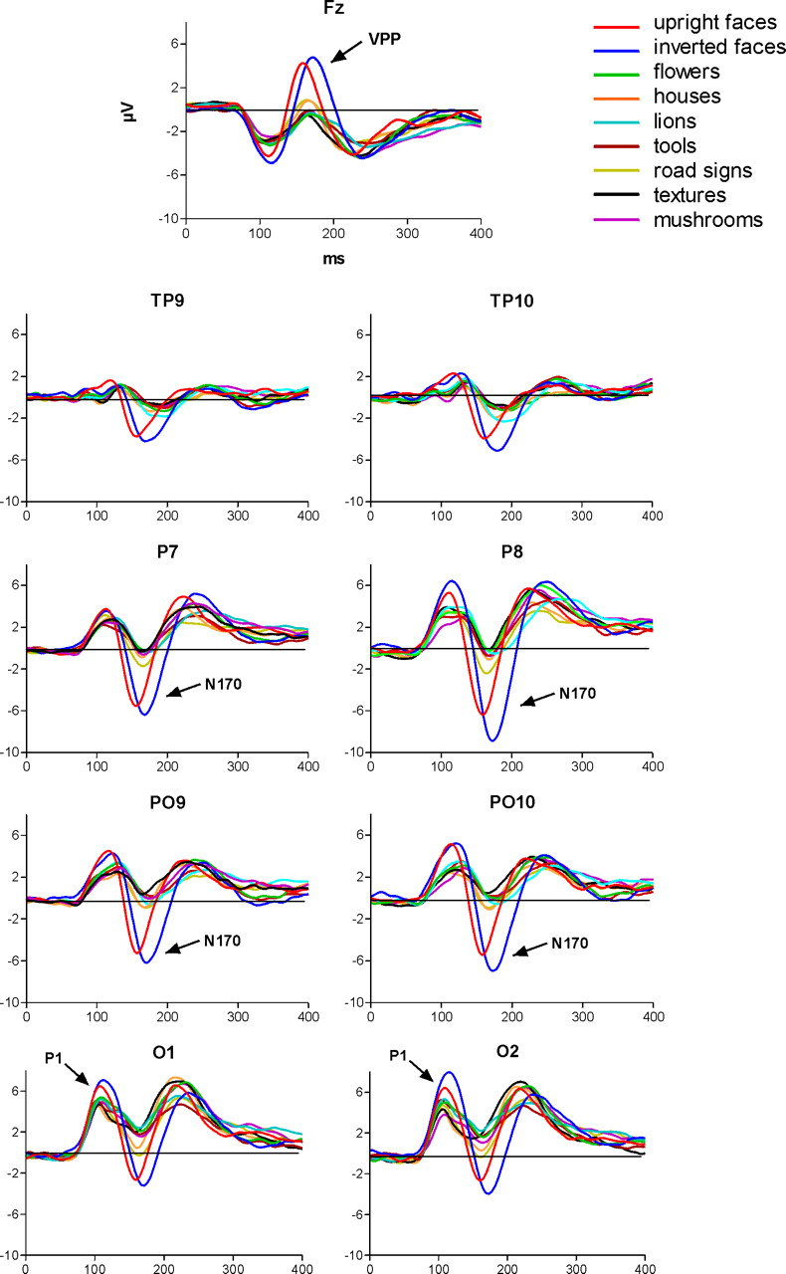
Figure 2. Grand-average ERPs displayed between 0 and 400 ms for the nine categories at medial frontal (Fz), ...
Notes:
Figure 2. Grand-average ERPs displayed between 0 and 400 ms for the nine categories at medial frontal (Fz), temporal-parietal (TP9/TP10), parietal (P7/P8), parietal-occipital (PO9/PO10) and occipital (O1/O2) sites. Note the larger P1 and N170 components for upright and inverted faces compared to all other categories.
Unless provided in the caption above, the following copyright applies to the content of this slide:

Slide 3
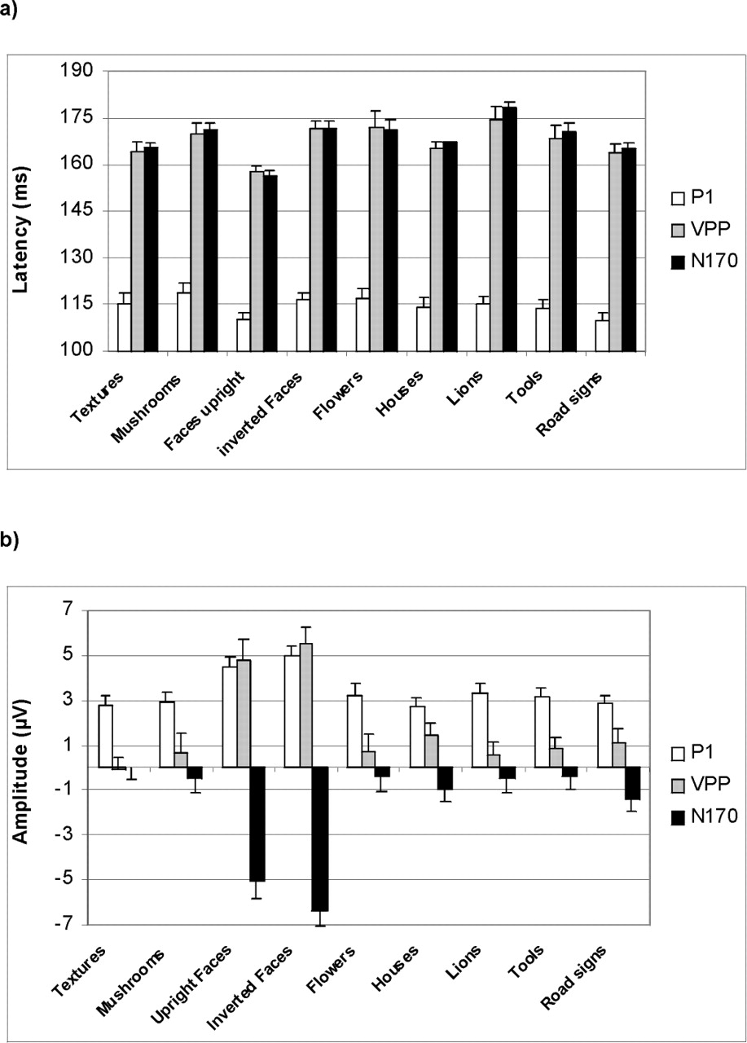
Figure 3. Mean latencies (a) and amplitudes (b) of P1, VPP and N170 components displayed for all nine ...
Notes:
Figure 3. Mean latencies (a) and amplitudes (b) of P1, VPP and N170 components displayed for all nine categories. Note the earlier P1, VPP and N170 for upright faces compared to other categories and the larger P1, VPP and N170 for upright and inverted faces compared to all other categories.
Unless provided in the caption above, the following copyright applies to the content of this slide:

Slide 4
Figure 4. Mean pictures of the nine categories obtained after averaging the 50 stimuli of each category pixel ...
Notes:
Figure 4. Mean pictures of the nine categories obtained after averaging the 50 stimuli of each category pixel by pixel; only upright and inverted faces yield recognizable stimuli.
Unless provided in the caption above, the following copyright applies to the content of this slide:

Slide 5
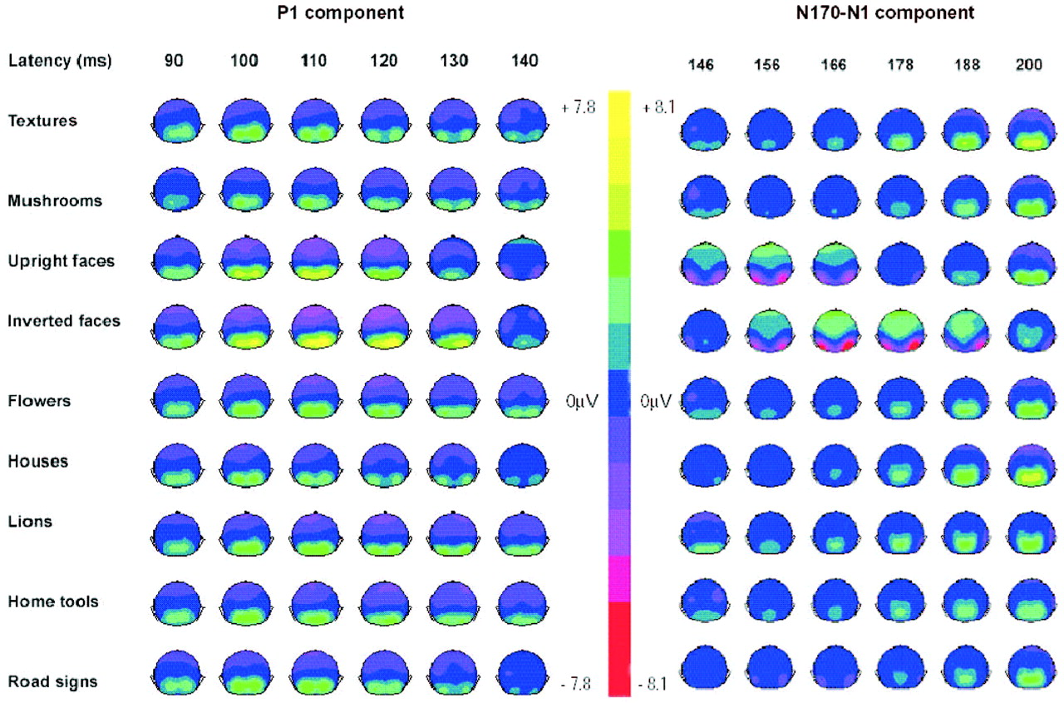
Figure 5. Back views of voltage maps (in µV) displayed between 90 and 140 ms (P1 component, left panel) and ...
Notes:
Figure 5. Back views of voltage maps (in µV) displayed between 90 and 140 ms (P1 component, left panel) and between 146 and 200 ms (N170–N1 component, right panel) for all nine categories. Note the larger occipital positivity for upright and inverted faces compared to objects reflecting larger P1s. The delayed latency of the P1 for inverted faces compared to upright faces is also visible. On the right panel, parietal-occipital bilateral generators of negative amplitude (in red) representing N170 are clearly seen for upright and inverted faces only. The latency delay for inverted face N170 is visible, starting only at 156 ms. Note also that the activity corresponding to the objects’ N1 resembles that of P1 and shows zero or positive occipital activity, an argument in favor of the hypothesis that N1 differs from faces’ N170 and likely represents the return to baseline of the P1 component.
Unless provided in the caption above, the following copyright applies to the content of this slide:

Slide 6
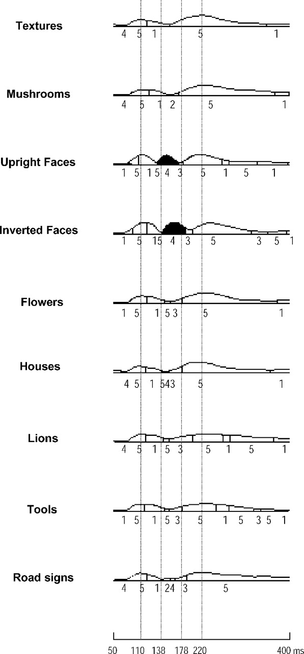
Figure 6. The results of the segmentation analysis performed on grand averages of all categories are ...
Notes:
Figure 6. The results of the segmentation analysis performed on grand averages of all categories are represented in the form of maps (clusters of activity) across the global field power (GFP) between 50 and 400 ms. Five maps were found to be optimal. Note that upright and inverted faces displayed an extra map (in black) compared to all objects. The maximum GFP of this extra map was found at the maximum of N170 peak.
Unless provided in the caption above, the following copyright applies to the content of this slide:

