Slide 1
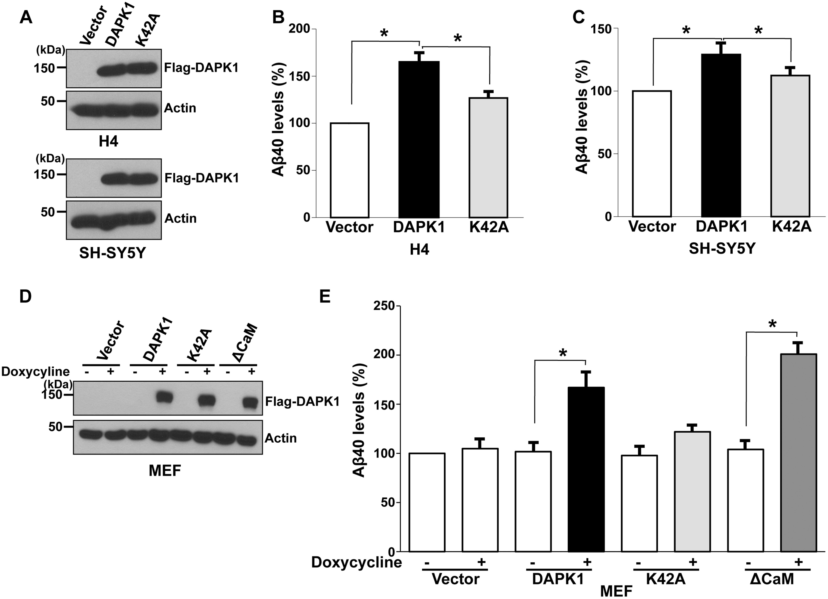
Figure 1. DAPK1 stimulates the secretion of human- and mouse Aβ40. (A–C) Human H4 and SH-SY5Y cells were transfected ...
Notes:
Figure 1. DAPK1 stimulates the secretion of human- and mouse Aβ40. (A–C) Human H4 and SH-SY5Y cells were transfected with pRK5-Flag, pRK5-Flag-DAPK1 or pRK5-Flag-DAPK1K42A for 32 h. The cell lysates were subjected to western blot analysis with anti-Flag or anti-actin antibody and the levels of human Aβ40 in cell culture supernatants were determined by a solid phase sandwich ELISA assay. Each data point represents the mean ± standard error of three independent experiments (*P < 0.05; ANOVA/Dunnett’s test). (D, E) MEF cells were transfected with pTRE-Tight vector, pTRE-Tight-DAPK1, pTRE-Tight-DAPK1K42A or pTRE-Tight-DAPK1ΔCaM for 8 h followed by treatment with or without 1 μg/ml doxycycline for 48 h. The cell lysates were subjected to western blot analysis with anti-Flag or anti-actin antibody and the levels of mouse Aβ40 in cell culture supernatants were determined by a solid phase sandwich ELISA assay. Each data point represents the mean ± standard error of three independent experiments (*P < 0.05; ANOVA/Dunnett’s test).
Unless provided in the caption above, the following copyright applies to the content of this slide: © The Author 2016. Published by Oxford University Press. All rights reserved. For permissions, please e-mail: journals.permissions@oup.com

Slide 2
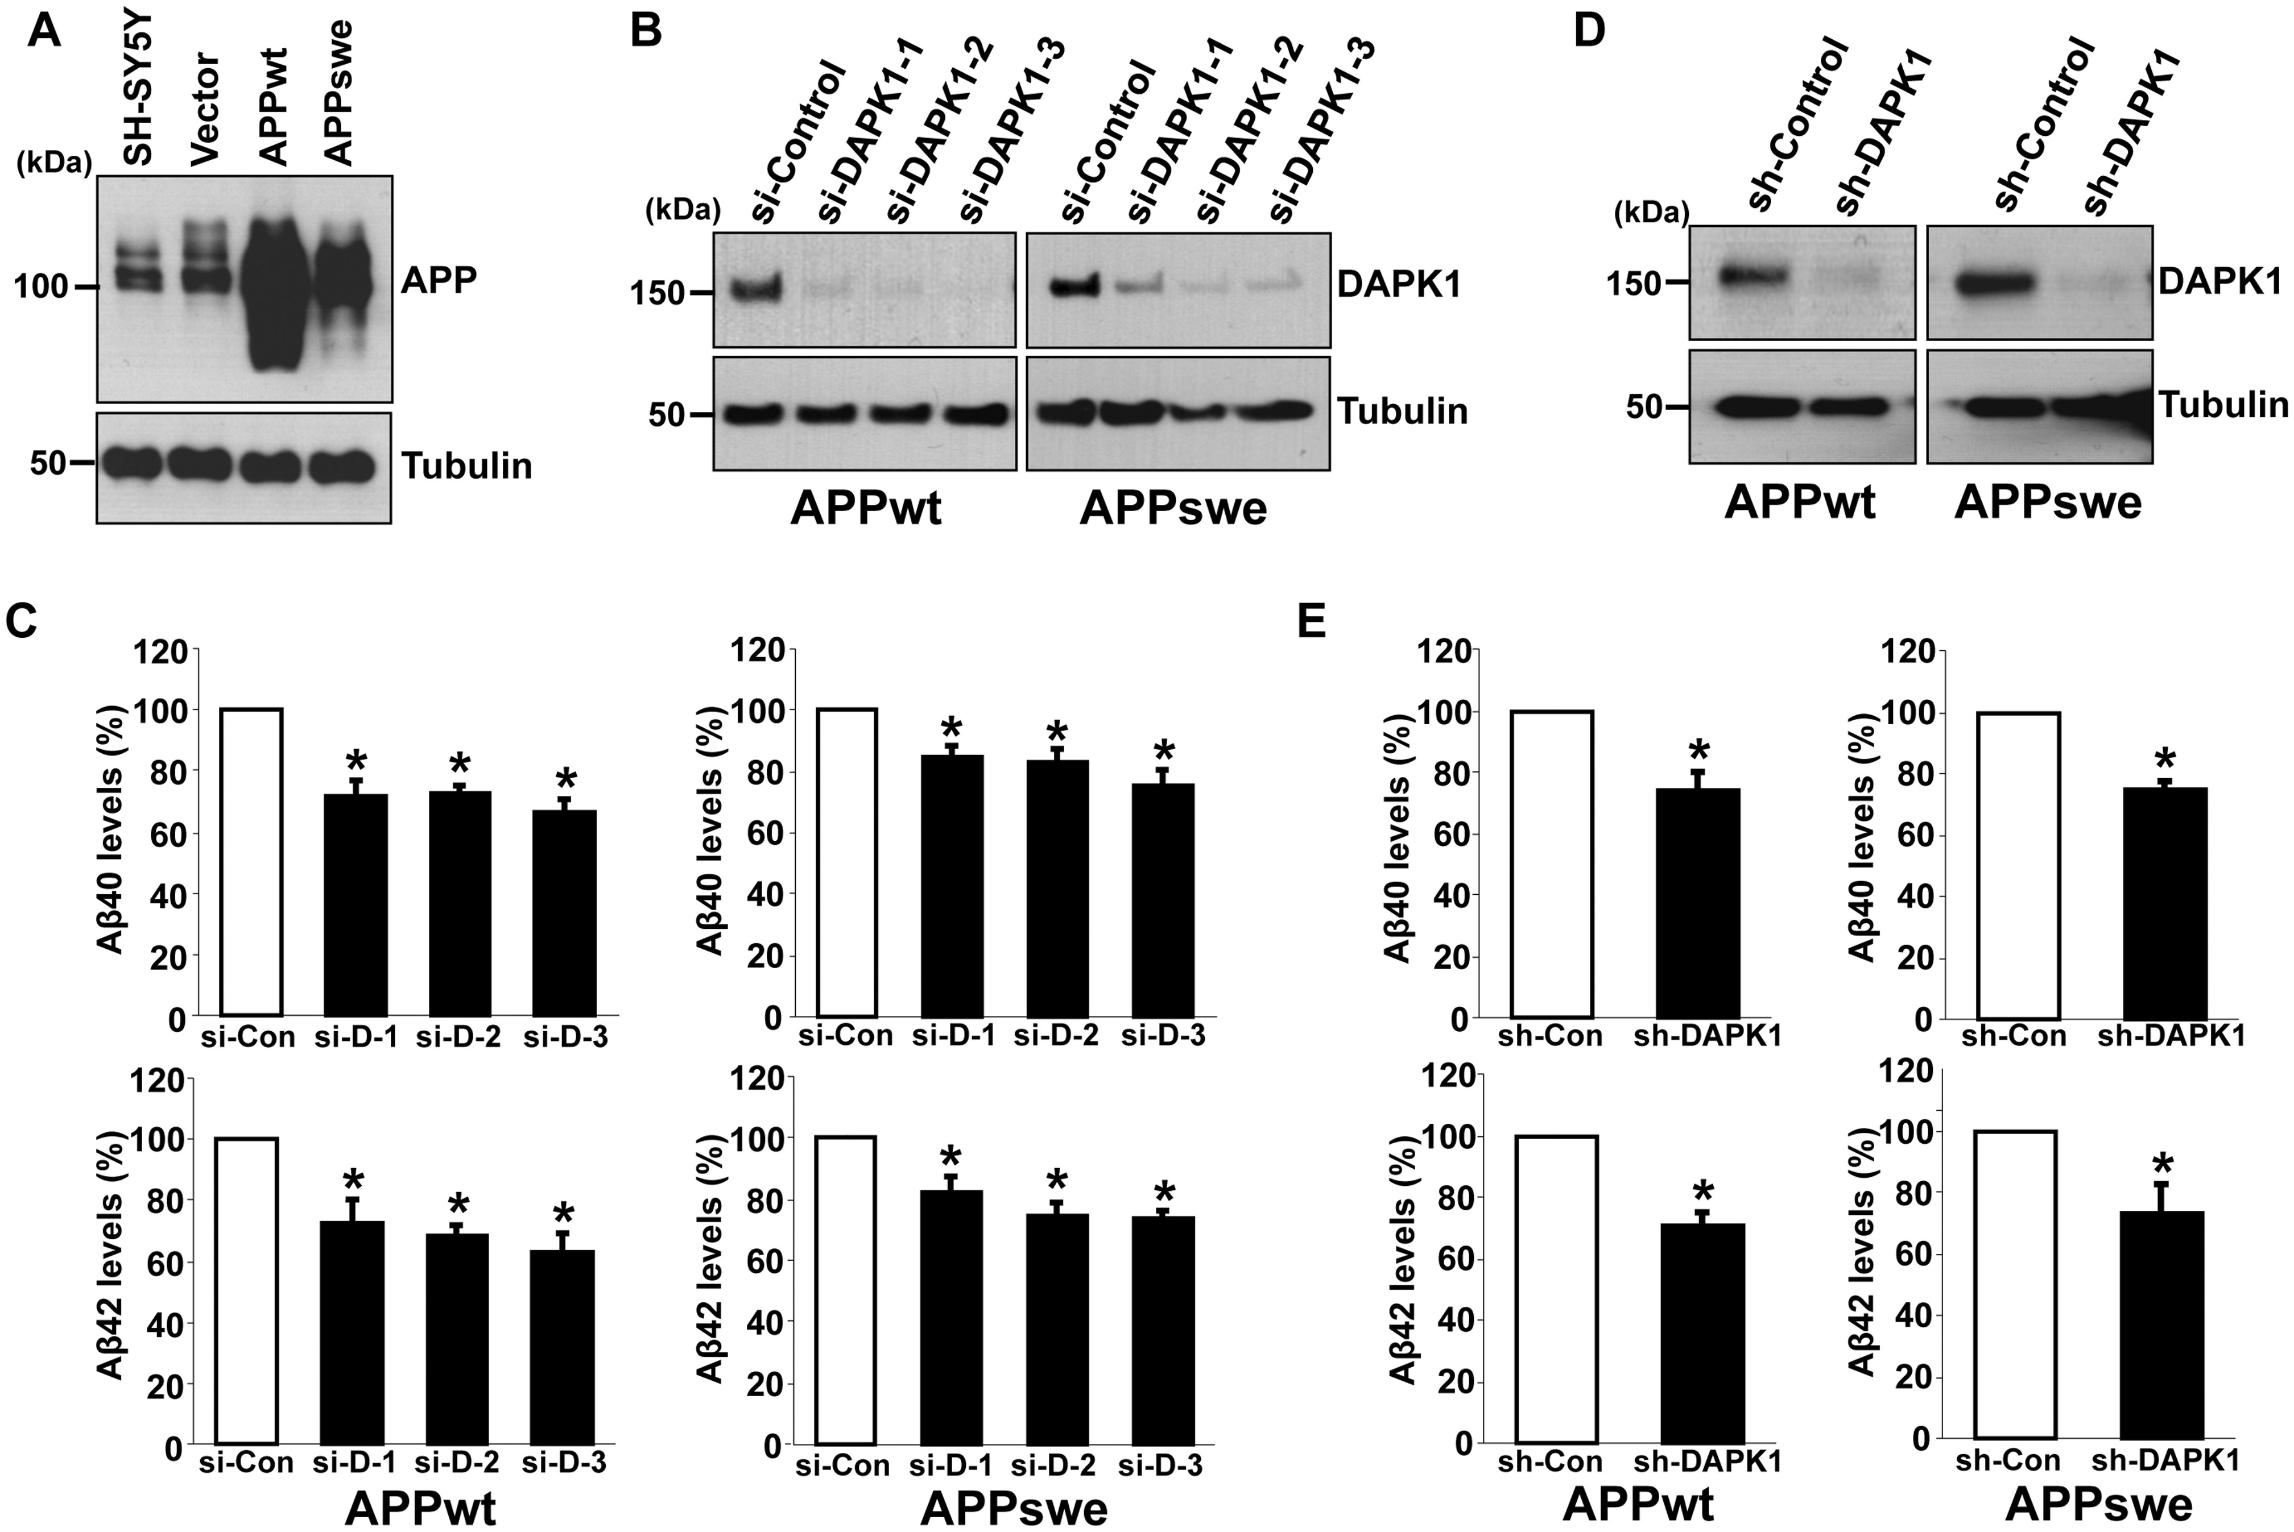
Figure 2. DAPK1 inhibition reduces the secretion of human Aβ40 and Aβ42 from both SH-SY5Y APPwt and SH-SY5Y APPswe ...
Notes:
Figure 2. DAPK1 inhibition reduces the secretion of human Aβ40 and Aβ42 from both SH-SY5Y APPwt and SH-SY5Y APPswe cells. (A) Baseline expression of APP in parent SH-SY5Y cells and SH-SY5Y cells stably expressing empty vector (pcDNA3), APP WT (pcDNA3-hAPP695) or APP Swedish mutant (pcDNA3-hAPP695swe). The cell lysates were subjected to western blot analysis with anti-APP or anti-tubulin antibody. The blots are representative of three independent experiments. (B, C) SH-SY5Y APPwt and SH-SY5Y APPswe cells were transfected with three different human DAPK1-sepcific siRNAs or scrambled control siRNA for 60 h. The cell lysates were subjected to western blot analysis with anti-DAPK1 or anti-tubulin antibody and the supernatants were subjected to human Aβ40 and Aβ42 ELISA analyses. The blots are representative of three independent experiments and ELISA data shown represent the mean ± standard error of three independent experiments (*P < 0.05; ANOVA/Dunnett’s test). (D) SH-SY5Y APPwt and SH-SY5Y APPswe cells were infected with control lentiviral vector (pLKO.1) or vectors encoding human DAPK1-specific shRNA, and selected using puromycin (2 μg/ml) for 2 days. The obtained stable cell lines were maintained in low dose puromycin (0.25 μg/ml). The cell lysates were subjected to western blot analysis with anti-DAPK1 or anti-tubulin antibody. The blots are representative of three independent experiments. (E) SH-SY5Y APPwt and SH-SY5Y APPswe cells with stably silenced DAPK1 obtained from (D) were cultured for 30 h. The supernatants were subjected to Aβ40 and Aβ42 ELISA analyses as in (C). Each data point represents the mean ± standard error of three independent experiments (*P < 0.05; ANOVA/Dunnett’s test).
Unless provided in the caption above, the following copyright applies to the content of this slide: © The Author 2016. Published by Oxford University Press. All rights reserved. For permissions, please e-mail: journals.permissions@oup.com

Slide 3
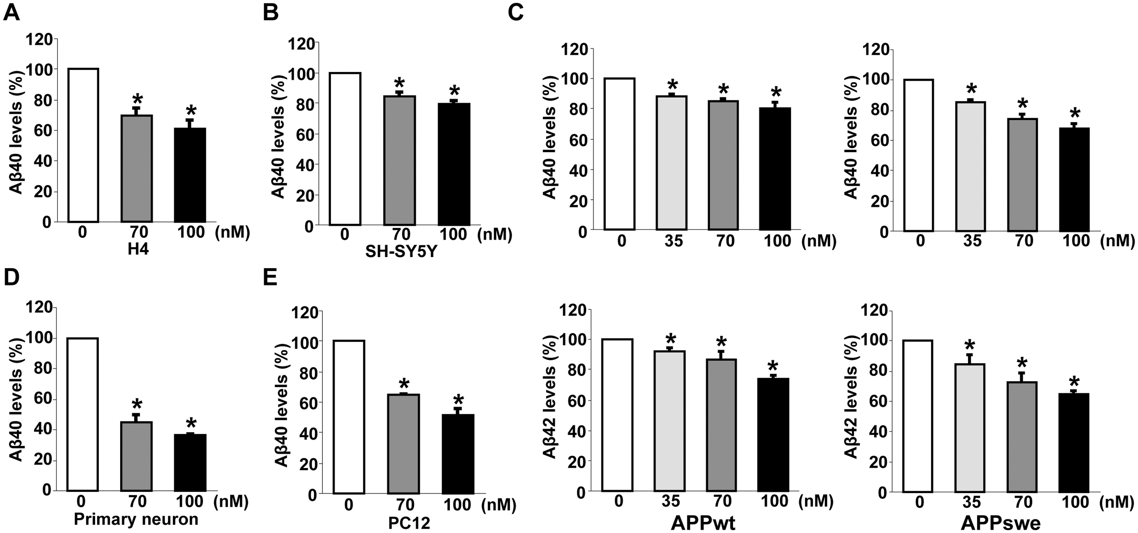
Figure 3. The pharmacological inhibitor of DAPK1 reduces the secretion of Aβ40 and Aβ42. (A, B) Human H4 (A) and ...
Notes:
Figure 3. The pharmacological inhibitor of DAPK1 reduces the secretion of Aβ40 and Aβ42. (A, B) Human H4 (A) and SH-SY5Y (B) cells were treated with the indicated concentrations of DAPK1 pharmacological inhibitor for 24 h. Levels of human Aβ40 in cell culture supernatants after 24 h incubation were determined by a solid phase sandwich ELISA assay as in (B) and (C). Each data point represents mean ± standard error of three independent experiments (*P < 0.05; ANOVA/Dunnett’s test). (C) SH-SY5Y APPwt and SH-SY5Y APPswe cells were incubated with the indicated concentrations of DAPK1 pharmacological inhibitor for 24 h. The supernatants were subjected to human Aβ40 and Aβ42 ELISA analyses as in (C). Each data point represents mean ± standard error of three independent experiments (*P < 0.05; ANOVA/Dunnett’s test). (D, E) Primary cortical neurons (D) at DIV 8–10 and the rat adrenal pheochromocytoma PC12 (E) cells were treated with the indicated concentrations of DAPK1 pharmacological inhibitor for 36 h. Levels of Aβ40 in cell culture supernatants after 36 h incubation were determined by a solid phase sandwich ELISA assay. Each data point represents mean ± standard error of three independent experiments (*P < 0.05; ANOVA/Dunnett’s test).
Unless provided in the caption above, the following copyright applies to the content of this slide: © The Author 2016. Published by Oxford University Press. All rights reserved. For permissions, please e-mail: journals.permissions@oup.com

Slide 4
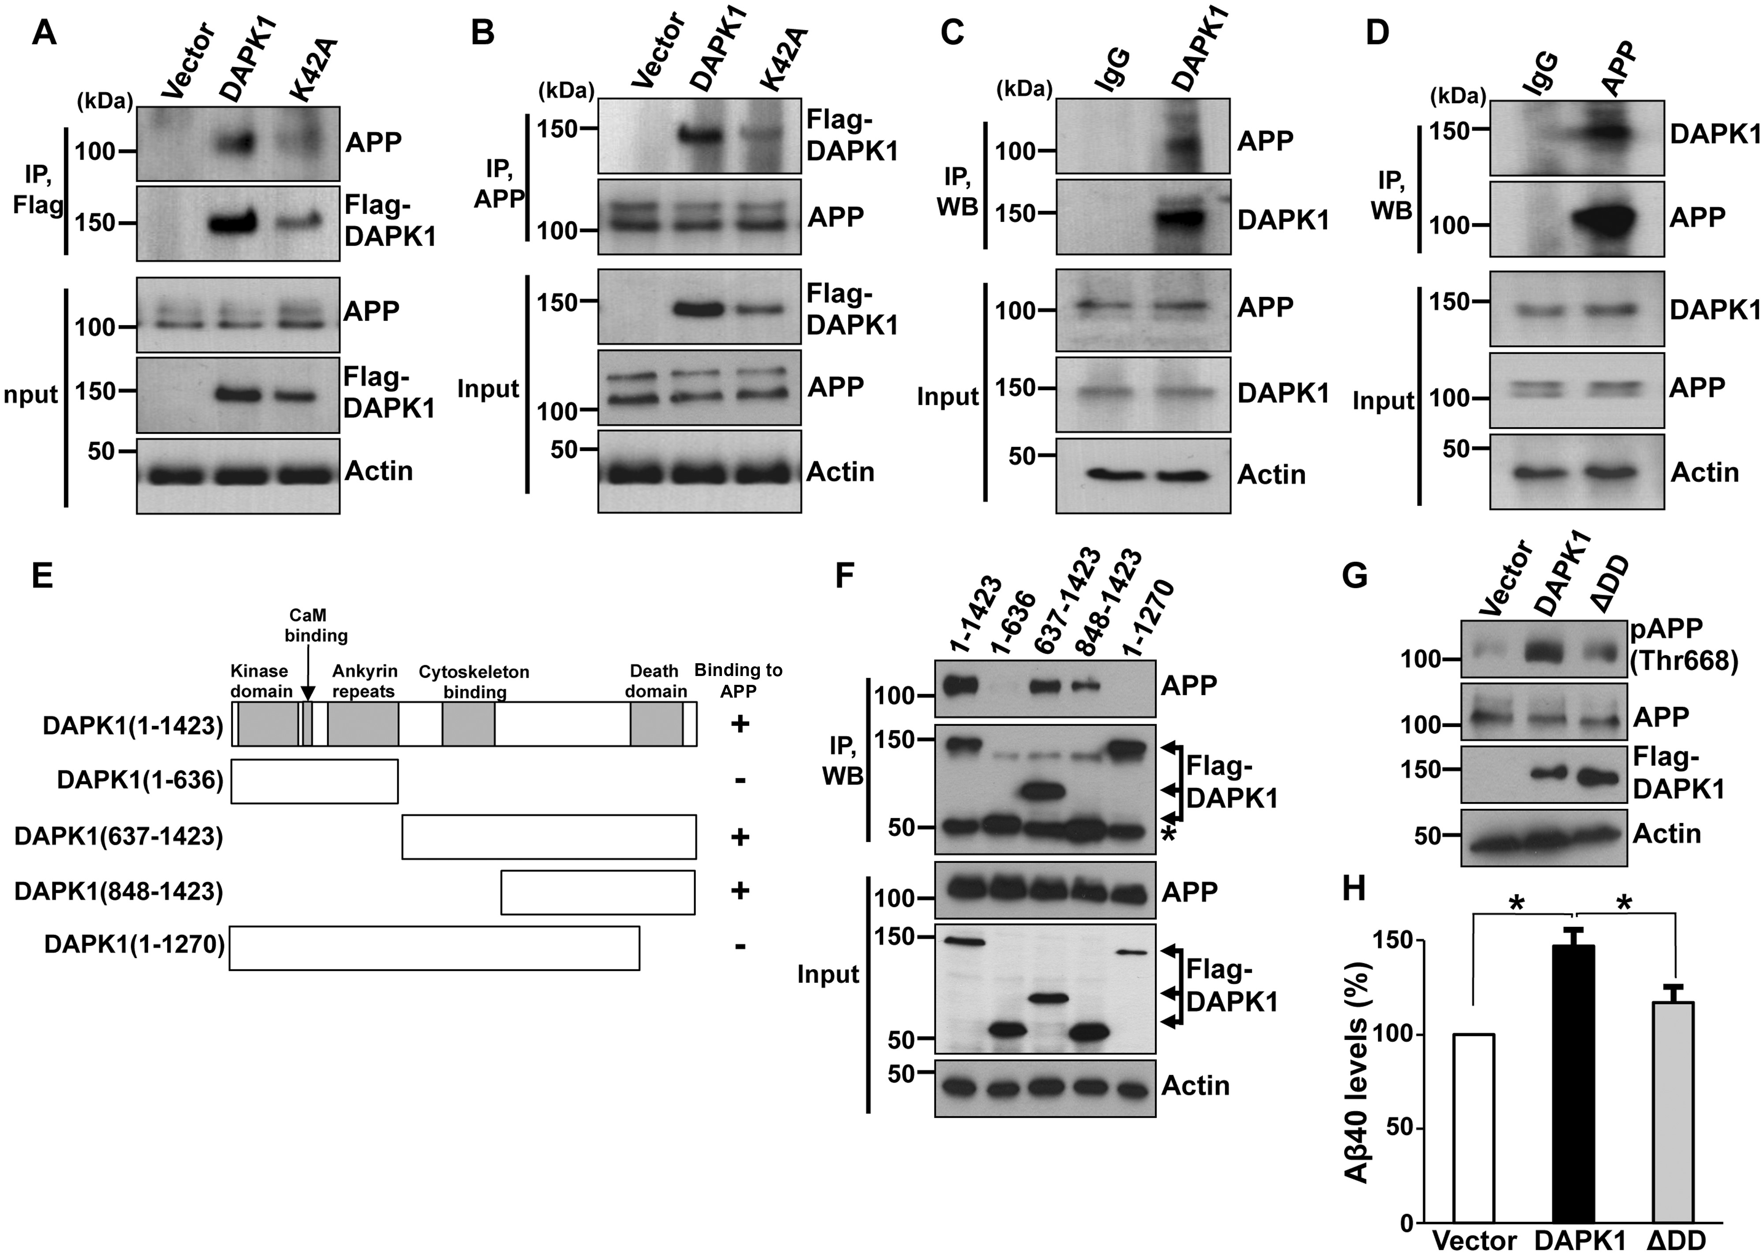
Figure 4. Interaction between DAPK1 and APP. (A, B) CHO cells stably expressing APP WT were transfected with pRK5-Flag, ...
Notes:
Figure 4. Interaction between DAPK1 and APP. (A, B) CHO cells stably expressing APP WT were transfected with pRK5-Flag, pRK5-Flag-DAPK1 or pRK5-Flag-DAPK1K42A for 12 h. Cell lysates were immunoprecipitated with rabbit anti-Flag or rabbit anti-APP antibody. The precipitated samples were analyzed by western blotting with mouse anti-Flag or mouse anti-APP antibody. Total lysates, corresponding to 1% input, were also analyzed by western blotting with same antibodies. Anti-actin antibody was used as a loading control. The blots are representative of three independent experiments. (C, D) Endogenous DAPK1 (C) or APP (D) in SH-SY5Y cells was immunoprecipitated with mouse anti-DAPK1 or rabbit anti-APP antibody, respectively. Immunoprecipitated DAPK1 and APP were subjected to western blot analysis with mouse anti-DAPK1 or mouse anti-APP antibody. Anti-actin antibody was used as a loading control and the blots are representative of three independent experiments. (E) Schematic representation of full-length DAPK1 and its truncated mutants. (F) CHO cells stably expressing APP WT were transfected with pRK5-Flag-DAPK1 or its truncated mutants. Cell lysates were immunoprecipitated with mouse anti-Flag antibody. The precipitated samples were analyzed by western blotting with rabbit anti-APP antibody. Total lysates, corresponding to 1% input, were also analyzed by western blotting with same antibodies. Anti-actin antibody was used as a loading control. The blots are representative of three independent experiments. Asterisks denote heavy chain. (G, H) SH-SY5Y cells were transfected with pRK5-Flag, pRK5-Flag-DAPK1 or pRK5-Flag-DAPK1ΔDD for 32 h. The cell lysates were subjected to western blot analysis to detect phosphorylated APP at Thr668 and total APP protein. Anti-actin antibody was used as a loading control. The levels of human Aβ40 in cell culture supernatants were determined by a solid phase sandwich ELISA assay. Each data point represents the mean ± standard error of three independent experiments (*P < 0.05; ANOVA/Dunnett’s test).
Unless provided in the caption above, the following copyright applies to the content of this slide: © The Author 2016. Published by Oxford University Press. All rights reserved. For permissions, please e-mail: journals.permissions@oup.com

Slide 5
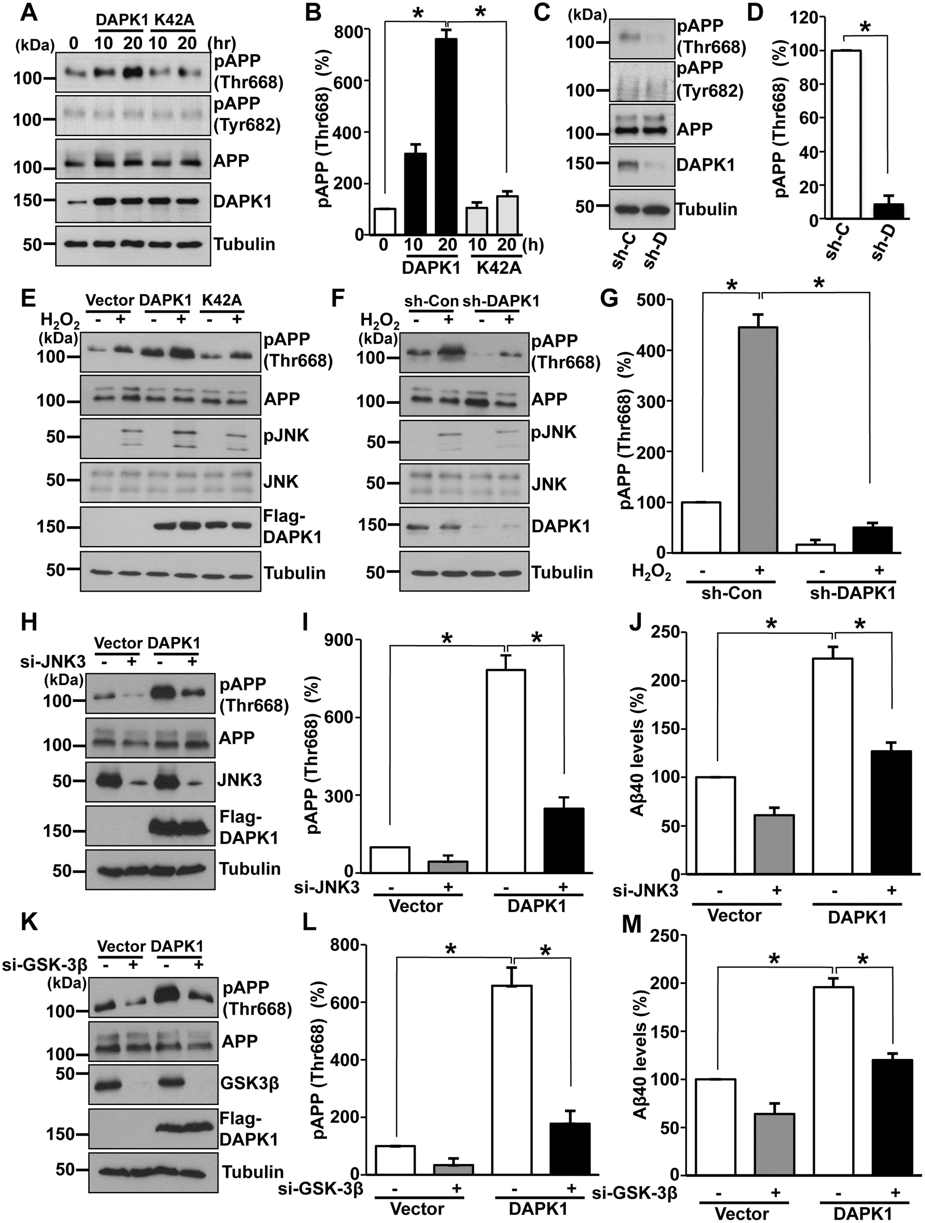
Figure 5. DAPK1 induces APP phosphorylation at Thr668. (A, B) SH-SY5Y cells were transfected with pRK5-Flag-DAPK1 or ...
Notes:
Figure 5. DAPK1 induces APP phosphorylation at Thr668. (A, B) SH-SY5Y cells were transfected with pRK5-Flag-DAPK1 or pRK5-Flag-DAPK1K42A for the indicated time periods. The cell lysates were subjected to western blot analysis to detect phosphorylated (Thr668 and Tyr682) and total APP protein. Anti-tubulin antibody was used as a loading control. The blots are representative of three independent experiments. Phosphorylated APP intensities were quantified by computer-assisted densitometry (*P < 0.05; ANOVA/Dunnett’s test). (C, D) Lysates from SH-SY5Y APPwt cells with stably silenced DAPK1 were subjected to western blot analysis to detect phosphorylated (Thr668 and Tyr682) and total APP protein. Anti-tubulin antibody was used as a loading control. The blots are representative of three independent experiments. Phosphorylated APP intensities were quantified by computer-assisted densitometry (*P < 0.05; ANOVA/Dunnett’s test). (E) SH-SY5Y cells were transfected with pRK5-Flag, pRK5-Flag-DAPK1 or pRK5-Flag-DAPK1K42A for 12 h and treated with 0.5 mm H2O2 for 2 h. The cell lysates were subjected to western blot analysis to detect phosphorylated (Thr668) and total APP protein and to detect phosphorylated (Thr183/Tyr185) and total JNK protein. Anti-tubulin antibody was used as a loading control. The blots are representative of three independent experiments. (F, G) SH-SY5Y cells expressing scrambled control shRNA or human DAPK1-specific shRNA were treated with 0.5 mm H2O2 for 2 h. The cell lysates were subjected to western blot analysis to detect phosphorylated (Thr668) and total APP protein and to detect phosphorylated (Thr183/Tyr185) and total JNK protein. Anti-tubulin antibody was used as a loading control. The blots are representative of three independent experiments. Phosphorylated APP intensities were quantified by computer-assisted densitometry (*P < 0.05; ANOVA/Dunnett’s test). (H–J) SH-SY5Y cells were transfected with human JNK3-specific siRNA or scrambled control siRNA in combination with pRK5-Flag or pRK5-Flag-DAPK1 for 60 h. The cell lysates were subjected to western blot analysis to detect phosphorylated (Thr668) and total APP protein. Anti-tubulin antibody was used as a loading control. The blots are representative of three independent experiments. Phosphorylated APP intensities were quantified by computer-assisted densitometry and human Aβ40 levels in cell culture supernatants were determined by a solid phase sandwich ELISA assay (*P < 0.05; ANOVA/Dunnett’s test). (K–M) SH-SY5Y cells were transfected with human GSK-3β-specific siRNA or scrambled control siRNA in combination with pRK5-Flag or pRK5-Flag-DAPK1 for 60 h. The cell lysates were subjected to western blot analysis to detect phosphorylated (Thr668) and total APP protein. Anti-tubulin antibody was used as a loading control. The blots are representative of three independent experiments. Phosphorylated APP intensities were quantified by computer-assisted densitometry and human Aβ40 levels in cell culture supernatants were determined by a solid phase sandwich ELISA assay (*P < 0.05; ANOVA/Dunnett’s test).
Unless provided in the caption above, the following copyright applies to the content of this slide: © The Author 2016. Published by Oxford University Press. All rights reserved. For permissions, please e-mail: journals.permissions@oup.com

Slide 6
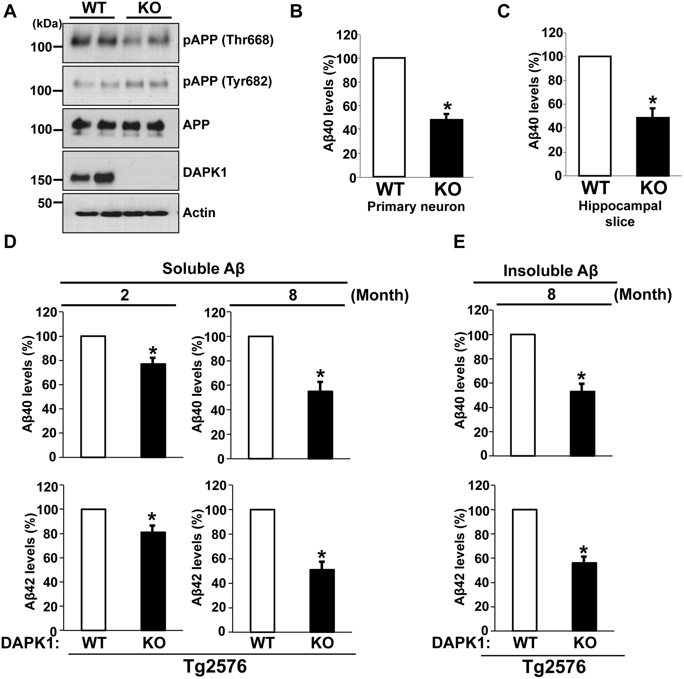
Figure 6. DAPK1 KO reduces the secretion of Aβ40 and Aβ42 in mouse models. (A) Whole brain lysates from WT and DAPK1 KO ...
Notes:
Figure 6. DAPK1 KO reduces the secretion of Aβ40 and Aβ42 in mouse models. (A) Whole brain lysates from WT and DAPK1 KO mice harvested at 6 month of age were analyzed for the levels of phosphorylated (Thr668 and Tyr682) and total APP protein as well as DAPK1. Anti-actin antibody was used as a loading control. The blots are representative of three independent experiments. Analyzed mice number: WT (n = 6, 3 male (M) and 3 female (F)), DAPK1 KO (3M, 3F). (B, C) Primary cortical neurons (B) at DIV 8-10 of WT and DAPK1 KO mice and the brain hippocampal tissue slices (C) prepared from WT and DAPK1 KO mice at 6 month of age were cultured for 36 h. Levels of mouse Aβ40 in cell culture supernatants after 36 h incubation were determined by a solid phase sandwich ELISA assay. Each data point represents mean ± standard error of three independent experiments (*P < 0.05; ANOVA/Dunnett’s test). (D) TBS-buffer soluble hippocampal tissue fraction from Tg2576/WT or Tg2576/DAPK1 KO mice at 2 or 8 month of age was prepared. Levels of human Aβ40 and Aβ42 were determined by a solid phase sandwich ELISA assay. Each data point represents mean ± standard error of three independent experiments (*P < 0.05; ANOVA/Dunnett’s test). Analyzed mice number, 2-month-old groups: Tg2576/WT (3M, 3F), Tg2576/DAPK1 KO (3M, 3F); 8-month-old groups: Tg2576/WT (3M, 3F), Tg2576/DAPK1 KO (3M, 3F). (E) TBS-buffer insoluble hippocampal tissue fraction from Tg2576/WT or Tg2576/DAPK1 KO mice at 8 month of age was prepared. Levels of human Aβ40 and Aβ42 were determined by a solid phase sandwich ELISA assay. Each data point represents mean ± standard error of three independent experiments (*P < 0.05; ANOVA/Dunnett’s test). Analyzed mice number: Tg2576/WT (3M, 3F), Tg2576/DAPK1 KO (3M, 3F).
Unless provided in the caption above, the following copyright applies to the content of this slide: © The Author 2016. Published by Oxford University Press. All rights reserved. For permissions, please e-mail: journals.permissions@oup.com

Slide 7
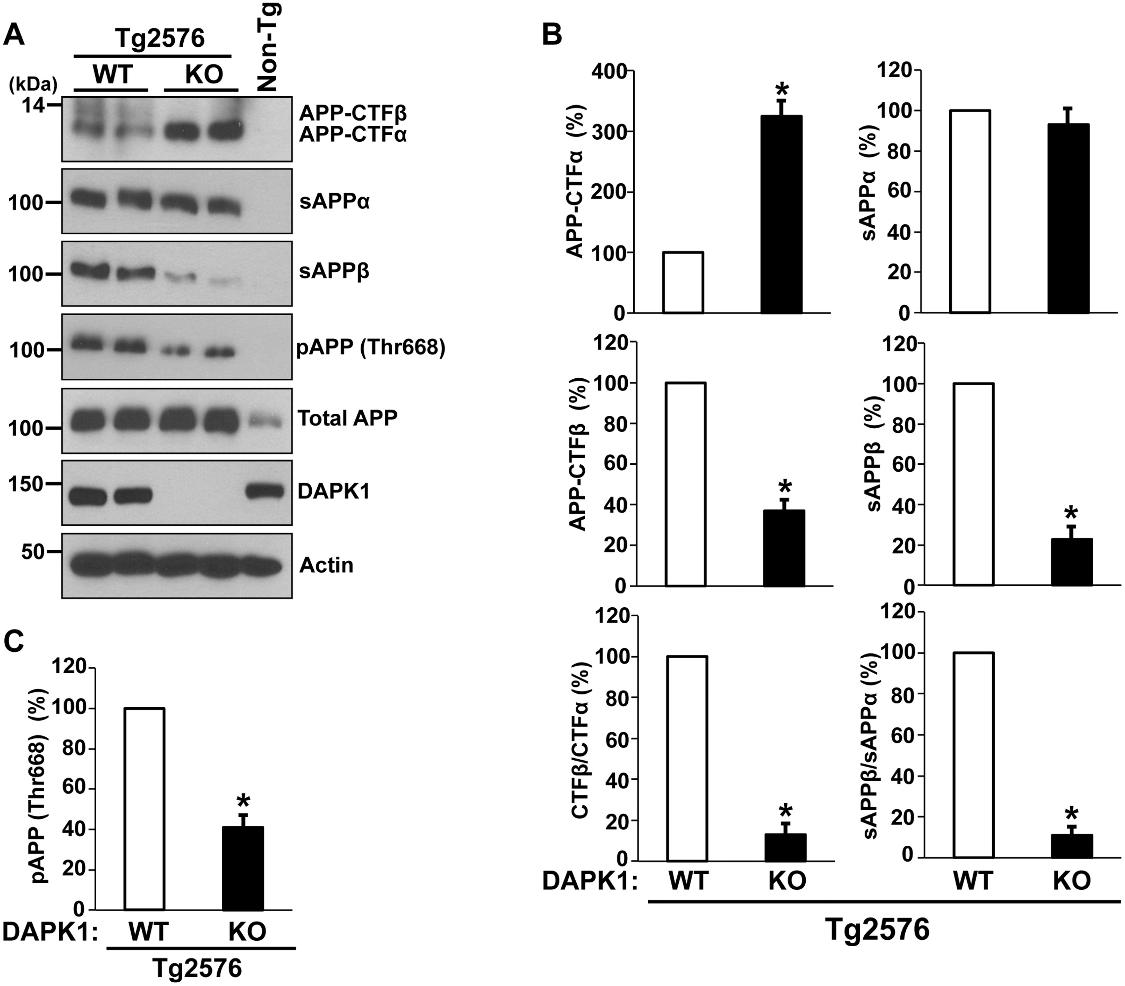
Figure 7. The effect of DAPK1 KO on APP processing in the Tg2576 APP transgenic mice. (A) APP processing in the brains ...
Notes:
Figure 7. The effect of DAPK1 KO on APP processing in the Tg2576 APP transgenic mice. (A) APP processing in the brains of 8-month-old Tg2576/WT or Tg2576/DAPK1 KO mice was examined (3M, 3F). Total APP (G12A), sAPPα (6E10), sAPPβ-swedish (IBL), APP-CTFα (G12A), APP-CTFβ (G12A) and pThr668-APP were detected. (B) Densitometric analysis of APP-CTFα, APP-CTFβ, sAPPα, and sAPPβ and ratios of CTFβ:CTFα and sAPPβ:sAPPα (*P < 0.05; ANOVA/Dunnett’s test). (C) Densitometric analysis of pThr668-APP. (*P < 0.05; ANOVA/Dunnett’s test).
Unless provided in the caption above, the following copyright applies to the content of this slide: © The Author 2016. Published by Oxford University Press. All rights reserved. For permissions, please e-mail: journals.permissions@oup.com

Slide 8
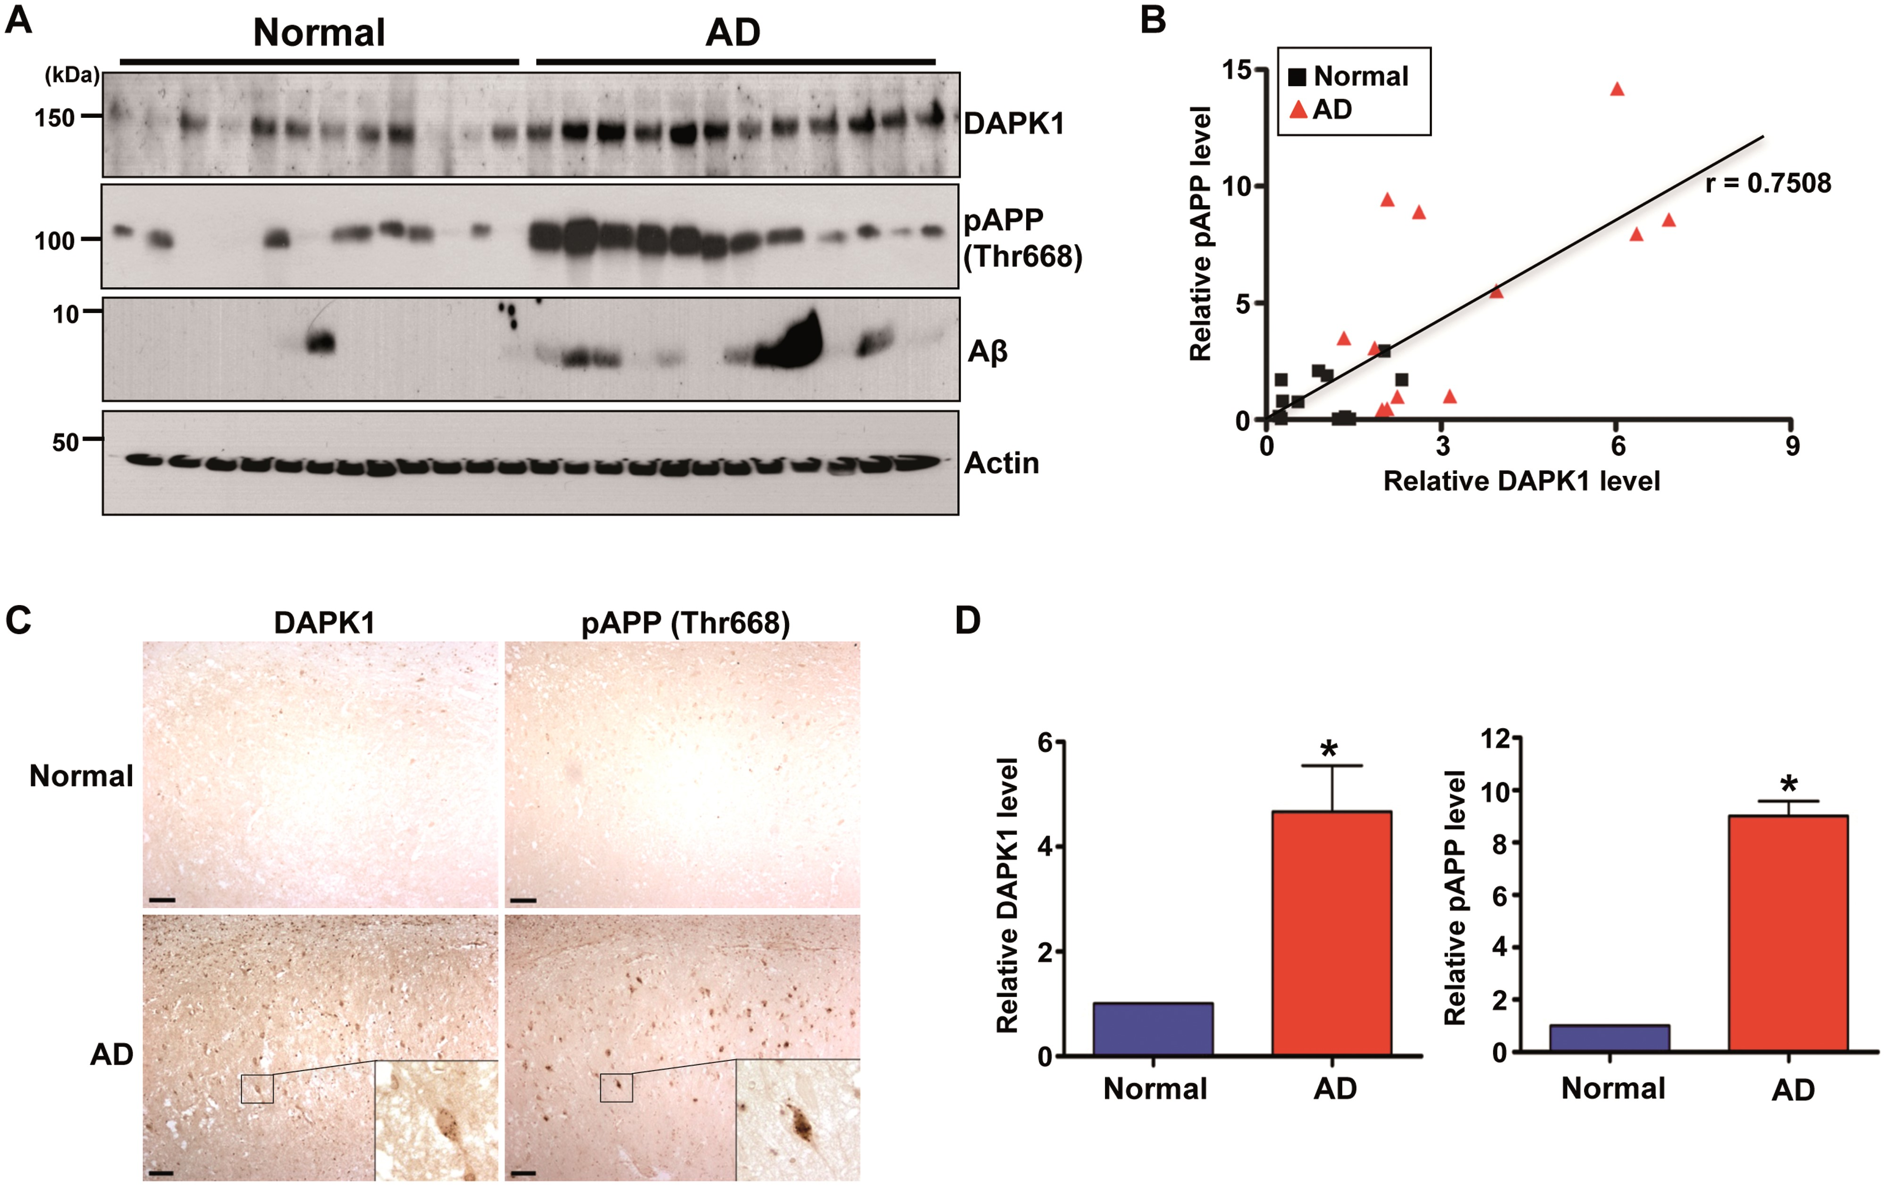
Figure 8. The expression of DAPK1, APP phosphorylation at Thr668, and Aβ in the AD patient and normal brains. (A, B) ...
Notes:
Figure 8. The expression of DAPK1, APP phosphorylation at Thr668, and Aβ in the AD patient and normal brains. (A, B) Hippocampal tissues of 12 AD patients and 12 age-matched normal controls were harvested. (A) Proteins from normal and AD hippocampus were used for immunoblotting with anti-DAPK1, anti-pThr668-APP, anti-Aβ or anti-actin antibody. The blots are representative of three independent experiments. (B) Linear regression analysis was used to estimate the correlation between DAPK1 expression and APP phosphorylation at Thr668 (r = 0.7508; Pearson's correlation coefficient). (C) Immunohistochemistry using a monoclonal antibody specific for DAPK1 or a polyclonal antibody specific for phosphorylated APP at Thr668 was conducted on hippocampal regions from AD patient and normal control. ×100 (main photographs); ×400 (insets); scale bar = 50 μm. Representative images from five experiments are shown. (D) Quantitation of DAPK1 and pThr668 APP. Results shown are mean ± standard error (*P < 0.05; ANOVA/Dunnett’s test).
Unless provided in the caption above, the following copyright applies to the content of this slide: © The Author 2016. Published by Oxford University Press. All rights reserved. For permissions, please e-mail: journals.permissions@oup.com

