Slide 1
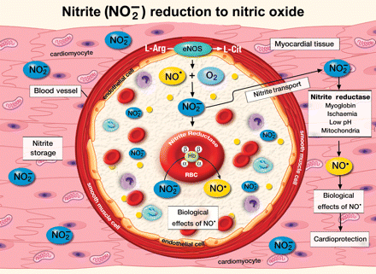
Figure 1 Predominant pathways for the generation of nitric oxide (NO) from nitrite. Nitrite is formed when NO ...
Notes:
Figure 1 Predominant pathways for the generation of nitric oxide (NO) from nitrite. Nitrite is formed when NO generated from endothelial nitric oxide synthase reacts with molecular oxygen. Nitrite is then stored in the blood stream and myocardium. During conditions of hypoxia and/or ischaemia nitrite stored in the blood and heart is converted to NO via the action of a number of nitrite reductases. In the myocardium, nitrite is thought to be reduced to NO by myoglobin, low pH, hypoxia, and mitochondria. Conversion of nitrite to NO increases myocardial blood flow and directly protects the myocardium against ischaemic injury.
Unless provided in the caption above, the following copyright applies to the content of this slide: Published on behalf of the European Society of Cardiology. All rights reserved. © The Author 2009. For permissions please email: journals.permissions@oxfordjournals.org.

Slide 2
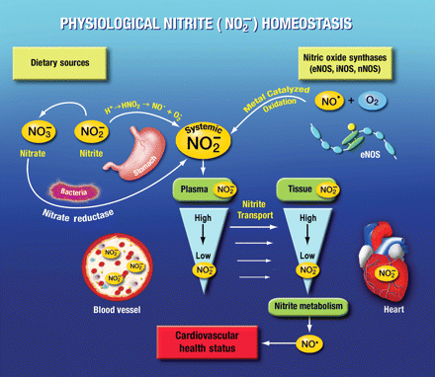
Figure 2 Nitrite homeostasis is determined by nitric oxide (NO) generation from NO synthases and dietary consumption ...
Notes:
Figure 2 Nitrite homeostasis is determined by nitric oxide (NO) generation from NO synthases and dietary consumption of nitrate. Nitrate enters the stomach and then circulates in the blood and is converted into nitrite via salivary bacteria containing nitrate reductase. Nitrite derived from the diet and NOS activity rapidly accumulates in the plasma and is transported into tissues such as the heart. Nitrite is then stored in the myocardium and is metabolized into NO during hypoxia or ischaemia.
Unless provided in the caption above, the following copyright applies to the content of this slide: Published on behalf of the European Society of Cardiology. All rights reserved. © The Author 2009. For permissions please email: journals.permissions@oxfordjournals.org.

