Slide 1
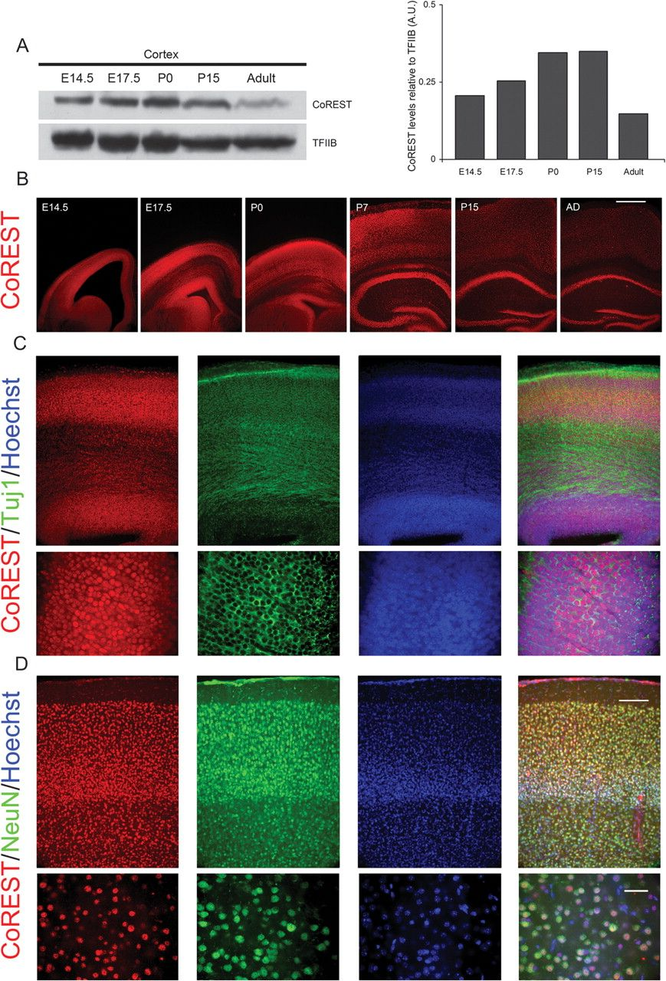
Figure 1. CoREST is expressed during cortical development and in the adult cortex. ( A) Left panel: western analysis of ...
Notes:
Figure 1. CoREST is expressed during cortical development and in the adult cortex. ( A) Left panel: western analysis of CoREST expression at the indicated developmental times; TFIIB expression, known to occur at constant levels is used a gel load control. Right panel: quantification of the expression of CoREST relative to TFIIB. (B) Immunofluorescence analysis of CoREST expression in the mouse brain throughout development shows ubiquitous and sustained expression during intrauterine and postnatal brain development; coincidentally with the results shown in A, relative expression in the adult brain appears lower than during intrauterine and neonatal development. (C) CoREST is expressed in neurons in the developing brain cortex, as shown by coexpression with β3 tubulin at E17.5. (D) CoREST occurs in all cortical neurons in the adult (3 months) brain, as revealed by coexpression with NeuN in the somatosensorial cortex.
Unless provided in the caption above, the following copyright applies to the content of this slide: © The Author 2011. Published by Oxford University Press. All rights reserved. For permissions, please e-mail: journals.permissions@oup.com

Slide 2
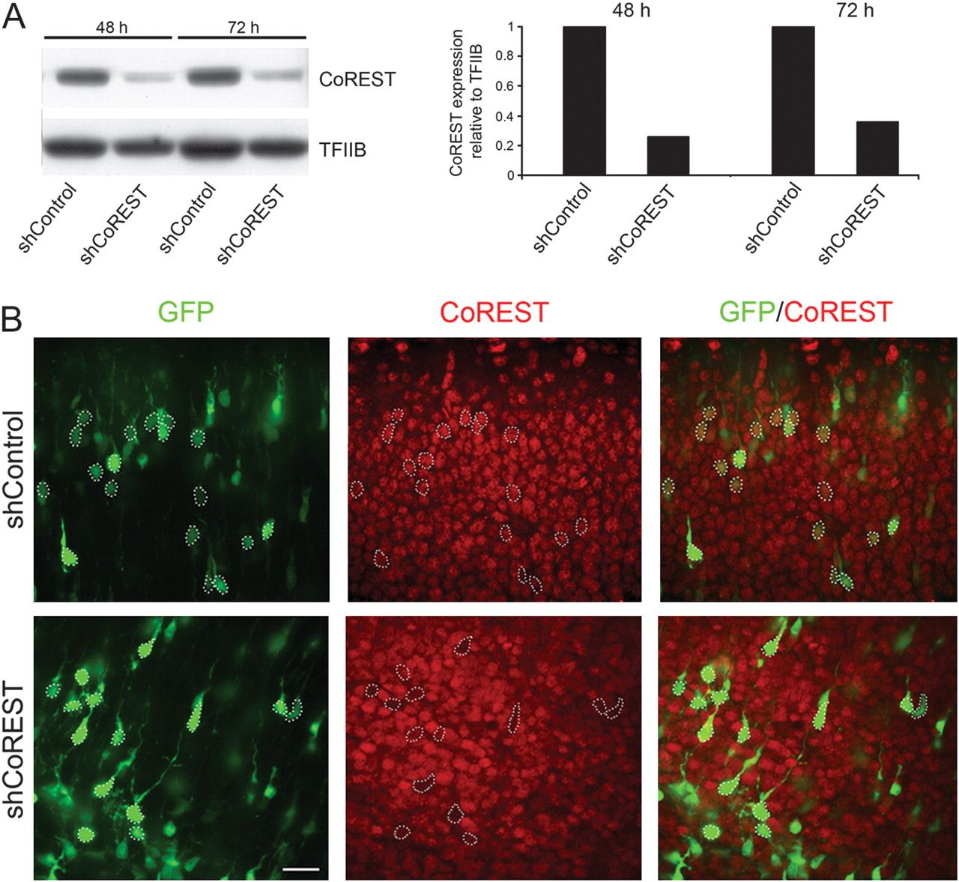
Figure 2. p-shCoREST effectively inhibits CoREST expression in vitro and in vivo. ( A) Left panel: western analysis of ...
Notes:
Figure 2. p-shCoREST effectively inhibits CoREST expression in vitro and in vivo. ( A) Left panel: western analysis of CoREST expression in N2A cells transfected with the missense control plasmid or p-shCoREST; the right panel shows the quantification of CoREST expression relative to TFIIB expression. (B) Immunofluorescence analysis of CoREST expression in neurons in the SVZ/IZ at E17.5 after electroporation of the control plasmid or p-shCoREST at E14.5. Some cells contours are marked by dotted lines to facilitate the identification of the same cell in different views.
Unless provided in the caption above, the following copyright applies to the content of this slide: © The Author 2011. Published by Oxford University Press. All rights reserved. For permissions, please e-mail: journals.permissions@oup.com

Slide 3
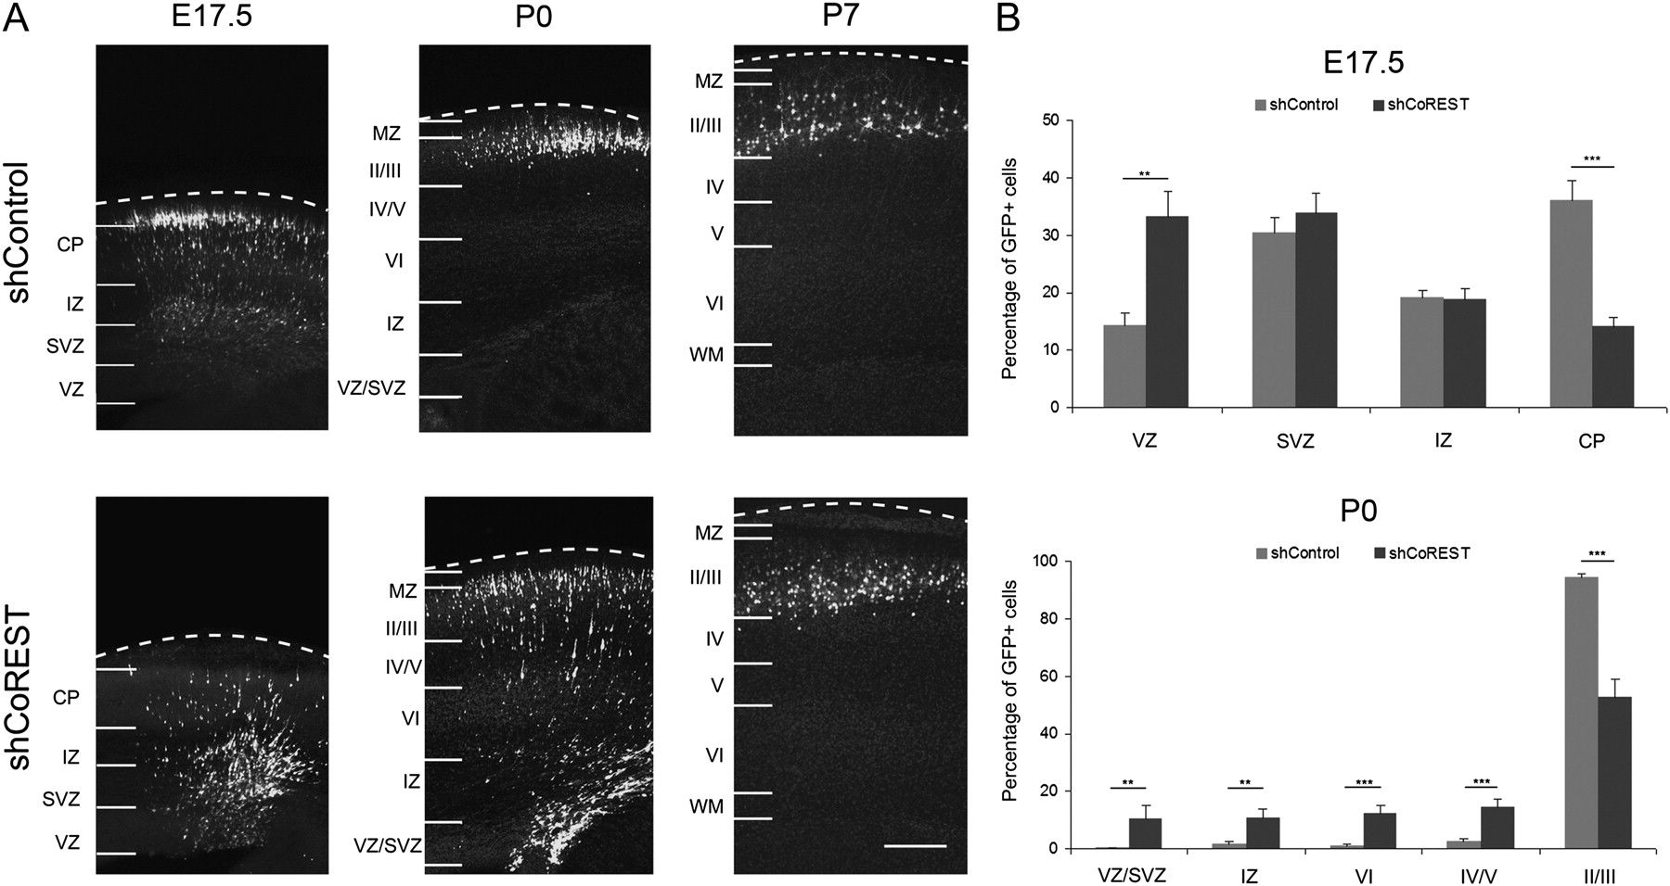
Figure 3. Interference of CoREST expression delays migration out of the VZ/SVZ. (A) Coronal sections of the dorsal ...
Notes:
Figure 3. Interference of CoREST expression delays migration out of the VZ/SVZ. (A) Coronal sections of the dorsal telencephalon of mice that were electroporated at E14.5 with either the control plasmid or p-shCoREST and allowed to develop to the indicated ages. Electroporated cells are visualized by GFP fluorescence. The limits between the developing cortex regions (VZ, SVZ, IZ, CP, and marginal zone, MZ) and the cortical layers (II–VI) are indicated on the left of each image. (B) Quantification of the cell position at E17.5 (upper graph) and P0 (lower graph), expressed as percent of the total number of fluorescent cells found in each of the bins corresponding to the VZ-CP, in brains electroporated with p-Control and p-shCoREST. Statistically significant differences between both conditions are marked with asterisks; **P < 0.01, ***P < 0.001. Only results at E17.5 and P0 are shown, as it is evident that all cells reached the CP at P7.
Unless provided in the caption above, the following copyright applies to the content of this slide: © The Author 2011. Published by Oxford University Press. All rights reserved. For permissions, please e-mail: journals.permissions@oup.com

Slide 4
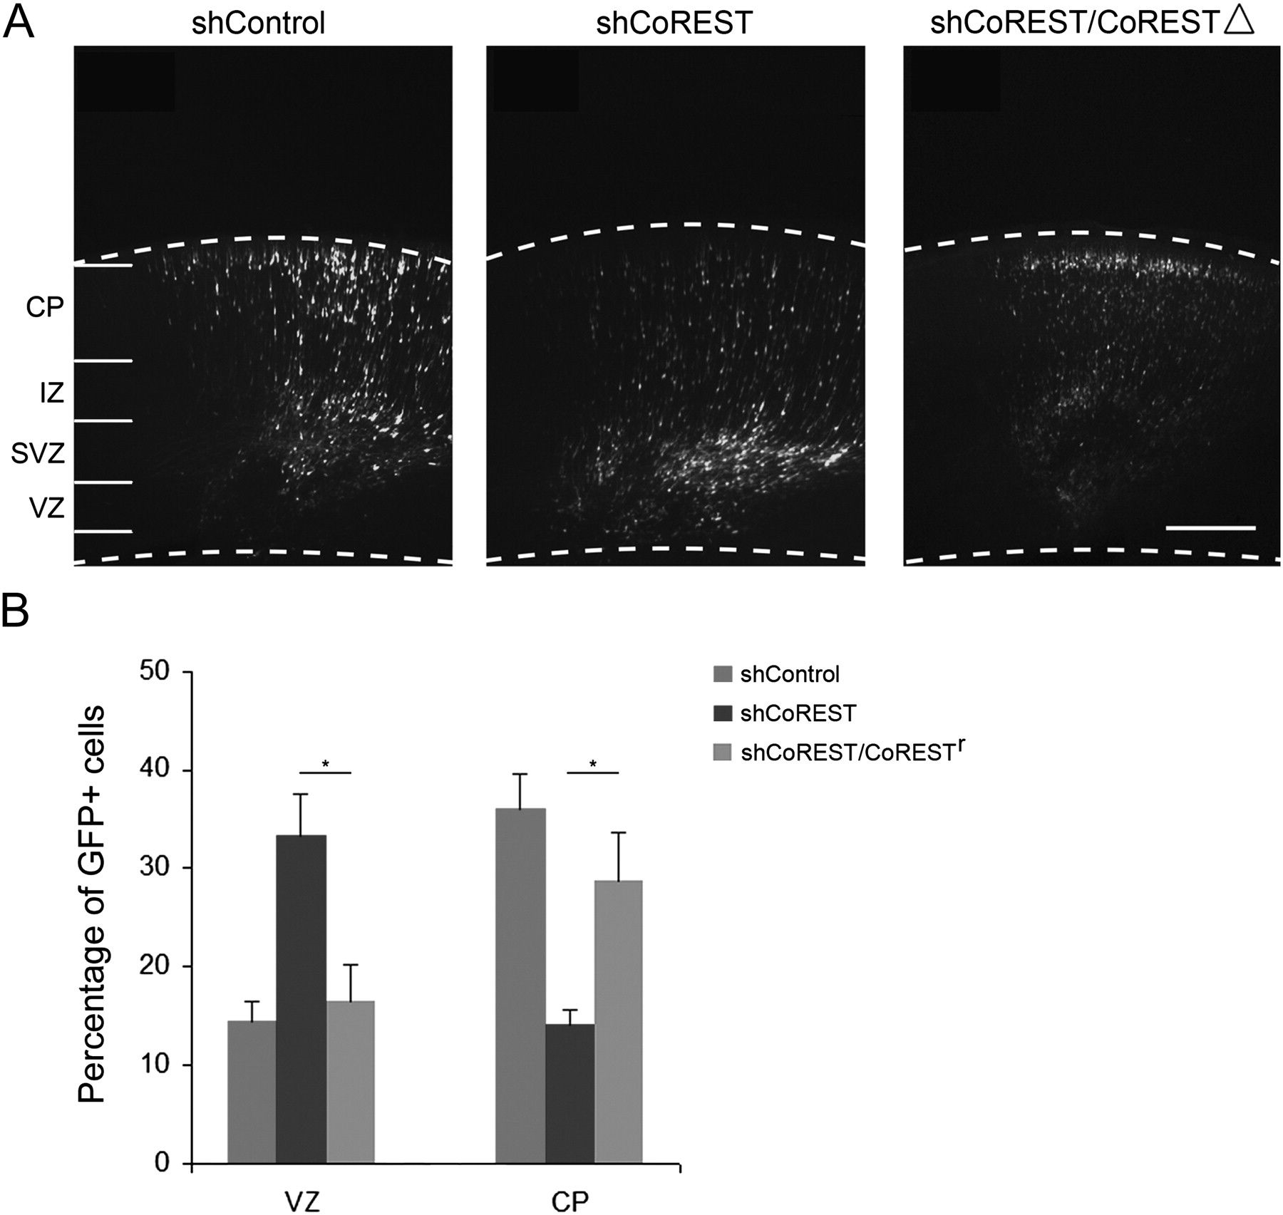
Figure 4. Coelectroporation of pCoREST△ together with p-shCoREST at E14.5 rescues the migratory defect observed at ...
Notes:
Figure 4. Coelectroporation of pCoREST△ together with p-shCoREST at E14.5 rescues the migratory defect observed at E17.5. (A) Coronal sections of the dorsal telencephalon of mice that were electroporated at E14.5 with either the control plasmid, the p-shCoREST, or p-shCoREST and pCoREST△ (1:2 molar ratio) and allowed to develop until E17.5; electroporated cells are visualized by GFP fluorescence. (B) Quantification of the cell position in each condition, considered as the percent of electroporated cells found in the VZ or the CP. n = 7 (shControls), 7 (shCoREST), and 4 (p-shCoREST/pCoREST), *P < 0.05.
Unless provided in the caption above, the following copyright applies to the content of this slide: © The Author 2011. Published by Oxford University Press. All rights reserved. For permissions, please e-mail: journals.permissions@oup.com

Slide 5
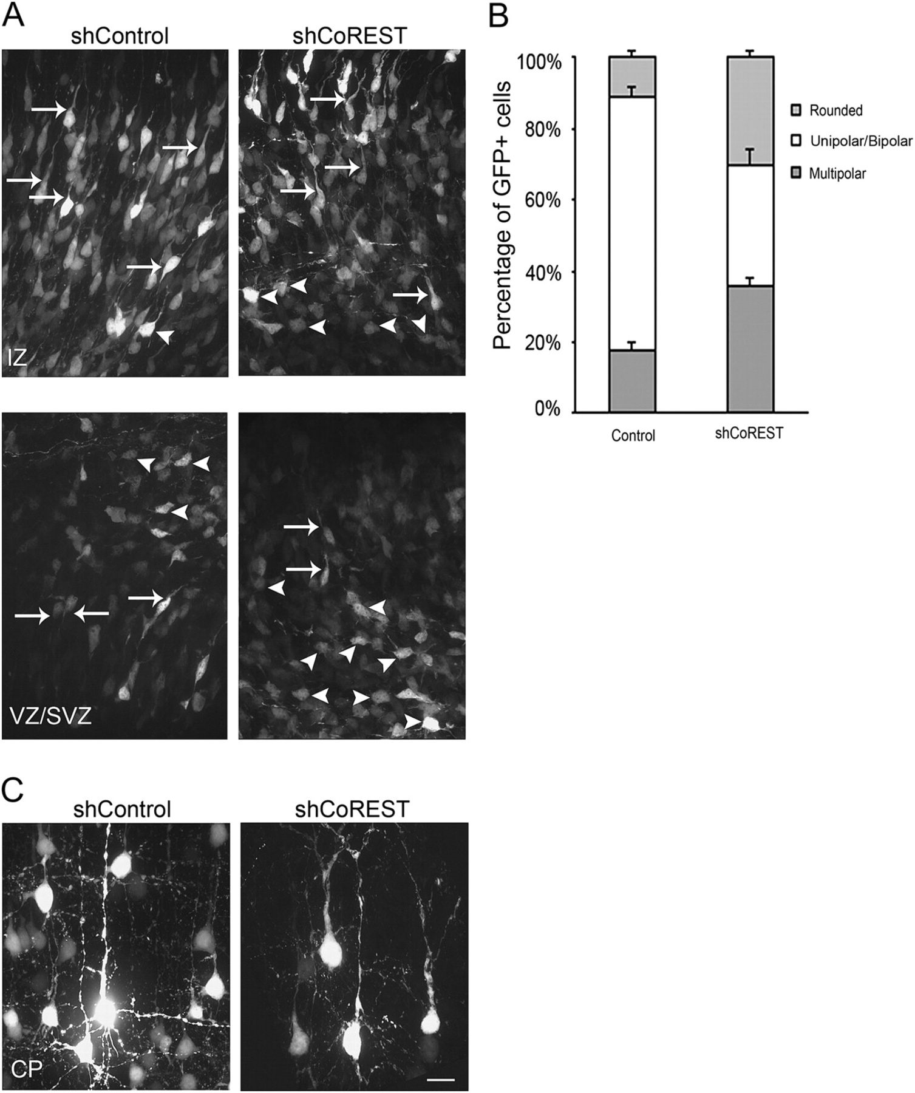
Figure 5. Depletion of CoREST associates to a marked increase of cells remaining in the multipolar stage at E17.5 and ...
Notes:
Figure 5. Depletion of CoREST associates to a marked increase of cells remaining in the multipolar stage at E17.5 and to later morphological alterations. The region from which images were obtained is indicated in each photograph (VZ, SVZ, IZ, and cortical layer II/II). (A) At E17.5, most cells with decreased levels of CoREST have not acquired a bipolar shape and remain in a multipolar, unipolar, or rounded stage. As an example, some multipolar and some bipolar and unipolar cells are indicated by arrowheads and arrows, respectively. (B) Quantification of the data shown in A; each cell was ascribed to the category of multipolar, unipolar/bipolar, or rounded. The graph represents data obtained from 7 brains in each condition. (C) Decreased levels of CoREST reduced the number of basal dendrites of pyramidal neurons in the CP examined at P7.
Unless provided in the caption above, the following copyright applies to the content of this slide: © The Author 2011. Published by Oxford University Press. All rights reserved. For permissions, please e-mail: journals.permissions@oup.com

Slide 6
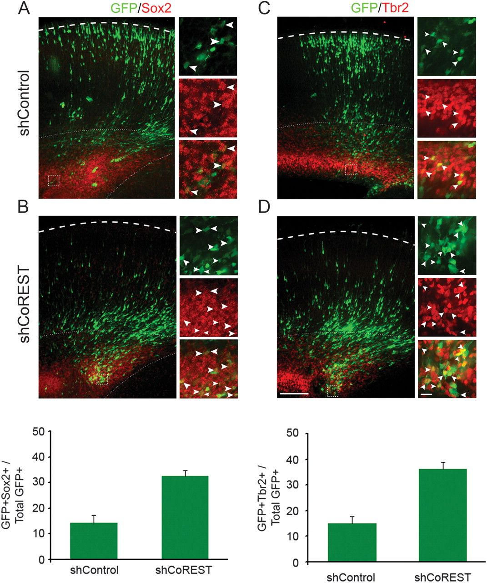
Figure 6. Loss of CoREST increases the proportion of cells in progenitor stages. Sections of E17.5 brains, ...
Notes:
Figure 6. Loss of CoREST increases the proportion of cells in progenitor stages. Sections of E17.5 brains, electroporated at E14.5 with the control or p-shCoREST plasmids and immunostained for Sox2 (left) or Tbr2 (right), which are used as markers of neuroepithelial cells and basal (intermediate) progenitors, respectively. Colabeling of GFP and each marker was examined at higher magnification. Representative magnified frames are shown at the right of each main picture. Arrowheads are used to show cases of coexpression. The percent of GFP/Sox2 or GFP/Tbr2-labeled cells with respect to the total number of GFP-expressing cells is shown in the lower panel graphs. Differences between shControl and shCoREST are significant for both Sox2 and Tbr2, *P < 0.05, **P < 0.01 respectively.
Unless provided in the caption above, the following copyright applies to the content of this slide: © The Author 2011. Published by Oxford University Press. All rights reserved. For permissions, please e-mail: journals.permissions@oup.com

Slide 7
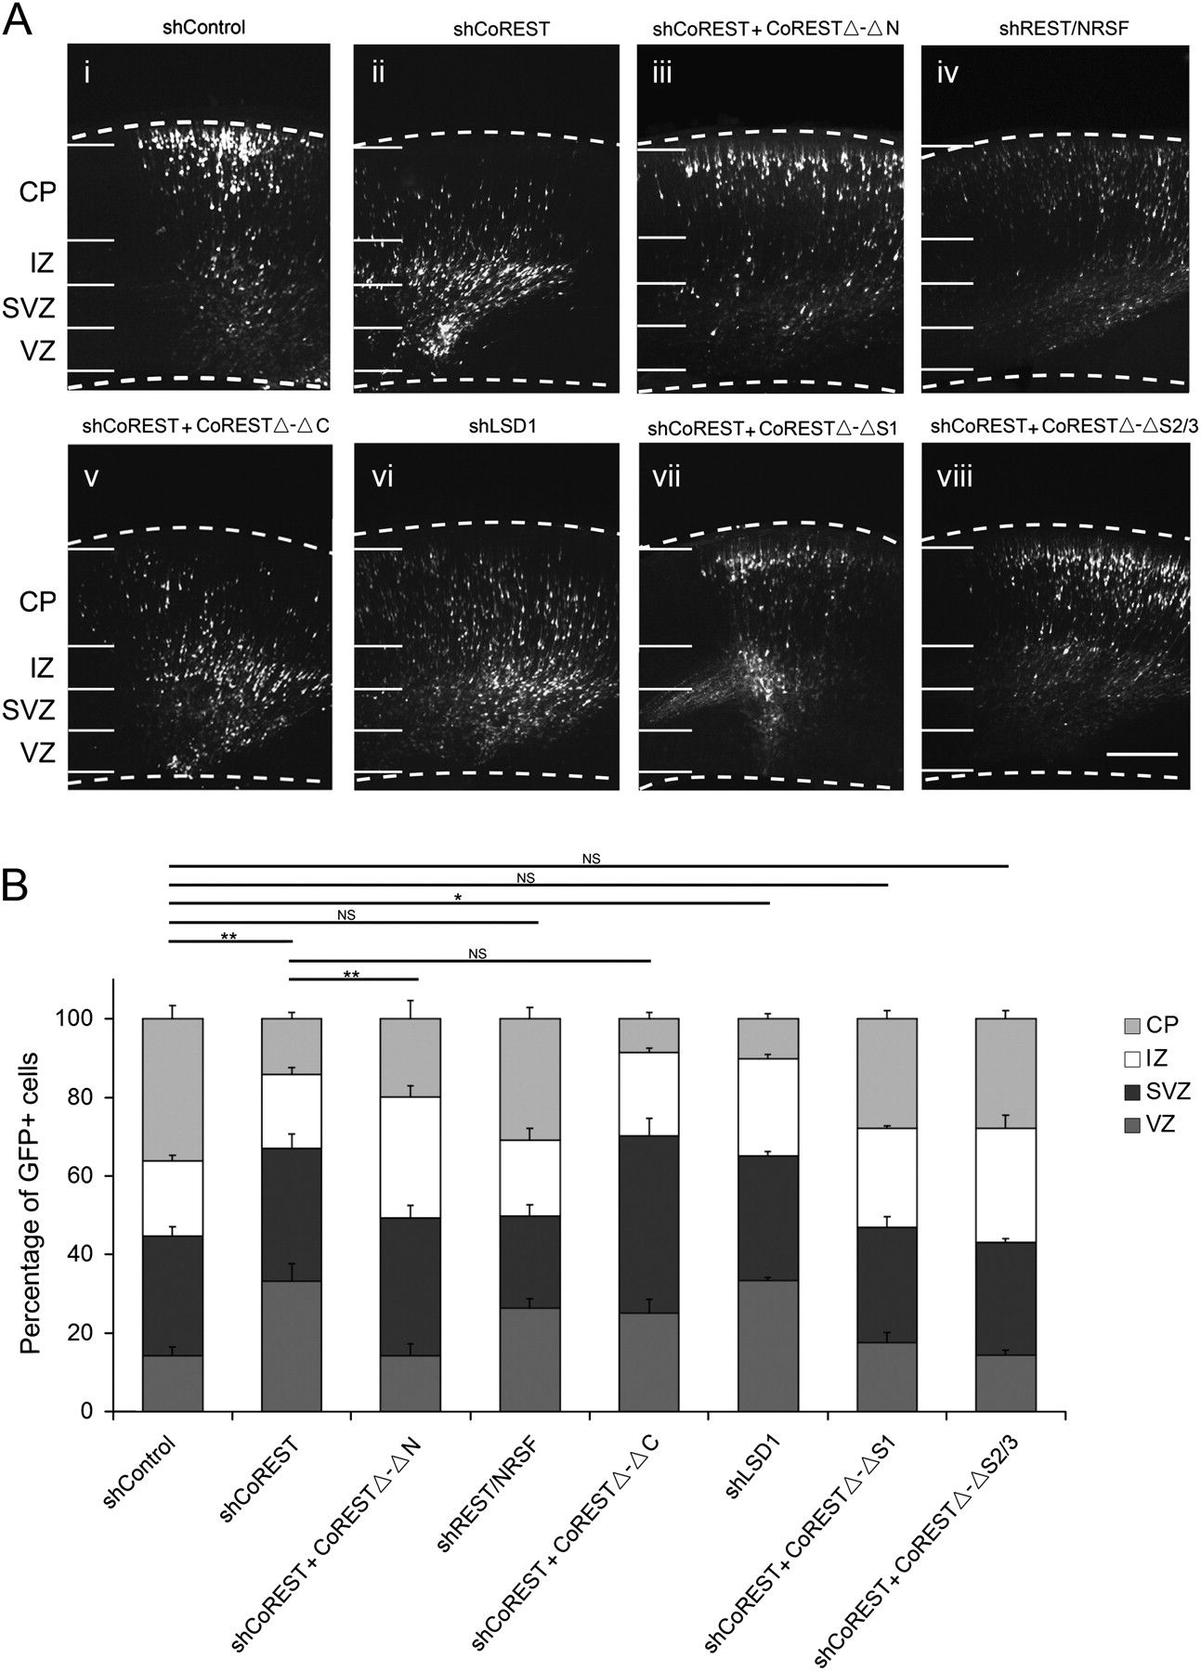
Figure 7. The regulation of neuronal migration by CoREST depends on the association with LSD1, while the association ...
Notes:
Figure 7. The regulation of neuronal migration by CoREST depends on the association with LSD1, while the association with REST/NRSF, SUMO1, or SUMO2/3 is not critical. (A). Representative images of coronal sections of brains electroporated at E14.5 and fixed at E17.5. The electroporated constructs are mentioned next to each image. (i) Control. (ii) p-shCoREST causes a delay of the exit of cells from the VZ at 17.5. (iii) Deletion of the N-terminus of CoREST, which binds to REST/NRSF, does not impair its ability to sustain normal migration of pyramidal neurons. (iv) Depletion of REST/NRSF does not affect neuronal migration. (v) Deletion of the C-terminus of CoREST impairs migration of pyramidal neurons. (vi) Interference of LSD1 expression delays neuronal migration. (vii) The deletion of the amino acids target of sumoylation by SUMO1 does not alter migration. (viii) The domain of CoREST that associates to SUMO2/3 is not required to sustain the normal migration of pyramidal neurons. (B) Distribution of electroporated (fluorescent) cells among the 4 defined bins, expressed as percent of total fluorescent cells for each experimental condition. Histograms summarize results obtained from 4 to 7 brains, corresponding to at least 3 different litters, in each condition. The statistical significance of differences among percent of cells remaining in the VZ bin is shown above the histogram. The comparison is made between the conditions under the end points of each horizontal line. *P < 0.05, **P < 0.01, NS: nonsignificant difference.
Unless provided in the caption above, the following copyright applies to the content of this slide: © The Author 2011. Published by Oxford University Press. All rights reserved. For permissions, please e-mail: journals.permissions@oup.com

