Slide 1
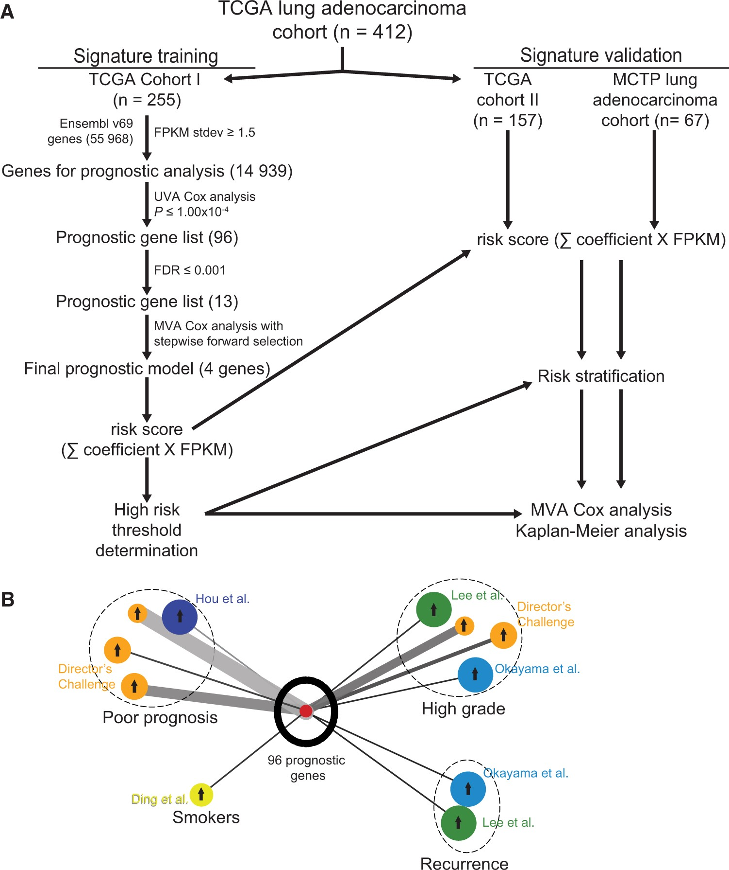
Figure 1. Identification of prognostic gene signature. A) RNA-seq prognostic analysis and signature generation ...
Notes:
Figure 1. Identification of prognostic gene signature. A) RNA-seq prognostic analysis and signature generation pipeline. The Cancer Genoma Atlas (TCGA) lung adenocarcinoma cohort was divided chronologically into TCGA cohort I (n = 255) and TCGA cohort II (n = 157). In TCGA cohort I, we filtered the 55 968 Ensembl v69 genes by standard deviation (stdev) greater than or equal to 1.5 fragments per kilobase of transcript per million reads (FPKM). The resulting 14 939 genes were analyzed individually for prognostic significance by univariate Cox proportional hazards models, and 96 genes were statistically significant at the level of P ≤ 1.00x10-4. We further narrowed this gene list to 13 genes with false discovery rates (FDRs) ≤ 0.001 and used multivariable Cox proportional hazards stepwise regression with forward selection to build a prognostic model that included four genes: RHOV, CD109, LINC00941, and FRRS1. This model was used to calculate risk scores for all TCGA cohort I patients by summing the product of model coefficient and FPKM for each gene, and a high risk threshold was chosen. This risk score calculation and high risk threshold was then applied to TCGA cohort II and Michigan Center for Translational Pathology cohort, and prognostic significance was analyzed with multivariable Cox proportional hazards models and Kaplan-Meier analysis. B) Oncomine lung adenocarcinoma signature concept analysis of top 96 prognostic genes. Results were exported as the nodes and edges of a concept association network and visualized using Cytoscape v3.1.1. Oncomine lung adenocarcinoma signatures are color-coded for the cohort in which they were generated, as labeled, and grouped (dashed circles) by the concept of the signature (Poor prognosis, Smokers, High grade, or Recurrence). The size of each signature circle is proportional to the number of genes in the signature, including for the top 96 prognostic genes in our study. Arrows in the center of each signature circle indicate positive (up arrow) or negative (down arrow) correlation with the top 96 prognostic genes, and the width of the connecting line indicates the strength of correlation. FDR = Benjamini-Hochberg false discovery rate; FPKM = fragments per kilobase of transcript per million reads; MCTP = Michigan Center for Translational Pathology; MVA = multivariable; Stdev = standard deviation; TCGA = The Cancer Genome Atlas; UVA = univariate.
Unless provided in the caption above, the following copyright applies to the content of this slide: © The Author 2016. Published by Oxford University Press. All rights reserved. For Permissions, please email: journals.permissions@oup.comThis article is published and distributed under the terms of the Oxford University Press, Standard Journals Publication Model (https://academic.oup.com/journals/pages/about_us/legal/notices)

Slide 2
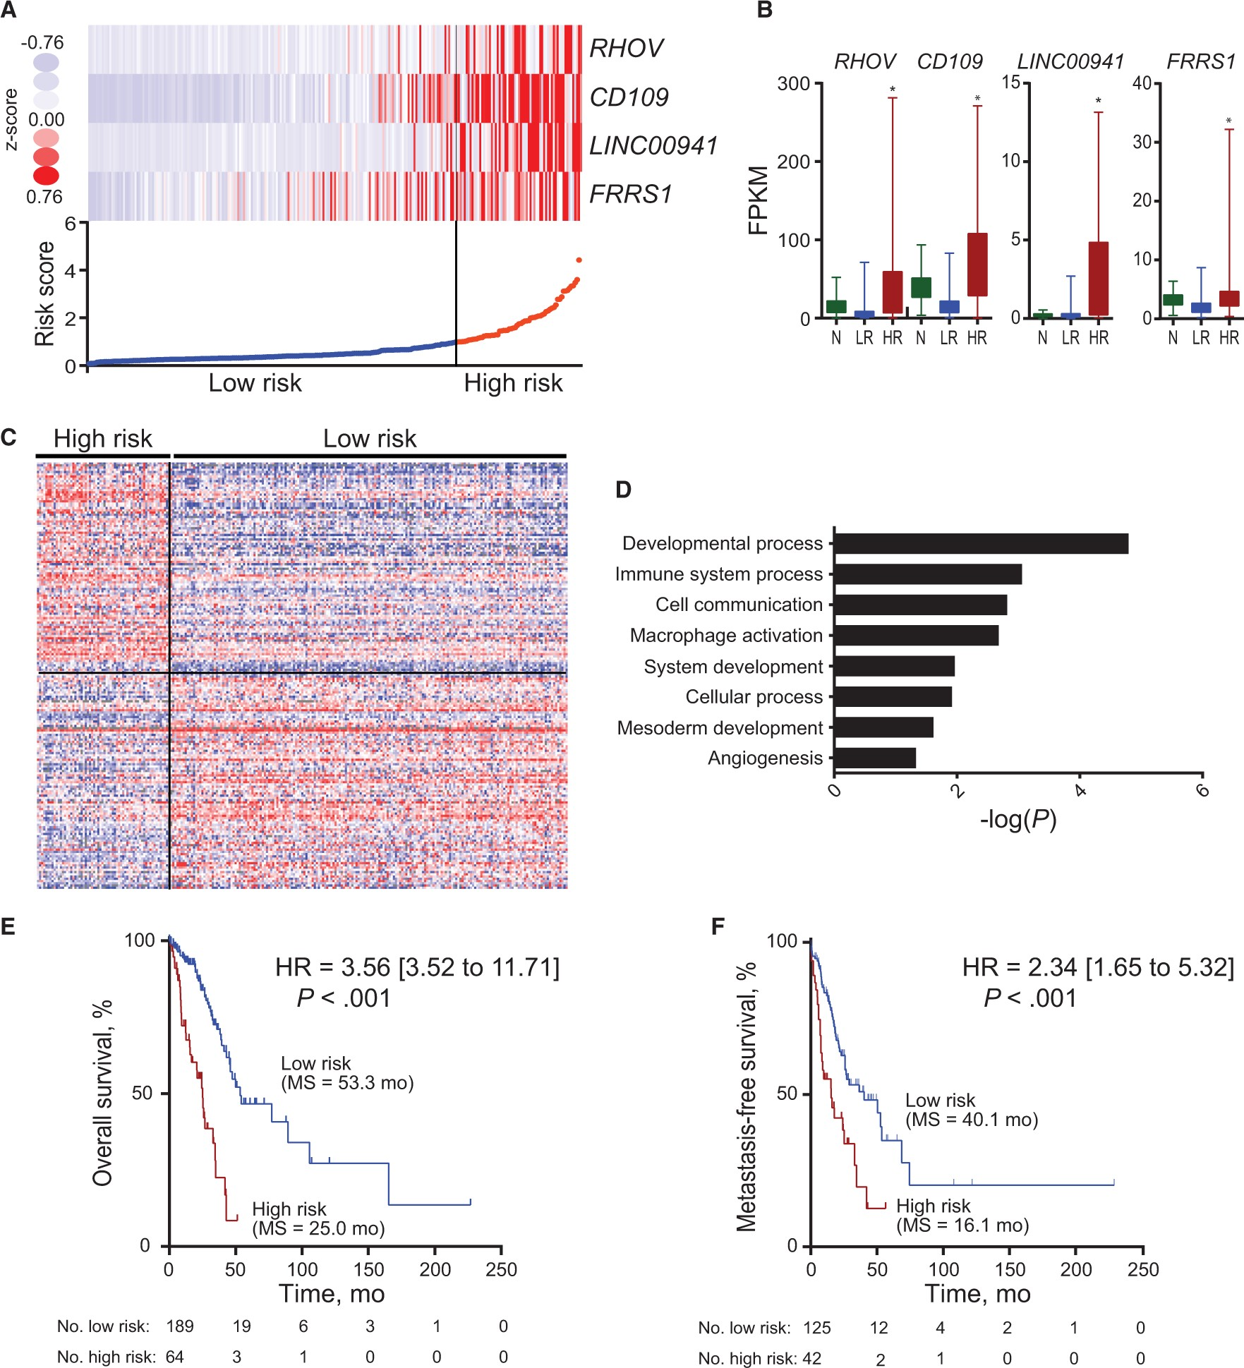
Figure 2. Four-gene prognostic signature biomarker characteristics in The Cancer Genoma Atlast (TCGA) cohort I. A) ...
Notes:
Figure 2. Four-gene prognostic signature biomarker characteristics in The Cancer Genoma Atlast (TCGA) cohort I. A) Four-gene expression and risk score distribution in TCGA cohort I by z-score, with red indicating higher expression and light blue indicating lower expression. The risk scores for all patients in TCGA cohort I are plotted in ascending order and marked as low risk (blue) or high risk (red), as divided by the threshold (vertical black line). B) Fragments per kilobase of transcript per million reads (FPKM) expression distribution of the signature genes in Normal (N), low risk (LR), and high risk (HR) tumors in TCGA cohort I. Bar represents mean, with error bar showing minimum and maximum values. C) Heatmap of the top 200 genes differentially expressed between high and low risk, with red indicating higher expression and blue indicating lower expression. D) Statistically significant Gene Ontology–Slim Biological Processes from PantherDB analysis of the genes differentially overexpressed in high-risk tumors. Full PantherDB results can be found in Supplementary Table 5 (available online). Kaplan-Meier curves of overall survival (E) and metastasis-free survival (F) in TCGA cohort I stratified by four-gene prognostic signature in high and low risk. A two-sided log-rank test was used to calculate hazard ratio (HR). HR, 95% confidence interval, P value, and median survival are shown. *P < .001. FPKM = fragments per kilobase of transcript per million reads; HR = hazard ratio.
Unless provided in the caption above, the following copyright applies to the content of this slide: © The Author 2016. Published by Oxford University Press. All rights reserved. For Permissions, please email: journals.permissions@oup.comThis article is published and distributed under the terms of the Oxford University Press, Standard Journals Publication Model (https://academic.oup.com/journals/pages/about_us/legal/notices)

Slide 3
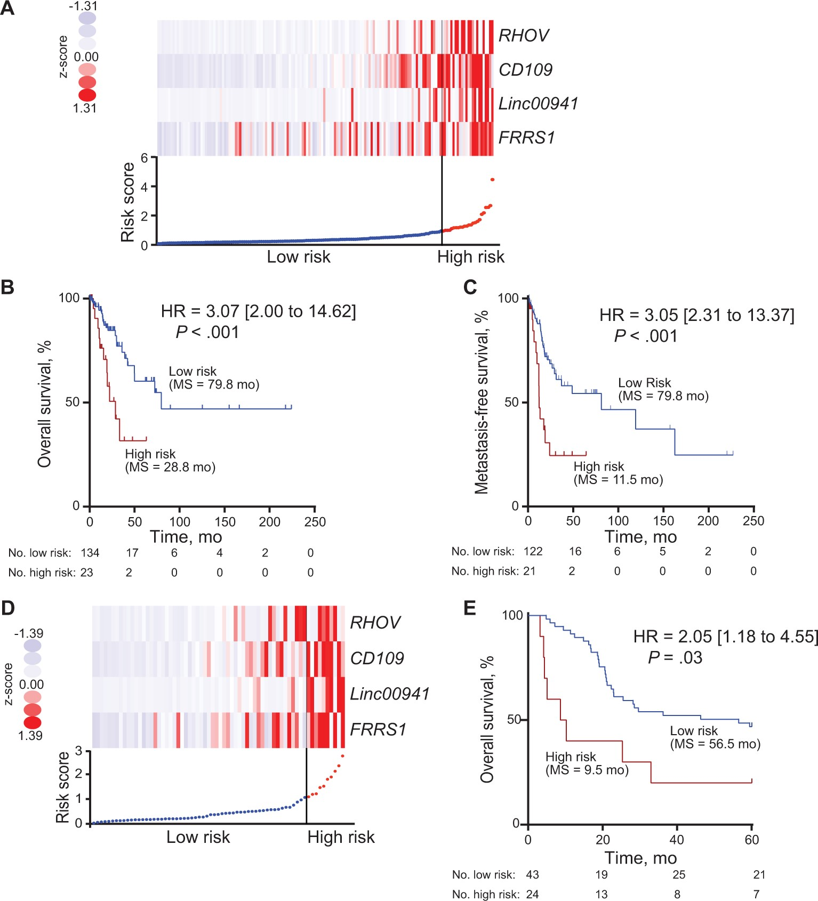
Figure 3. Four-gene prognostic signature biomarker performance in two validation cohorts. A) Four-gene expression and ...
Notes:
Figure 3. Four-gene prognostic signature biomarker performance in two validation cohorts. A) Four-gene expression and risk score distribution in The Cancer Genome Atlas (TCGA) cohort II by z-score, with red indicating higher expression and light blue indicating lower expression. The risk scores for all patients in TCGA cohort II are plotted in ascending order and marked as low risk (blue) or high risk (red), as divided by the threshold (vertical black line). B and C) Kaplan-Meier curves of overall survival (B) and metastasis-free survival (C) in TCGA cohort II stratified by four-gene prognostic signature high and low risk with log-rank hazard ratio (HR), 95% confidence interval (CI), P value, and median survival. D) Four-gene expression and risk score distribution in the Michigan Center for Translational Pathology (MCTP) cohort by z-score, with red indicating higher expression and light blue indicating lower expression. The risk scores for all patients in MCTP cohort are plotted in ascending order and marked as low risk (blue) or high risk (red), as divided by the threshold (vertical black line). E) Kaplan-Meier curves of overall survival in the MCTP cohort stratified by four-gene prognostic signature in high and low risk. A two-sided log-rank test was used to calculate hazard ratio (HR). HR, 95% CI, P value, and median survival are shown. HR = hazard ratio.
Unless provided in the caption above, the following copyright applies to the content of this slide: © The Author 2016. Published by Oxford University Press. All rights reserved. For Permissions, please email: journals.permissions@oup.comThis article is published and distributed under the terms of the Oxford University Press, Standard Journals Publication Model (https://academic.oup.com/journals/pages/about_us/legal/notices)

Slide 4
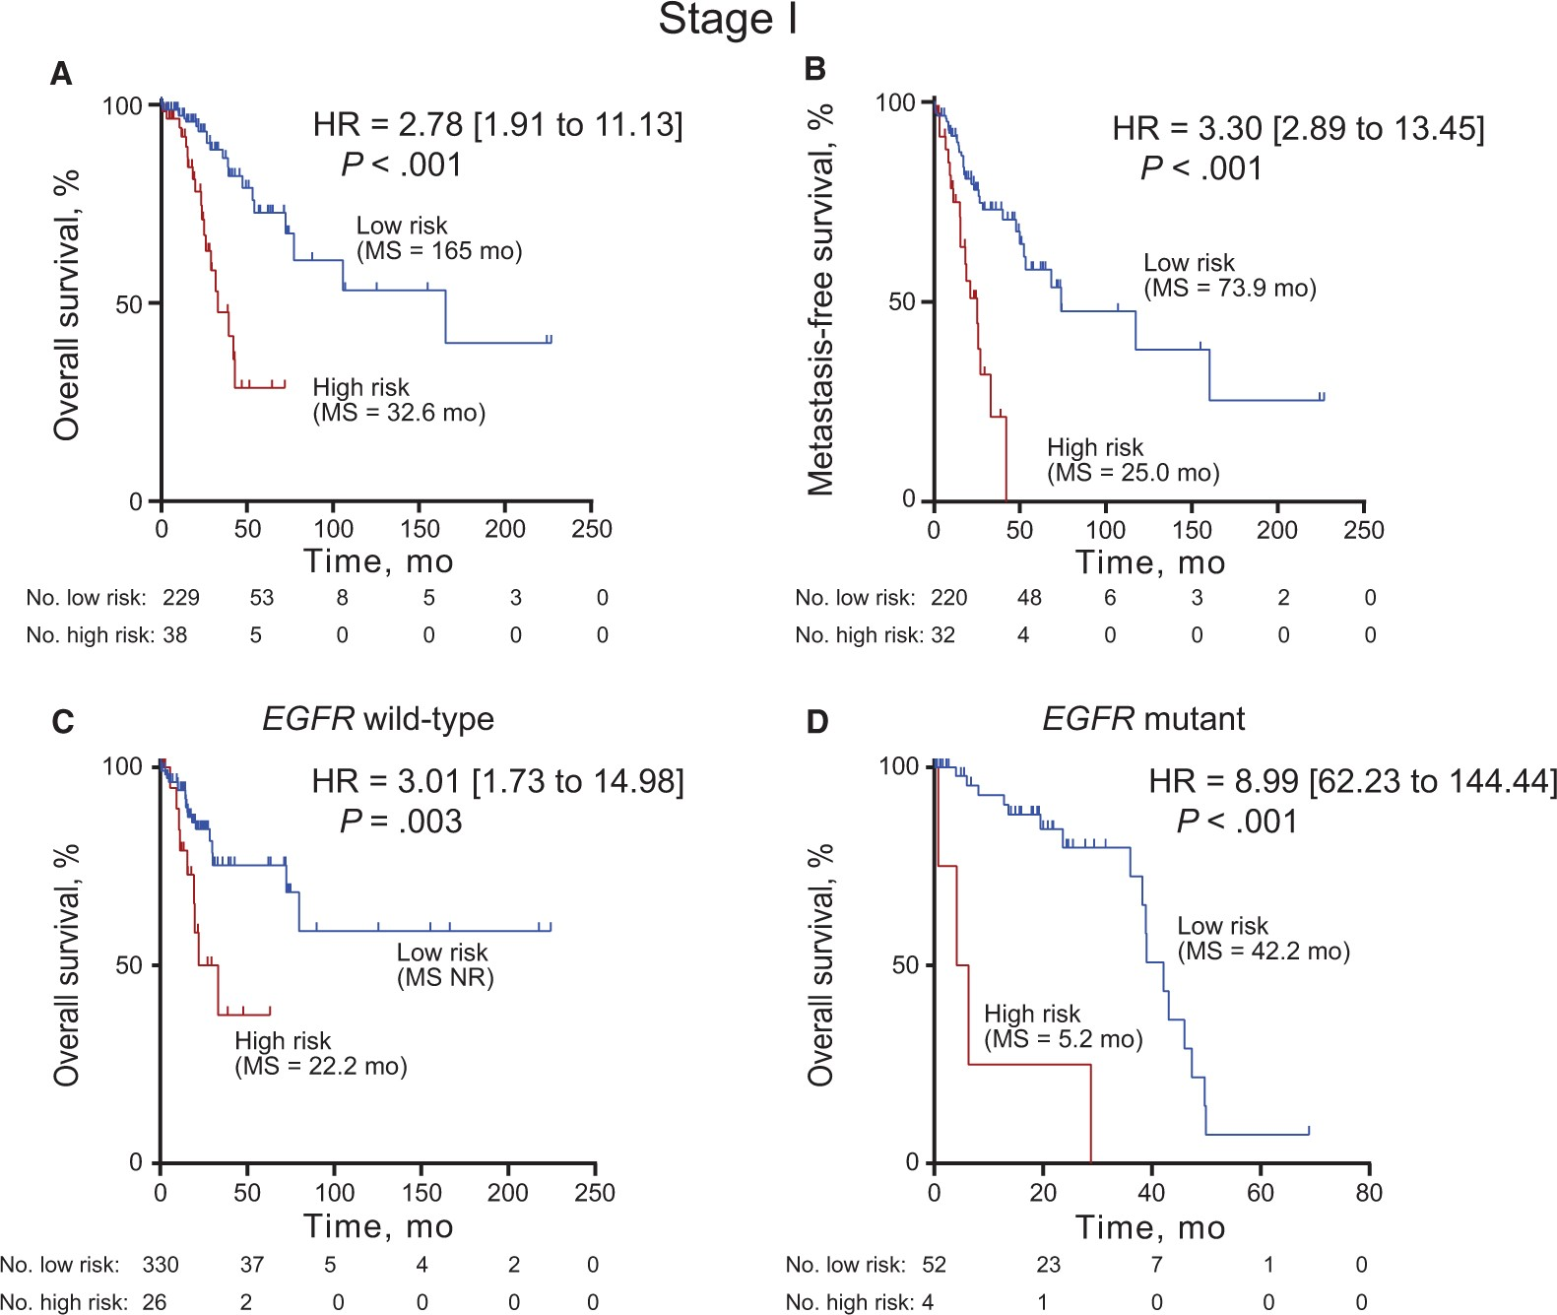
Figure 4. Four-gene prognostic signature biomarker performance in stage I and EGFR mutation subsets. Kaplan-Meier ...
Notes:
Figure 4. Four-gene prognostic signature biomarker performance in stage I and EGFR mutation subsets. Kaplan-Meier curves with log-rank hazard ratio (HR), 95% confidence interval (CI), P value, and median survival for overall survival (A, C, D) and metastasis-free survival (B) in the stage I cases in The Cancer Genome Atlas (TCGA) cohort I (A, B), EGFR wild-type cases from validation cohort TCGA cohort II (C), and EGFR mutant cases from the full TCGA cohort (D) stratified by four-gene signature into high and low risk. A two-sided log-rank test was used to calculate hazard ratio (HR). HR, 95% CI, P value, and median survival are shown. The hazard ratio and 95% CI for the EGFR mutant analysis could not be accurately calculated due to the small number of patients. HR = hazard ratio.
Unless provided in the caption above, the following copyright applies to the content of this slide: © The Author 2016. Published by Oxford University Press. All rights reserved. For Permissions, please email: journals.permissions@oup.comThis article is published and distributed under the terms of the Oxford University Press, Standard Journals Publication Model (https://academic.oup.com/journals/pages/about_us/legal/notices)

