Slide 1
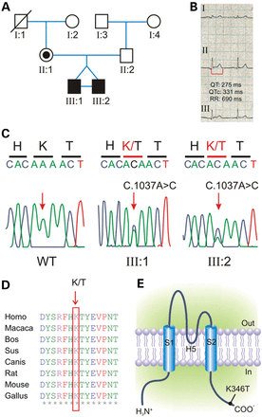
Figure 1. Mutation detection by sequence analysis of the KCNJ2 coding region. (A) Pedigree of the family harboring a ...
Notes:
Figure 1. Mutation detection by sequence analysis of the KCNJ2 coding region. (A) Pedigree of the family harboring a novel mutations in KCNJ2. Squares are males and circles females; solid black symbols represent propositi and slash deceased individual. (B) ECG recording from propositi showing shortened QT interval (heart rate, 87 bpm; QT 275 ms; paper speed 25 mm/s). (C) Electropherograms showing the heterozygous c.1037A>C transition (arrow-headed), predicting a novel non-synonymous p.K346T variant in propositi compared with the sequence of a healthy individual (WT). (D) Alignments of several KCNJ2 sequences flanking the K346T substitution (K/T, arrow-headed) showing that this residue is highly conserved in several vertebrate species. (E) Schematic representation of the membrane topology of a human Kir2.1 subunit indicating the position of the p.K346T variant.
Unless provided in the caption above, the following copyright applies to the content of this slide: © The Author 2014. Published by Oxford University Press.This is an Open Access article distributed under the terms of the Creative Commons Attribution License (http://creativecommons.org/licenses/by/4.0/), which permits unrestricted reuse, distribution, and reproduction in any medium, provided the original work is properly cited.

Slide 2
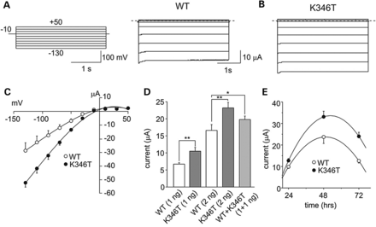
Figure 2. The K346T mutation increases Kir2.1 currents. Sample current families recorded from oocytes expressing WT (A) ...
Notes:
Figure 2. The K346T mutation increases Kir2.1 currents. Sample current families recorded from oocytes expressing WT (A) or K346T (B) mRNA (the pulse protocol is shown as inset). (C) I–V relationships for WT (white circles, 3 ng) and K346T (black circles, 3 ng) channels. (D) Current amplitudes recorded at −100 mV from cells injected with the indicated mRNAs whose amounts are reported in brackets (mean ± SEM; n = 120; *P < 0.05; **P < 0.01). (E) Current amplitudes recorded at −60 mV for WT (white circles) and K346T (black circles) channels and plotted as a function of time after mRNA injection (mean ± SEM; n = 6).
Unless provided in the caption above, the following copyright applies to the content of this slide: © The Author 2014. Published by Oxford University Press.This is an Open Access article distributed under the terms of the Creative Commons Attribution License (http://creativecommons.org/licenses/by/4.0/), which permits unrestricted reuse, distribution, and reproduction in any medium, provided the original work is properly cited.

Slide 3
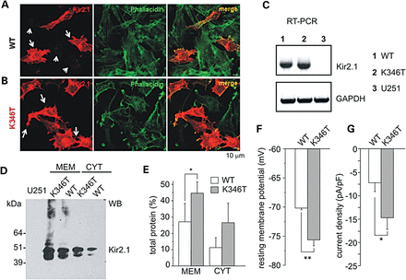
Figure 3. Characterization of astrocytoma cells expressing WT and K346T channels. Co-immunofluorescences of cells ...
Notes:
Figure 3. Characterization of astrocytoma cells expressing WT and K346T channels. Co-immunofluorescences of cells expressing WT (A) or K346T (B) channels with anti-Kir2.1 pAb (red) and FITC-conjugated phallacidin (green) show that WT channels are localized in perinuclear vesicles (short arrows in A) and occasionally at plasma membranes (long arrows in A), while mutated channels are mainly expressed at plasma membranes (long arrows in B). Scale bar: 10 μm. (C) RT-PCR analysis of Kir2.1 mRNA in WT (1), K346T (2) channel or empty-vector expressing U251 cell lines (3). GAPDH housekeeping gene normalizes the amount of template. (D) WB analysis of membrane (MEM) and cytosolic (CYT) proteins derived from WT or K346T Kir2.1-expressing cells after Histidine co-purification. Molecular weight markers are on the left (kDa). (E) Densitometric analysis of protein bands from four independent experiments (mean ± SEM, *P < 0.05). (F) The resting membrane potential and (G) current density (at −100 mV) were evaluated in cells expressing WT (white bars) or K346T (gray bars) channels (data are mean ± SEM; n = 6; *P < 0.05; **P < 0.01).
Unless provided in the caption above, the following copyright applies to the content of this slide: © The Author 2014. Published by Oxford University Press.This is an Open Access article distributed under the terms of the Creative Commons Attribution License (http://creativecommons.org/licenses/by/4.0/), which permits unrestricted reuse, distribution, and reproduction in any medium, provided the original work is properly cited.

Slide 4
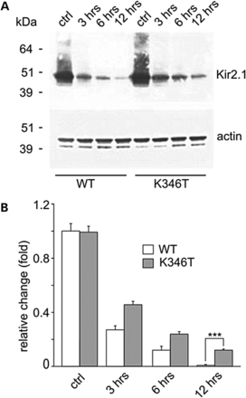
Figure 4. The K346T mutation increases protein stability. (A) WB analysis of protein extracts derived from cells ...
Notes:
Figure 4. The K346T mutation increases protein stability. (A) WB analysis of protein extracts derived from cells expressing WT and K346T channels treated with the protein synthesis inhibitor cycloheximide for 3, 6 and 12 h. WT protein degradation is almost complete after 12 h treatment, while K346T protein is still detectable at this time. Actin is used as loading control. Molecular weight markers are on the left (kDa). (B) Densitometric analysis of protein bands normalized with respect to the amount of either WT (white bar) or K346T (gray bar) Kir2.1 protein in control conditions. Data are expressed as mean ± SEM from four independent experiments (***P < 0.001).
Unless provided in the caption above, the following copyright applies to the content of this slide: © The Author 2014. Published by Oxford University Press.This is an Open Access article distributed under the terms of the Creative Commons Attribution License (http://creativecommons.org/licenses/by/4.0/), which permits unrestricted reuse, distribution, and reproduction in any medium, provided the original work is properly cited.

Slide 5
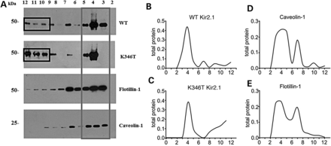
Figure 5. The K346T mutation affects the distribution of Kir2.1 channels in membrane lipid rafts. (A) WB analysis of ...
Notes:
Figure 5. The K346T mutation affects the distribution of Kir2.1 channels in membrane lipid rafts. (A) WB analysis of cholesterol-rich (triton insoluble fractions: 3–5) and cholesterol-poor membrane fractions (triton soluble fractions: 10–12) of WT or K346T Kir2.1-expressing cells. WT channels are mainly distributed in triton insoluble fractions (gray box), whereas K346T is also abundantly localized in cholesterol-poor fractions (black boxes). Cav-1 and flotillin-1 identify the caveolar raft fractions. Molecular weight markers are on the left (kDa). (B–E) Normal distributions of total protein (indicated on top) in membrane fractions isolated by sucrose density gradient. The levels of protein in each fraction are normalized to the total protein amount recovered from all the fractions together.
Unless provided in the caption above, the following copyright applies to the content of this slide: © The Author 2014. Published by Oxford University Press.This is an Open Access article distributed under the terms of the Creative Commons Attribution License (http://creativecommons.org/licenses/by/4.0/), which permits unrestricted reuse, distribution, and reproduction in any medium, provided the original work is properly cited.

Slide 6
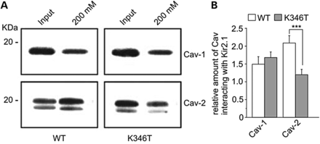
Figure 6. The K346T mutation reduces Kir2.1 channels interaction with Cav-2. (A) WB analysis of Kir2.1 channel's ...
Notes:
Figure 6. The K346T mutation reduces Kir2.1 channels interaction with Cav-2. (A) WB analysis of Kir2.1 channel's interactors after Histidine (His) co-purification of astrocytoma cells expressing WT or K346T channels. Input lanes represent protein extracts before His co-purification. WT and K346T channels co-purify similarly with Cav-1, whereas the K346T mutation reduces the association with Cav-2. One representative experiment out of three is shown. Molecular weight markers are indicated on the left (kDa). (B) Densitometric analysis (ratio) of protein bands corresponding to Cav-1 and Cav-2 normalized respect to WT (white bars) or K346T (gray bars) Kir2.1 protein levels. Data are expressed as mean ± SEM from three independent experiments (***P < 0.001).
Unless provided in the caption above, the following copyright applies to the content of this slide: © The Author 2014. Published by Oxford University Press.This is an Open Access article distributed under the terms of the Creative Commons Attribution License (http://creativecommons.org/licenses/by/4.0/), which permits unrestricted reuse, distribution, and reproduction in any medium, provided the original work is properly cited.

