Slide 1
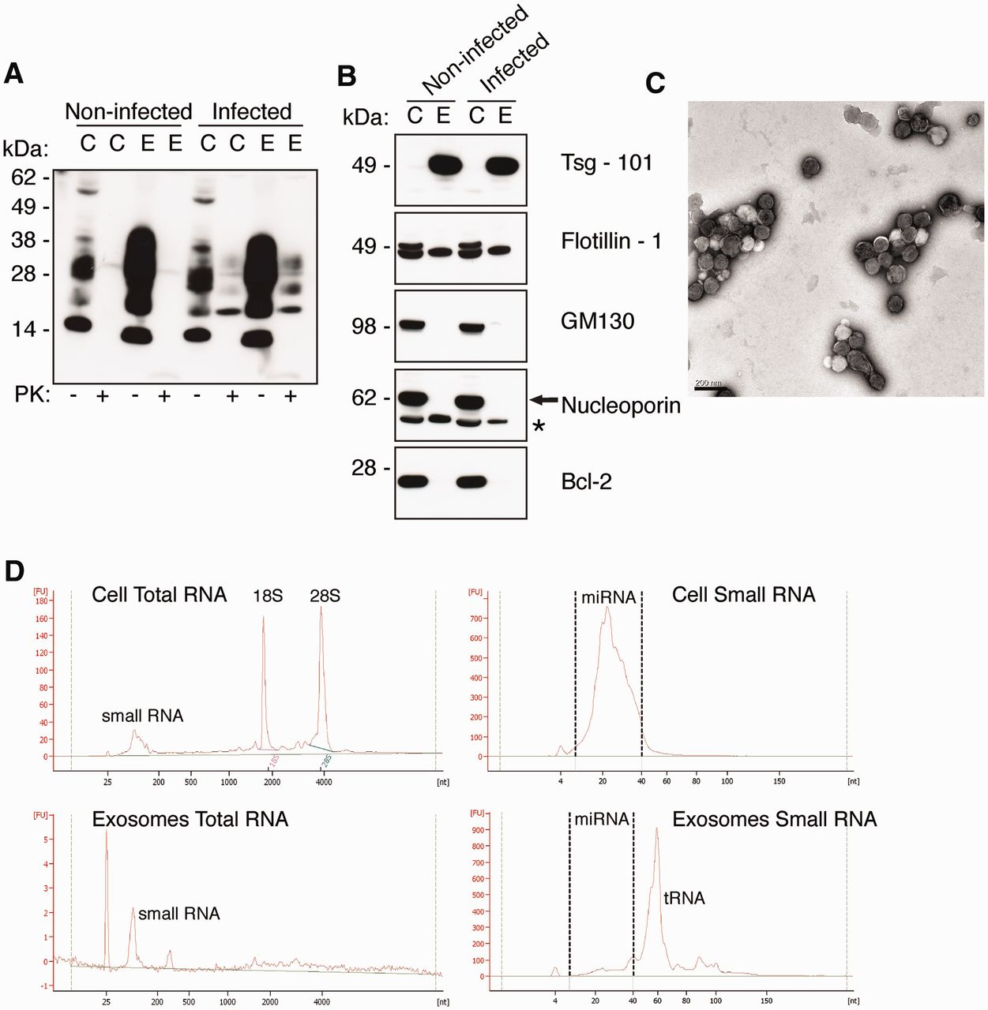
Figure 1. Exosomes isolated from prion-infected cells contain small RNA. ( A ) Western blot of PrP ^{C} and ...
Notes:
Figure 1. Exosomes isolated from prion-infected cells contain small RNA. ( A ) Western blot of PrP C and PrP Sc in GT1-7 cell lysates and GT1-7 exosomes. Anti-PrP antibody ICSM-18 reveals the presence of PrP in GT1-7 cell (C) lysates and GT1-7 exosome (E) lysates (40 µg total protein loaded) from both non-infected and infected samples, and following PK-digested (100 µg total protein digested with 25 µg/ml PK) PrP Sc is indicated by presence PK-resistant protein in infected (C) cell lysates and exosomes (E). ( B ) Isolated exosomes were confirmed by enrichment of exosome markers tsg-101 and flotillin-1, and negative for Golgi marker GM130, nuclear marker nucleoporin and mitochondrial marker Bcl-2. Asterisks indicate non-specific band for anti-nucleoporin, p62. ( C ) Representative TEM of non-infected GT1-7 exosomes revealed homogenous populations of extracellular vesicles of ∼100 nm in diameter that are characteristic of exosomes. Scale bar 200 nm. ( D ) Bioanalyser analysis of RNA isolated from cells and exosomes on the total RNA and small RNA Chips. Exosomes lack detectable 18 S and 28S rRNA bands compared to total cell RNA. Cells and exosomes both contain miRNA between 4 and 40 nt, with exosomes enriched in tRNA at ∼60 nt.
Unless provided in the caption above, the following copyright applies to the content of this slide: © The Author(s) 2012. Published by Oxford University Press.This is an Open Access article distributed under the terms of the Creative Commons Attribution Non-Commercial License (http://creativecommons.org/licenses/by-nc/3.0), which permits unrestricted non-commercial use, distribution, and reproduction in any medium, provided the original work is properly cited.

Slide 2
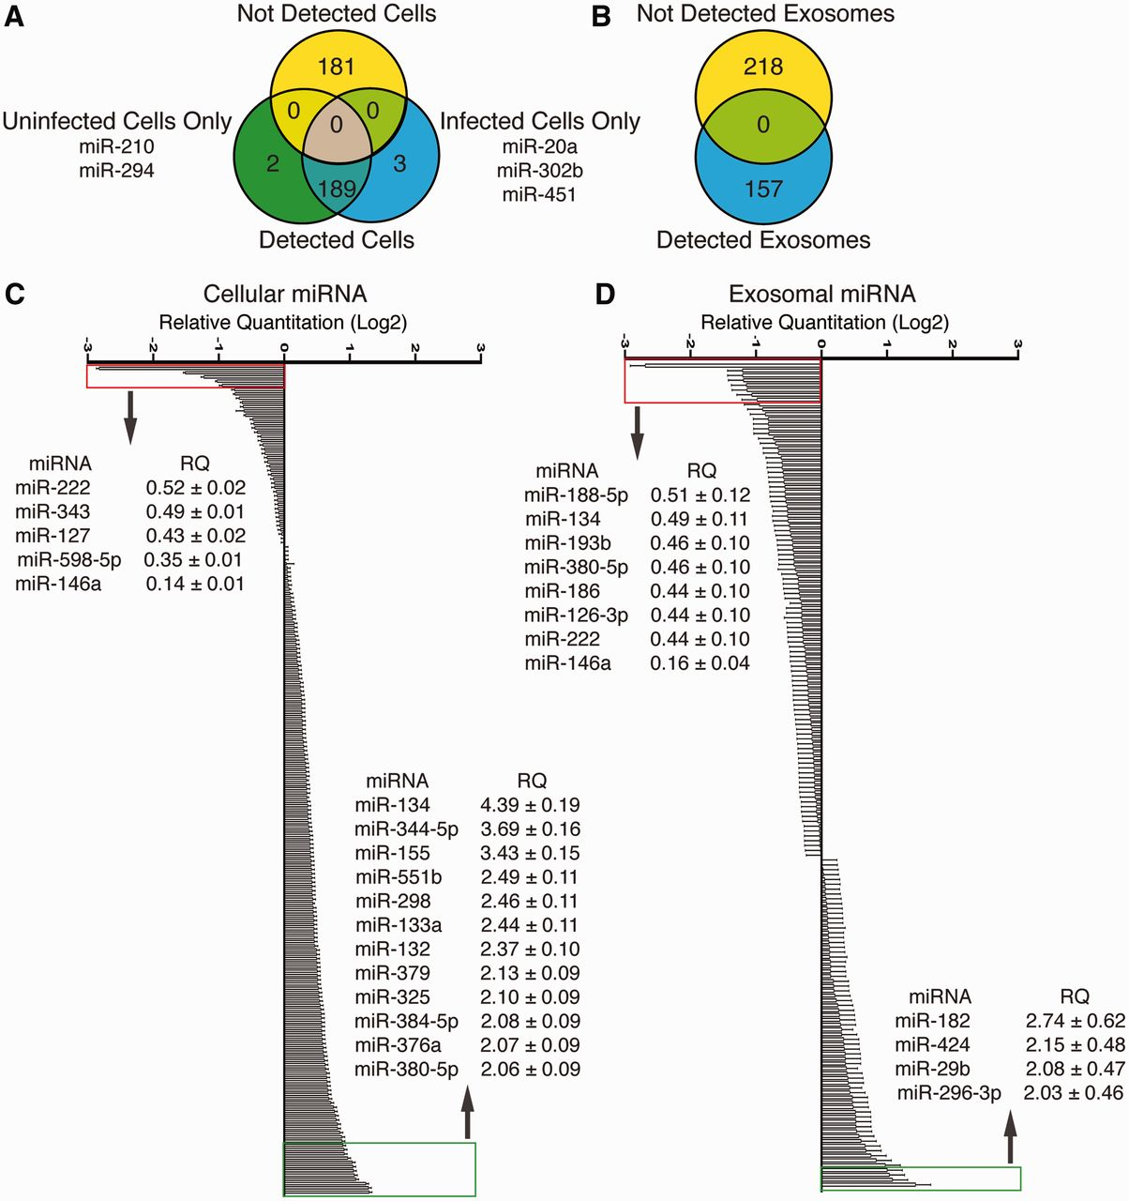
Figure 2. Profiling of miRNA Isolated from prion-infected cells and exosomes. ( A ) Venn diagram of detected miRNA in ...
Notes:
Figure 2. Profiling of miRNA Isolated from prion-infected cells and exosomes. ( A ) Venn diagram of detected miRNA in uninfected and prion-infected cells with TLDA cards that detect 375 known miRNA ( n = 2). ( B ) Venn diagram of detected miRNA in uninfected and prion-infected exosomes with TLDA cards that detect 375 known miRNA ( n = 2). ( C ) Relative quantitation of 189 miRNA is detected in uninfected and infected cells. Twelve miRNAs were detected >2-fold up-regulated and five miRNAs were detected as <2-fold down-regulated. Data represent mean ± SEM normalized to sno135 and sno202 endogenous controls using ΔΔC t method ( n = 2). ( D ) Relative quantitation of 157 miRNAs detected in uninfected and infected exosomes. Four miRNAs were detected >2-fold up-regulated and eight miRNA were detected as <2-fold down-regulated. Data represent mean ± SEM normalized to sno135 and sno202 endogenous controls using ΔΔC t method ( n = 2).
Unless provided in the caption above, the following copyright applies to the content of this slide: © The Author(s) 2012. Published by Oxford University Press.This is an Open Access article distributed under the terms of the Creative Commons Attribution Non-Commercial License (http://creativecommons.org/licenses/by-nc/3.0), which permits unrestricted non-commercial use, distribution, and reproduction in any medium, provided the original work is properly cited.

Slide 3
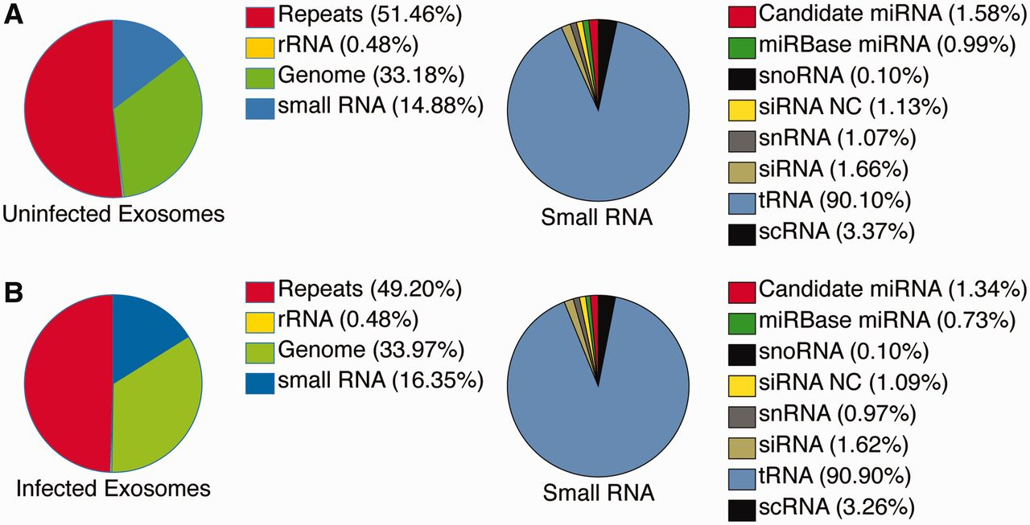
Figure 3. Small RNA library composition from deep sequencing of neuronal exosomes. ( A and B ) Percentage reads ...
Notes:
Figure 3. Small RNA library composition from deep sequencing of neuronal exosomes. ( A and B ) Percentage reads mapping in uninfected exosome (A) and infected exosome (B) libraries to RNA repeats, rRNA, genomic regions and small RNA. Small RNA mapping is further categorized to tRNA, siRNA and siRNA derived from ncRNA, snoRNA, scRNA, snRNA, mirBase miRNA and candidate miRNA sequences ( n = 2).
Unless provided in the caption above, the following copyright applies to the content of this slide: © The Author(s) 2012. Published by Oxford University Press.This is an Open Access article distributed under the terms of the Creative Commons Attribution Non-Commercial License (http://creativecommons.org/licenses/by-nc/3.0), which permits unrestricted non-commercial use, distribution, and reproduction in any medium, provided the original work is properly cited.

Slide 4
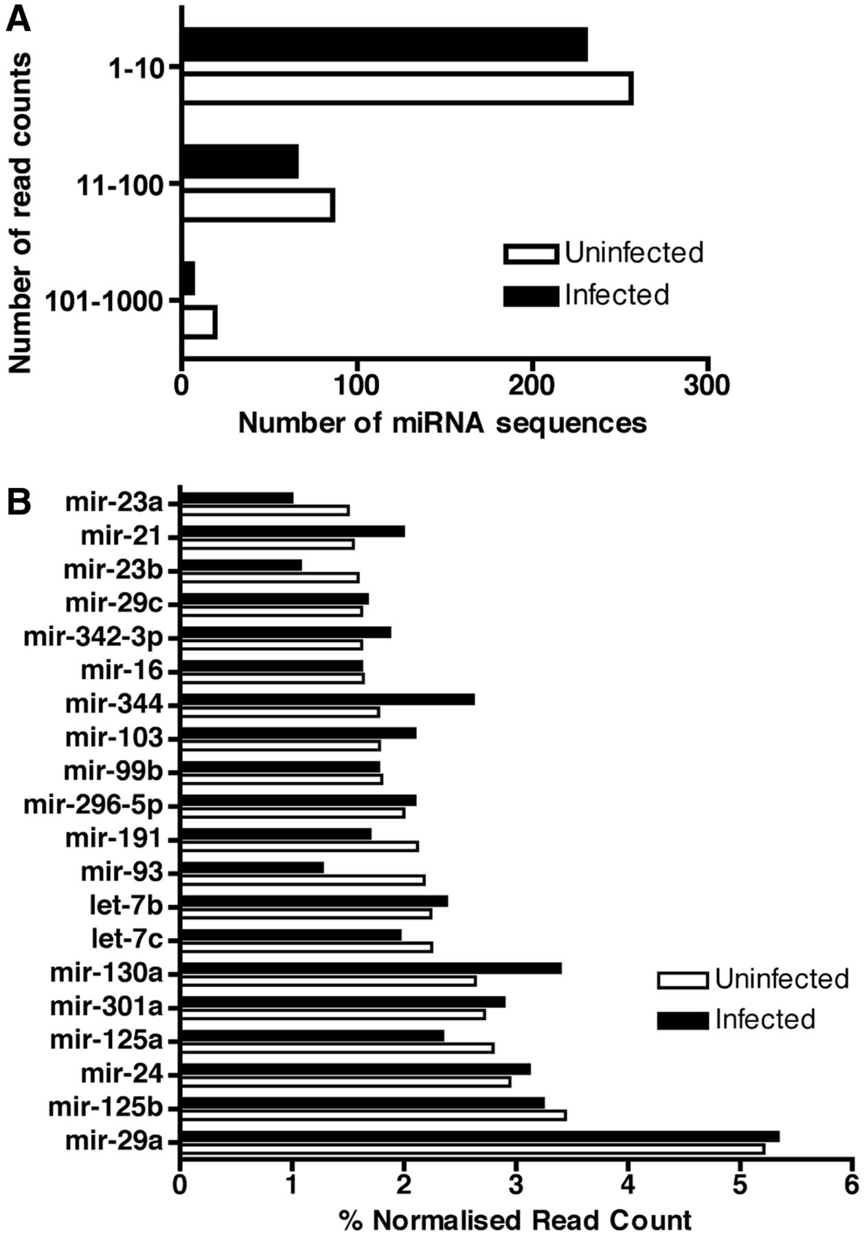
Figure 4. Known miRNAs sequenced in uninfected and prion-infected exosomes. ( A ) Distribution of known miRNA ...
Notes:
Figure 4. Known miRNAs sequenced in uninfected and prion-infected exosomes. ( A ) Distribution of known miRNA sequences in uninfected and infected exosomes based on the total read counts. Mature miRNA sequences are categorized by number of read counts corresponding to each individual miRNA ( n = 2). ( B ) Top 20 known miRNAs expressed in uninfected and infected exosomes. The percent contribution of each miRNA sequence in the total pool of known miRNA sequences was calculated by dividing the individual miRNA read count by the total number of known miRNAs sequenced in the corresponding library ( n = 2).
Unless provided in the caption above, the following copyright applies to the content of this slide: © The Author(s) 2012. Published by Oxford University Press.This is an Open Access article distributed under the terms of the Creative Commons Attribution Non-Commercial License (http://creativecommons.org/licenses/by-nc/3.0), which permits unrestricted non-commercial use, distribution, and reproduction in any medium, provided the original work is properly cited.

Slide 5
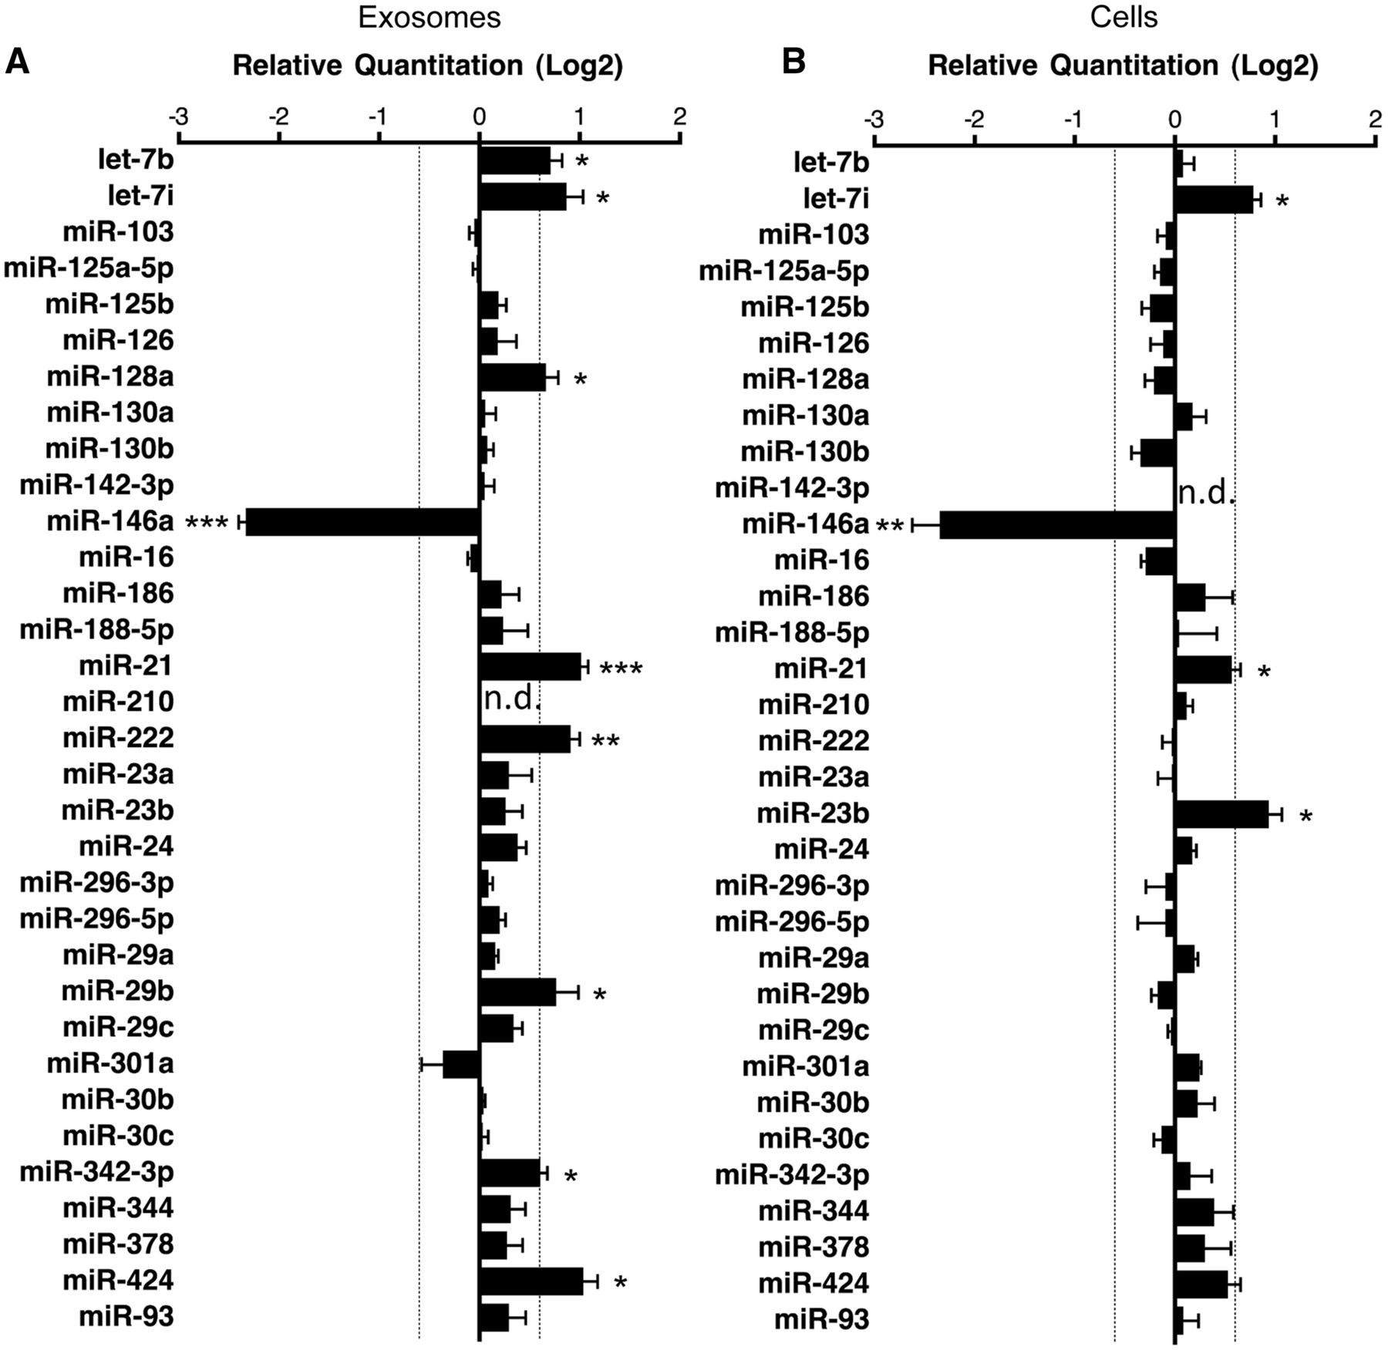
Figure 5. Validation of miRNA ‘hits’ in infected exosomes and cells. ( A ) Exosomes miRNA detection by TaqMan qPCR ...
Notes:
Figure 5. Validation of miRNA ‘hits’ in infected exosomes and cells. ( A ) Exosomes miRNA detection by TaqMan qPCR miRNA assay, miR-210 was used as a negative control for exosomal miRNA. Relative quantitation data represent mean ±SEM normalized to sno135 and sno202 using ΔΔC t method. Fold change >1.5 or <1.5 is indicated with significance determined by Mann–Whitney U -test; * P < 0.05; ** P < 0.01; *** P < 0.001 ( n = 6–7 independent experiments, n.d. = not detected). ( B ) Cellular miRNA detection by TaqMan qPCR miRNA assay, miR-142-3 p was used as a negative control for cellular miRNA. Relative quantitation data represent mean ± SEM of normalized to sno135 and sno202 using ΔΔC t method. Fold change >1.5 or <1.5 is indicated by the dashed line with significance determined by Mann–Whitney U-test; * P < 0.05; ** P < 0.01 ( n = 6–7 independent experiments, n.d. = not detected).
Unless provided in the caption above, the following copyright applies to the content of this slide: © The Author(s) 2012. Published by Oxford University Press.This is an Open Access article distributed under the terms of the Creative Commons Attribution Non-Commercial License (http://creativecommons.org/licenses/by-nc/3.0), which permits unrestricted non-commercial use, distribution, and reproduction in any medium, provided the original work is properly cited.

