Slide 1
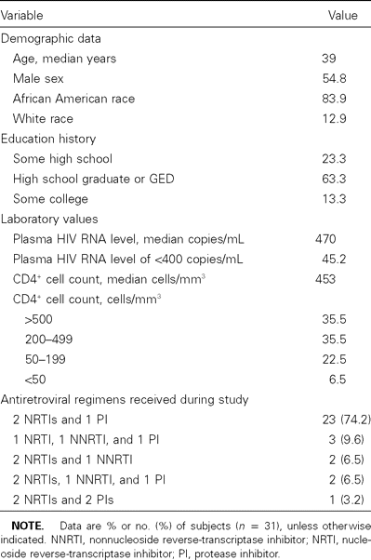
Table 1 Demographic characteristics of and clinical data at baseline for subjects in a study of directly-observed ...
Notes:
Table 1 Demographic characteristics of and clinical data at baseline for subjects in a study of directly-observed antiretroviral therapy.
Unless provided in the caption above, the following copyright applies to the content of this slide: © 2003 by the Infectious Diseases Society of America

Slide 2
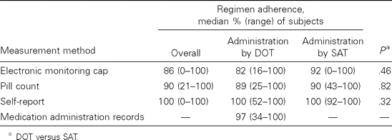
Table 2 Median adherence to regimens of antiretrovirals administered by directly observed therapy (DOT) or by ...
Notes:
Table 2 Median adherence to regimens of antiretrovirals administered by directly observed therapy (DOT) or by self-administered therapy (SAT).
Unless provided in the caption above, the following copyright applies to the content of this slide: © 2003 by the Infectious Diseases Society of America

