Slide 1
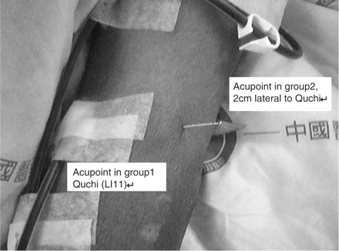
Fig. 1. The location of the Quchi (LI11) acupoint in group 1, and the non-acupoint used in group 2 (control group).
Notes:
Fig. 1. The location of the Quchi (LI11) acupoint in group 1, and the non-acupoint used in group 2 (control group).
Unless provided in the caption above, the following copyright applies to the content of this slide: © The Author [2005]. Published by Oxford University Press on behalf of ERA-EDTA. All rights reserved. For Permissions, please email: journals.permissions@oupjournals.org

Slide 2
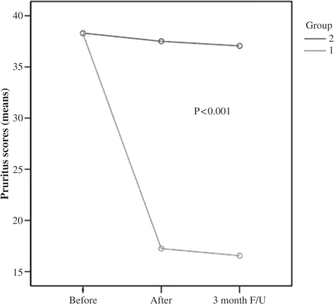
Fig. 2. The plot of mean pruritus scores before and after acupuncture and at the 3 month follow-up in groups 1 and ...
Notes:
Fig. 2. The plot of mean pruritus scores before and after acupuncture and at the 3 month follow-up in groups 1 and 2.
Unless provided in the caption above, the following copyright applies to the content of this slide: © The Author [2005]. Published by Oxford University Press on behalf of ERA-EDTA. All rights reserved. For Permissions, please email: journals.permissions@oupjournals.org

