Slide 1
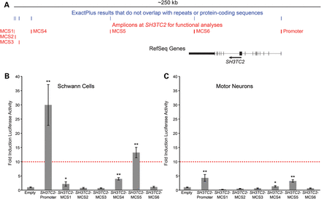
Table 1. Multiple-species conserved sequences (MCSs) at SH3TC2 ªCoordinates are from the March 2006 UCSC ...
Notes:
Table 1. Multiple-species conserved sequences (MCSs) at SH3TC2 aCoordinates are from the March 2006 UCSC Human Genome Browser (hg18). Figure 1.Identification of cis-acting transcriptional regulatory elements at SH3TC2. (A) The human SH3TC2 locus is shown with transcription proceeding from right to left. Genomic segments at least 5 bp in length, conserved among six mammalian species, and that map outside of protein-coding and repetitive sequences [identified by ExactPlus (EP)] are indicated in blue. Clusters of EP hits that represent multiple-species conserved sequences (MCSs) and that were used to design PCR products for functional studies are indicated in red. (B and C) The promoter and each MCS were cloned upstream of a luciferase reporter gene and tested for regulatory activity in cultured Schwann (S16) cells (B) and motor neurons (MN-1 cells; C). All data are expressed relative to a control vector that does not harbor an insert (‘Empty’ in B and C), dashed red lines indicate the 10-fold cutoff for ‘strong enhancer activity’, error bars show standard deviations, and * and ** indicate a significant change in activity (P ≤ 0.01 and P ≤ 0.001, respectively).
Unless provided in the caption above, the following copyright applies to the content of this slide: © The Author 2014. Published by Oxford University Press. All rights reserved. For Permissions, please email: journals.permissions@oup.com

Slide 2
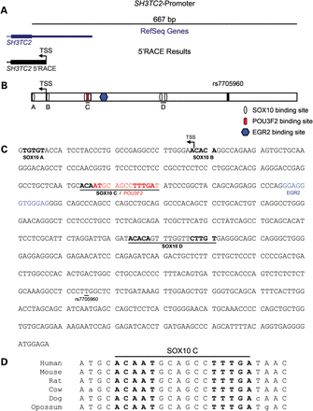
Figure 2. The SH3TC2 promoter harbors multiple transcription factor consensus sequences relevant for Schwann cells. (A) ...
Notes:
Figure 2. The SH3TC2 promoter harbors multiple transcription factor consensus sequences relevant for Schwann cells. (A) The SH3TC2 promoter (black line) spans 667 bp upstream of the initiating methionine codon based on the SH3TC2 RefSeq mRNA (indicated in blue). 5′RACE was employed to identify the TSS of SH3TC2 in cultured Schwann cells (indicated by the left-pointing black arrow). (B) Cartoon depicting the relative location of TRANSFACbinding site predictions in the SH3TC2 promoter. The TSS identified in Schwann cells is indicated by the left-pointing arrow. Specific transcription factor binding predictions are indicated in the key and head-to-head SOX10 consensus sequences are underlined. The position of the SNP rs7705960 is indicated by a vertical black line. (C) Sequence of the SH3TC2 promoter annotated with TRANSFACbinding site predictions. SOX10 (bold text), POU3F2 (red text) and EGR2 (blue text) predictions are indicated. Dimeric SOX10 head-to-headbinding sites are underlined, as is the position of the rs7705960 SNP. (D) Orthologous sequences from the indicated species at the dimeric, head-to-head ‘SOX10 C’ consensus sequences were aligned. Individual SOX10 consensus sequences are in bold text and base pairs conserved between human and other species are capitalized.
Unless provided in the caption above, the following copyright applies to the content of this slide: © The Author 2014. Published by Oxford University Press. All rights reserved. For Permissions, please email: journals.permissions@oup.com

Slide 3
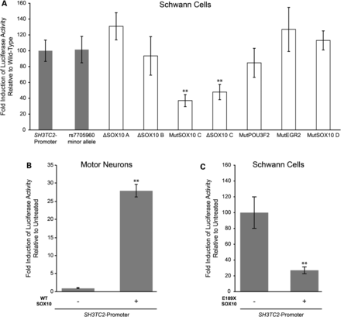
Figure 3. SOX10 regulates the SH3TC2 promoter. (A) Constructs harboring the wild-type SH3TC2 promoter, the promoter ...
Notes:
Figure 3. SOX10 regulates the SH3TC2 promoter. (A) Constructs harboring the wild-type SH3TC2 promoter, the promoter with the minor allele of rs7705960 or the promoter with the indicated mutation (all upstream of a luciferase reporter gene) were transfected into cultured Schwann (S16) cells. Luciferase assays were performed to determine the regulatory activity of each promoter segment relative to the wild-type SH3TC2 promoter. Gray columns indicate naturally occurring sequences, whereas white columns indicate synthetic mutations. ‘Mut’ denotes mutation of the consensus sequence by reversing but not complementing the nucleotides, and ‘Δ’ denotes a complete deletion of the consensus sequence (see text for details). (B) A construct harboring the SH3TC2 promoter directing luciferase expression was transfected into cultured motor neurons (MN-1 cells) with or without a construct to express wild-type (WT) SOX10. Luciferase assays were employed to test the activity of the SH3TC2 promoter in the presence of SOX10 relative to the activity of the promoter in the absence of SOX10. (C) A construct harboring the SH3TC2 promoter directing luciferase expression was transfected into cultured Schwann (S16) cells with or without a construct to express a dominant-negative form of SOX10 (E189X). Luciferase assays were employed to test the activity of the SH3TC2 promoter in the presence of E189X SOX10 relative to the activity of the promoter in the absence of E189X SOX10. In each panel, error bars indicate standard deviations and ** indicates a significant change in activity (P ≤ 0.001).
Unless provided in the caption above, the following copyright applies to the content of this slide: © The Author 2014. Published by Oxford University Press. All rights reserved. For Permissions, please email: journals.permissions@oup.com

Slide 4
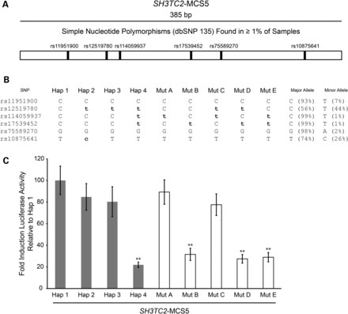
Figure 4. Haplotype-specific regulatory activity of SH3TC2-MCS5. (A) The SH3TC2-MCS5 amplicon (black line) spans 385 ...
Notes:
Figure 4. Haplotype-specific regulatory activity of SH3TC2-MCS5. (A) The SH3TC2-MCS5 amplicon (black line) spans 385 bp. The six SNPs with a minorallele frequency ≥0.01 that map within this region are indicated by vertical black lines. (B) SH3TC2-MCS5 was cloned from a pooled sample of human genomic DNA allowing the acquisition of four naturally occurring haplotypes (Hap 1–4). Synthetic haplotypes (Mut A–E) were engineered via mutagenesis. Each haplotype is indicated across the top and each SNP accession number indicated on the left. Major alleles are capitalized and minor alleles are in bold, lower-case text. Major and minorallele frequencies are listed on the right. (C) Each of the nine haplotypes at SH3TC2-MCS5 was cloned upstream of a luciferase reporter gene and transfected into cultured Schwann (S16) cells. Luciferase assays were performed to determine the regulatory activity of each genomic segment relative to Hap 1. Naturally occurring and synthetic haplotypes are indicated by gray and white bars, respectively. Error bars represent standard deviations and **indicates a significant change in activity (P ≤ 0.001).
Unless provided in the caption above, the following copyright applies to the content of this slide: © The Author 2014. Published by Oxford University Press. All rights reserved. For Permissions, please email: journals.permissions@oup.com

Slide 5
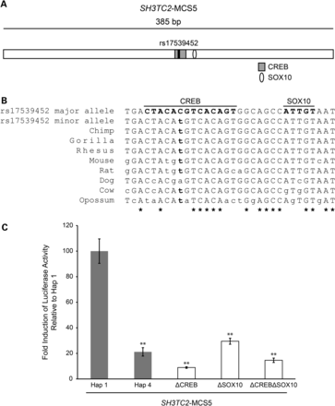
Figure 5. The minor allele of rs17539452 disrupts a CREB consensus sequence. (A) A cartoon depicting SH3TC2-MCS5. The ...
Notes:
Figure 5. The minor allele of rs17539452 disrupts a CREB consensus sequence. (A) A cartoon depicting SH3TC2-MCS5. The CREB and SOX10 consensus sequences are indicated with a gray box and white oval, respectively. SNP rs17539452 is indicated within the CREB consensus sequence with a vertical black line. (B) Orthologous genomic sequences surrounding the CREB and SOX10 predictions from human (major and minor alleles of rs17539452) and eight additional mammalian species were aligned. CREB and SOX10 consensus sequences are indicated by capitalized, bold text. The minor allele of rs17539452 is in lower case, bold text. Lower case text indicates nucleotides that are not identical to the human major allele sequence and asterisks denote base pairs that are conserved across all of the shown species. (C) CREB and SOX10 consensus sequences were deleted (Δ), individually or together and the resulting SH3TC2-MCS5 genomic segments were cloned upstream of a luciferase reporter gene. Luciferase assays were performed to determine the regulatory activity of each genomic segment relative to Hap 1. Naturally occurring and synthetic alleles are indicated by gray and white bars, respectively. Error bars represent standard deviations and **indicates a significant change in activity (P ≤ 0.001).
Unless provided in the caption above, the following copyright applies to the content of this slide: © The Author 2014. Published by Oxford University Press. All rights reserved. For Permissions, please email: journals.permissions@oup.com

Slide 6
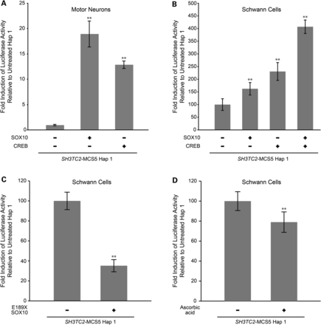
Figure 6. SOX10 and CREB activate SH3TC2-MCS5. (A) Constructs harboring SH3TC2-MCS5 Hap 1 were transfected into ...
Notes:
Figure 6. SOX10 and CREB activate SH3TC2-MCS5. (A) Constructs harboring SH3TC2-MCS5 Hap 1 were transfected into SOX10-negative motor neurons (MN-1 cells) with or without constructs to express SOX10 or CREB. Luciferase assays were performed to determine the effect of each transcription factor on the activity of SH3TC2-MCS5 relative to experiments without SOX10 and CREB. (B) Similar experiments as described in (A) performed in cultured Schwann (S16) cells. Note that in this experiment SOX10 and CREB have an additive effect on the activity of SH3TC2-MCS5. (C and D) Luciferase assays were also performed to determine the effect of dominant-negative (E189X) SOX10 (C) and ascorbic acid (D) on SH3TC2-MCS5 activity. In all panels, error bars indicate standard deviations and ** indicates a significant change in activity (P ≤ 0.001).
Unless provided in the caption above, the following copyright applies to the content of this slide: © The Author 2014. Published by Oxford University Press. All rights reserved. For Permissions, please email: journals.permissions@oup.com

Slide 7
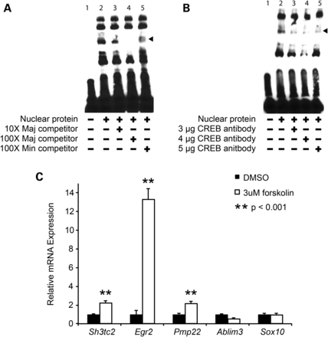
Figure 7. The cAMP/CREB pathway interacts with the SH3TC2 locus. (A) EMSAs were performed on nuclear extracts from ...
Notes:
Figure 7. The cAMP/CREB pathway interacts with the SH3TC2 locus. (A) EMSAs were performed on nuclear extracts from cultured Schwann (S16) cells using a biotinylated probe carrying the major allele (Maj) of SNP rs17539452. Competition between labeled and unlabeled Maj probes, and between labeled Maj and unlabeled Min probes (the latter harboring the minor allele of SNP rs17539452) were performed to determine the specificity of DNA binding. The nuclear protein and competitor probe content of each lane is indicated across the bottom. Reactions in all lanes contain the same amount of labeled Maj probe. (B) ‘Supershift’ EMSAs were performed on nuclear extracts from cultured Schwann (S16) cells in the presence of increasing amounts of CREB antibody (indicated along the bottom). Arrowheads in (A) and (B) indicate specific interactions between nuclear proteins and labeled probe. (C) Rat primary Schwann cells were serum starved overnight and then treated with forskolin (3 µm) or DMSO (control) for 24 h. Quantitative RT-PCR was then performed on RNA isolated from each sample to determine the expression level of each endogenous gene (indicated along the bottom). All data were normalized to the level of 18S rRNA and expressed relative to the DMSO-only control sample. Double asterisks (**) indicate a change in gene expression (P ≤ 0.001) and error bars represent standard error.
Unless provided in the caption above, the following copyright applies to the content of this slide: © The Author 2014. Published by Oxford University Press. All rights reserved. For Permissions, please email: journals.permissions@oup.com

