Slide 1
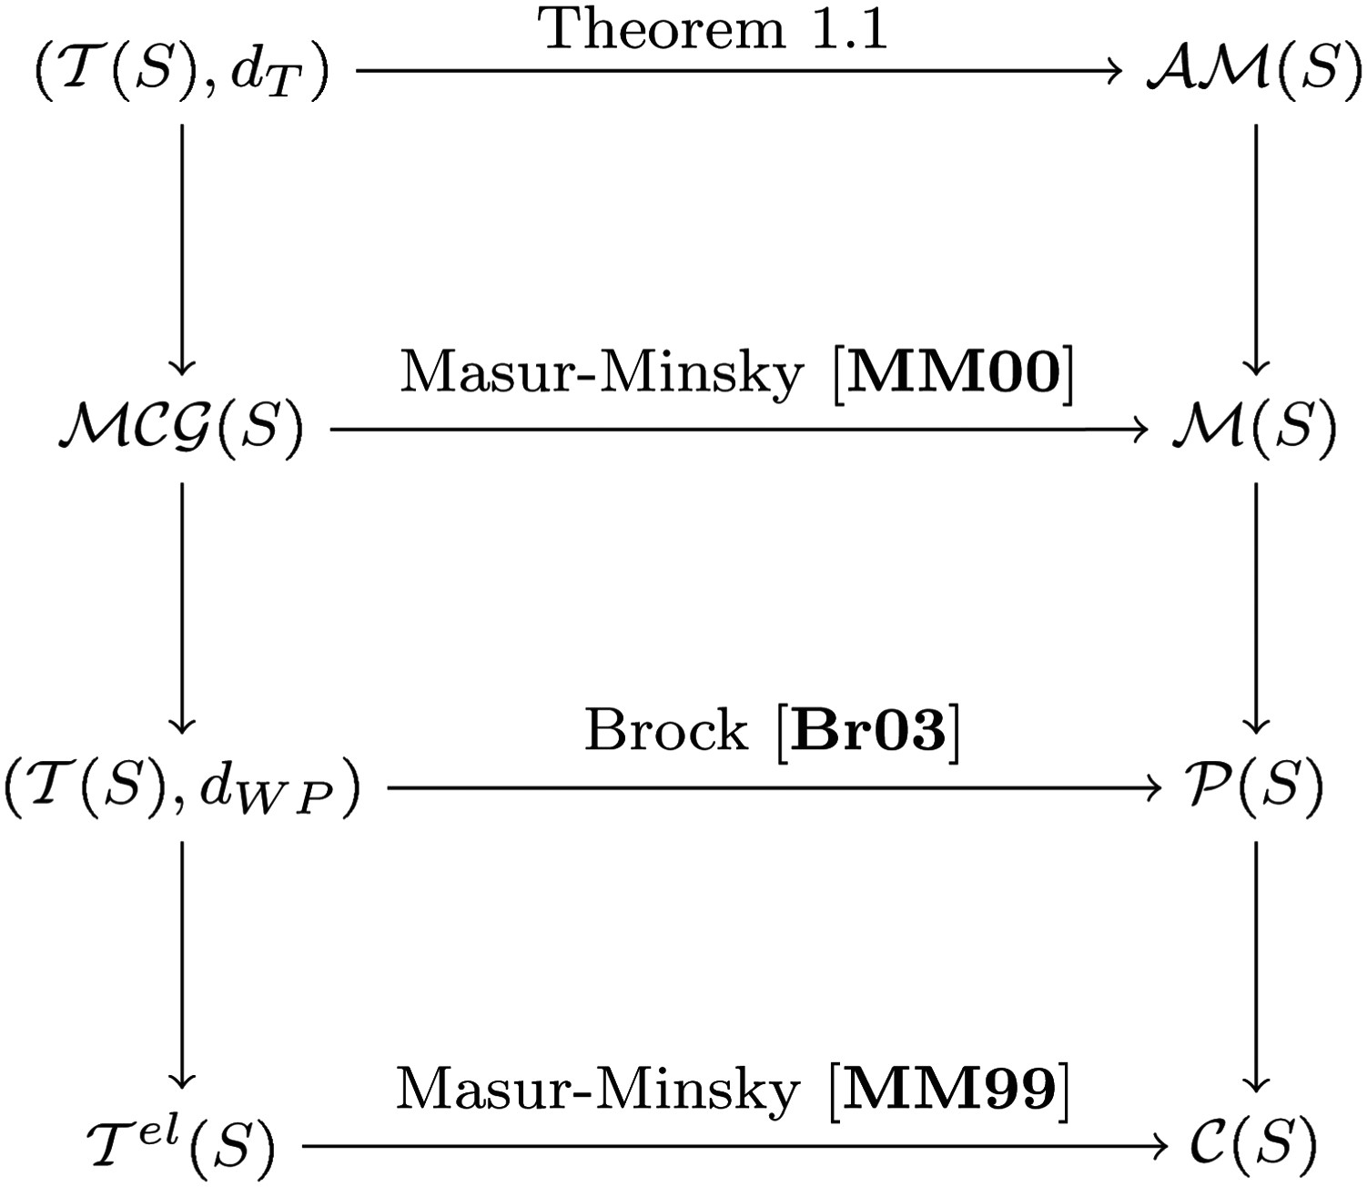
Fig. 1. The above figure represents a flow of ideas: the vertical arrows indicate a reduction of complexity, while ...
Notes:
Fig. 1. The above figure represents a flow of ideas: the vertical arrows indicate a reduction of complexity, while all horizontal arrows are $\mathcal {MCG}(S)$-equivariant quasiisometries.
Unless provided in the caption above, the following copyright applies to the content of this slide: © 2016 London Mathematical Society

Slide 2
Fig. 2. (a) A marking on a genus two surface, where (in red) consists of the central separating curve and the outer ...
Notes:
Fig. 2. (a) A marking on a genus two surface, where (in red) consists of the central separating curve and the outer curves which pass through the genera, and the other three curves are the transversals (in blue); (b) $\mu $ after a twist move around the left base curve; (c) $\mu $ after a flip move at the left transverse pair.
Unless provided in the caption above, the following copyright applies to the content of this slide: © 2016 London Mathematical Society

Slide 3
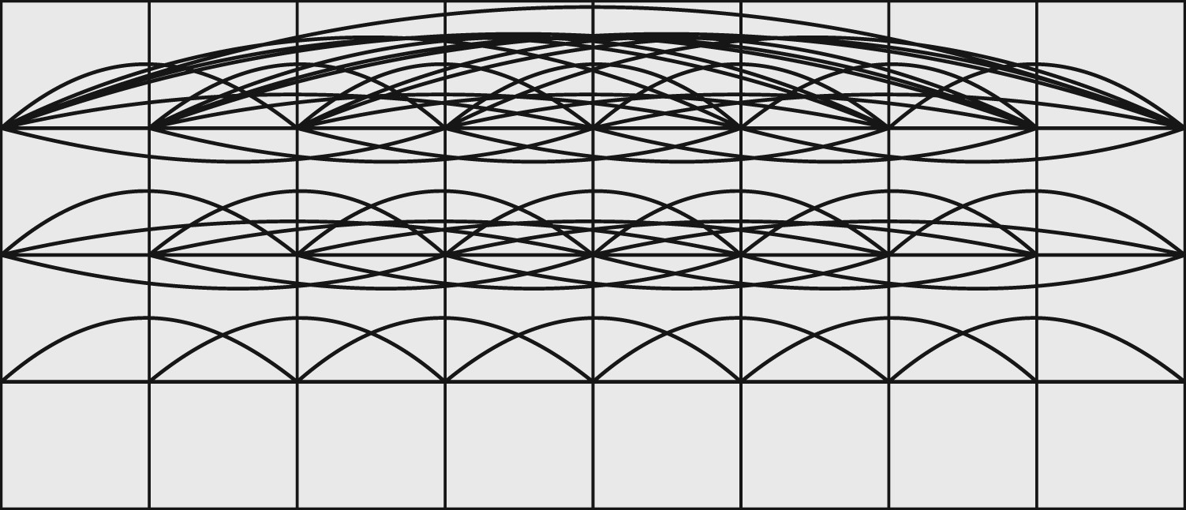
Fig. 3. A busy $(4 \times 8)$-slice of the base of a combinatorial horoball over $\mathbb {Z};$ every edge has length ...
Notes:
Fig. 3. A busy $(4 \times 8)$-slice of the base of a combinatorial horoball over $\mathbb {Z};$ every edge has length 1. Note that at height $2,$ each vertex is connected to half the others by edges, while all vertices are connected by edges at height 3.
Unless provided in the caption above, the following copyright applies to the content of this slide: © 2016 London Mathematical Society

Slide 4
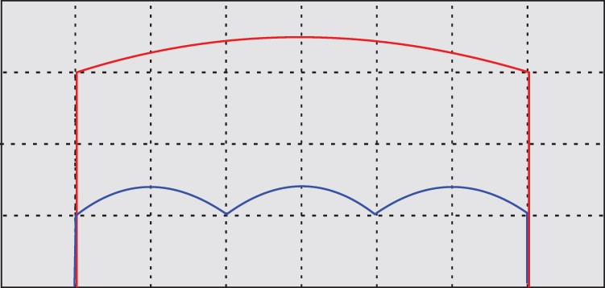
Fig. 4. Two paths between a pair of points in a combinatorial horoball: The top path is a preferred path, while the ...
Notes:
Fig. 4. Two paths between a pair of points in a combinatorial horoball: The top path is a preferred path, while the bottom path is a geodesic.
Unless provided in the caption above, the following copyright applies to the content of this slide: © 2016 London Mathematical Society

