Slide 1
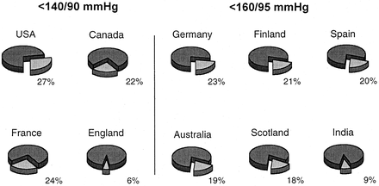
Figure 1. Percentage of hypertensive patients (expressed by numbers in each panel) with controlled blood pressure ...
Notes:
Figure 1. Percentage of hypertensive patients (expressed by numbers in each panel) with controlled blood pressure values in different countries. (Italy, not shown, reports 10%). (redrawn with permission from Mancia G and Grassi G.)2
Unless provided in the caption above, the following copyright applies to the content of this slide: © American Journal of Hypertension, Ltd. 2001

