Slide 1
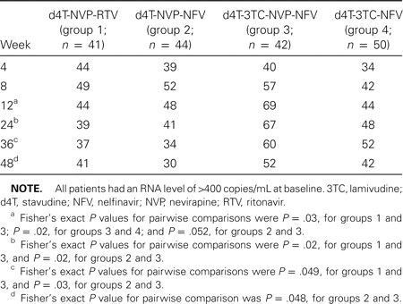
Table 3 Proportion of children receiving original randomized treatment who had an RNA level of ⩽400 copies/mL, by ...
Notes:
Table 3 Proportion of children receiving original randomized treatment who had an RNA level of ⩽400 copies/mL, by treatment group.
Unless provided in the caption above, the following copyright applies to the content of this slide: © 2002 by the Infectious Diseases Society of America

Slide 2
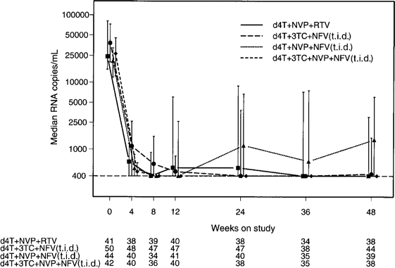
Figure 1 Comparison of the 4 combination treatment regimens, by median human immunodeficiency virus type 1 (HIV-1) RNA ...
Notes:
Figure 1 Comparison of the 4 combination treatment regimens, by median human immunodeficiency virus type 1 (HIV-1) RNA levels. Bars denote the 95% CIs. The number of assessable subjects at each visit is listed below the figure. Four patients had undetectable HIV-1 RNA levels at baseline and are excluded from this analysis. 3TC, lamivudine; d4T, stavudine; NFV, nelfinavir; NVP, nevirapine; RTV, ritonavir.
Unless provided in the caption above, the following copyright applies to the content of this slide: © 2002 by the Infectious Diseases Society of America

Slide 3
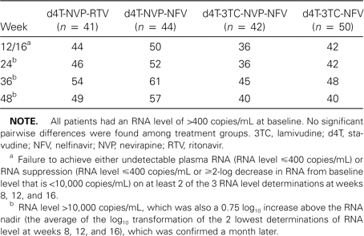
Table 2 Proportion of children experiencing virological failure, by treatment group.
Notes:
Table 2 Proportion of children experiencing virological failure, by treatment group.
Unless provided in the caption above, the following copyright applies to the content of this slide: © 2002 by the Infectious Diseases Society of America

Slide 4
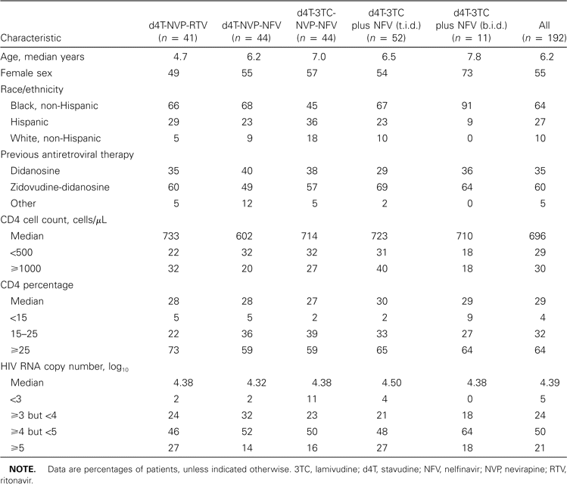
Table 1 Patient characteristics at baseline, by treatment group.
Notes:
Table 1 Patient characteristics at baseline, by treatment group.
Unless provided in the caption above, the following copyright applies to the content of this slide: © 2002 by the Infectious Diseases Society of America

Slide 5
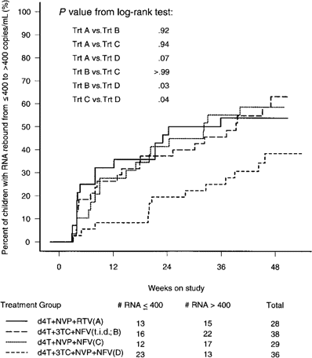
Figure 2 Kaplan-Meier analysis of time to rebound of human immunodeficiency virus type 1 (HIV-1) RNA level to ⩾400 ...
Notes:
Figure 2 Kaplan-Meier analysis of time to rebound of human immunodeficiency virus type 1 (HIV-1) RNA level to ⩾400 copies/mL, comparing the 4 combination treatment regimens. Includes data from patients with undetectable viral RNA at baseline. 3TC, lamivudine; d4T, stavudine; NFV, nelfinavir; NVP, nevirapine; RTV, ritonavir; Trt, treatment.
Unless provided in the caption above, the following copyright applies to the content of this slide: © 2002 by the Infectious Diseases Society of America

Slide 6
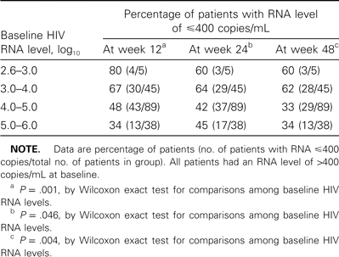
Table 4 Proportion of children receiving original randomized treatment who had an HIV RNA level of ⩽400 copies/mL, by ...
Notes:
Table 4 Proportion of children receiving original randomized treatment who had an HIV RNA level of ⩽400 copies/mL, by baseline HIV RNA level.
Unless provided in the caption above, the following copyright applies to the content of this slide: © 2002 by the Infectious Diseases Society of America

Slide 7
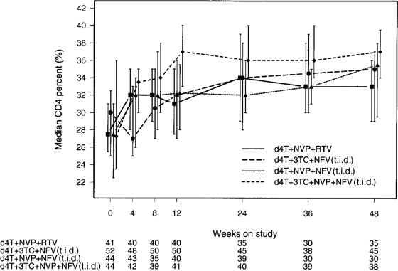
Figure 3 Median percentage of CD4⁺ lymphocytes in peripheral blood, by treatment regimen. Bars denote the ...
Notes:
Figure 3 Median percentage of CD4+ lymphocytes in peripheral blood, by treatment regimen. Bars denote the 95% CIs. 3TC, lamivudine; d4T, stavudine; NFV, nelfinavir; NVP, nevirapine; RTV, ritonavir.
Unless provided in the caption above, the following copyright applies to the content of this slide: © 2002 by the Infectious Diseases Society of America

Slide 8
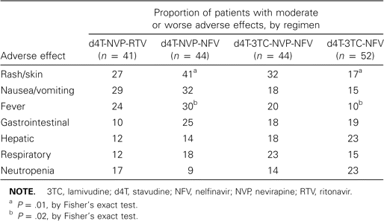
Table 5 Common adverse effects by treatment group.
Notes:
Table 5 Common adverse effects by treatment group.
Unless provided in the caption above, the following copyright applies to the content of this slide: © 2002 by the Infectious Diseases Society of America

Slide 9
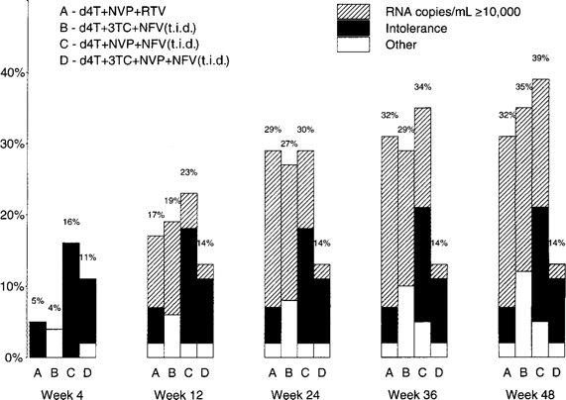
Figure 4 Distribution of reasons for permanent cessation of initial treatment, by treatment group. 3TC, lamivudine; ...
Notes:
Figure 4 Distribution of reasons for permanent cessation of initial treatment, by treatment group. 3TC, lamivudine; d4T, stavudine; NFV, nelfinavir; NVP, nevirapine; RTV, ritonavir.
Unless provided in the caption above, the following copyright applies to the content of this slide: © 2002 by the Infectious Diseases Society of America

