Slide 1
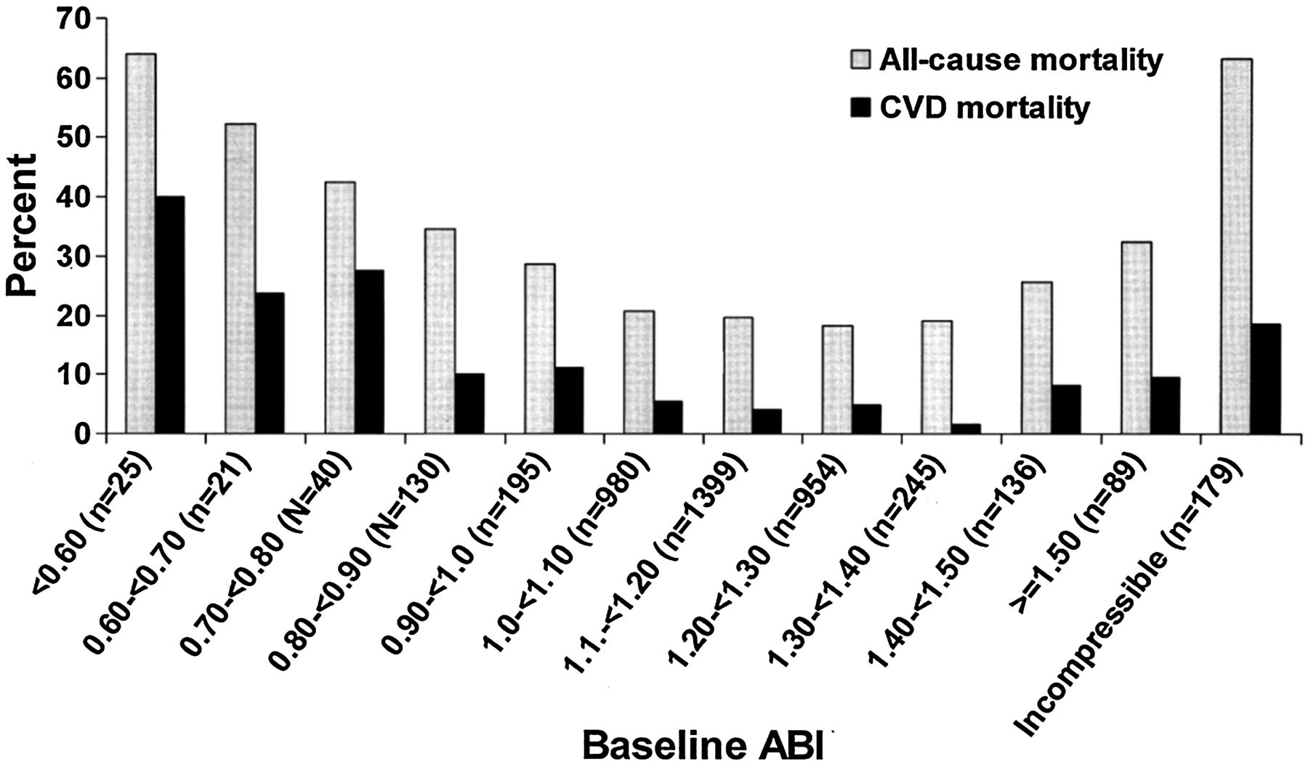
Fig. 1 All-cause and cardiovascular disease mortality according to the ABI group.¹⁸
Notes:
Fig. 1 All-cause and cardiovascular disease mortality according to the ABI group.18
Unless provided in the caption above, the following copyright applies to the content of this slide: © The Author 2012. Published by Oxford University Press. All rights reserved. For permissions, please e-mail: journals.permissions@oup.com

