Slide 1
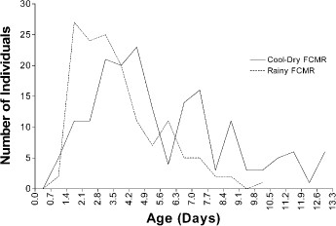
Fig. 8 Comparison of the actual age distribution between FCMR female Ae. aegypti collected in Thailand during the ...
Notes:
Fig. 8 Comparison of the actual age distribution between FCMR female Ae. aegypti collected in Thailand during the cool-dry (Feb–March 2000 and Jan–Feb 2001) and rainy (July–Aug 2000 and July–Aug 2001) seasons.
Unless provided in the caption above, the following copyright applies to the content of this slide: © 2004 Entomological Society of America

Slide 2
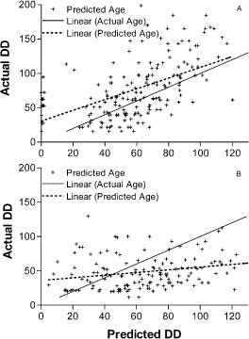
Fig. 7 Comparison of the linear regression of predicted age (predicted degree-days) versus actual age (actual ...
Notes:
Fig. 7 Comparison of the linear regression of predicted age (predicted degree-days) versus actual age (actual degree-days) to the linear regression where predicted age (degree-days) equals actual age (degree-days) for field collected, mark-released, recaptured female Ae. aegypti in Thailand (A) during the cool-dry season (Feb–March 2000 and Jan–Feb 2001) using model 4: DD = (12.6346 − 17.7977 × P1)2, and (B) during the rainy season collections (July–Aug 2000 and July–Aug 2001) using model 5: DD = (13.1 − 26.0134 × P1)2.
Unless provided in the caption above, the following copyright applies to the content of this slide: © 2004 Entomological Society of America

Slide 3
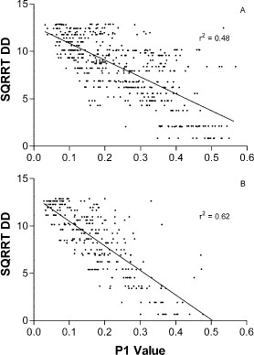
Fig. 6 Linear regression of the square root of actual degree-day data versus P1 values determined by GC analysis of ...
Notes:
Fig. 6 Linear regression of the square root of actual degree-day data versus P1 values determined by GC analysis of cuticular hydrocarbons from the legs of laboratory-reared Ae. aegypti females from Thailand (A) during the cool-dry seasons (Feb–March 2000 and Jan–Feb 2001) used to generate model 4: DD = [12.6346 – (17.7977 × P1)]2, and (B) during the rainy seasons (July–Aug 2000 and July–Aug 2001) used to generate model 5: DD = [13.1 − (26.0134 × P1)]2.
Unless provided in the caption above, the following copyright applies to the content of this slide: © 2004 Entomological Society of America

Slide 4
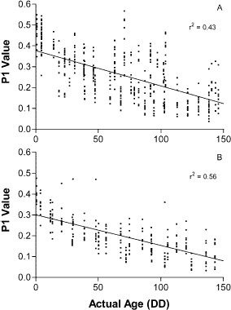
Fig. 5 Linear regression of actual degree-day data versus P1 values determined by GC analysis of cuticular ...
Notes:
Fig. 5 Linear regression of actual degree-day data versus P1 values determined by GC analysis of cuticular hydrocarbons from the legs of laboratory-reared Ae. aegypti females from Thailand (A) during the cool-dry seasons (Feb–March 2000 and Jan–Feb 2001) used to generate model 2: DD = (0.376872 − P1)/(0.00169), and (B) during the rainy seasons (July–Aug 2000 and July–Aug 2001) used to generate model 3: DD = (0.300224 − P1)/(0.00147).
Unless provided in the caption above, the following copyright applies to the content of this slide: © 2004 Entomological Society of America

Slide 5
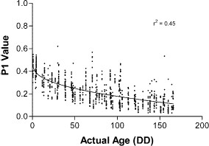
Fig. 4 The logarithmic fit of combined actual age (degree-days) data versus P1 values determined by GC analysis of ...
Notes:
Fig. 4 The logarithmic fit of combined actual age (degree-days) data versus P1 values determined by GC analysis of cuticular hydrocarbons from the legs of female Ae. aegypti maintained in a field laboratory at ambient environmental conditions in Thailand (2000–2001) during the cool-dry and rainy seasons.
Unless provided in the caption above, the following copyright applies to the content of this slide: © 2004 Entomological Society of America

Slide 6
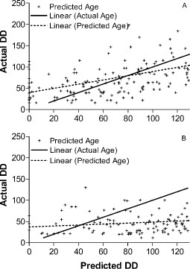
Fig. 3 Comparison of the linear regressions of predicted age (predicted degree-days) versus actual age (actual ...
Notes:
Fig. 3 Comparison of the linear regressions of predicted age (predicted degree-days) versus actual age (actual degree-days) to the linear regressions where predicted age (degree-days) equals actual age (degree-days) for field-collected, mark-released, recaptured female Ae. aegypti in Thailand during (A) the cool-dry season (Feb–March 2000 and Jan–Feb 2001) and (B) rainy season (July–Aug 2000 and July–Aug 2001) using model 1: DD = (P1 − 0.371848)/ (−0.00169).
Unless provided in the caption above, the following copyright applies to the content of this slide: © 2004 Entomological Society of America

Slide 7
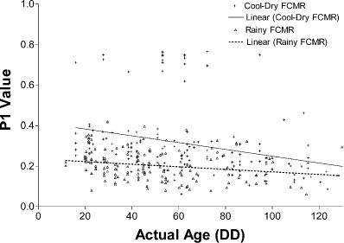
Fig. 2 Comparison of the linear regressions of actual degree-day data versus P1 values determined by GC analysis of ...
Notes:
Fig. 2 Comparison of the linear regressions of actual degree-day data versus P1 values determined by GC analysis of cuticular hydrocarbons from the legs of FCMR female Ae. aegypti in Thailand during the cool-dry (cool-dry FCMR)and rainy seasons (rainy FCMR) of 2000–2001.
Unless provided in the caption above, the following copyright applies to the content of this slide: © 2004 Entomological Society of America

Slide 8
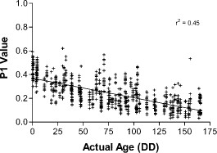
Fig. 1 Linear regression of actual degree-day data versus P1 values determined by GC analysis of cuticular ...
Notes:
Fig. 1 Linear regression of actual degree-day data versus P1 values determined by GC analysis of cuticular hydrocarbons from the legs of laboratory-reared Ae. aegypti females from the Rockefeller strain and Thailand collections (2000– 2001) used to generate model 1: DD = (P1 − 0.371848)/ (−0.00169).
Unless provided in the caption above, the following copyright applies to the content of this slide: © 2004 Entomological Society of America

