Slide 1
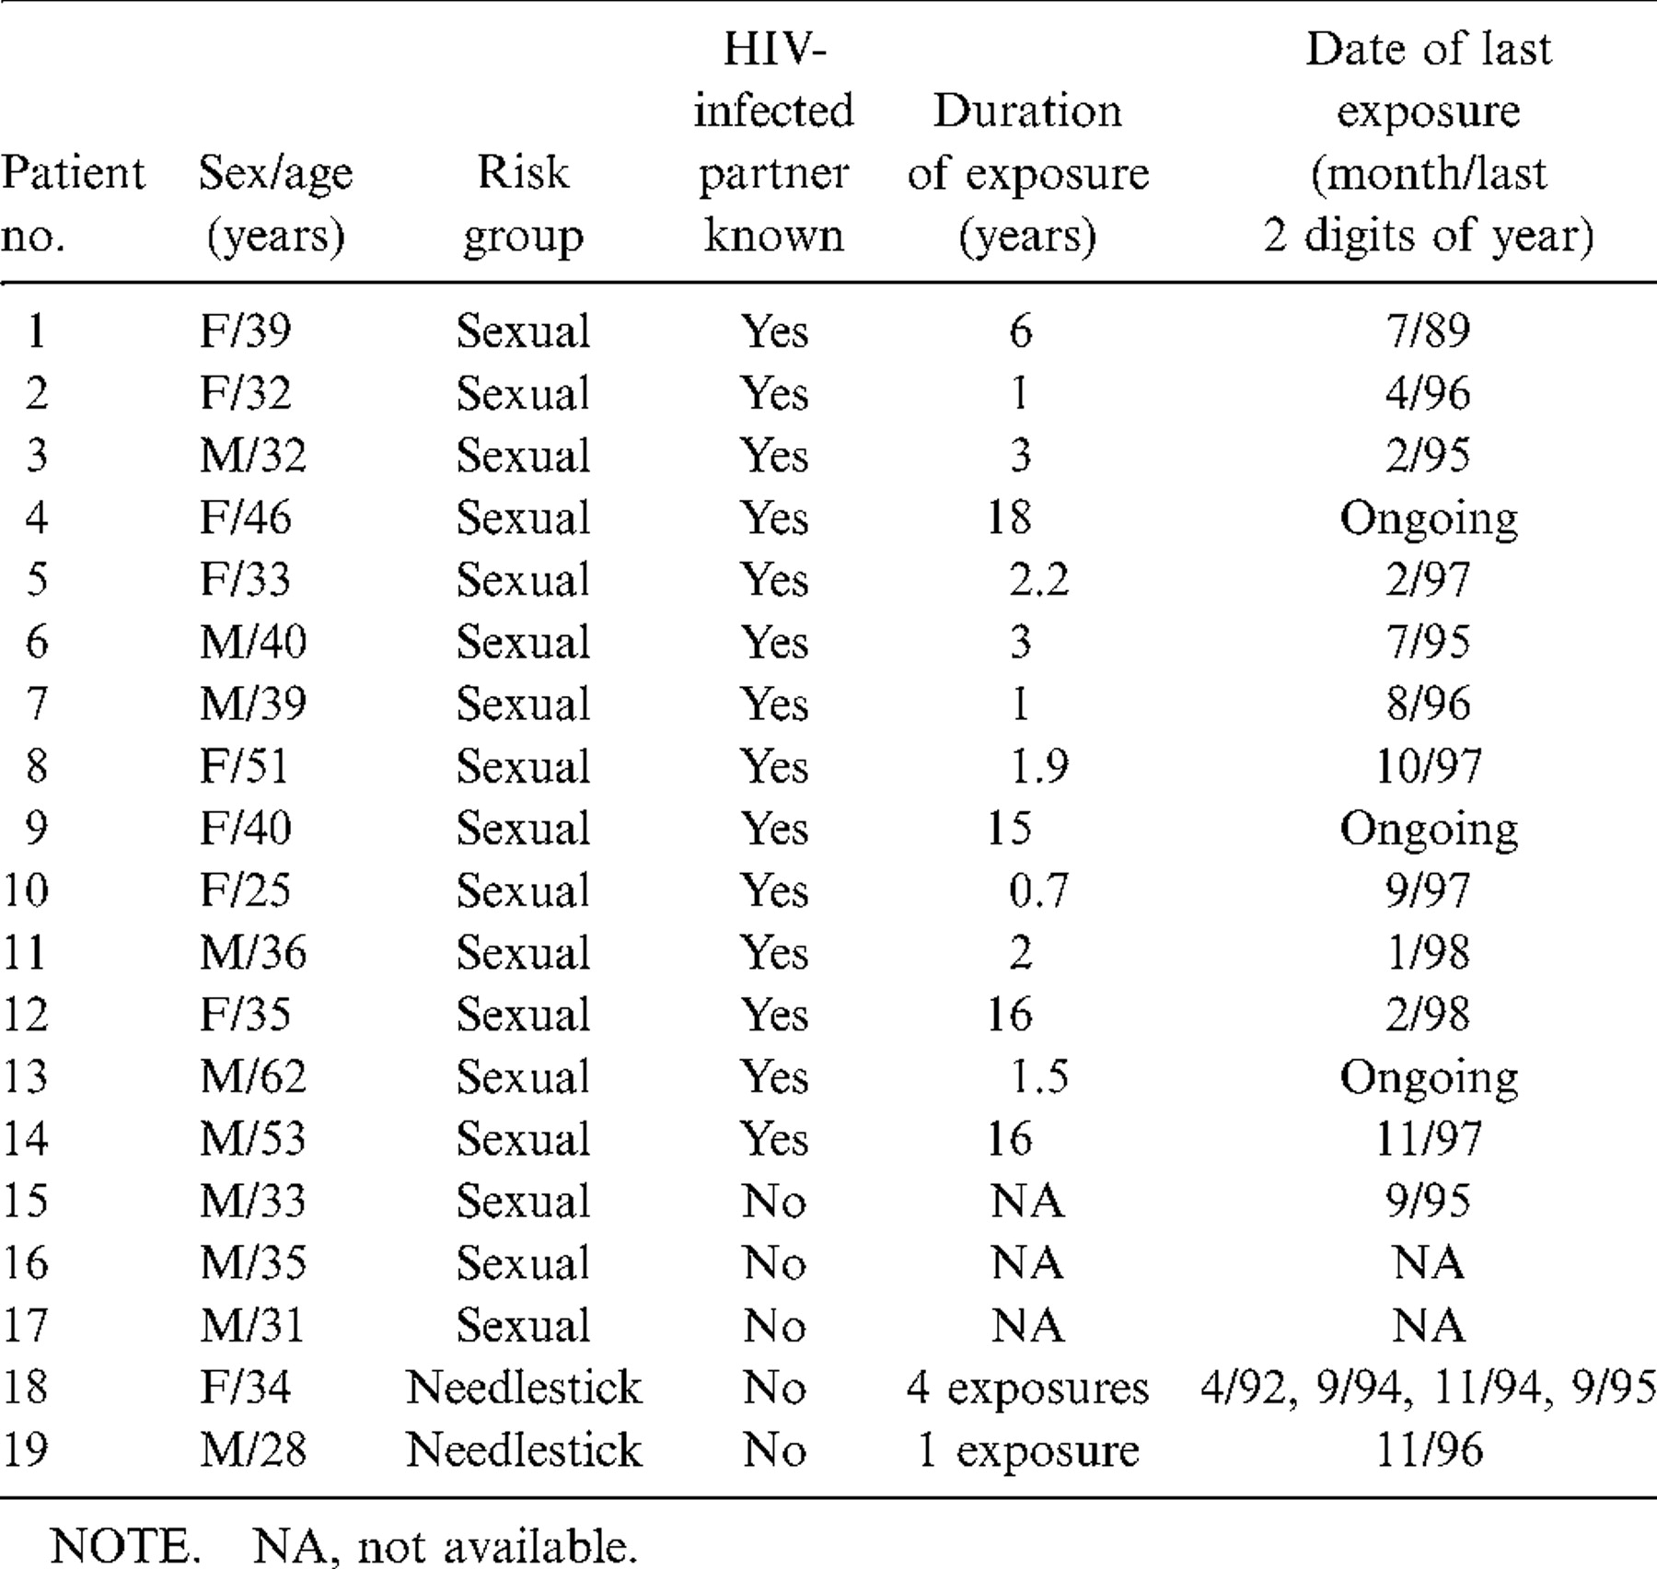
Table 1 Characteristics of HIV-exposed uninfected study subjects.
Notes:
Table 1 Characteristics of HIV-exposed uninfected study subjects.
Unless provided in the caption above, the following copyright applies to the content of this slide: © 1999 by the Infectious Diseases Society of America

Slide 2
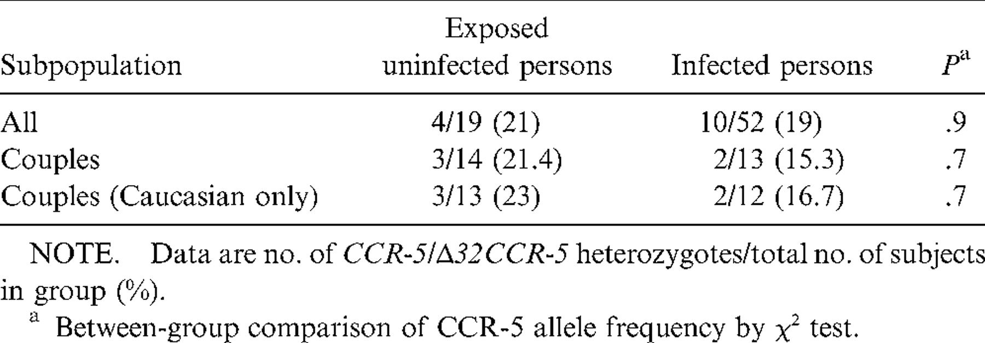
Table 2 CCR-5/Δ32CCR-5 heterozygotes in exposed uninfected and HIV-infected subjects.
Notes:
Table 2 CCR-5/Δ32CCR-5 heterozygotes in exposed uninfected and HIV-infected subjects.
Unless provided in the caption above, the following copyright applies to the content of this slide: © 1999 by the Infectious Diseases Society of America

Slide 3
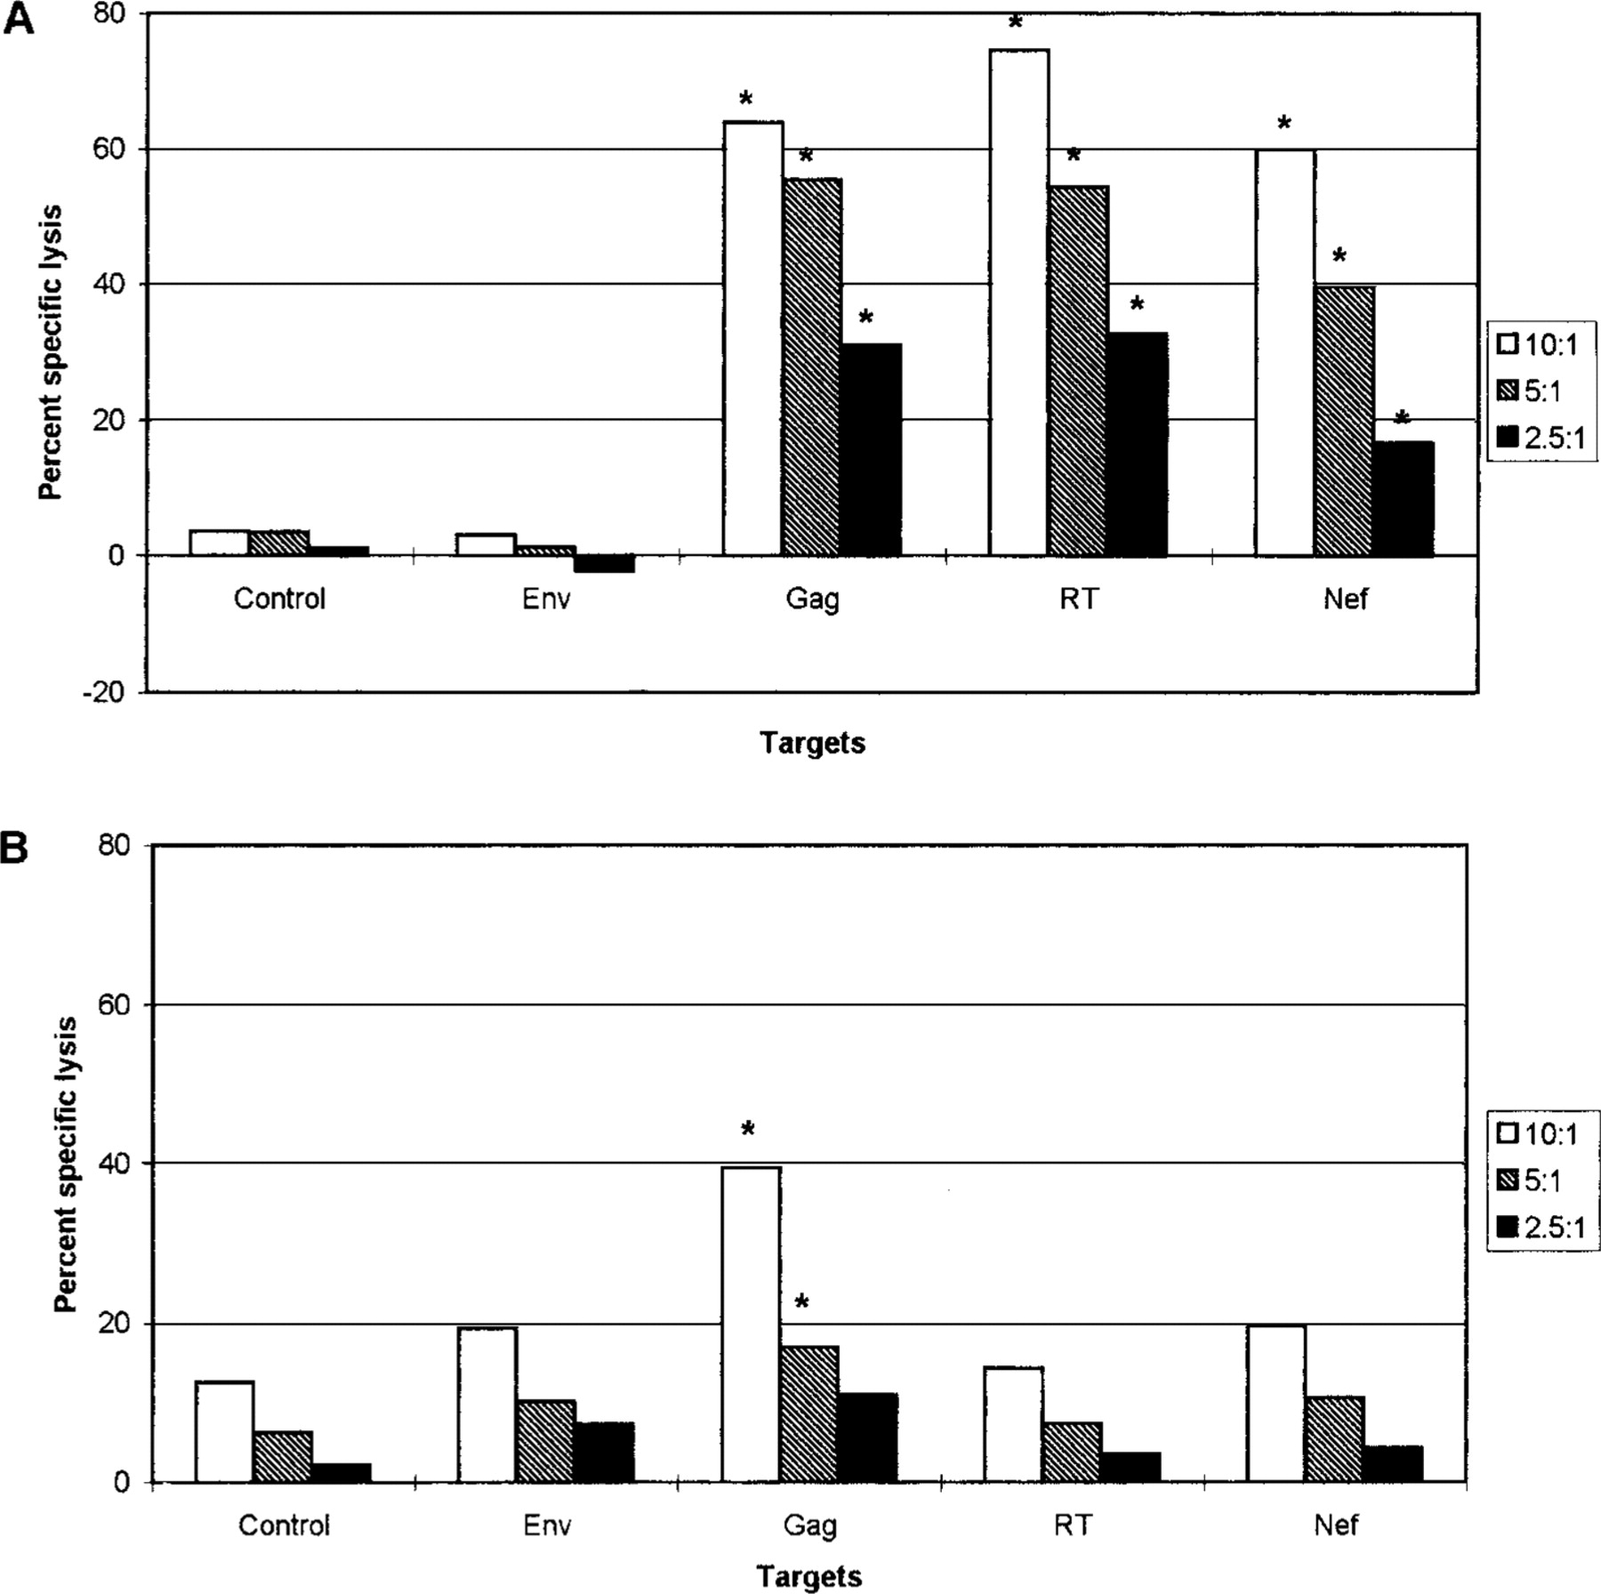
Figure 1 HIV-specific cytotoxic T lymphocyte activity in 2 HIV-seropositive subjects (A, B), 2 seronegative subjects ...
Notes:
Figure 1 HIV-specific cytotoxic T lymphocyte activity in 2 HIV-seropositive subjects (A, B), 2 seronegative subjects at low risk for HIV infection (C, D), and 2 HIV-exposed seronegative subjects (E, F). * Positive (% specific lysis >10% above lysis of control targets expressing LacZ [non-HIV gene product]). RT, reverse transcriptase. SDs were <10%.
Unless provided in the caption above, the following copyright applies to the content of this slide: © 1999 by the Infectious Diseases Society of America

Slide 4
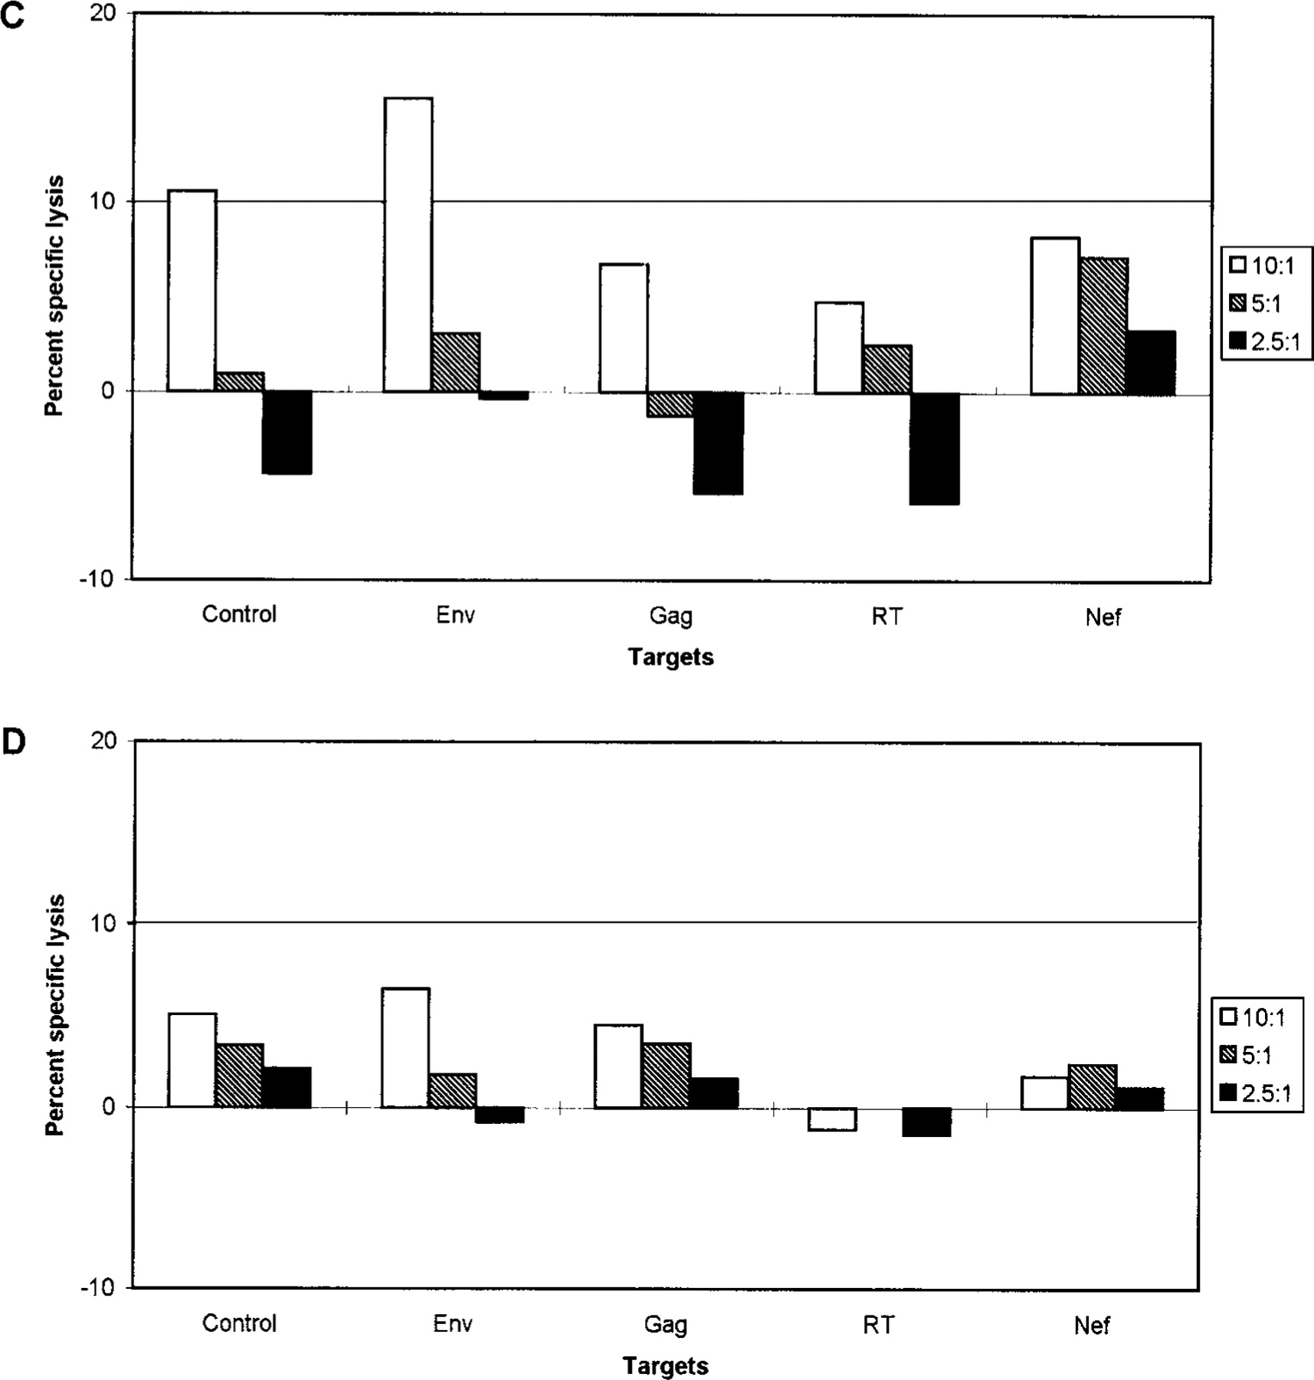
Figure 1 (Continued).
Notes:
Figure 1 (Continued).
Unless provided in the caption above, the following copyright applies to the content of this slide: © 1999 by the Infectious Diseases Society of America

Slide 5
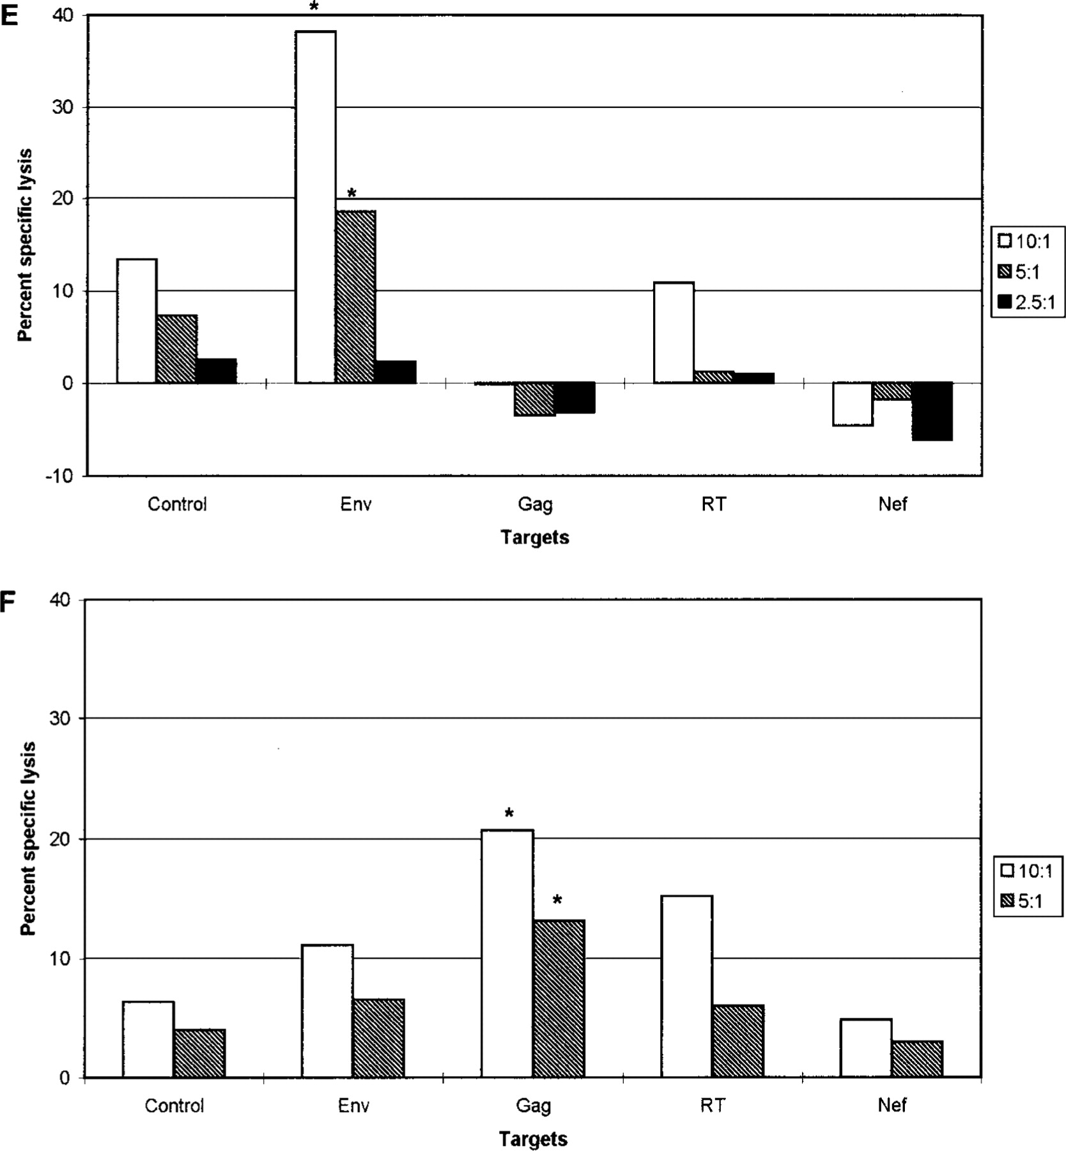
Figure 1 (Continued).
Notes:
Figure 1 (Continued).
Unless provided in the caption above, the following copyright applies to the content of this slide: © 1999 by the Infectious Diseases Society of America

Slide 6
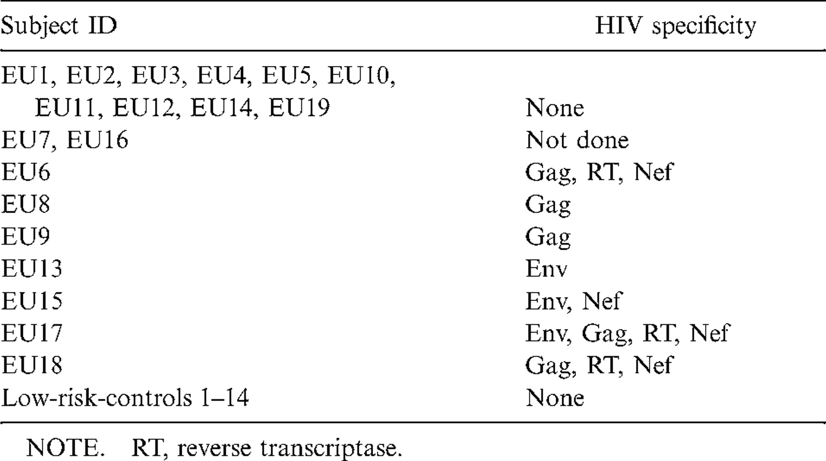
Table 3 HIV specificity of antigen-driven cytotoxic T lymphocyte lines prepared from HIV-exposed uninfected (EU) ...
Notes:
Table 3 HIV specificity of antigen-driven cytotoxic T lymphocyte lines prepared from HIV-exposed uninfected (EU) subjects and low-risk controls.
Unless provided in the caption above, the following copyright applies to the content of this slide: © 1999 by the Infectious Diseases Society of America

Slide 7
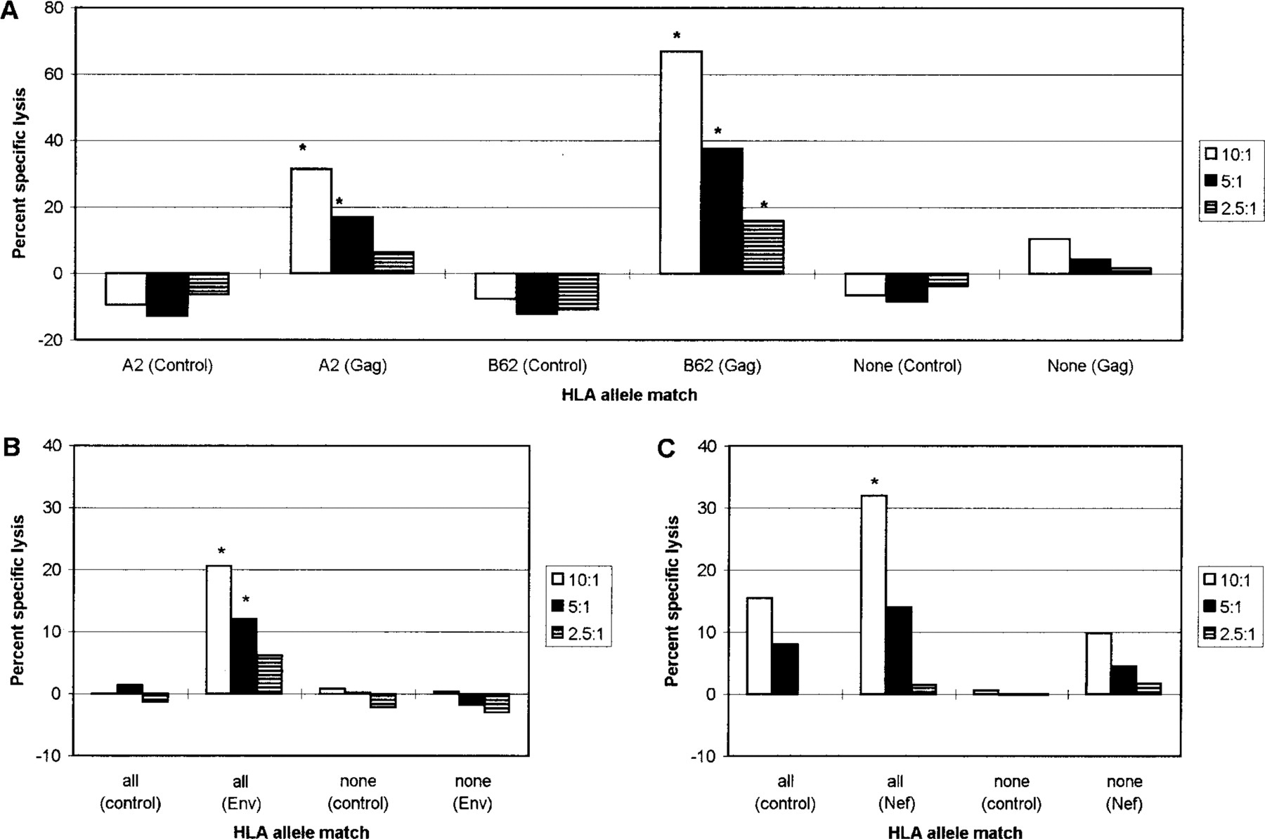
Figure 2 HIV-specific cytotoxic T lymphocyte (CTL) activity in exposed HIV-seronegative (EU) subject is restricted by ...
Notes:
Figure 2 HIV-specific cytotoxic T lymphocyte (CTL) activity in exposed HIV-seronegative (EU) subject is restricted by major histocompatibility complex class I antigens. In A, CTL activity in bulk cultures from EU8 was tested on targets matched with effectors for HLA-A2, HLA-B62, or no HLA alleles expressing either LacZ as non-HIV background control or HIV Gag. B shows CTL activity in bulk cultures from EU13 tested on autologous targets or major histocompatibility complex (MHC)-unmatched targets expressing either LacZ as non-HIV background control or HIV Env. C shows CTL activity in bulk cultures from EU18 tested on autologous targets or MHC class I-unmatched targets expressing either LacZ as non-HIV background control or HIV Nef. * Positive (% specific lysis 110% above lysis of control targets). SDs were <10%.
Unless provided in the caption above, the following copyright applies to the content of this slide: © 1999 by the Infectious Diseases Society of America

Slide 8
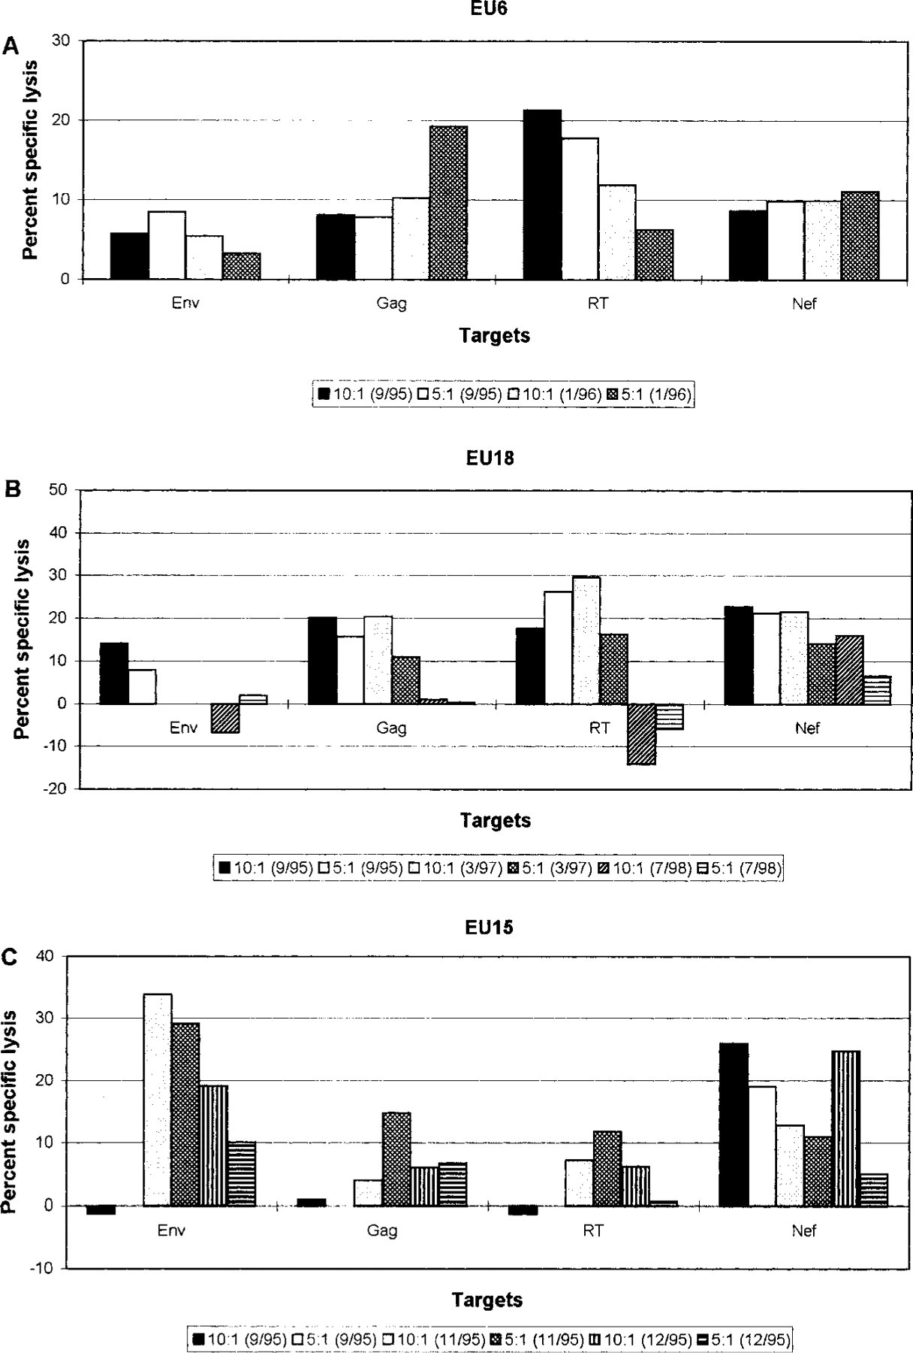
Figure 3 Persistence of HIV-specific cytotoxic T lymphocyte (CTL) activity in HIV-exposed uninfected (EU) subjects. In ...
Notes:
Figure 3 Persistence of HIV-specific cytotoxic T lymphocyte (CTL) activity in HIV-exposed uninfected (EU) subjects. In A, EU6 was tested for presence of memory HIV-specific CTL activity twice. Assays were done on samples obtained 2 and 6 months after last exposure to HIV in July 1995. In B, EU18 was tested for presence of memory HIV-specific CTL activity 3 times. Assays were done on samples obtained within 1 month, 18 months, and 34 months after last exposure to HIV in September 1995. In C, EU15 was tested for presence of memory HIV-specific CTL activity twice. Last exposure date is unknown, but he was not exposed to HIV after September 1995. HIV-specific CTL activity was assessed on samples obtained at 3 time points in September, November, and December 1995. Results were generated in 4-h 51Cr-release assay and are mean of triplicate cultures at E:T ratios shown. Effectors were generated from peripheral blood mononuclear cells obtained at indicated times. Effectors were stimulated with fixed autologous PBMC expressing HIV gene products and expanded for 14 days before assay. % specific lysis of control targets expressing LacZ (non-HIV gene product) has been subtracted from that of each HIV gene product-expressing target for each E: T ratio. % specific lysis >10% above background is considered positive. SDs were <10%.
Unless provided in the caption above, the following copyright applies to the content of this slide: © 1999 by the Infectious Diseases Society of America

