Slide 1
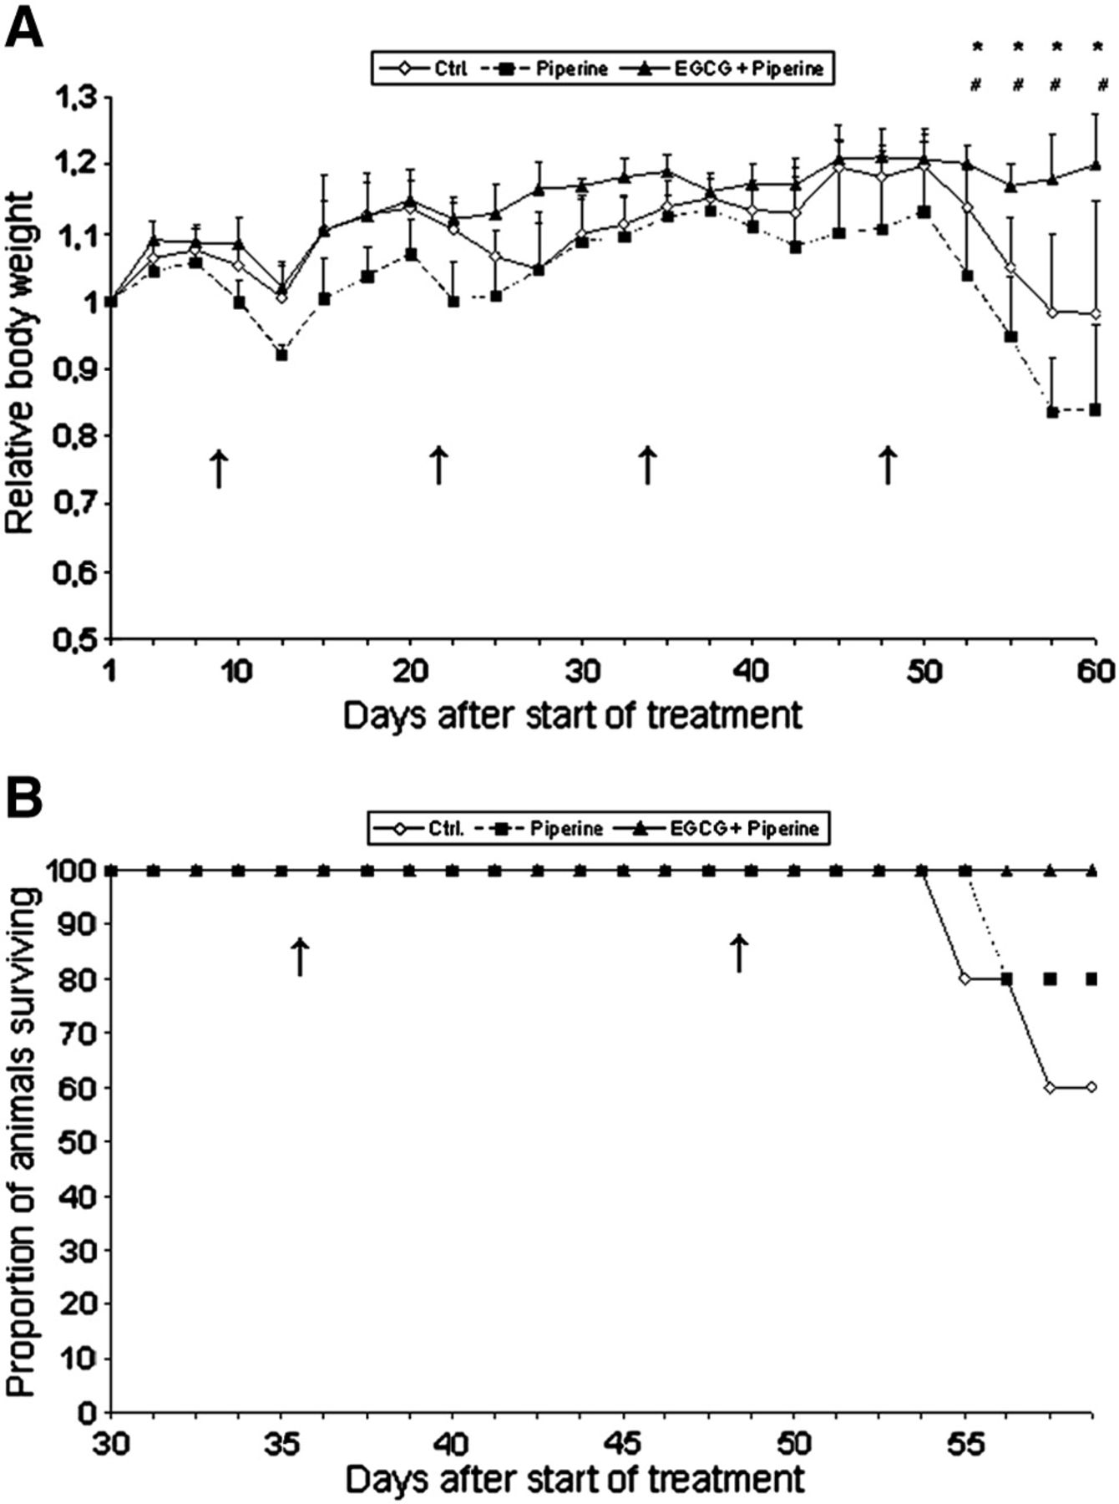
Figure 1 A. Changes in the relative weight over 60-day period of alternating 2% (w/v) DSS treatment (arrows). Daily ...
Notes:
Figure 1 A. Changes in the relative weight over 60-day period of alternating 2% (w/v) DSS treatment (arrows). Daily administration of H2O, piperine and the combination of EGCG & piperine started 1 week prior to the first DSS treatment. Asterisks/pounds depict significant differences in body weight (p < 0.05) between groups “Control”/“Piperine” and “EGCG + Piperine”. Data are means ± SD; n = 5 per group at the beginning of a single experiment. This experiment was repeated 4 times with comparable results. Overall weight loss between different treatments was significantly different calculated by including all experiments performed under the same settings (p = 0.001, ANOVA). B. Kaplan–Meier estimate of survival of groups “Control”, “Piperine” and “EGCG + Piperine” after 2% (w/v) DSS-administration (arrows). Regarding all comparable trials with the same test conditions, evaluation with a log rank test showed a significantly increased risk of earlier death in the control group receiving water only (p < 0.05).
Unless provided in the caption above, the following copyright applies to the content of this slide: © 2011 European Crohn's and Colitis Organisation

Slide 2
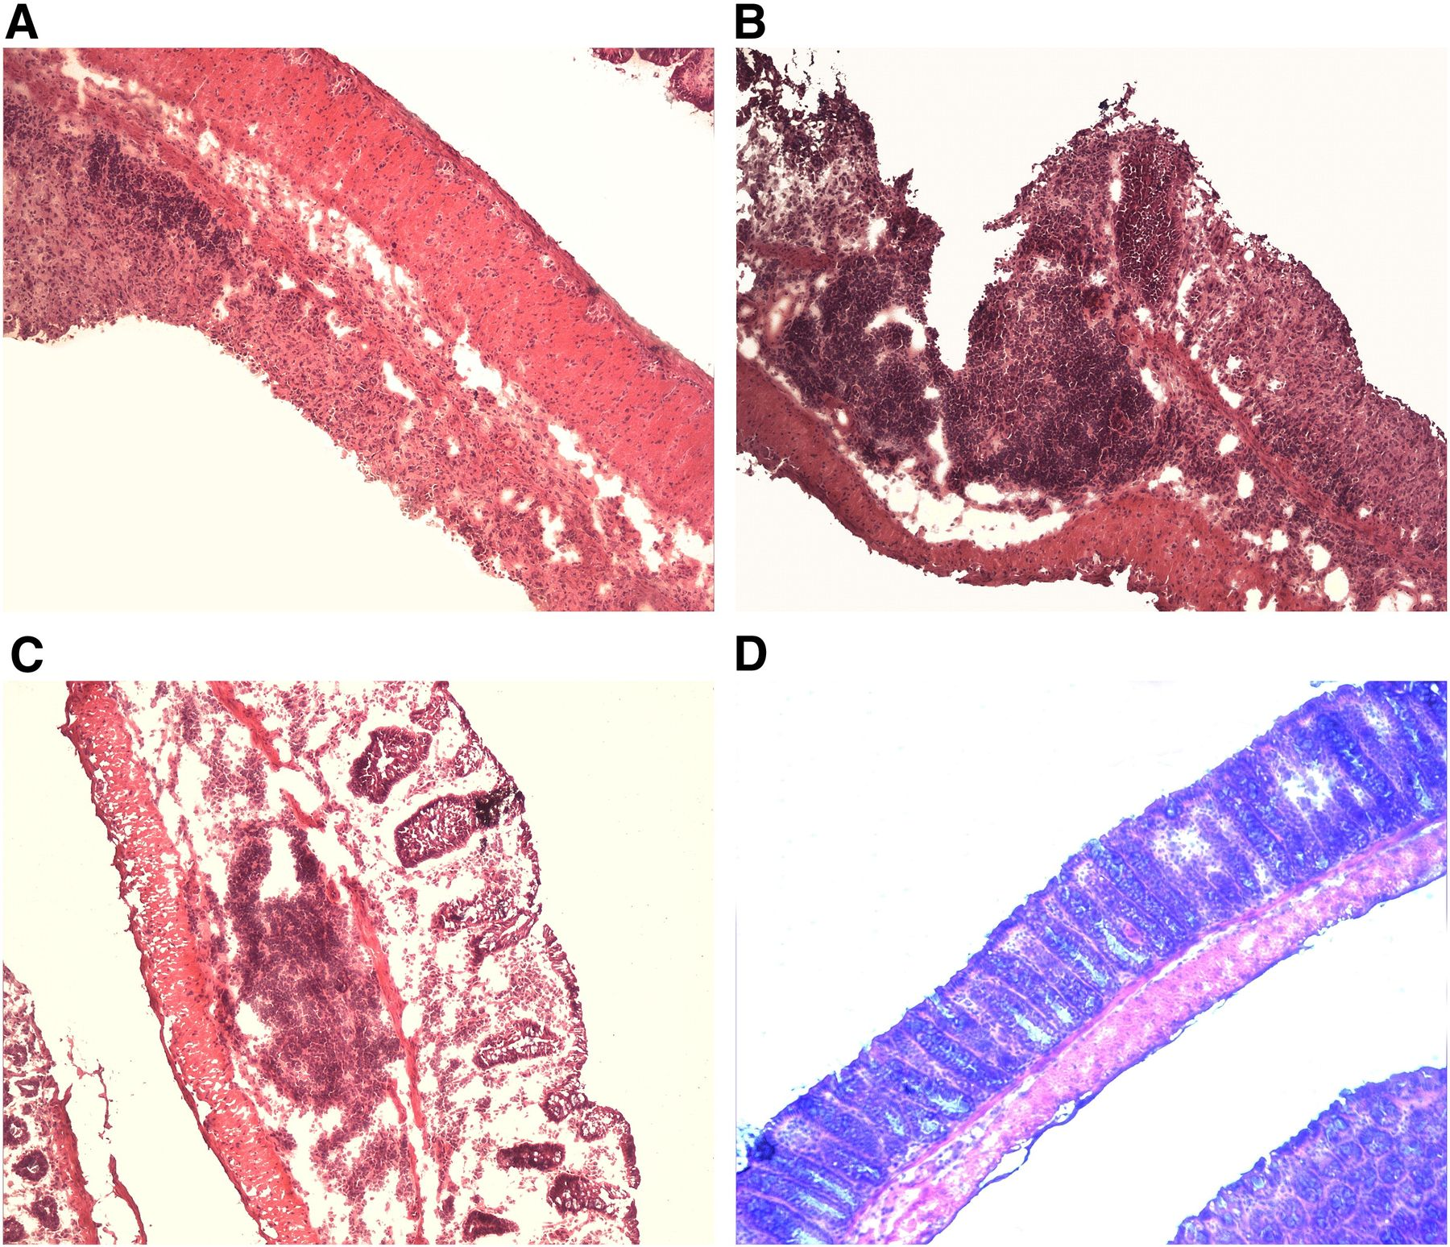
Figure 2 Histological analysis of colonic tissue of mice subjected to the induction of chronic DSS colitis. Mice ...
Notes:
Figure 2 Histological analysis of colonic tissue of mice subjected to the induction of chronic DSS colitis. Mice receiving only H2O in group “Control” exhibited a severely destroyed crypt architecture (A). Similary, mice of group “Piperine” showed a dense immune cell infiltrate, transmural inflammation and ulcerations (B). In comparison, mice treated with “EGCG + Piperine” showed only very mild changes with reduced epithelial denudation, and less ulcerations (C; D: uninflamed control). Representative examples of each group are shown.
Unless provided in the caption above, the following copyright applies to the content of this slide: © 2011 European Crohn's and Colitis Organisation

Slide 3
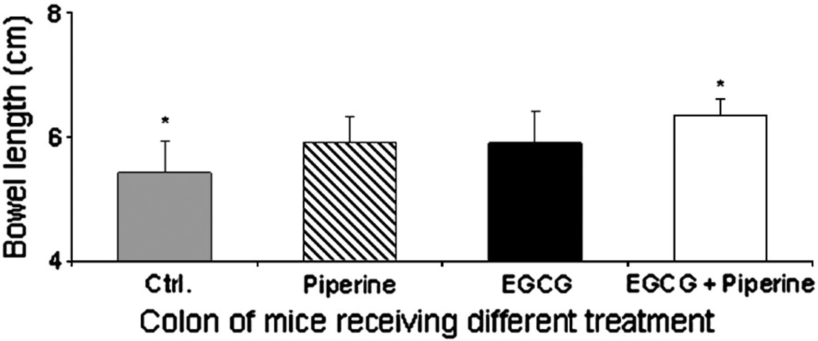
Figure 3 Effects of different treatment of groups “Control”, “Piperine”, “EGCG” and “EGCG ± Piperine” on changes in ...
Notes:
Figure 3 Effects of different treatment of groups “Control”, “Piperine”, “EGCG” and “EGCG ± Piperine” on changes in bowel length induced by DSS. Mice of the groups “Control” (5.4 ± 0.5 cm), “Piperine” (5.9 ± 0.4 cm) or “EGCG” (5.9 ± 0.5 cm) showed a reduced bowel length with comparison to group “EGCG ± Piperine” (6.3 ± 0.2 cm). A significant difference could only be found between groups “Control” and “EGCG ± Piperine” (* p ≤ 0.05 vs. treatment with water, one way ANOVA followed by Tukey post-hoc test). Healthy reference mice without DSS treated with EGCG or EGCG plus piperine exhibited a bowel length of 6.7 ± 0.2 cm and 6.8 ± 0.3 cm.
Unless provided in the caption above, the following copyright applies to the content of this slide: © 2011 European Crohn's and Colitis Organisation

Slide 4
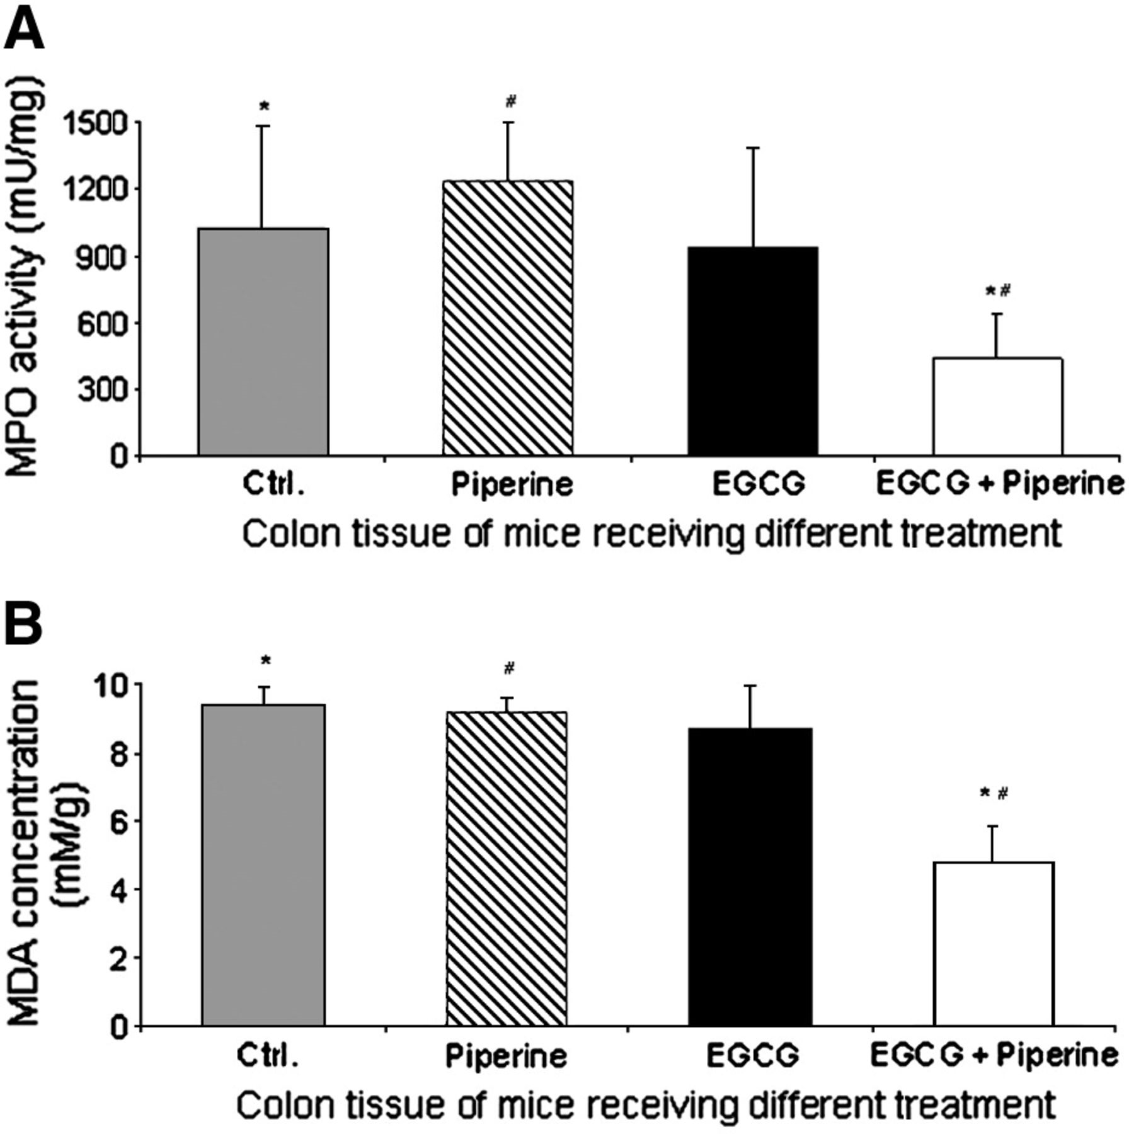
Figure 4 A. MPO activity in colonic tissue. MPO activity determined in colon samples showed a significantly higher MPO ...
Notes:
Figure 4 A. MPO activity in colonic tissue. MPO activity determined in colon samples showed a significantly higher MPO activity (* p ≤ 0.05 vs. treatment with water, # p ≤ 0.05 vs. treatment with piperine) in mice of groups “Control” (1027.4 ± 464.4 mU MPO/mg bowel tissue) and “Piperine” (1238.5 ± 259.5 mU MPO/mg bowel tissue) in comparison with animals of groups “EGCG ± Piperine” (441.2 ± 205.2 mU MPO/mg bowel tissue). Overall MPO activity between the different treatments was significantly different (p ≤ 0.05, one way ANOVA). MPO activity was also elevated in group “EGCG” (943.4 ± 448.8 mU MPO/mg bowel tissue). B. Effects of treatment of group “EGCG + Piperine” on the concentration of MDA in bowel tissue. In groups “Control” (9.4 ± 0.5 mM MDA/g), “Piperine” (9.2 ± 0.4 mM MDA/g) and “EGCG” (8.7 ± 1.3 mM MDA/g) the concentration of MDA in the colonic tissue was significantly higher than in the group “EGCG ± Piperine” (4.8 ± 1 mM MDA/g) (* p ≤ 0.05 vs. treatment with water, # p ≤ 0.05 vs. treatment with piperine). Concentration of MDA between different treatments was significantly different (p = 0.001, one way ANOVA).
Unless provided in the caption above, the following copyright applies to the content of this slide: © 2011 European Crohn's and Colitis Organisation

Slide 5
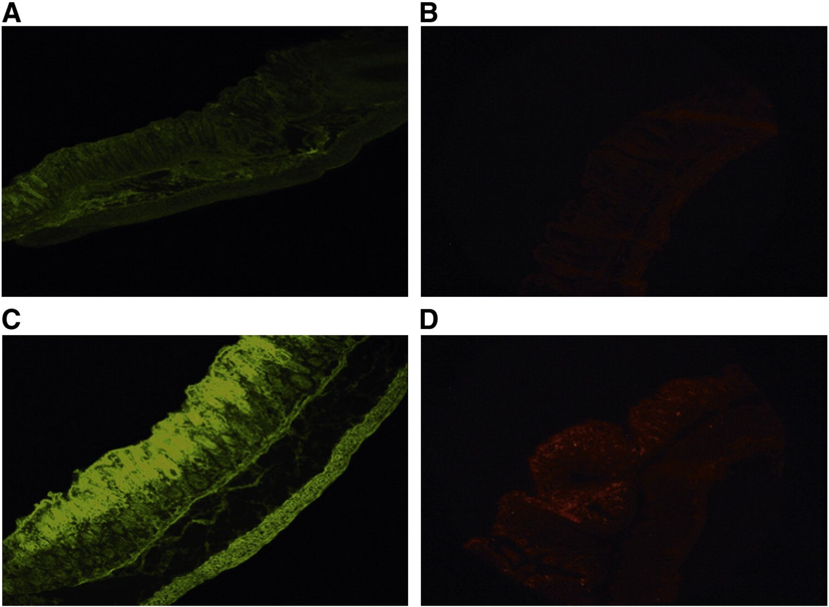
Figure 5 Immunohistochemical analysis of colonic tissue after induction of chronic DSS colitis. (A) shows staining of ...
Notes:
Figure 5 Immunohistochemical analysis of colonic tissue after induction of chronic DSS colitis. (A) shows staining of SOD, and (B) staining of GPO in colonic tissue of animals treated with H2O only. In both images there is only a weak signal to be seen, indicating low antioxidant defense. In contrast, colonic tissue staining of animals treated whith EGCG plus piperine showed significant expression of SOD (C) and GPO (D). Representative examples of each group are shown.
Unless provided in the caption above, the following copyright applies to the content of this slide: © 2011 European Crohn's and Colitis Organisation

Slide 6
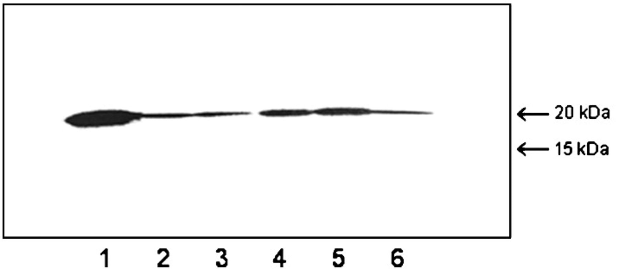
Figure 6 Immunoblot showing SOD being constitutively expressed by HT-29 as seen in group 1. The treatment with the ...
Notes:
Figure 6 Immunoblot showing SOD being constitutively expressed by HT-29 as seen in group 1. The treatment with the combination of EGCG plus piperine in different concentrations (lane 4 and 5) induced a significant expression of SOD (15–20 kDa protein) after stimulation with LPS whereas single treatment with EGCG (lane 3) or piperine (lane 6) did not induce comparable effects.
Unless provided in the caption above, the following copyright applies to the content of this slide: © 2011 European Crohn's and Colitis Organisation

Slide 7
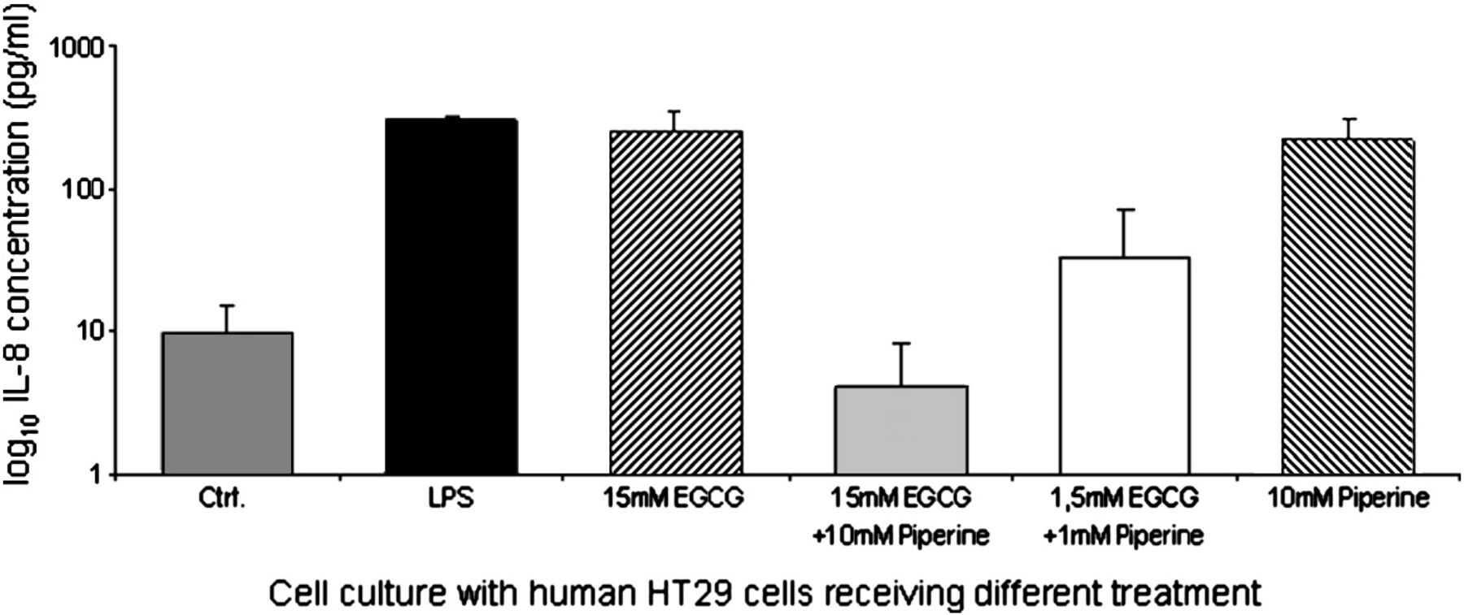
Figure 7 Production of IL-8 after stimulation with LPS (100 ng/ml) in HT-29 cells after different treatments with ...
Notes:
Figure 7 Production of IL-8 after stimulation with LPS (100 ng/ml) in HT-29 cells after different treatments with EGCG/piperine alone or the combination of EGCG and piperine. Cells treated with the combination (15 mM EGCG + 10 mM piperine) exhibit an exponentially reduced secretion of proinflammatory cytokines IL-8 (p = 0.001), whereas cells treated with EGCG or piperine alone did not show a significant reduction in comparison to untreated controls.
Unless provided in the caption above, the following copyright applies to the content of this slide: © 2011 European Crohn's and Colitis Organisation

