Slide 1
Table 1 Treatment adherence among 137 patients observed for <12 months from the beginning of the observation period.
Notes:
Table 1 Treatment adherence among 137 patients observed for <12 months from the beginning of the observation period.
Unless provided in the caption above, the following copyright applies to the content of this slide: © 2008 Infectious Diseases Society of America

Slide 2
Table 2 Characteristics of 394 patients observed for 12 months.
Notes:
Table 2 Characteristics of 394 patients observed for 12 months.
Unless provided in the caption above, the following copyright applies to the content of this slide: © 2008 Infectious Diseases Society of America

Slide 3
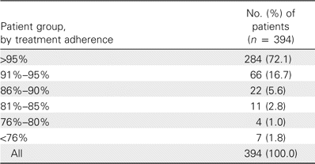
Table 3 Treatment adherence among 394 patients observed for 12 months.
Notes:
Table 3 Treatment adherence among 394 patients observed for 12 months.
Unless provided in the caption above, the following copyright applies to the content of this slide: © 2008 Infectious Diseases Society of America

Slide 4
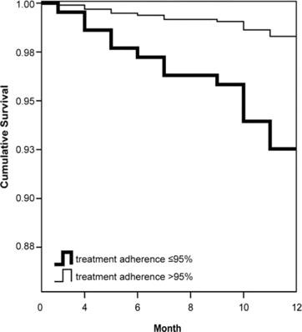
Figure 3 Cox proportional hazards regression showing cumulative survival over time among the 394 patients who received ...
Notes:
Figure 3 Cox proportional hazards regression showing cumulative survival over time among the 394 patients who received a first-line HAART regimen and were observed for 12 months.
Unless provided in the caption above, the following copyright applies to the content of this slide: © 2008 Infectious Diseases Society of America

Slide 5
Table 5 Cox proportional hazards regression for viral load ⩾1000 copies/mL in 394 patients observed for 12 months.
Notes:
Table 5 Cox proportional hazards regression for viral load ⩾1000 copies/mL in 394 patients observed for 12 months.
Unless provided in the caption above, the following copyright applies to the content of this slide: © 2008 Infectious Diseases Society of America

Slide 6
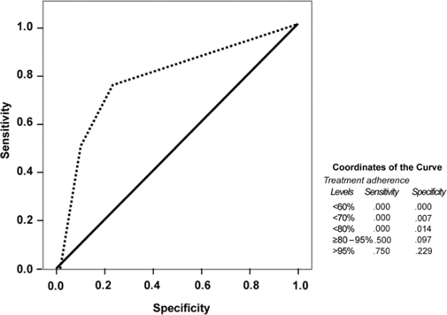
Figure 2 Receiver operating characteristic curve showing the relationship between treatment adherence and viral load ...
Notes:
Figure 2 Receiver operating characteristic curve showing the relationship between treatment adherence and viral load 27 months of HAART exposure at the end of the observation period.
Unless provided in the caption above, the following copyright applies to the content of this slide: © 2008 Infectious Diseases Society of America

Slide 7
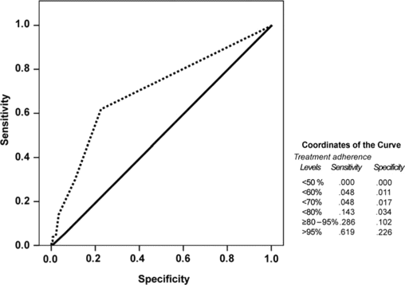
Figure 1 Receiver operating characteristic curve showing the relationship between treatment adherence and viral load ...
Notes:
Figure 1 Receiver operating characteristic curve showing the relationship between treatment adherence and viral load <1000 copies/mL for the 236 patients who had 15–27 months of HAART exposure at the end of the observation period.
Unless provided in the caption above, the following copyright applies to the content of this slide: © 2008 Infectious Diseases Society of America

Slide 8
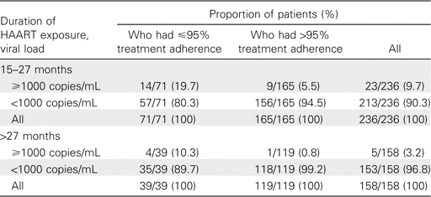
Table 4 Treatment adherence, by duration of HAART exposure and viral load at the end of the observation period, for ...
Notes:
Table 4 Treatment adherence, by duration of HAART exposure and viral load at the end of the observation period, for 394 patients observed for 12 months.
Unless provided in the caption above, the following copyright applies to the content of this slide: © 2008 Infectious Diseases Society of America

