Slide 1
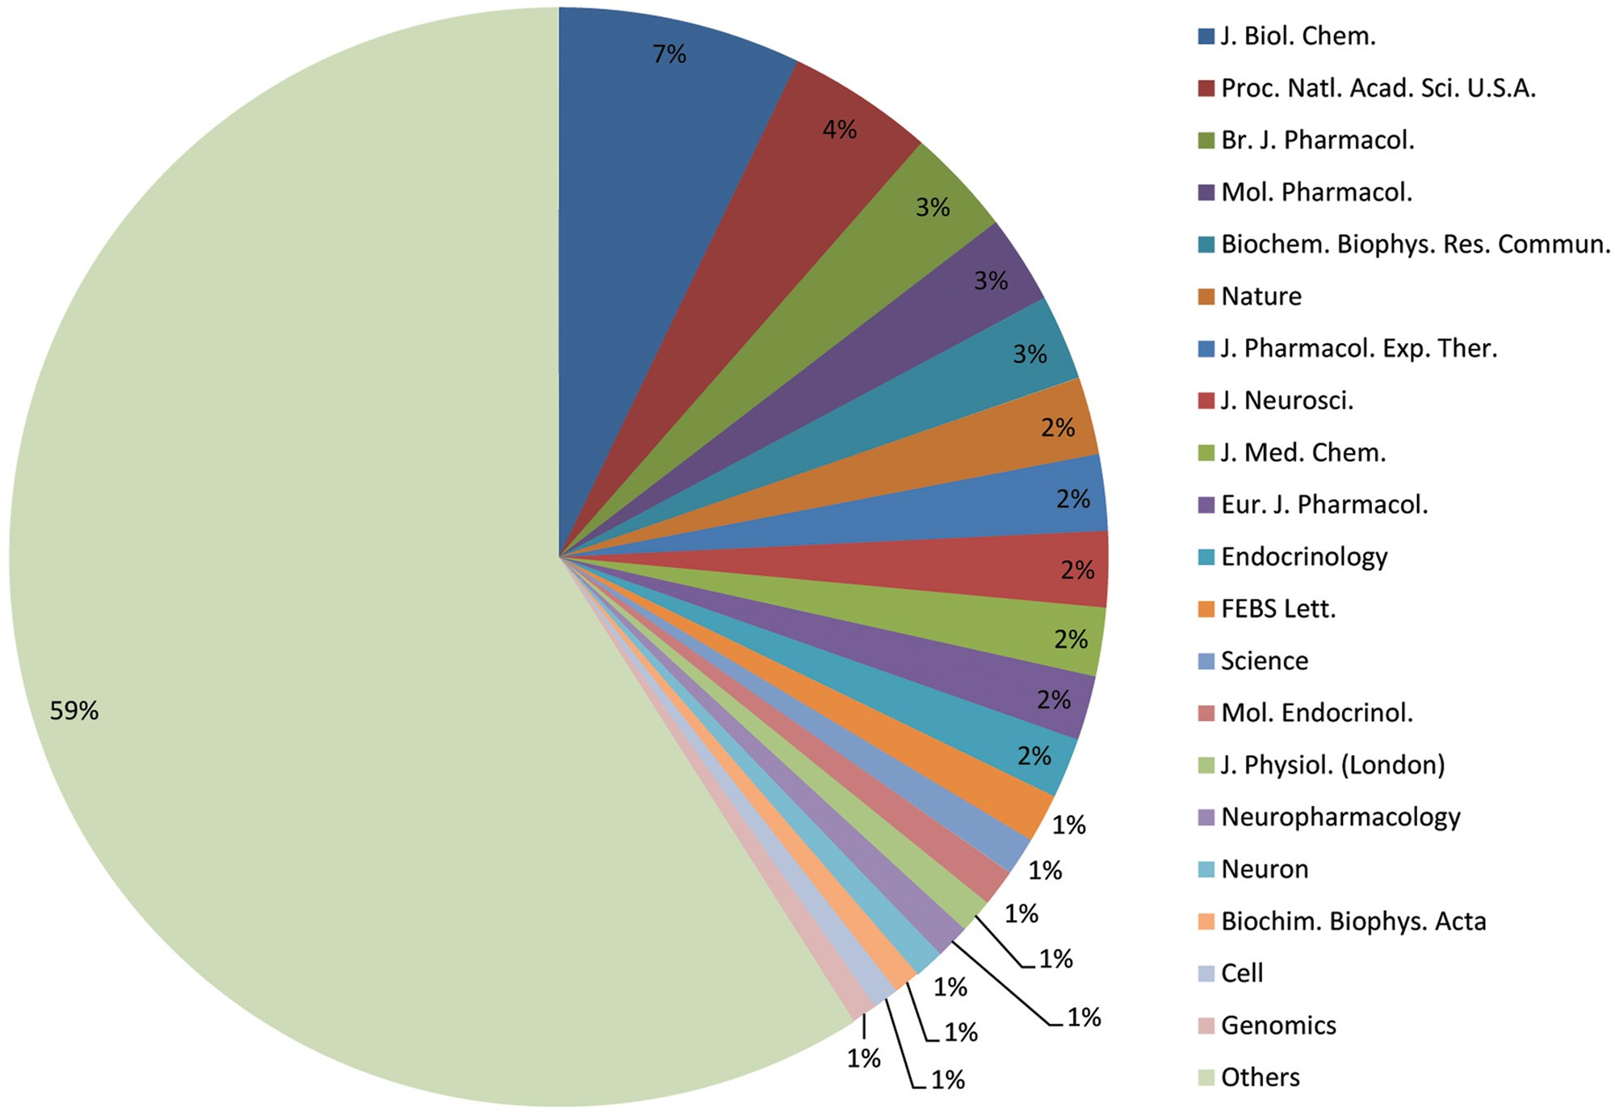
Figure 1. Breakdown of scientific journals cited in the resource. The chart shows the top 20 most cited journals in the ...
Notes:
Figure 1. Breakdown of scientific journals cited in the resource. The chart shows the top 20 most cited journals in the resource, and the contribution of each journal as a percentage of the total.
Unless provided in the caption above, the following copyright applies to the content of this slide: © The Author(s) 2013. Published by Oxford University Press.This is an Open Access article distributed under the terms of the Creative Commons Attribution License (http://creativecommons.org/licenses/by/3.0/), which permits unrestricted reuse, distribution, and reproduction in any medium, provided the original work is properly cited.

Slide 2
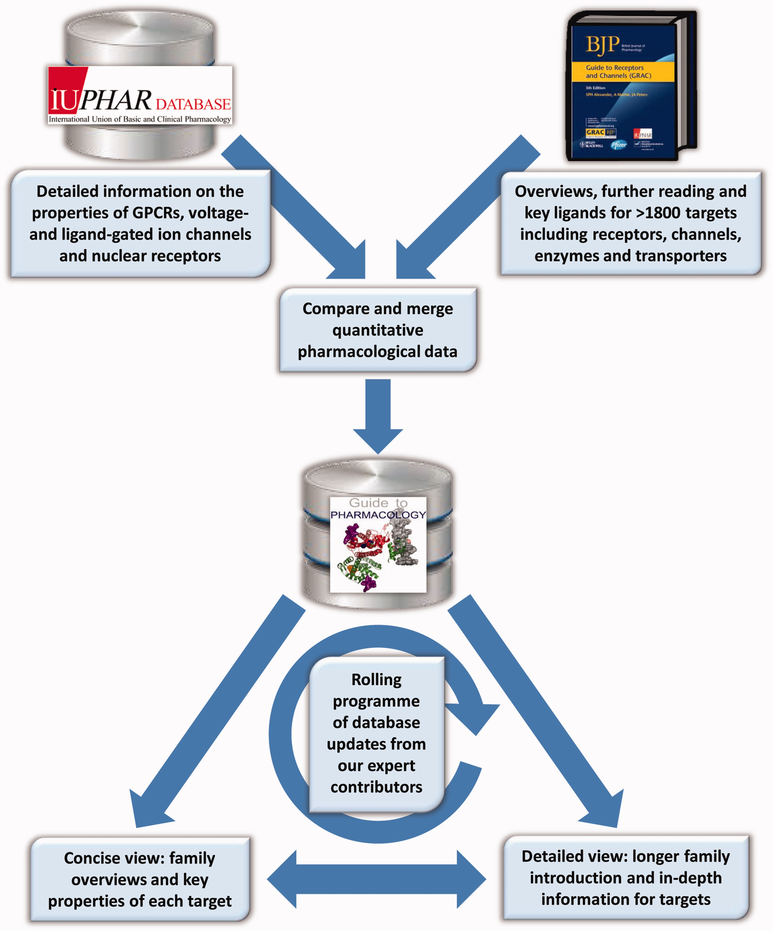
Figure 2. The Guide to PHARMACOLOGY curation process and organizational chart.
Notes:
Figure 2. The Guide to PHARMACOLOGY curation process and organizational chart.
Unless provided in the caption above, the following copyright applies to the content of this slide: © The Author(s) 2013. Published by Oxford University Press.This is an Open Access article distributed under the terms of the Creative Commons Attribution License (http://creativecommons.org/licenses/by/3.0/), which permits unrestricted reuse, distribution, and reproduction in any medium, provided the original work is properly cited.

Slide 3
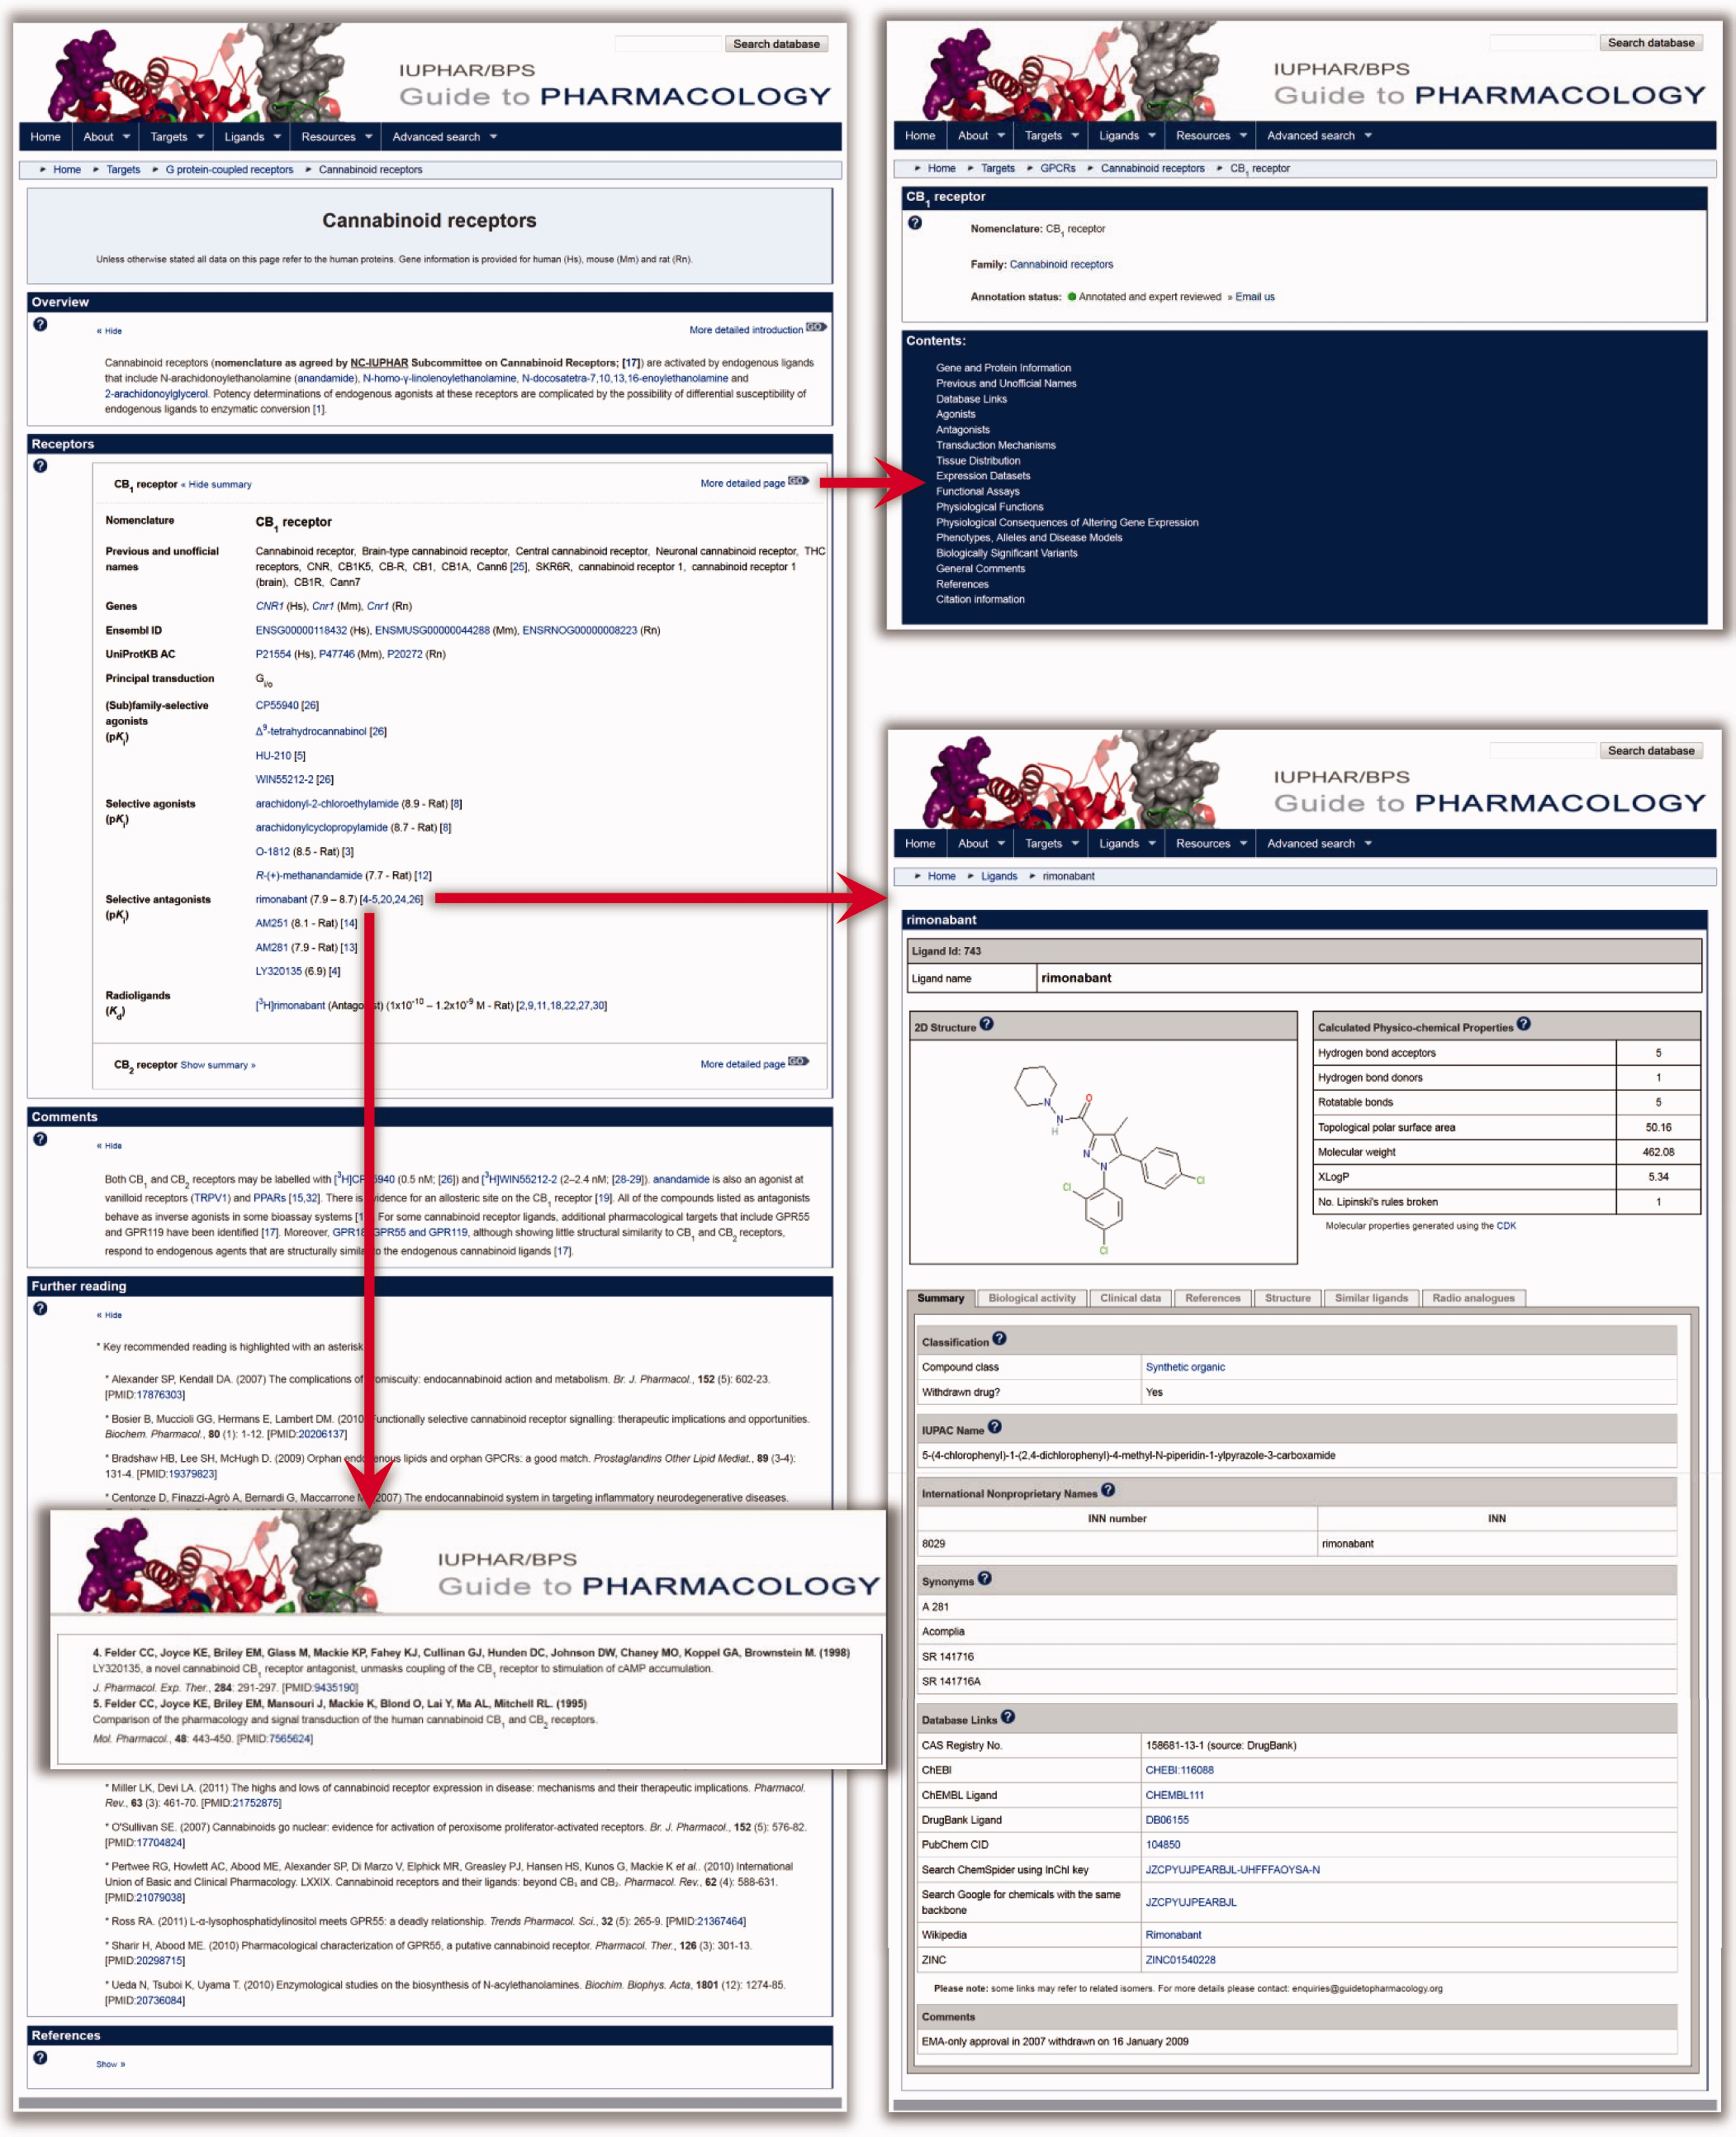
Figure 3. Screenshot of the Cannabinoid receptor family page in the Guide to PHARMACOLOGY, with overlaying screenshots ...
Notes:
Figure 3. Screenshot of the Cannabinoid receptor family page in the Guide to PHARMACOLOGY, with overlaying screenshots of a typical ligand page and reference page with link-out to PubMed. Also shown is a link to the ‘More detailed page’ of the CB1 receptor with a screenshot of the top section of the target page showing the ‘Contents’ table listing the types of information available for this target.
Unless provided in the caption above, the following copyright applies to the content of this slide: © The Author(s) 2013. Published by Oxford University Press.This is an Open Access article distributed under the terms of the Creative Commons Attribution License (http://creativecommons.org/licenses/by/3.0/), which permits unrestricted reuse, distribution, and reproduction in any medium, provided the original work is properly cited.

