Slide 1
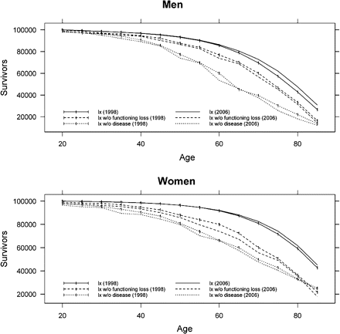
Figure 1. Survivors in the life table population, survivors without mobility functioning loss, and survivors without ...
Notes:
Figure 1. Survivors in the life table population, survivors without mobility functioning loss, and survivors without disease by sex: 1998 and 2006. Source: Prevalence of disease and functioning loss from National Health Interview Survey 1998, 2006; life tables from National Center for Health Statistics (1998, 2006).
Unless provided in the caption above, the following copyright applies to the content of this slide: © The Author 2010. Published by Oxford University Press on behalf of The Gerontological Society of America. All rights reserved. For permissions, please e-mail: journals.permissions@oup.com.

