Slide 1
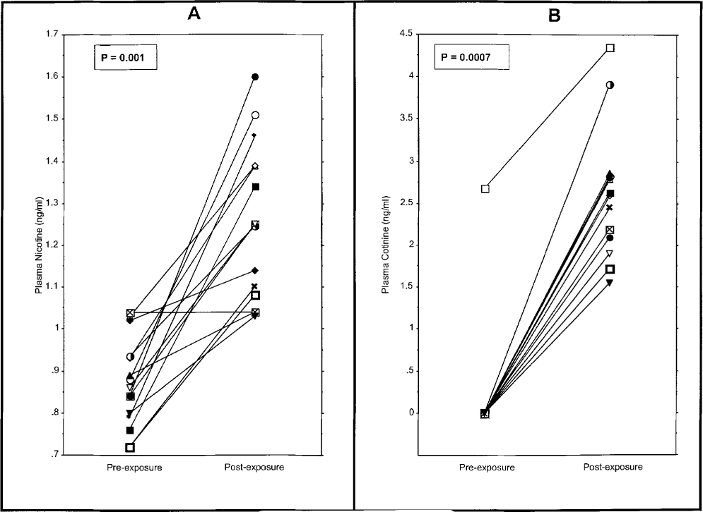
Fig. 1. Distribution of plasma concentrations of nicotine ( A ) and cotinine ( B ) in the overall study population ...
Notes:
Fig. 1. Distribution of plasma concentrations of nicotine ( A ) and cotinine ( B ) in the overall study population at pre- and post-exposure times.
Unless provided in the caption above, the following copyright applies to the content of this slide: © Oxford University Press

Slide 2
Fig. 2. Representative chromatograms of the ³² P-post-labeled DNA adducts in induced sputum of a ...
Notes:
Fig. 2. Representative chromatograms of the 32 P-post-labeled DNA adducts in induced sputum of a non-smoker at pre- and post-exposure times ( A and B , respectively), the BPDE–DNA adduct standard (1 adduct/10 8 nucleotides) ( C ) and a known smoker ( D ). Spots 1, 2 and 3 are encircled and the DRZ is bordered with two lines. The radioactivity in the upper left-hand corner was also observed at the same location in non-modified calf thymus DNA and therefore, considered as background.
Unless provided in the caption above, the following copyright applies to the content of this slide: © Oxford University Press

