Slide 1
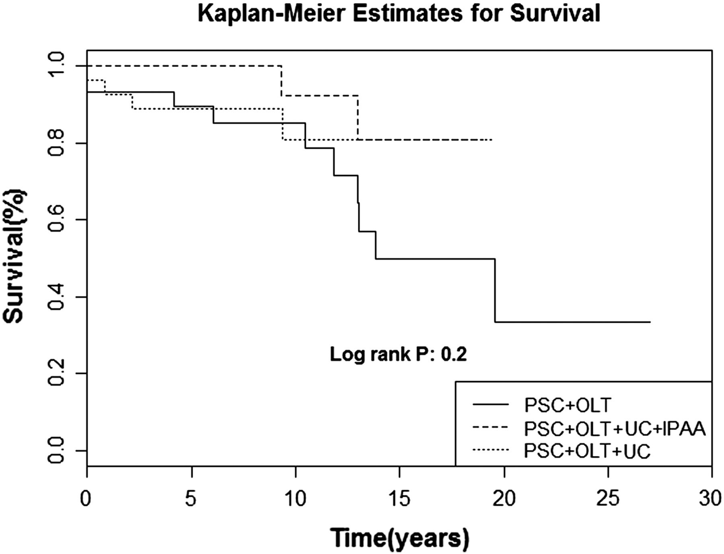
Figure 1 Comparison of patient survival between the 3 groups.
Notes:
Figure 1 Comparison of patient survival between the 3 groups.
Unless provided in the caption above, the following copyright applies to the content of this slide: © 2012 European Crohn's and Colitis Organisation

Slide 2
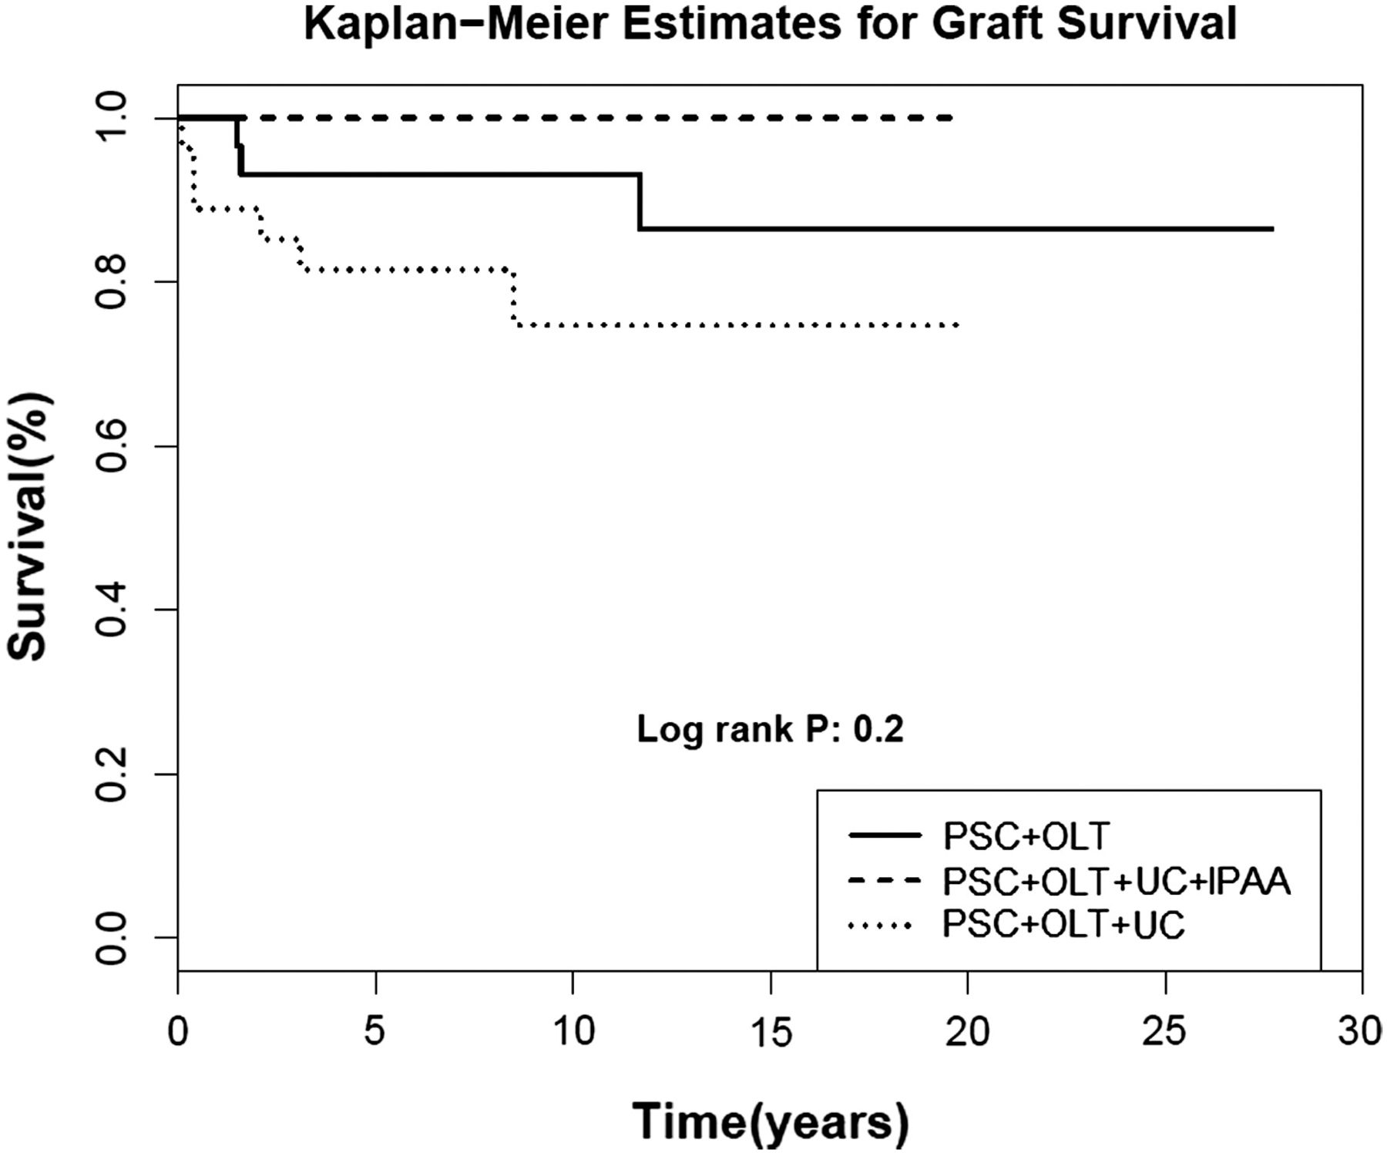
Figure 2 Comparison of graft survival between the 3 groups.
Notes:
Figure 2 Comparison of graft survival between the 3 groups.
Unless provided in the caption above, the following copyright applies to the content of this slide: © 2012 European Crohn's and Colitis Organisation

