Slide 1
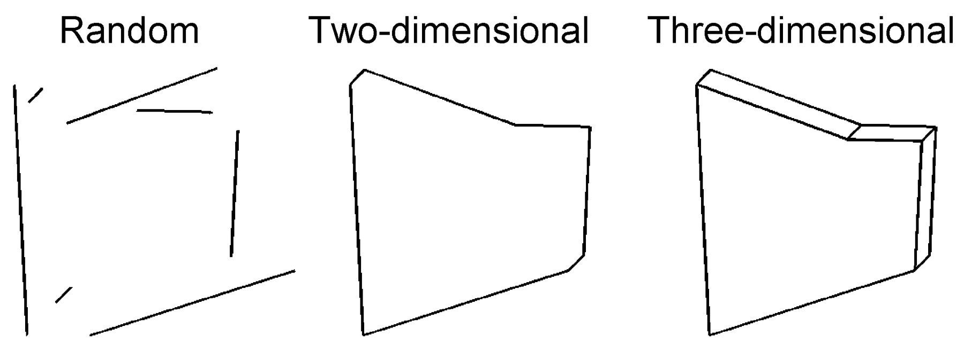
Figure 1. Examples of the stimuli used to analyze shape processing. Actual figures were white lines on a black ...
Notes:
Figure 1. Examples of the stimuli used to analyze shape processing. Actual figures were white lines on a black background subtending, on average, 8° of visual angle.
Unless provided in the caption above, the following copyright applies to the content of this slide: © Oxford University Press

Slide 2
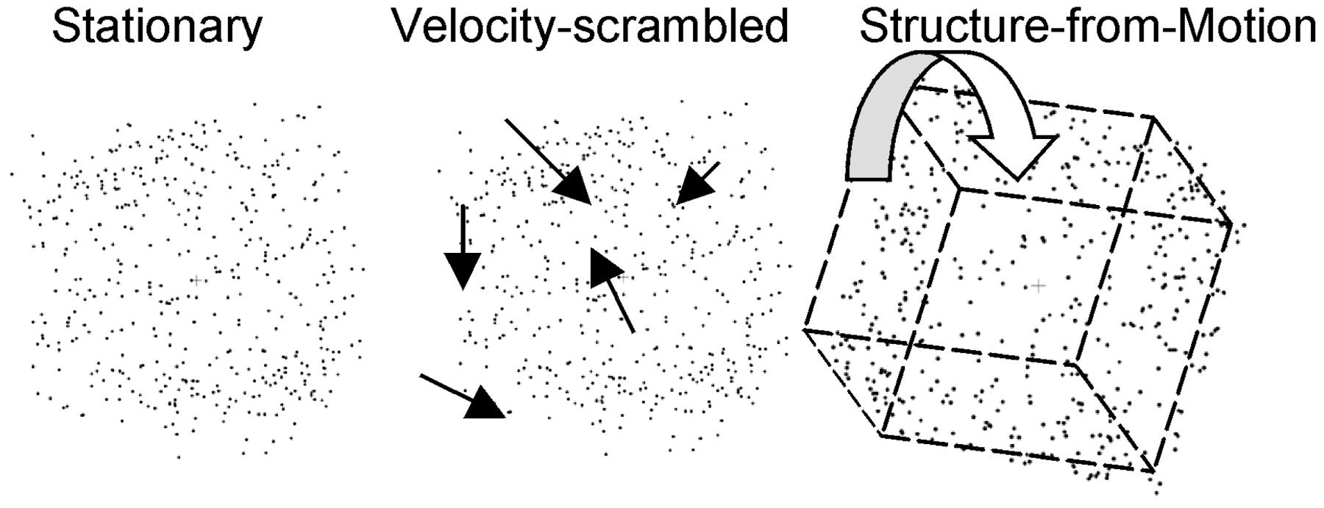
Figure 2. Examples of the stimuli used to analyze structure-from-motion (SFM) processing. Actual figures were white ...
Notes:
Figure 2. Examples of the stimuli used to analyze structure-from-motion (SFM) processing. Actual figures were white dots on a black background subtending 9° of visual angle. The velocity-scrambled stimuli had identical velocities as the SFM stimuli but were randomly re-assigned to different dots creating perceptually random motion. (The dashed line and arrows are added for illustration.) Movie demonstrations of the stimuli can be viewed at http://redwood.ucdavis.edu/scott/research/sfm/.
Unless provided in the caption above, the following copyright applies to the content of this slide: © Oxford University Press

Slide 3
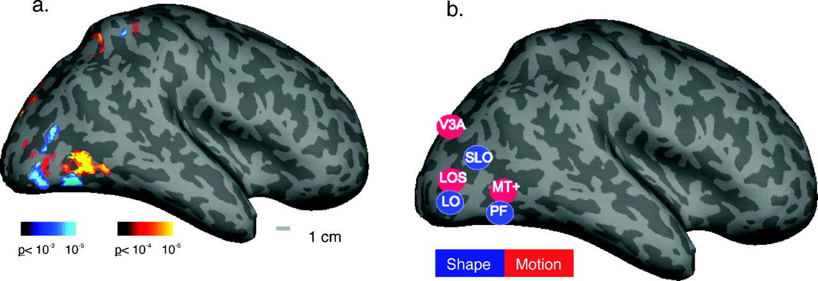
Figure 3. (a) Data are from a single subject displayed on the inflated cortex of the right hemisphere. The yellow/red ...
Notes:
Figure 3. (a) Data are from a single subject displayed on the inflated cortex of the right hemisphere. The yellow/red color-map shows areas of increased activity in response to motion stimuli compared with stationary stimuli. The blue color-map shows areas of increased activity to 3-D line drawings compared with random lines (parietal cortex activity is presented in detail in later figures). (b) A schematic showing the relative locations of motion areas (red) including visual area 3A (V3A), lateral occipital sulcus (LOS), and middle temporal area (MT+) and shape areas (blue) including superior lateral occipital (SLO), lateral occipital (LO) and posterior fusiform (PF).
Unless provided in the caption above, the following copyright applies to the content of this slide: © Oxford University Press

Slide 4
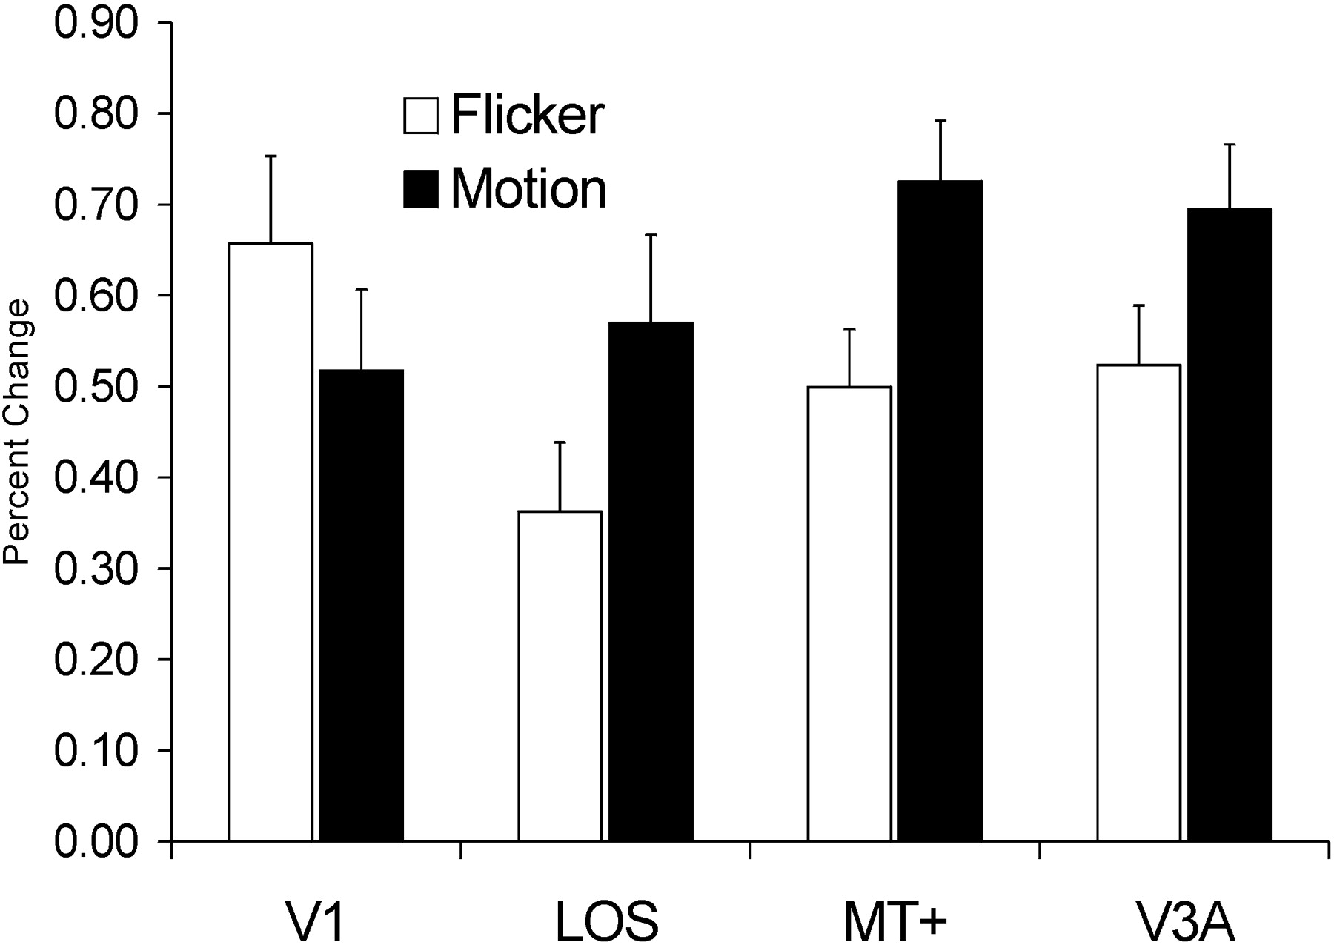
Figure 4. The average percent signal change of motion areas from a baseline of stationary dots comparing motion and ...
Notes:
Figure 4. The average percent signal change of motion areas from a baseline of stationary dots comparing motion and flicker stimuli. All extra-striate motion areas show significant increases in activity (P < 10−3) for motion versus flicker stimuli. V1 shows a significant (P < 10−3) decrease in activity in response to motion versus flicker.
Unless provided in the caption above, the following copyright applies to the content of this slide: © Oxford University Press

Slide 5
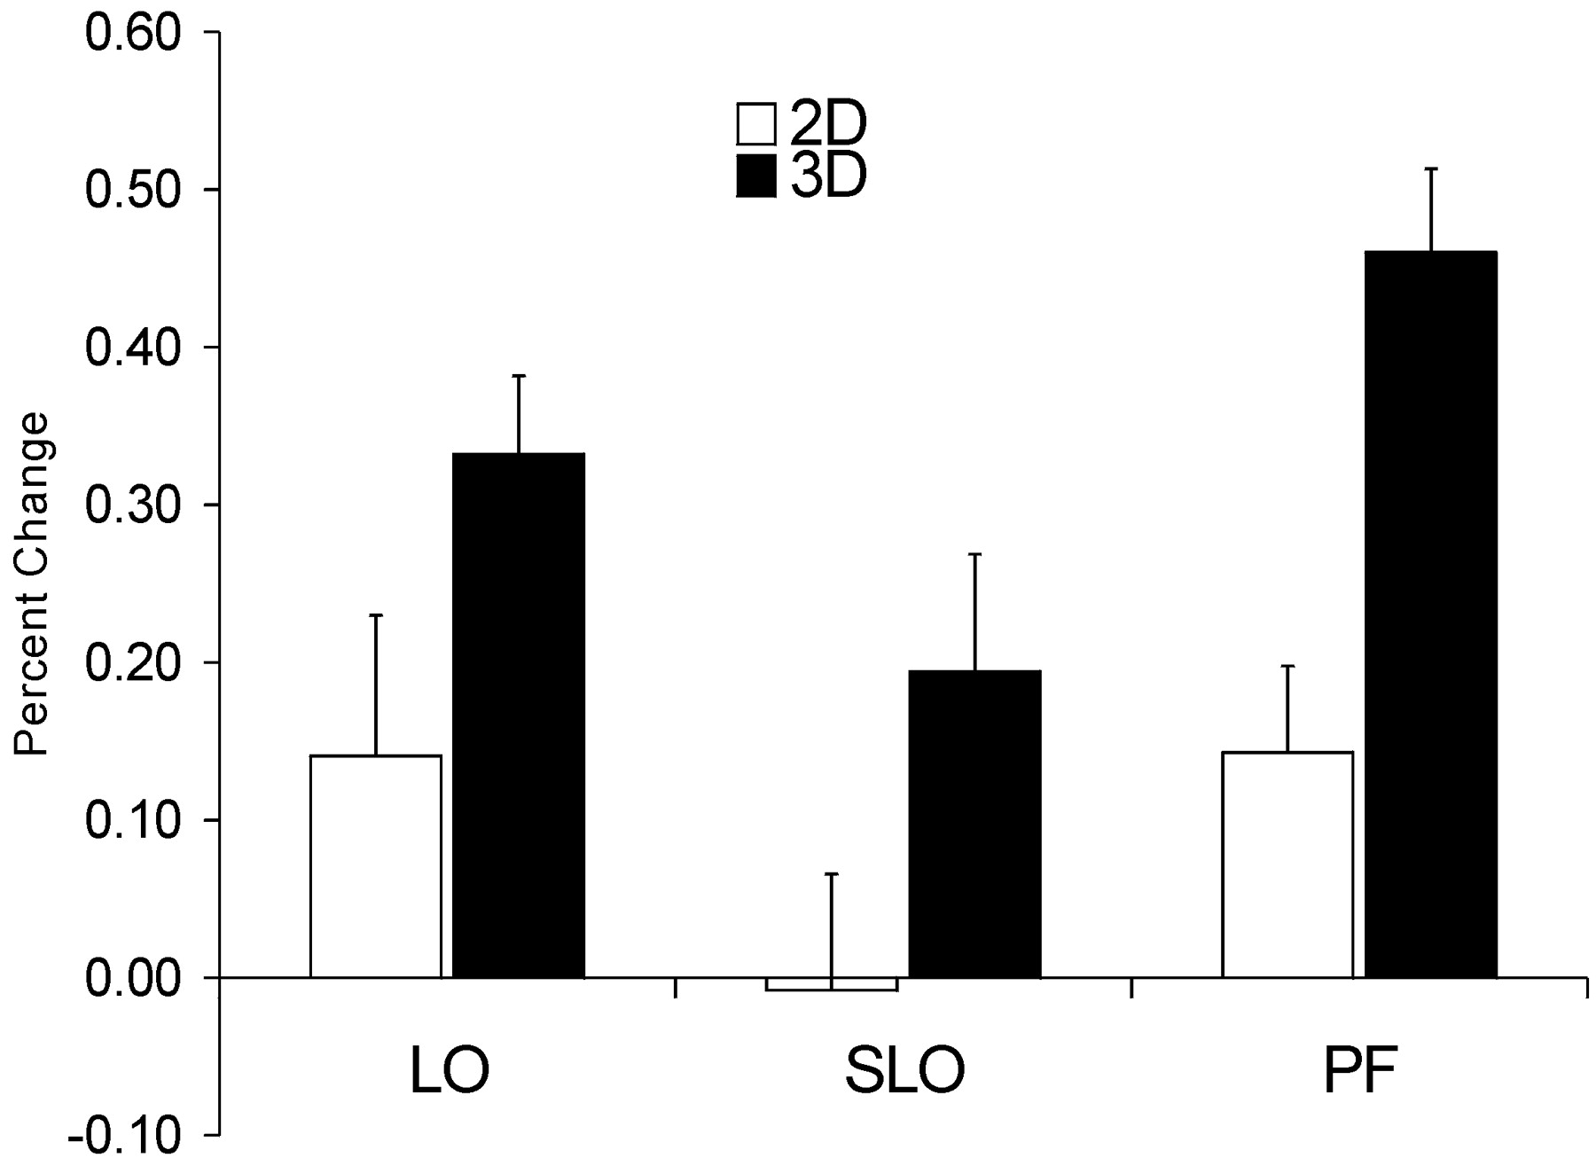
Figure 5. Average percent signal change of shape areas to 2-D and 3-D figures calculated from a baseline of random ...
Notes:
Figure 5. Average percent signal change of shape areas to 2-D and 3-D figures calculated from a baseline of random lines. Areas LO and PF show significant changes from the baseline random-line condition for the 2-D figures and all three areas show significant increases comparing 3-D to 2-D figures.
Unless provided in the caption above, the following copyright applies to the content of this slide: © Oxford University Press

Slide 6
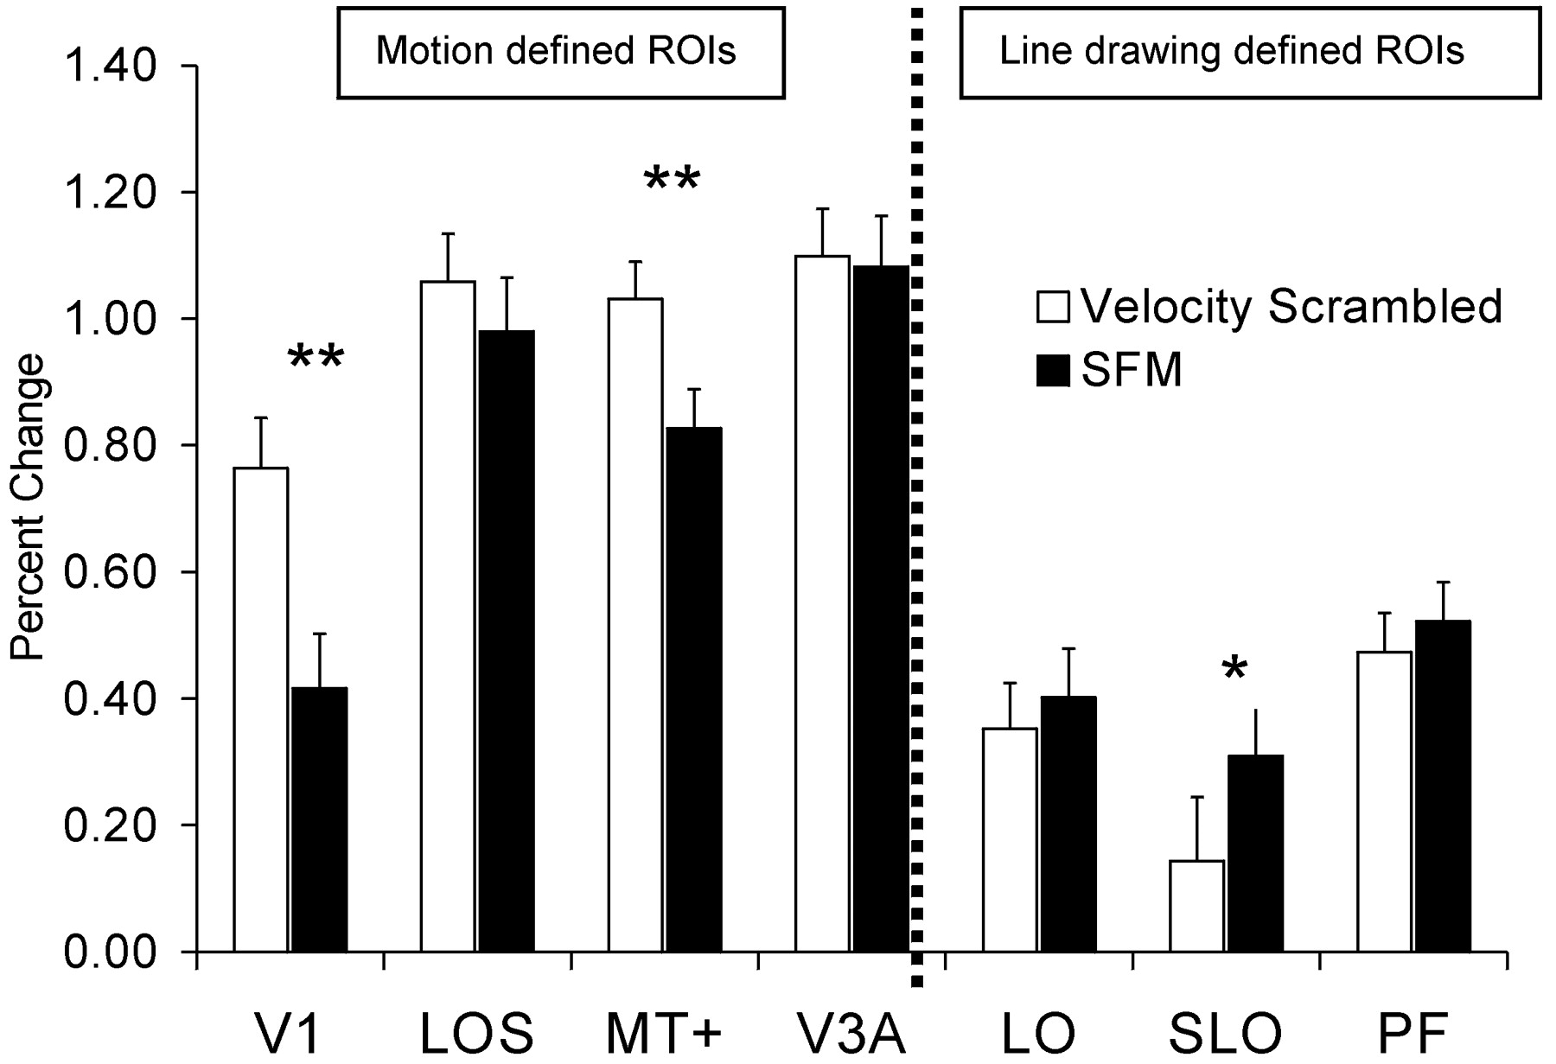
Figure 6. Average percent signal change for ROIs comparing the random (velocity- scrambled) stimuli to SFM, calculated ...
Notes:
Figure 6. Average percent signal change for ROIs comparing the random (velocity- scrambled) stimuli to SFM, calculated from a baseline of the stationary condition. Only area SLO showed a significant (P < 10−2) increase in activity for the SFM stimuli. Both MT+ and V1 showed significant (P < 10−3) decreases in activity.
Unless provided in the caption above, the following copyright applies to the content of this slide: © Oxford University Press

Slide 7
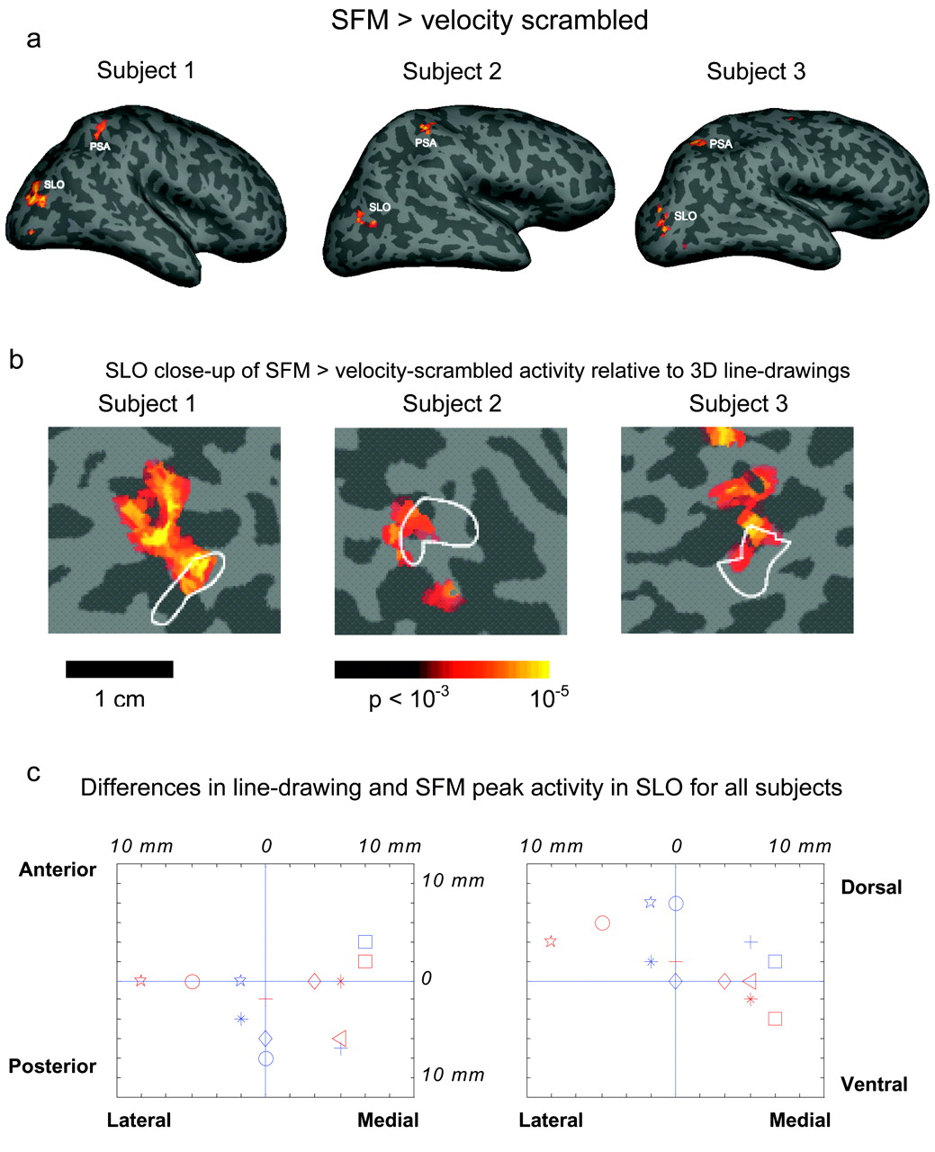
Figure 7. (a) Statistical maps comparing SFM and velocity-scrambled stimuli on the inflated right hemispheres of three ...
Notes:
Figure 7. (a) Statistical maps comparing SFM and velocity-scrambled stimuli on the inflated right hemispheres of three subjects. (b) Close-up views of SFM activity in SLO from the same subjects. The white outline shows the P < 10−3 boundary of activity comparing static 3-D line drawings and random lines. While there is considerable overlap, there is a posterior and/or dorsal shift in the SFM activity. (c) The activation peak (x, y, z coordinates) for the line drawing and SFM stimuli were subtracted in each hemisphere for every subject. Each point represents the position of the SFM peak relative to the line drawing peak. Each hemisphere and subject is a single point with its own color/symbol that correspond in the two plots. The left plot shows the medial/lateral versus anterior/posterior distribution and the right plot shows the medial/lateral versus dorsal/ventral distribution.
Unless provided in the caption above, the following copyright applies to the content of this slide: © Oxford University Press

Slide 8
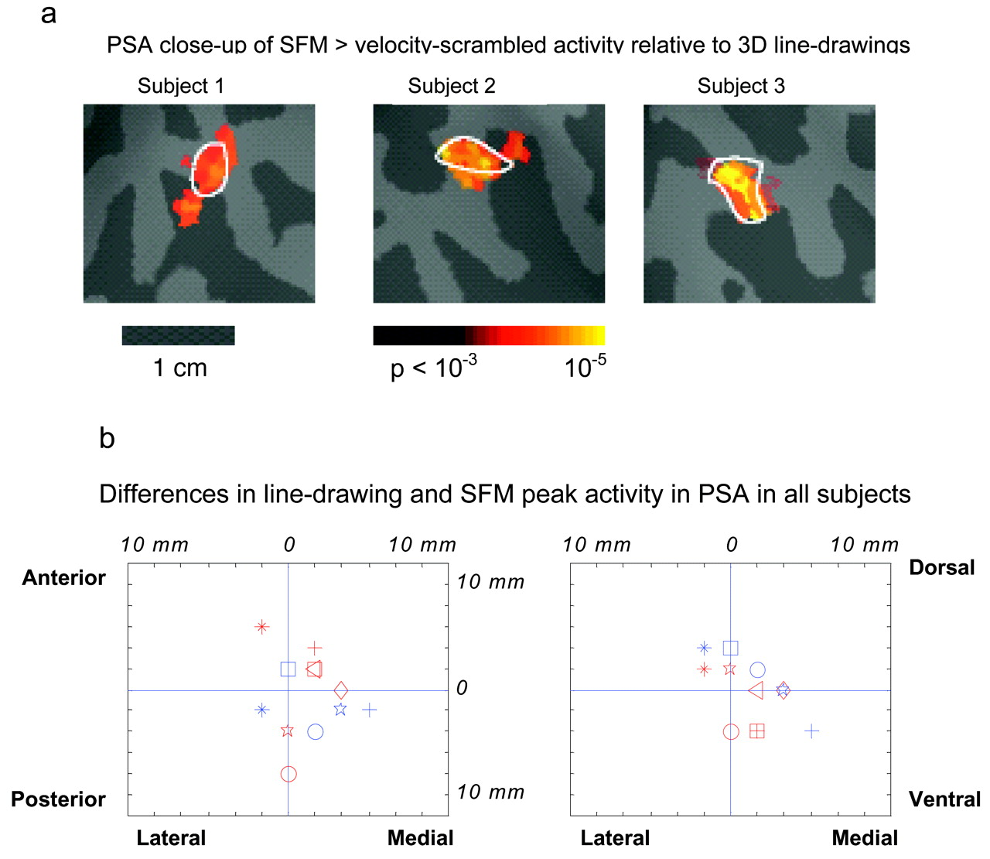
Figure 8. (a) Activation maps from the same three subjects in Figure 7 comparing SFM and velocity-scrambled stimuli in ...
Notes:
Figure 8. (a) Activation maps from the same three subjects in Figure 7 comparing SFM and velocity-scrambled stimuli in the PSA. The white outline shows the P < 10−3 boundary of activity comparing static 3-D line drawings and random lines. While there are small differences between SFM and line drawings in the extent of activation, the positions are highly overlapping. (b) The same method as Figure 7c was used to compare activation peaks for the line drawing and SFM stimuli. There is no consistent difference in the location of activation peaks in the two conditions in the PSA.
Unless provided in the caption above, the following copyright applies to the content of this slide: © Oxford University Press

Slide 9
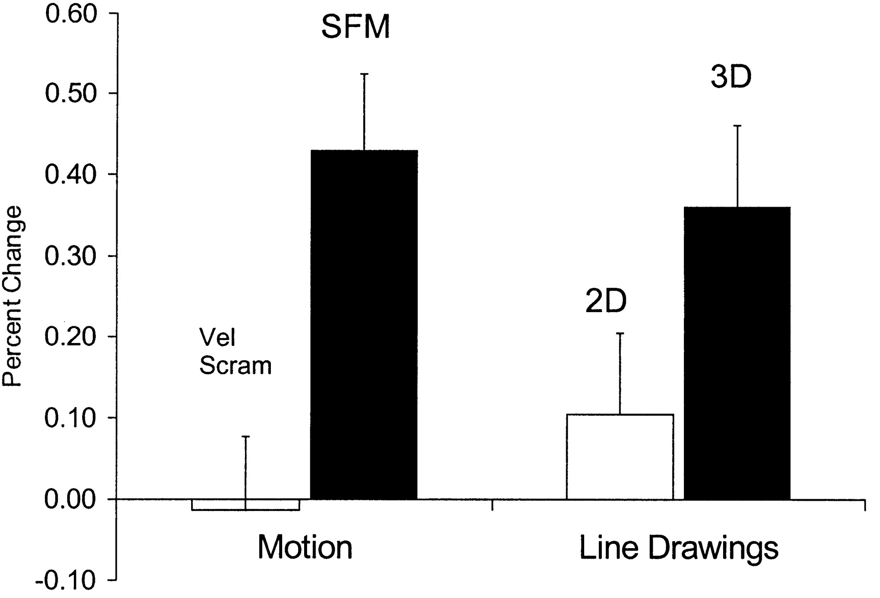
Figure 9. Activity in the PSA to motion and line drawings. The PSA showed a significant increase in activity to SFM ...
Notes:
Figure 9. Activity in the PSA to motion and line drawings. The PSA showed a significant increase in activity to SFM stimuli compared to the velocity-scrambled stimuli. In addition, this area showed increases to 3-D versus 2-D line drawings similar to areas that comprise the LOC (compare with Fig. 5).
Unless provided in the caption above, the following copyright applies to the content of this slide: © Oxford University Press

